Slide 1
Data Science in Azure
Andrey Vykhodtsev

Slide 2
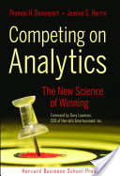
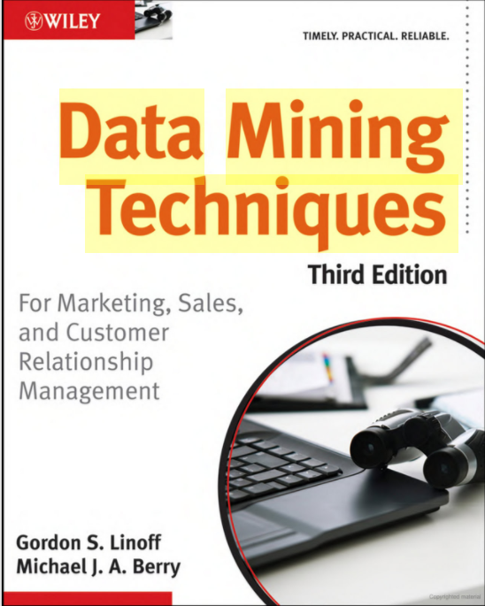
What is this about
How to use Azure cloud for advanced analytics
Overview of a few business scenarios for Retail
Overview of various tools and methods

Slide 3
What is data science
Programming Skills
Statistics (Science*)
Business Analysis
Is it the same as data mining?
Is it the same as business analysis?
It is about time to benefits form analytics

Slide 4
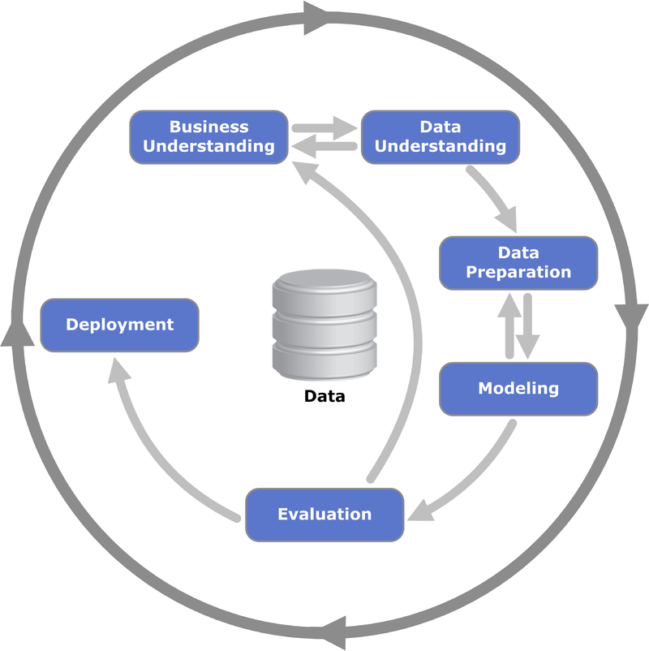
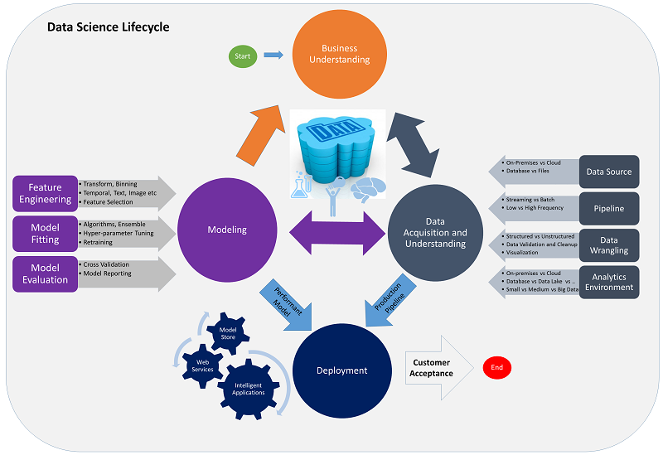
Data Science process
Microsoft TDSP
CRISP-DM

Slide 5
Typical advanced analytics lifecycle
Preparation
Modeling
Model
Ingest
Transform
Explore
Model
Deploy





ƒ(x)
Operationalization
Score
Score
Visualize
Measure





Slide 6
Typical time spend per stage
15%
Data scientist focus time
80%
15%
Preparation
Modeling
Model
Ingest
Transform
Explore
Model
Deploy





5%
ƒ(x)
Operationalization
Score
Score
Visualize
Measure




Notes:
Slide objective
Illustrate the typical advanced analytics lifecycle phases of preparation, modeling, and operationalization.
Talking points
Advanced analytics is generally a three-phase process.
[CLICK]
The three phases are preparation, where the data is taken in, transformed, cleansed, and denormalized. Then, the data is profiled, explored, and visualized.
[CLICK]
Next is the modeling phase, where feature and algorithm selection takes place, along with model testing and validation of data before it is deployed to the operationalization phase,
[CLICK]
And that is where it is scored, visualized, measured, and then used for predictive analytics.
[CLICK]
And then it’s back to more advanced analytics.

Slide 7
Why cloud for Data Science?
Infrastructure on demand
Seamlessly publish models
Always cutting edge analytic tools
DevOps and automation
Self service for data scientists

Slide 8
Cortana Intelligence Suite | Overview
Information Management
Big Data Stores
Machine Learning and Analytics
Intelligence
Data
Sources
People
Data Factory
Data Lake Store
Machine Learning
Cognitive Services
Data Catalog
SQL Data
Warehouse
Data Lake Analytics
Bot
Framework
Web
Apps
Event Hubs
HDInsight
Cortana
Mobile
Apps
Stream Analytics
Bots
Dashboards & Visualizations
Sensors
and
Devices
Power BI
Automated
Systems
Data
Intelligence
Action

Slide 9
Explaining the Azure toolchain

Slide 10
Another view on the process
Preparation
Modeling
Model
Ingest
Transform
Explore
Model
Deploy





ƒ(x)
Operationalization
Score
Score
Visualize
Measure





Slide 11
DEMO – AML

Slide 12
Ingest: Real time and batch
Ingest from Event Hubs in real time apply preprocessing, write to Cosmos DB or score Azure ML function directly
Orchestrate data pipeline processes. Schedule module re-train and batch scoring
Event ingestion engine
Specialized clusters available to accommodate Storm (more advanced Stream Analytics tool) and Kafka (analogue of Event Hubs)

Slide 13
Ingest: Data Stores
Database well suited for real-time ingestion. SQL Syntax an multiple API support
Scalable database for ad-hoc querying and DWH
General purpose storage. Suitable for many common tasks
General-purpose database for smaller datasets. Usable for transactional load.
Simple table store. Usable from AzureML
HDFS storage is based either on blobs or on Data Lake Store
HDFS storage is based either on blobs or on Data Lake Store

Slide 14
Explore
PowerBI is a very powerful visual exploration engine
Azure ML has basic visualization capabilies and integrated Jupyter notebooks
Full fledged VM based toolchain, contains R, Python, PowerBI and more. Also contains IDEAR tool for exploration.
Spark and R server are well suited for interactive data exploration of large datasets

Slide 15
DEMO – IDEAR
Link: https://github.com/Azure/Azure-TDSP-Utilities/blob/master/DataScienceUtilities/DataReport-Utils/MRS/team-data-science-process-idear-mrs-instructions.md

Slide 16
Model
Azure ML has a rich set of algorithms to train models. Also Python and R libraries are available for model training
Pre-installed Python, Microsoft R, Spark, CNTK, mxnet, and more. Microsoft R has Microsoft ML set of algorithms
Spark MLLib, Microsoft R server/ Microsoft ML.

Slide 17
Operationalize
Microsoft R server to publish R and Microsoft ML models
Microsoft R server to publish R and Microsoft ML models
SQL Server can score R or Python models
Azure ML can publish AML, R, or Python models for scoring

Slide 18
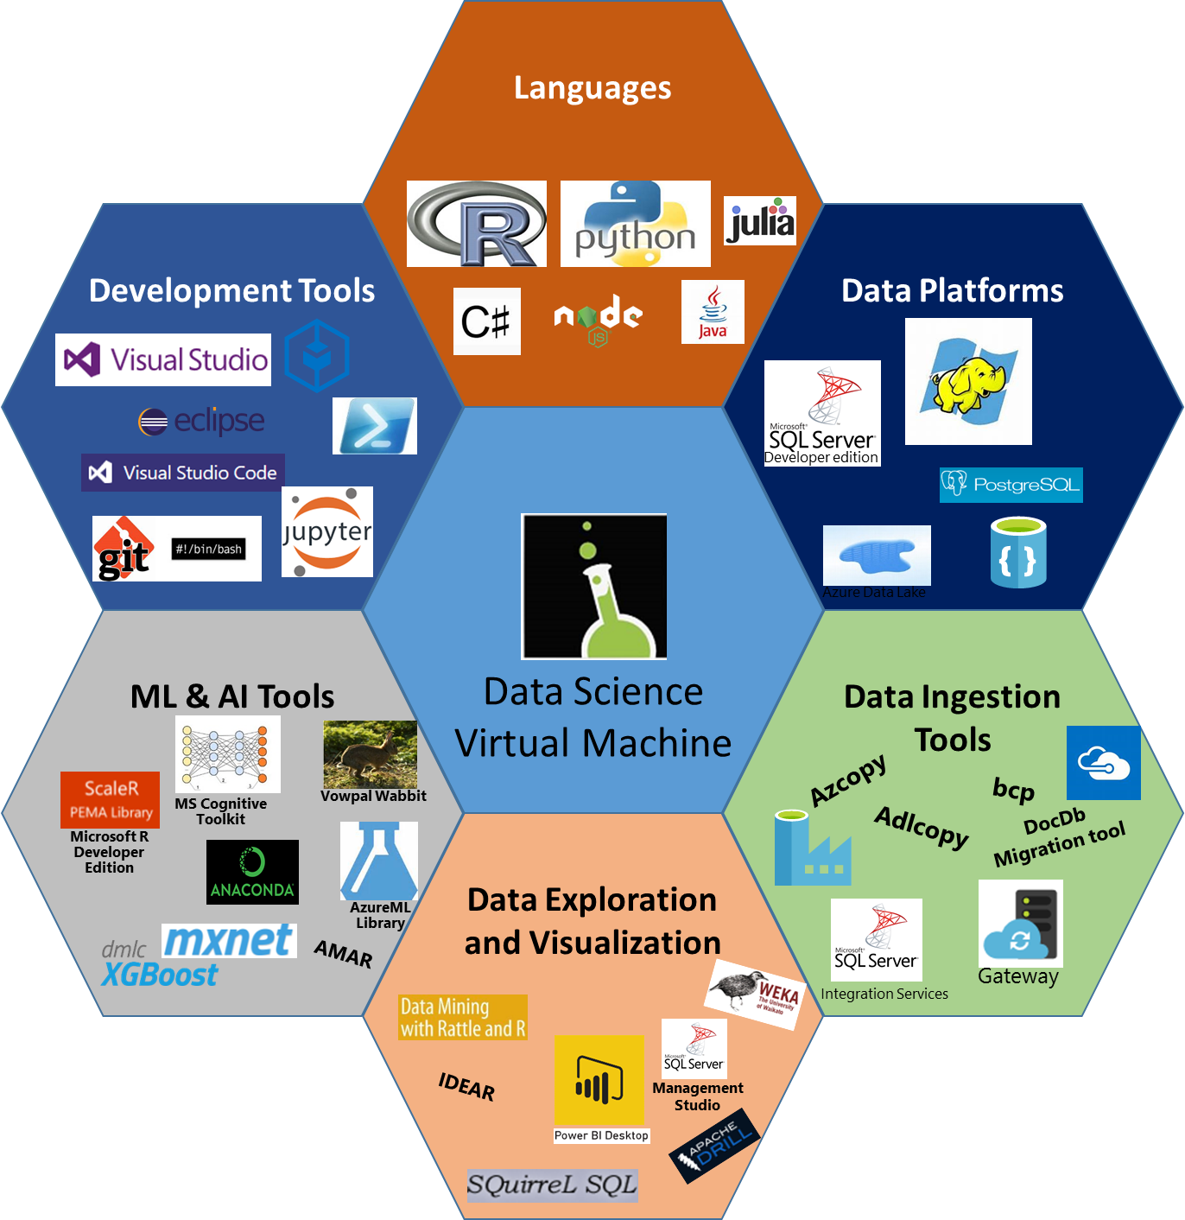


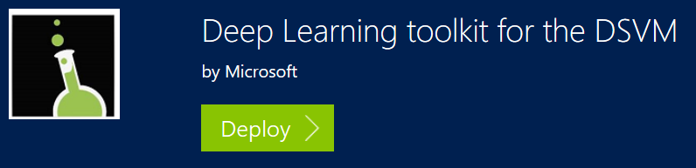


Development tools and DSVM

Slide 19
Industry example: retail

Slide 20
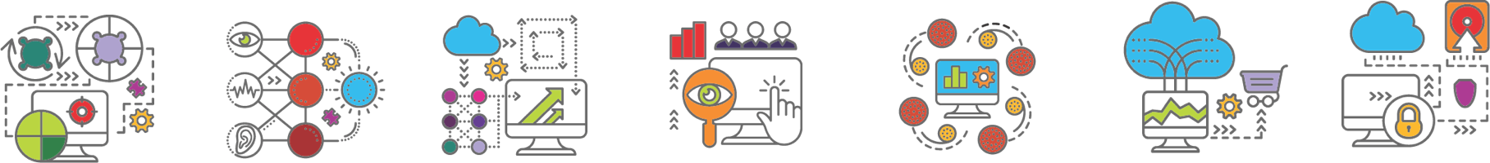
Advanced analytics in Retail
Marketing
Operations
Personalization
Marketing Optimization
Dynamic Pricing
Operational Efficiency
Inventory Optimization
Demand Forecasting
Retail Execution
What is best offer or content I can give to this customer right now?
(so I maximize my response rate and create a differentiated experience)
What SKU, store, teams, machines, people…are most effective ?
(so I can identify best practices and allocate resources)
What is the ideal feature mix to reach my ideal customer ?
(so I can differentiate versus competition)
What is the right amount of marketing spend to put into each channel?
(so get the maximum return on my investment)
What is right level and supplier for a part?
(so I can simplify and optimize procurement)
What is the best price for this product in this location right now?
(so I can maximize margin and/or market share)
What sales or usage volume can I expect?
(so I can optimize my staffing and asset utilization)
20

Slide 21







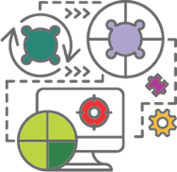

Building a Personalization solution
Input Data:
Web activity and online purchasing
Store traffic and sales patterns
Past campaign performance details
Addressable market demographics
“Our customers are like our product, very unique. We need to ensure we customize and personalize the right message at the right time using the most effective and efficient marketing vehicle in order to maximize our marketing efforts ,”
--- Eric Hunter, Executive VP Marketing, Pier1
Analytics:
The challenge:
Implementing an integrated marketing strategy that harnesses customer insights across a large, omni-channel retail operation
Delivering a compelling and differentiated user experience in a highly competitive market
Reliance on sales and discounting to drive business volumes
Kmeans clustering for segmentation
Linear regression algorithms for customer-specific prediction scoring
46%
402993
830
2.9x
Insight:
Identification of similar behaving and high value customers
Prescriptive and high-yield offers and campaign content
The impact:
More targeted, cost-efficient and effective marketing campaigns
Continuous learning of what works and what doesn’t which enables optimized web content and in-store merchandising
Flexible Azure cloud based technology architecture that has grown and supported the business for the past 3 years
933
402992
3x
38%
Intelligent Action:
Automated offers and ad-retargeting
Special offers, coupons and dynamic messaging on web
Store specific merchandising and offers
Premium loyalty programs, partner deals and service experience

Slide 22








Building a Demand Forecasting solution
Input Data:
“To build a big data and analytics strategy, our company needs to better understand what kind of data we can collect on the ships and what kind of data we need to have in the future…we want to use the data to get a better understanding of our operations and to help our ships be more efficient and sustainable.”
Alexander Klingelhoefer, Director of Continuous Improvement
Web and marketing activities
Offers, pricing and competitors
Sales coverage/capacity/incentives
Related external data sets
Analytics
Challenges Carnival was facing…
Better demand forecasting for key resources
Improve visibility and gain deeper insight into their business operations by
Centralize data management for thousands of devices and sensors across a fleet of 26 cruise ships
Predicting a quantity involves regression, and a good
starting point is to use linear or polynomial regression
Insight:
Sales and usage forecast for
next time period
And their impact on the business
Utilized the advanced analytics platform to optimize demand forecasting
Improved operations by analyzing historical data with custom models
Implemented a data warehouse to easily capture and mange data from all kinds of devices and sensors
Intelligent Action:
Update production plans
and MES system
Modify staff scheduling
Automate price changes
Update sales lead scoring models
Change logistics and warehousing plans

Slide 23
Retail Demand Forecasting end-to-end Architecture
Spark on HDInsight
Forecasts demand, calculates price elasticity and gives price recommendations
Azure Data Factory
Coordinates data transfer between HDInsight and Azure Data Lake Store.
Azure Data Lake Store
Stores raw transactional data, demand forecasts, price elasticity calculations and price recommendations.
Transactional data
C
O
N
T
Power BI
O
S
Creates reports and visualizations based on the
transactional data, forecasts, price elasticity and price recommendations
O
M
A
R
T

Slide 24
Personalized Offers | Architecture End-to-End
Azure Stream Analytics
HD Insight
Aggregates user-data into time intervals and sends it to the Table Store. Raw data is sent for storage.
Analyzes raw data and builds profiles based on this data.
Azure SQL Database
Stores raw data.
Azure Table Store
Azure Event Hub
Stores the aggregated data. The site sends a query for the user's data. This data is then passed through the site to Azure Machine Learning.
This highly-scalable service ingests and distributes user-action data.
Azure Data Factory
Coordinates data transfer and triggers components to run according to specifications.
Azure Machine Learning
Azure Blob Storage
Power BI
Creates and regularly retrains a model of the user to based on real-time and historical data to make personalized offers in real-time.
Stores analyzed data and profiles. Data is sent to PowerBI to be used for visualization and reporting. Data is also sent to Azure Machine Learning for model retraining.
Creates reports and visualizations based on the real-time and historical data.

Slide 25
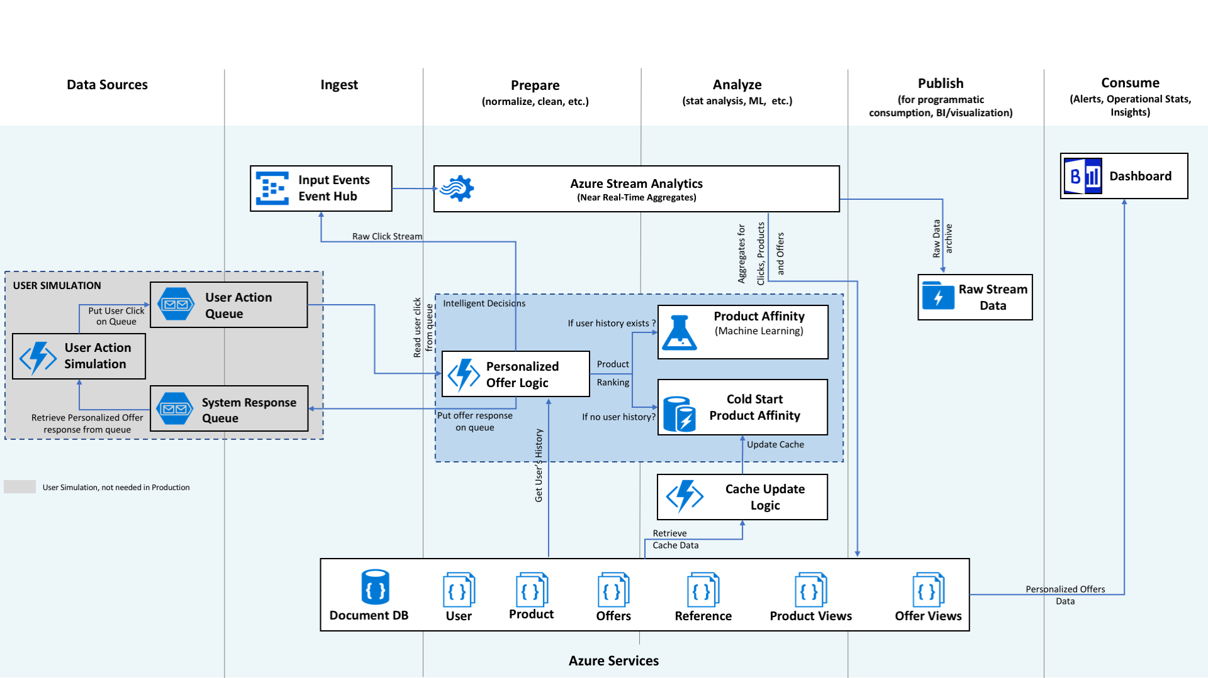

Slide 26
DEMO
Links : https://gallery.cortanaintelligence.com/Experiment/Retail-Forecasting-Step-1-of-6-data-preprocessing-5 https://github.com/Azure/cortana-intelligence-price-optimization

Slide 27
Deep neural networks and GPUs

Slide 28
Video analytics and deep learning in retail
Shelf analysis
Analyzing demographics/emotions
Window display A/B testing
Counting people
Cashier queues / scandal detection
Personalized offers

Slide 29
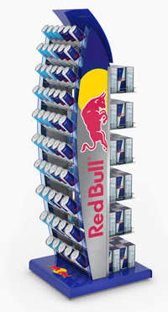


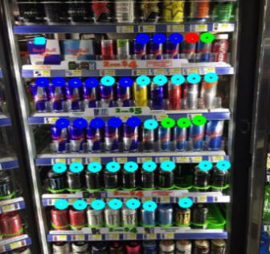

CASE STUDY: LEADING ENERGY DRINK MANUFACTURER SAVES 60% OF STORE AUDIT TIME. PROJECTED COST SAVINGS OF $ 1.7 MILLION PER ANNUM
Brillio’s visual analytics based Deep Learning engine compares shelf images with standard planogram
Image Analytics provides insights
On Shelf Inventory Levels
Automated Compliance Checks
Competitive Insights
On field user (ASM) device CLICKS THE IMAGES using the mobile app, keys in certain details and uploads them onto the server ….
60% Reduction in Average Time Taken per store Audit
23% Fewer Sales Representatives required for store audits
96%Accuracy of Image Recognition
$3Million/ Year Projected Value to be captured from fewer stock outs

Slide 30
Deep learning for retail –architecture

Slide 31
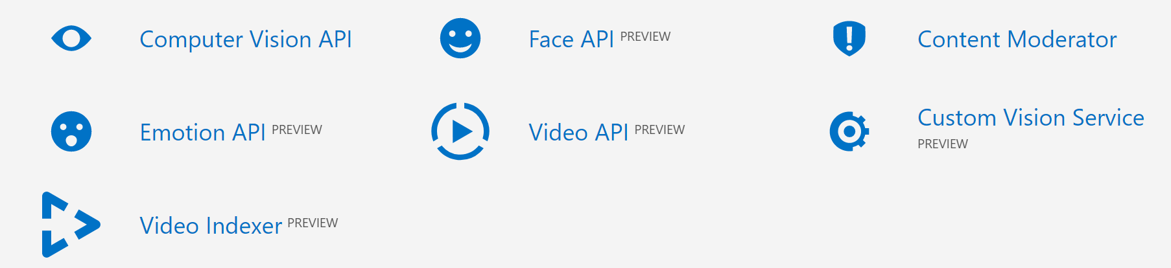
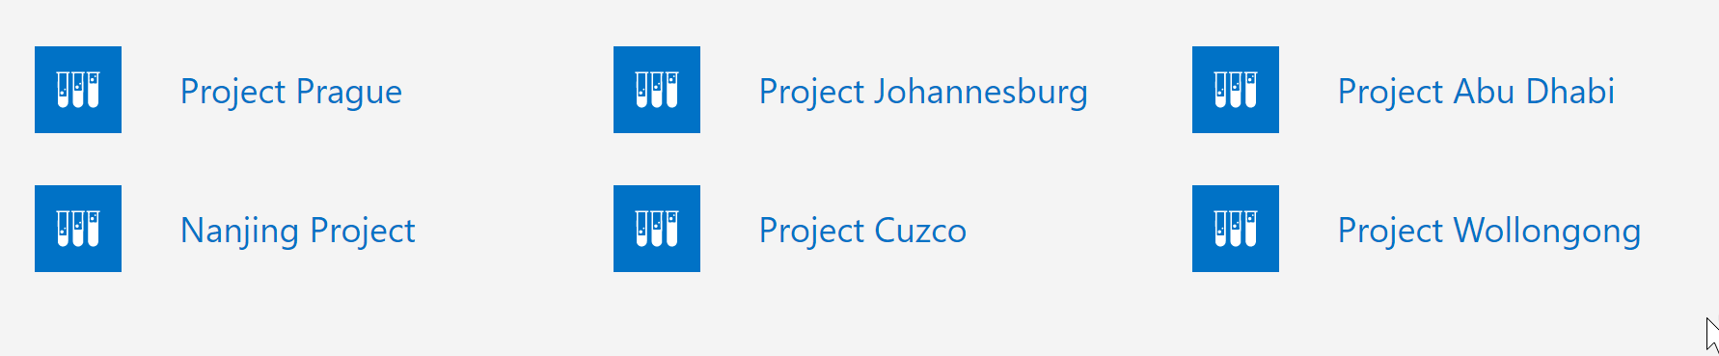
Cognitive services and Labs

Slide 32
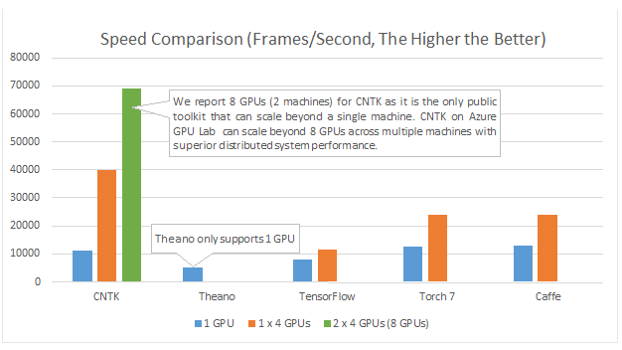
CNTK for Deep learning in Azure
Scale to multiple GPUs on multiple computers
Great 1 GPU performance
Tesla K80 Instances available on Azure
DSVM for deep learning

Slide 33
DEMO - DSVM and CNTK

