Slide 2
Robi Vončina
Robi.voncina@kompas-xnet.si
Upgrade to SharePoint 2019

Slide 3
About me
Economy graduate
Working @ Kompas Xnet
Speaker
10 years MCT
MVP from 2013
Recently worked on large scale projects for
  European Games in Baku, Azerbaijan
  Asian games in Ashgabat, Turkmenistan

Slide 4
Agenda
What‘s new
What‘s gone
Prerequisites
Upgrade methods
Design Goals for 2019 Upgrades
Modernization
Farm Upgrade Overview
  Planning
  Preparing
  Executing
  Finishing
Tools, Tips and Tricks

Slide 5
What‘s new

Slide 6
New and improved
  Web templates
  Modern teams sites → STS#3
  Communication sites → SITEPAGEPUBLISHING#0
  OneDrive personal site → SPSPERS#10
  Fast site creation
  Modern lists and libraries
Large file support
  Increased from 10GB to 15GB
Modern search experience

Slide 7
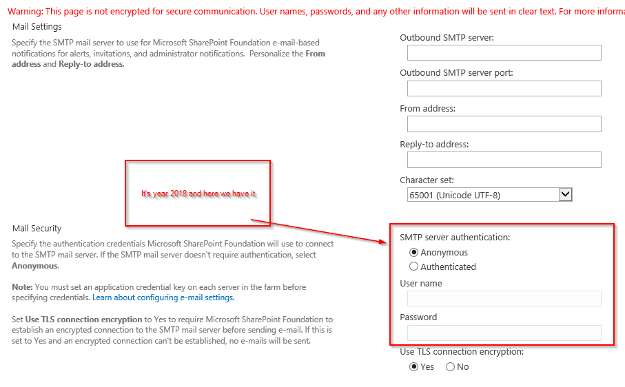
New and improved - SMTP
SMTP Connection encryption and SMTP ports
SMTP username and password
$CentralAdmin = Get-SPWebApplication -IncludeCentralAdministration | ? { $_.IsAdministrationWebApplication -eq $true }
$SmtpServer = "mail.dev.local"
$SmtpServerPort = 21
$FromAddress = "SP2019@dev.loc"
$ReplyToAddress = "robi@dev.loc"
$Credentials = Get-Credential
Set-SPWebApplication -Identity $CentralAdmin -SMTPServer $SmtpServer -SMTPServerPort $SmtpServerPort -OutgoingEmailAddress $FromAddress -ReplyToEmailAddress $ReplyToAddress #-SMTPCredentials $Credentials

Slide 8
New and improved - PowerShell
UPS
  Get-SPContentDatabase → DaysSinceLastProfileSync
  Clear-SPContentDatabaseSyncData
  Update-SPProfileSync
Get-SPContentDatabaseOrphanedData
Set-SPApplicationCredentialKey and Remove-SPApplicationCredentialKey

Slide 9
New and improved
Health rules
  People picker
  SMTP authentication
File paht limit → 400 charachters
Recycle bin
  With edit permissions you can restore items that were deleted by other users
Sync files with OneDrive Sync client
  Deploy OD4B sync client
  https://docs.microsoft.com/en-us/onedrive/deploy-on-windows

Slide 10
Not available
Hub sites
Site designs and site scripts

Slide 11
MIN role

Slide 12
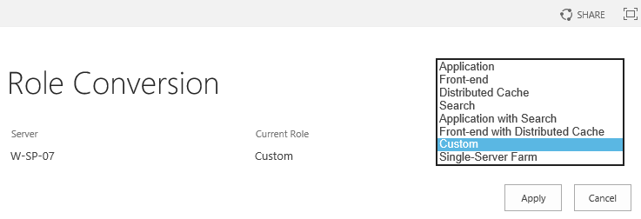
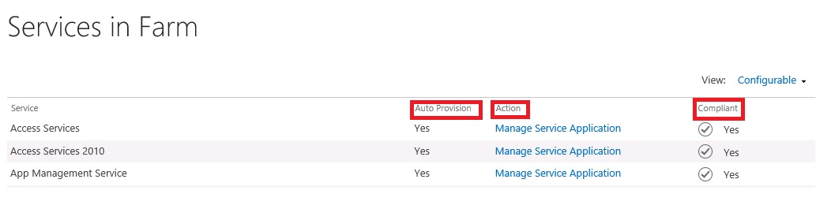
MIN Role overview
Installs only required services
Min role
  Web Front end
  DistributedCache
  Search
  Application server
  Custom
  Application with search
  Front-end with distributed cache
Compliance check

Slide 13
What‘s deprecated

Slide 14
What‘s deprecated
Definition „Deprecated“ vs „Removed“
Access services 2010 and 2013
Agregated newsfeed
InfoPath
  Support for InfoPath 2013 till 2026
Machine translations
PerformancePoint
  Silverlight dependency
  PowerBI as alternative
SharePoint Designer

Slide 15
What‘s gone

Slide 16
What‘s gone
Code based sandbox
PowerPivot Gallery and refresh
  PowerBI
Incoming email automatic mode
  Removing dependency on IIS 6
Visio services
  Silverlight based rendering

Slide 17
Introduction

Slide 18
Server Prerequisites
HW
  16GB
  4xCPU
Windows Server 2016 or Windows Server 2019 (with desktop experience)
  .NET 4.6
SQL 2016 or SQL 2017
  MAXDOP=1

Slide 19
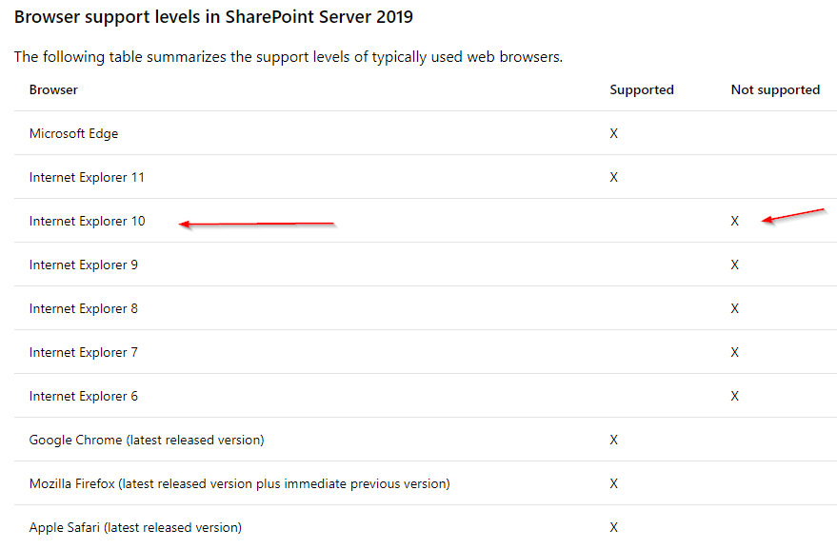
Client Minimum Software Requirements
Mobile browser support
Internet Explorer and Microsoft Edge on Windows Phone 8.1 or later.
Latest version of Chrome on Android 4.4 or later.
Latest versions of Safari and Chrome on iOS 8 or later.

Slide 20
Upgrade Methods
SharePoint Server 2019 supports an upgrade from a RTM version of SharePoint Server 2016.
Database Attach Upgrade
  Only available method for version to version (V2V) upgrades
  Works for both version to version (V2V) and build to build (B2B) upgrades
  Works for content and services databases
  Option to manually or automatically upgrade site collections
In-Place Farm Upgrade
  Only available for build to build (B2B) upgrades

Slide 21
Databases Supporting Database Attach Upgrade
Content databases
Project databases
Search admin database
Search analytics reporting
Profile database
Social database
Managed Metadata database
Secure Store database
  Note: Passphrase required to retain passwords in store

Slide 22
Databases Not Supporting Database Attach Upgrade
Configuration database
  Unsupported for both V2V and B2B upgrades
  Has never been supported in prior versions
Search index databases
  Unsupported for V2V upgrades only
Word automation
Machine translation

Slide 23
Authentication Mode Support & Upgrade
Windows Classic Support (Legacy)
Windows Claims Support
  Migration before upgrade recommended
Forms Auth Support
  No changes from 2010
  Ensure provider installed with same name before database attachment
Database to Web Application authentication mode mismatches
  Database attach in SP2019 detects mismatched auth support
  Test-SPContentDatabase in SP2019 also detects this
  Fix before attaching is best advice

Slide 24
Claims Migration Best Practices WRT Upgrade
Should not group both events together
  Prevent stacked faults that could confuse troubleshooting
  Ideally migrate to claims before upgrade
    Alternately do so after upgrade is completed and verified successful
Find authentication mode mismatch issues between content databases and web applications with Test-SPContentDatabase first
  If partial migration within content database, solve that before continuing
  If misconfigured web application, fix before doing database attach/upgrades
Ensure all external data source/web services work as expected after claims migration

Slide 25
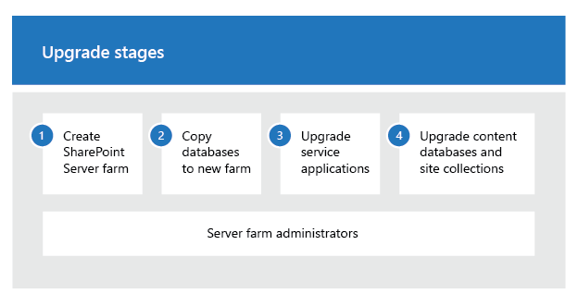
Upgrade process
Backup content db on a SP2013 farm
  Claims
  Classic Windows Authentication on SP2013
Restore content db on SQL for SP2016
Mount and Upgrade content db
Site collection upgrade*
  May be upgraded automatically

Slide 26
Demo
Create web app
Test, Mount SPContentdatabase

Slide 27
Miscellaneous Upgrade Items

Slide 28
Upgrade Log Improvements
ULS Logging
  TSV format with headers, easily imported into Excel
  Separate Site Collection level upgrade logs (SiteUpgrade_DateTime.log)
Correlation Ids
  Helps track specific upgrade sessions into ULS
  Also helpful tracking unique sessions from merged parallel upgrade logs
Error Codes
  Can help determine error cause/location/fix in debugging (Binging for answers)
  Some progress at RTM, more codes will follow
Categorization of Operations
  Better detail to track when entering/exiting sequences and actions
  Planned for future update

Slide 29
Maintenance Log
Gallery added during any upgrade
  Only added if it doesn’t exist
  Will add during both version to version and build to build upgrades
Contains site collection upgrade logs
  Only contains local site collection’s reduced logging level upgrade log
  Full site collection and database logs still on file system for farm admin access
Logging level is separate from file system upgrade logs
  Less detail than file system logs, not configurable

Slide 30
Farm Upgrade Overview

Slide 31
Planning Farm Upgrades
Learn about upgrade (how it works, what to plan for)
  Documentation/posters
  Training
  Try it out on a test environment
Gather data on existing farms (i.e. farm surveys)
  Collect all settings within the farm
  Get report on farm state including services, databases, and sites
  Collect all customizations with installation/configuration documents
  SPDocKit (www.spdockit.com)
Plan business continuity
  Outage length planning and mitigation methods

Slide 32
Preparing Farm Upgrades
Remove orphaned items
  Customizations you can’t move forward (e.g. incompatible with 2013)
Build-out new 2019 farm(s)
  If using federated services on different farms, target the services farm first
  If possible leave old farms running while upgrading to new ones (for outage reduction)
  Set farm CompatibilityRange as appropriate
  Install customizations onto new farm
    Ensure you install customizations for both 15 and 16 mode as appropriate

Slide 33
Executing Farm Upgrades
Backup everything
Upgrade services first
    Search Administration database
    Profile, Social, and Sync databases
    Managed Metadata/Taxonomy database
    Secure Store database
      Remember to have Secure Store passphrase or you will lose all existing passwords
Upgrade content databases
  Site collection upgrade part of database upgrade except if explicitly excluded
Mount-SPContentDatabase "SP2019_Content_Upgrade" -WebApplication http://2019portal -SkipSiteUpgrade
  Upgrade site collections at your leisure

Slide 34
Finishing Up Farm Upgrades
Confirm successful upgrade state
  Verify services and content rendering
  Fix issues if necessary
Re-index existing content
  Search Crawls
  !! Query string parameter: !!
  ?contents=1

Slide 35
Workflow manager??
2 Scenarios
1.Connect to existing WF manager farm
2.Set up new WF manager farm

Slide 36
Upgrade WF manager
2.Set up new WF manager farm
Restore:
Workflow Manager Instance DB
Workflow Manager Resource Manager DB
Service Bus Message Container DB
Service Bus Gateway DB
Reconnect SharePoint and run:
$credential = [System.Net.CredentialCache]::DefaultNetworkCredentials
$site = Get-SPSite <siteurl>
$proxy = Get-SPWorkflowServiceApplicationProxy
$svcAddress = $proxy.GetWorkflowServiceAddress($site)
Copy-SPActivitiesToWorkflowService -WorkflowServiceAddress $svcAddress -Credential $credential -Force $true

Slide 37
Post upgrade steps
Page modernization

Slide 38
Disable modern??
#Site Collection Level
Add-PSSnapin microsoft.sharepoint.powershell -ea 0
$site = Get-SPSite http://spwfe
#Disable modern Lists and libraies at the Site Collection Level
$site.Features.Add([guid]"E3540C7D-6BEA-403C-A224-1A12EAFEE4C4")
#Re-enable the moden expirence at the site collection Level.
$site.Features.Remove([guid]"E3540C7D-6BEA-403C-A224-1A12EAFEE4C4")

Slide 39
Tools, tips and tricks

Slide 40
Tools, tips and tricks
Feature admin
  SharePoint Feature Administration and Clean Up Tool - Home
  http://www.featureadmin.com/
SPDocKit
SharePoint Manager
Scripts
  www.Get-spscripts.com

Slide 41
Tools, tips and tricks

Slide 42
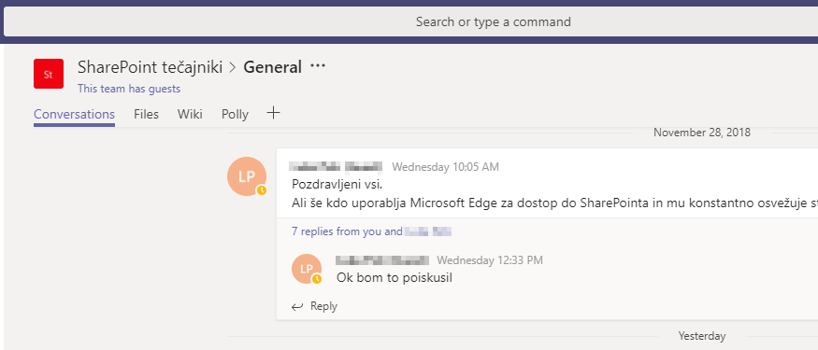
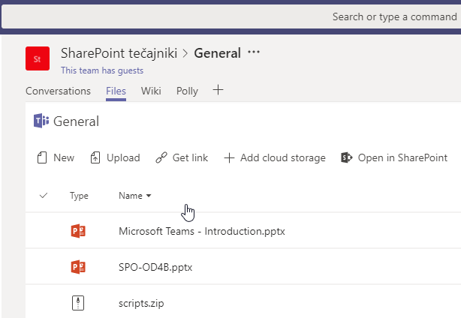
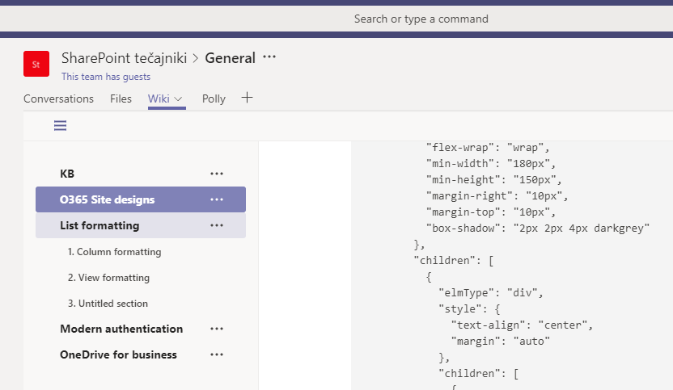
Xnet community on MS Teams
If you want to join, send us either your Live id or O365 account

Slide 43
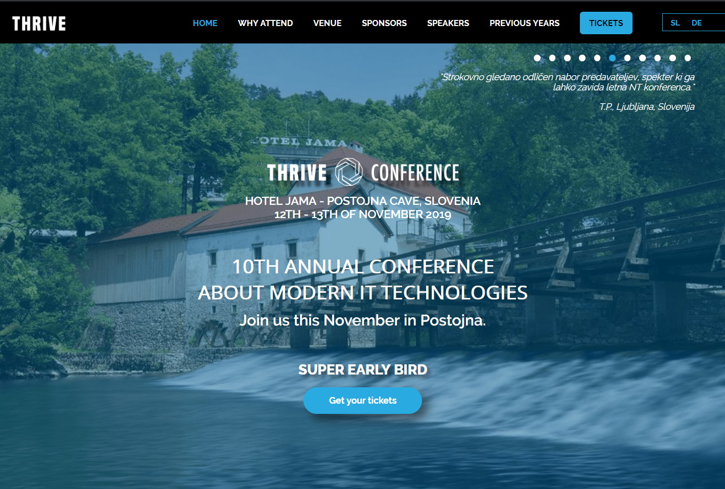
Learning
MS300 Deploying Microsoft 365 Teamwork 7.-11.10. 2019
MS 301 Deploying SharePoint Server Hybrid 26.-30.8.2019
SharePoint Online Power User 26.-29.8.2019
SharePoint Online for Administrators 2.-4.9.2019
Več: www.kompas-xnet.si
10. Thrive konferenca
Termin: 12. - 13. november 2019
Lokacija: Hotel Jama - Postojnska Jama https://www.thriveconf.com

Slide 44
Questions?

