Slide 1

Microsoft Teams aplikacije
Rajko Lah

Slide 2





Agenda
Uvod v Microsoft 365 & aplikacije
Upravljanje Teams Apps
App katalog
Varnost
Poročanjes

Slide 3


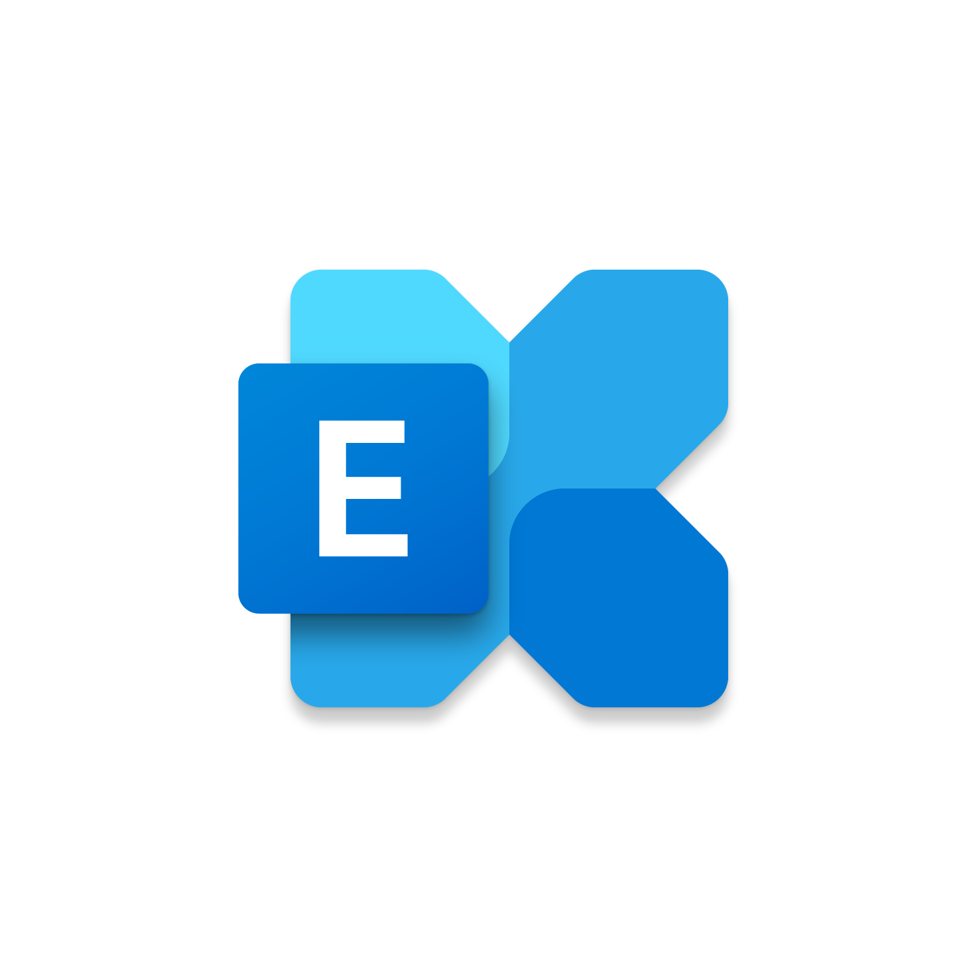

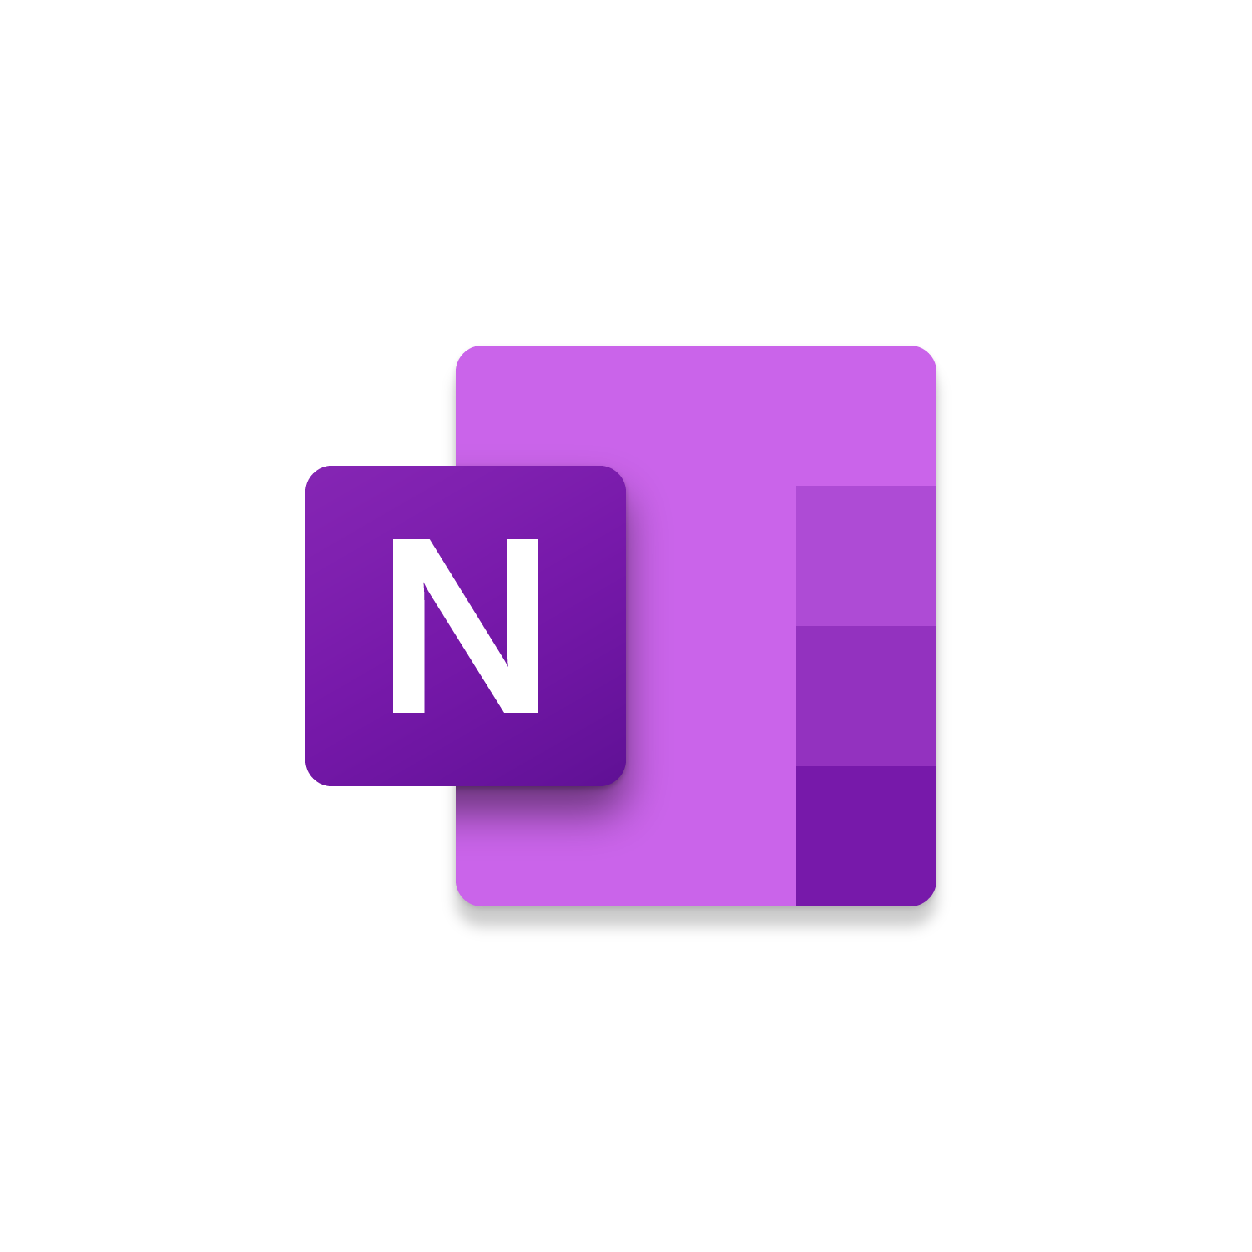

Foundation of Microsoft Teams
Exchange
Microsoft Teams
Azure
Active Directory
SharePoint Online
OneNote
Microsoft 365 Groups
Microsoft Teams is built on existing Microsoft technologies
Notes:
Key Points:
Describe how Teams is a hub to the rest of Microsoft 365
Teams is built on Exchange Online, Lync/SfBO/Teams calling, SharePoint Online/OneDrive for storage
Azure AD for authentication, guest access, conditional access
Microsoft 365 manage Team membership

Slide 4



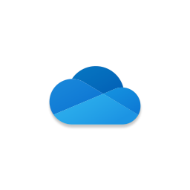
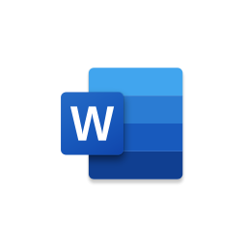
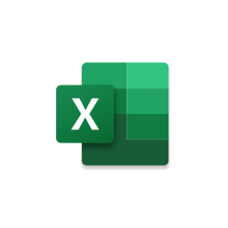



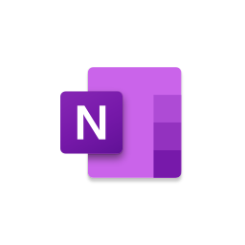
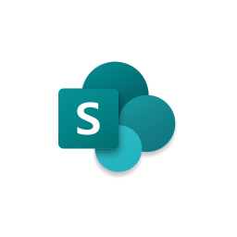







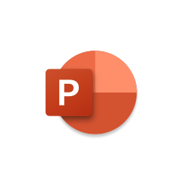














Who are Teams apps created by?
Power Platform (Low/No-Code)
Power
Virtual Agents
Power Apps
Power
Automate
Microsoft Apps
Third-Party Apps
Custom Apps
App Templates (Open-source ready)
Process
Automation
Productivity
Company Communicator
FAQ Plus
HR Support
Icebreaker
(40+ Templates)
Employee Services
Approvals & Workflows
Built from Scratch
45+ available
1000+ available
Unlimited possibilities
Bots
Tabs
Microsoft Graph
Messaging extensions

Slide 5
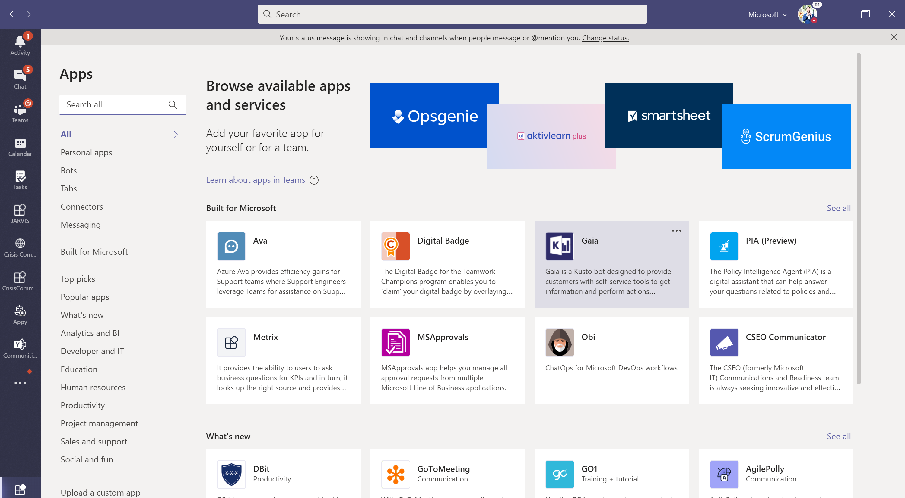
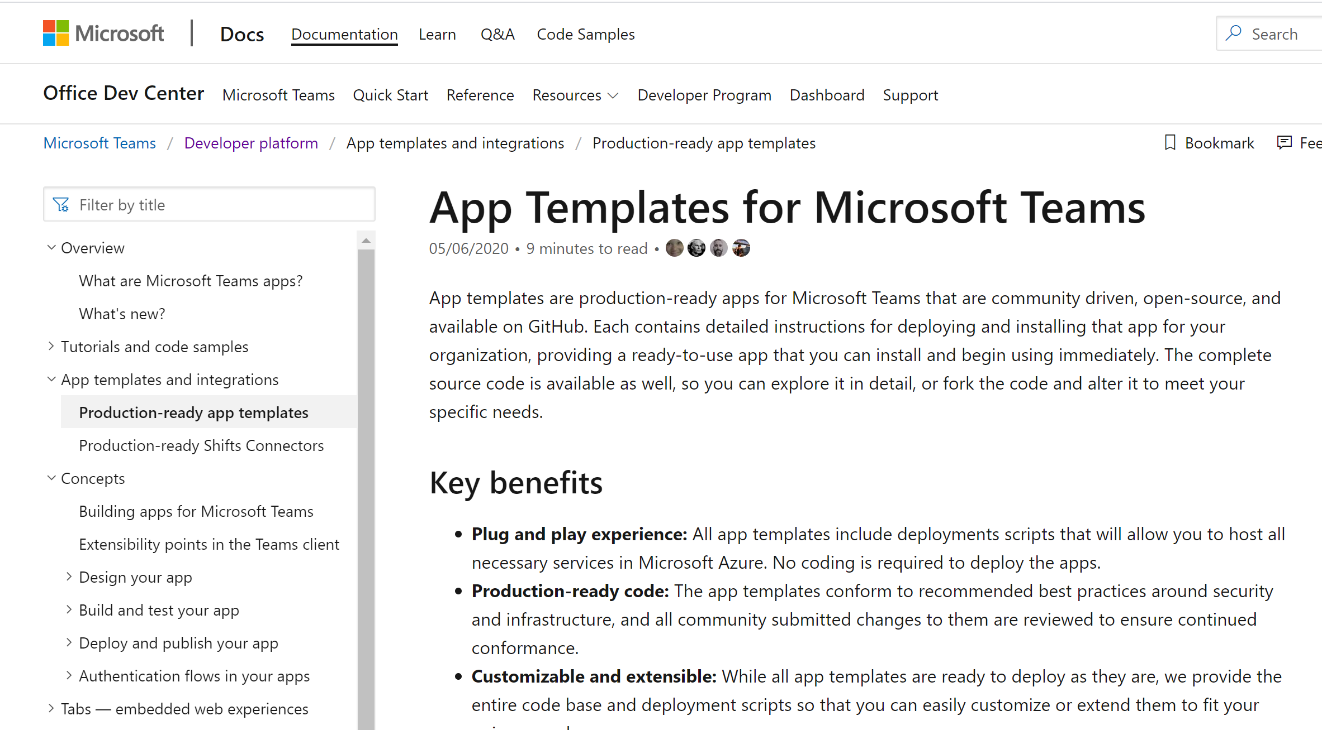




Where do I get the apps from?
I want to use existing solutions
I want to personalize existing solutions
I want to build my own solutions
Power Platform
Microsoft Teams
App Store
Microsoft Teams
App Templates
Power Apps, Power Automate (Flow), Power BI and Power Virtual Agents
aka.ms/AppSource
aka.ms/AppTemplates
powerplatform.microsoft.com
Notes:
And we don’t expect you to do this alone. We’ve taken those commonalities we’ve seen and started making it easier to create these experiences for your people in Teams.

Slide 6

Where do I publish Teams apps I created?
To the store
Available for all Microsoft Teams customers to use
To a tenant
Available for specific companies, controlled by tenant admins
To a team
For testing purposes, or for apps designed for specific functions and teams
Notes:
Speaker notes:
Once you’ve created a Teams app, there are 3 ways that the app can be published
Store:
Make your app available to the world. Let people know the category of your service, include screenshots and videos and easy to access app details that show off your app’s capabilities and skills.
Tenant:
When your app is designed to support a specific function in your company you can make it easy to find for all your company’s users. We’ve got a great place for your admin to host all your internal apps and they can suggest publicly available apps here too
Team:
When you want to test your app or if it was designed for a specific group of people, you can sideload your app and use it right away.

Slide 7
App Scope
Team and channel
Enable public collaboration and workflows with all team members
Example: share, discuss, and get notified about new service incidents
Chat
Lightweight collaboration in 1:1 or group setting without complex permissions
Example: 1:1 topics between manager and direct report
Personal
User-centric view, showing aggregate content along with private bot chat
Example: list of all tasks assigned to me

Slide 8
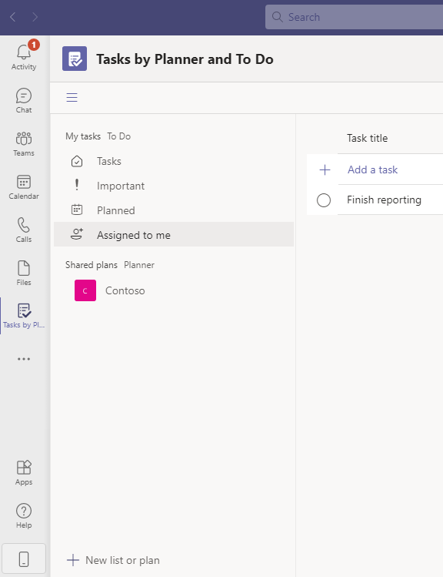
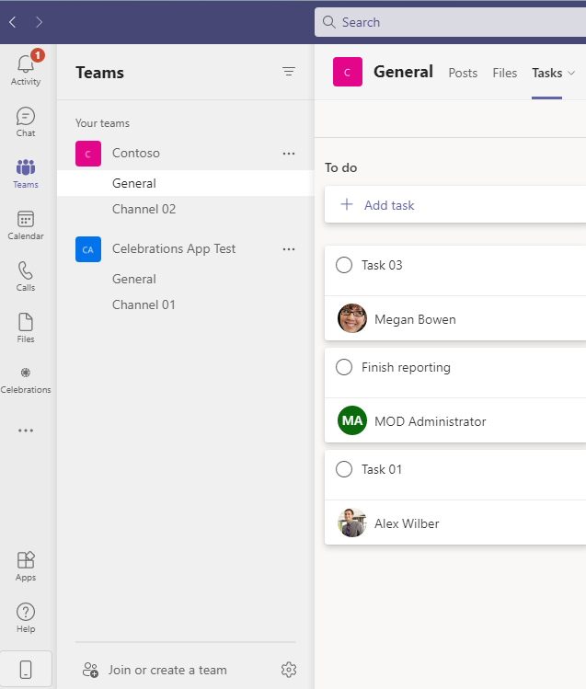
Tasks by Planner and To Do – Personal & Public
Some apps such as Tasks can be used in both a personal and public scope, each with different interfaces
When you open Tasks from the personal app flyout you can see tasks assigned to you.
These are across all plans, across different Teams.
When you open Tasks from the tab in the Team it will show all tasks
Not just those assigned to you

Slide 9
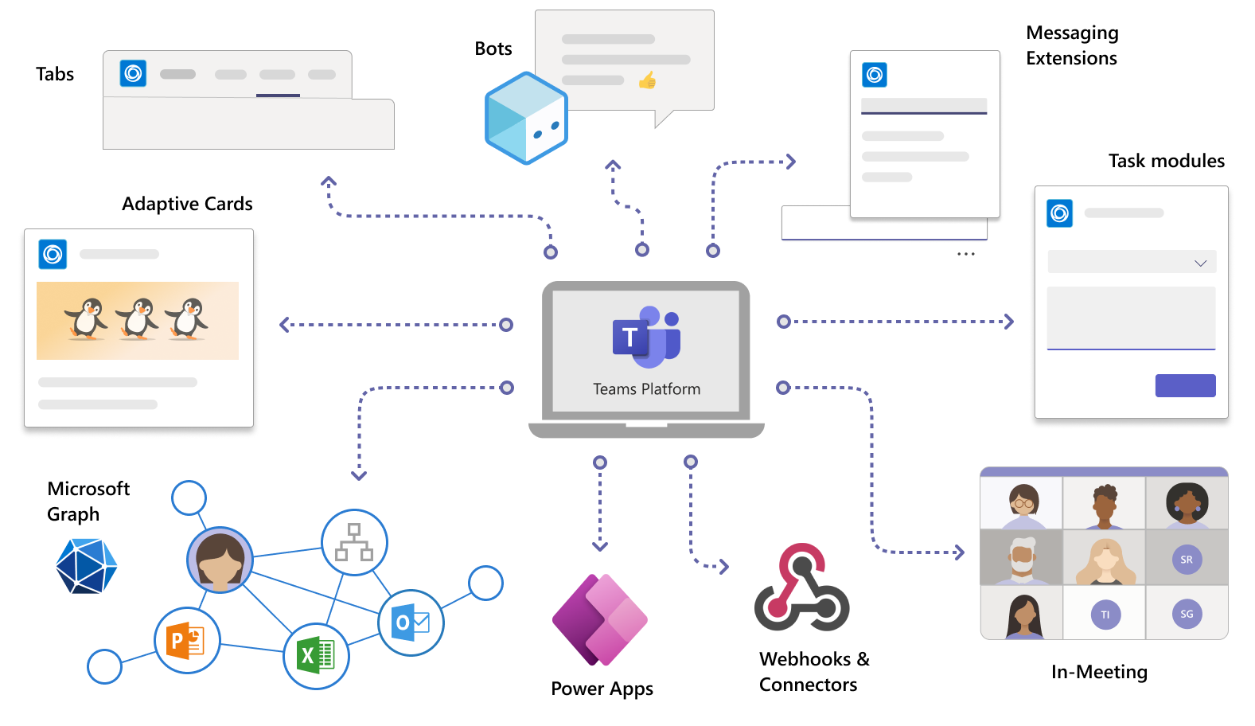
Types of Teams app features
Notes:
Teams app features: Tabs, bots, mess extensions, card and feeds are powered by different things that Microsoft offers
May integrate your LOB app you own and manage
May also integrated other services like AI capabilities
Bringing all this together into an application platform.

Slide 10
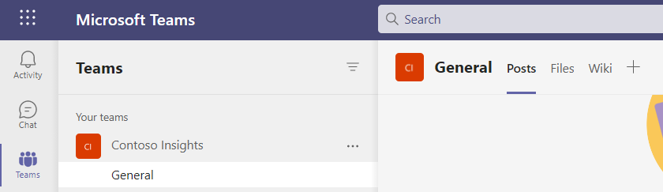
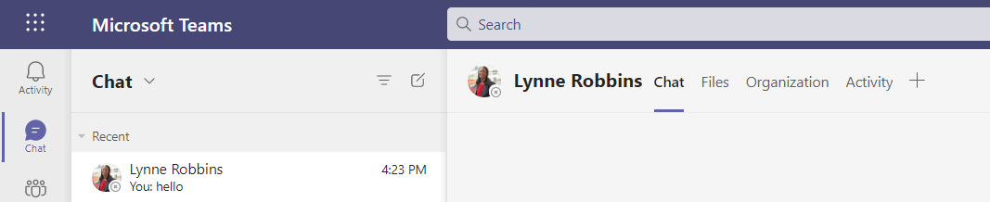
Tabs – Channel vs Chat
Tabs allow team members to access services and content in a dedicated space within a channel or in a chat
With every new channel, two tabs are provisioned by default: Posts, Files and Wiki.
With every private chat, four tabs are provisioned by default: Chat, Files, Organization and Activity.

Slide 11
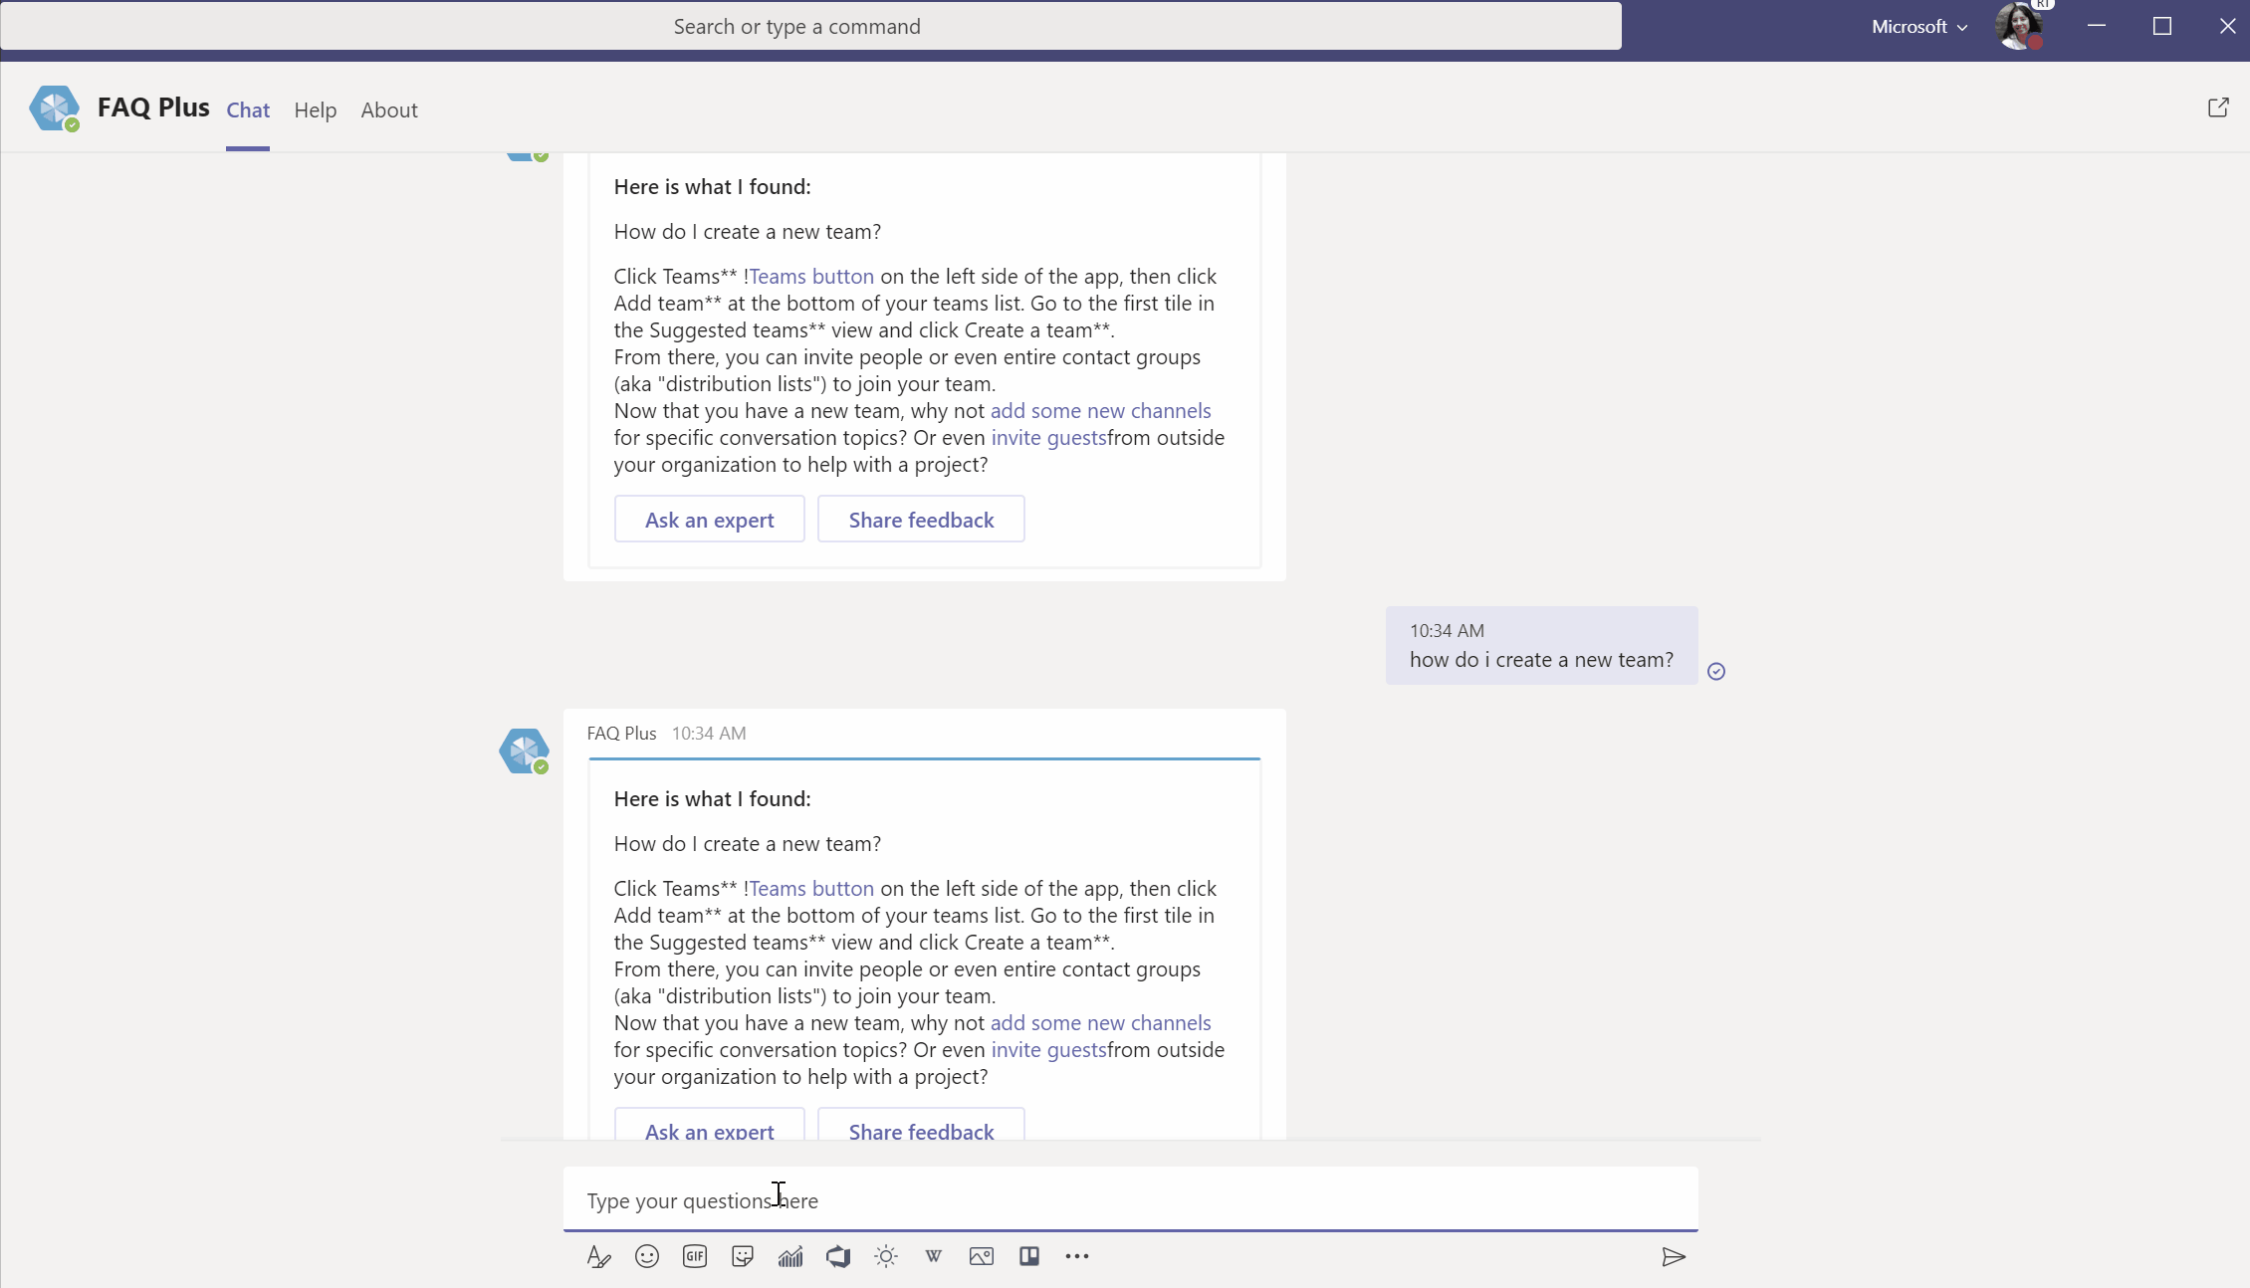
Bots
Bots are automated programs that respond to queries or give updates and notifications about details users find interesting or want to stay informed about
Bots allow users to interact with cloud services such as task management, scheduling, and polling in a Teams chat.
Bots can be used in 1:1, group chats or channels.
Notes:
In this video you can see a user interacting with the FAQ Plus app.
The user typing is looking for a specific expert, they then interact with an adaptive card.
See our developer documentation for more information.

Slide 12
Adaptive cards
Adaptive Cards are platform-agnostic snippets of UI, authored in JSON, that apps and services can openly exchange
When delivered to a specific app, the JSON is transformed into native UI that automatically adapts to its surroundings.
It helps design and integrate light-weight UI for all major platforms and frameworks.
GIF shows a user conversing with a bot in a one-to-one chat using both text and interactive cards. Don't forget, bots are much more than just text!
Notes:
In this video you can see a user interacting with the FAQ Plus app.
They are asking questions in natural language, and responses are given.
See our developer documentation for more information.

Slide 13
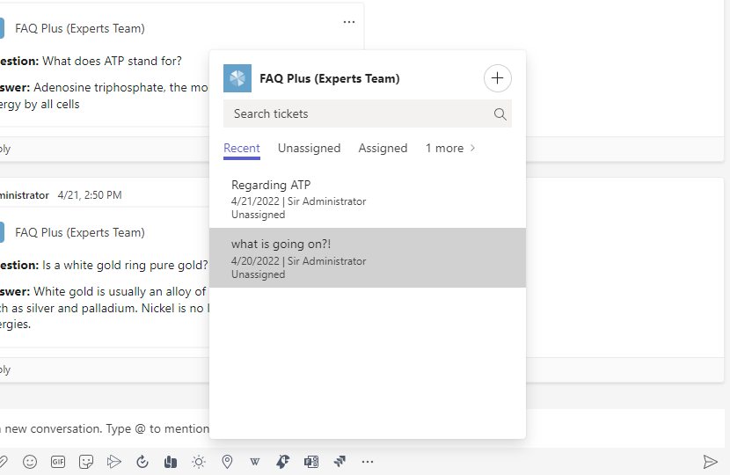
Messaging extensions
Messaging extensions allow the users to interact with your web service through buttons and forms in the Microsoft Teams client.
They can search or initiate actions in an external system from the compose message area, the command box, or directly from a message.
You can send back the results of that interaction to the Microsoft Teams client in the form of a richly formatted card.
Notes:
In this slide you can see a user interacting with the FAQ Plus app using Messaging Extension.
They are asking questions in natural language, and responses are given.
See our developer documentation for more information.

Slide 14
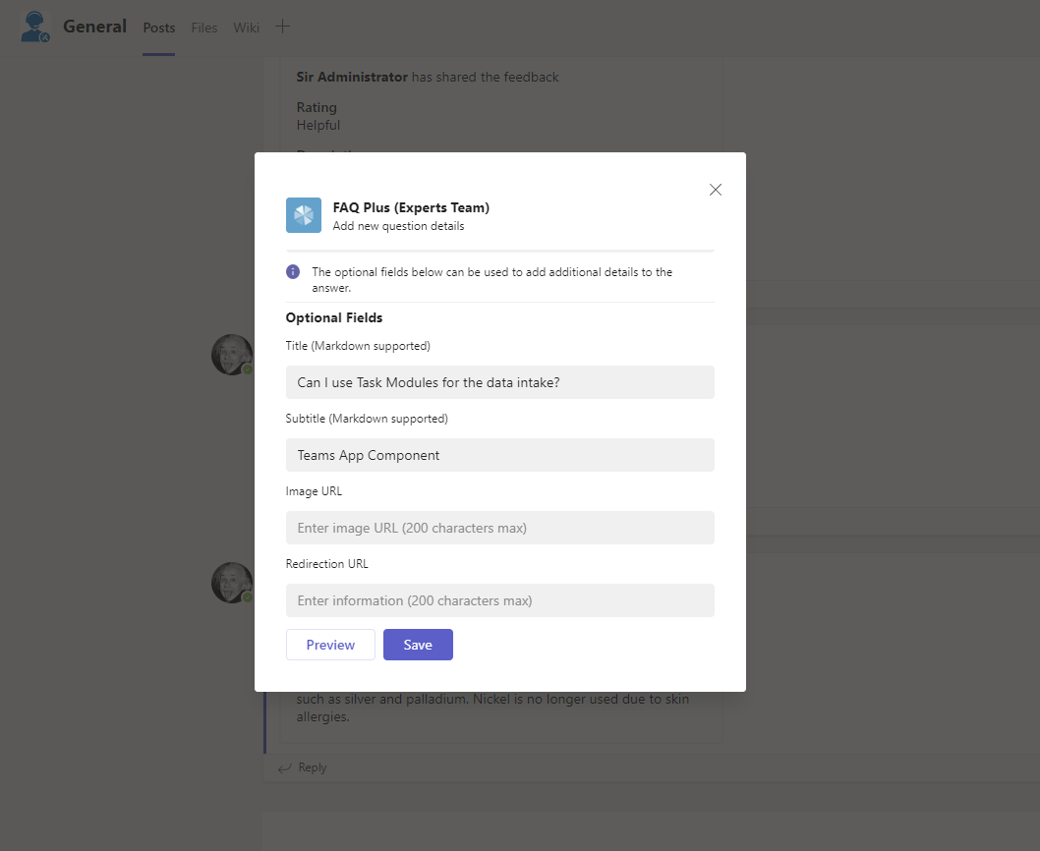
Task modules
Task modules permit you to create modal pop-up experiences in your Teams application
Task modules build on the foundation of Microsoft Teams tabs.
They are essentially a tab inside a pop-up window.
Notes:
In this slide you can see a user interacting with the FAQ Plus app using Task Module.
They are asking questions in natural language, and responses are given.
See our developer documentation for more information.

Slide 15
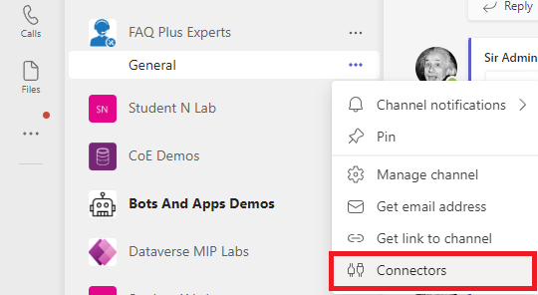
Connectors
Connectors keep your team current by delivering frequently used content and service updates directly into a channel
Currently, you can add connectors by using Microsoft Teams desktop and web clients. However, information posted by these connectors can be viewed in all clients including mobile.
To add a connector to a channel, click the ellipses (…), on the right of a channel name, then click Connectors.
Notes:
See our developer documentation for more information.

Slide 16
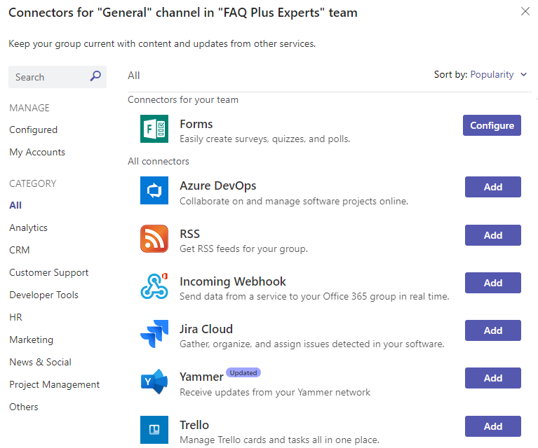
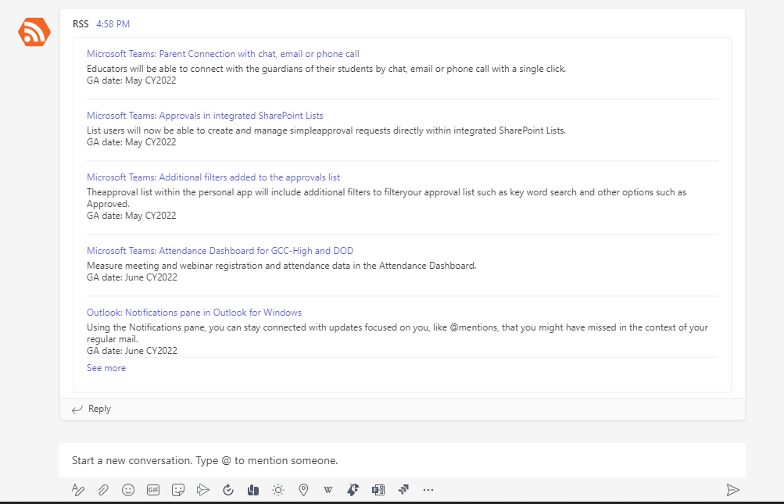
Using Connectors
With connectors, your Microsoft Teams users can receive updates from popular services such as Trello, Wunderlist, GitHub, and Azure DevOps Services within the chat stream in their team.
You can select from a variety of available connectors, and then click Add
Data provided by the connector is automatically posted to the channel
Notes:
See our developer documentation for more information.

Slide 17
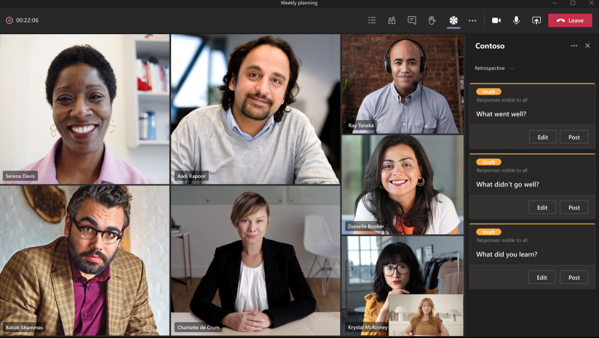
In-meetings apps
With the in-meeting app experience, you can engage participants during the meeting by using apps and the in-meeting dialog box.
A meeting lifecycle consists of pre-meeting, in-meeting, and post-meeting app experience. You can integrate tabs, bots, and message extensions in each stage of the meeting lifecycle.

Slide 18















Teams Apps can be built with anything!
Power
Platform
Every
Developer
(Low Code)
Power Apps
Power Automate
Power Virtual Agents
Power BI
Azure
services
Pro
Developer
(Code First)
Microsoft
Graph
API
Management
Azure
Functions
Kubernetes Service
Logic
Apps
Cognitive
Services
Bot
Services
Data Platform
Visual
Studio
VS
Code
Microsoft Dataverse
Azure or
on-prem SQL
Azure Synapse Analytics
Cosmos DB
…and more

Slide 19





Anatomy of Teams App
Teams App Package is a zip file that consists of:
color.png – colorful icon for Teams app catalog,
outline.png – used in left navigation,
maniseft.json – contains app information
Teams App
Color Icon
Outline
Manifest
Teams App Package
(*.zip package uploaded into Teams App Catalog)
Manifest is a crucial part of a Teams App. It defines app description, properties, permissions, features like tabs, bots and where they are hosted and valid domains for these hosted components.
Azure
Power Platform
Other
Hosted web applications
(Power Platform, Azure,
3rd Party, On-premises)
Tabs, bots, messaging extensions etc

Slide 20
Typical app challenges our customers face
Business data security
concerns regarding connectors
Understanding utilization of apps in the environment
Maintenance challenges regarding app distribution or updates
Security risks regarding “shadow IT”
Compliancy issues
regarding regulations like GDPR
ALM support regarding
apps being
created/deployed
Staff turnover challenges
regarding app ownership and responsibilities
Information risk management

Slide 21
Our Focus for Governance
Identifying the roles, responsibilities, and repeatable processes for the lifecycle of apps in your environment
Technical controls for managing which apps are in your environment and which users can leverage them
Help keep your organization's system secure and compliant
Settings and Policies
Supporting People and Processes
Security and Compliance
Notes:
Today isn’t just about Teams. Not just about developing apps. About governance – and while often in Teams – many of you want to better understand how to create processes or governance or whatever you call it around apps in general. 3rd party – homegrown – new.
Define the strategy for all deployments
Environment & Tenant Strategy
DLP
User Access
For every solution that comes to the COE, there will be toll gates at the end of each phase
Ideation
Problem statement
Any similar solutions available in the market?
Cost
Design
Build
Environment Provision
Development & Test
Deploy
DLP Strategy
User Access
Manage
Analytics – usage
Support - issues

Slide 22






Core App Deployment Considerations
App Availability Settings and Policies
App Permissions
Risk Profile
Management of Own, Microsoft and 3rd Party Apps
Components of the App
Connections to External Data
Roles and Responsibilities
Request and
Approval Procedures
Activity Reports
Notes:
Some of these we’ll cover in this module, others will be woven throughout the other modules.

Slide 23
How will users get access to apps?
Open (default)
Controlled
Closed
Users can add any third-party app or custom organizational app.
Users can side-load any custom app.
Users must request apps be enabled or uploaded in the environment.
Apps are made available to subsets of users based on policy.
IT developers can side-load apps (for testing), but users cannot.
The organization completes risk profiles on apps as they are made available.
Users cannot use any third-party apps.
Restricted to first-party collaboration apps.
Users cannot side-load any custom app.
Low effort, maximum flexibility
More effort,
full control
Low effort, limited collaboration
Notes:
This is a sliding scale, what works for some orgs will not work for others.
The more control you want to exert, the more effort it will take.

Slide 24
Roles and Responsibilities
Business Users
Just need the right tools to get their work done.
Business and Technical Strategy
Determine direction for which apps can / should be used in the environment and help drive usage of the platform.
Information Security / Legal
Need to ensure corporate data is protected, accounts are secure, and all regulations/requirements are adhered to.
IT and Security Architects
Ensure the apps work in our environment and appropriate data access and privacy is in place.
Citizen or Custom Developers
Builders of custom solutions to be deployed – may (or may not) be part of Technology teams.
Teams Admins and Support
Responsible for putting in place the right policies and settings.
What are the roles in your organization with a stake in the game?
Notes:
Sometimes these roles are well defined across different groups, sometimes these are all the same person!
Regular Business Users – The users that need these apps turned on so they can make things happen
Information Security / Legal - makes sure that these solutions adhere to our organizational security & compliance guardrails
Citizen Developers and Custom Developers – The implementers of solutions who want to deploy them in Teams
Business and Technical Strategy - Strategic sponsors providing vision and operational steering groups implement the vision and drive the program
Architects
Teams Admins
Others
Finance – are licensing or costs involved?

Slide 25
Developer Personas
Citizen Developer / App Maker
Develops for self or Team
Might be involved in other core business activities and build apps when needed.
Simple to Medium Complexity Processes
Focus on building App fit to purpose
Mostly Part of core Business Functions
Consumer of reusable libraries built by power developers
Pro-Developer
Develops for others
Being a professional developers, will focus mainly on building apps and related solutions
Medium to High Complexity Processes
Focus on building complete solutions considering various factors like performance etc.
Mostly part of core Information Technology and Digitization teams
Would be involved in building reusable libraries & functions to ease development for citizen developers

Slide 26

Ensure DevOps for in-house developed apps
The greatest value add from implementing DevOps is gained through the automation of manual processes allowing for the continuous delivery of value to customers.
Automate build and deploy
Increased speed to market
Faster mean time to resolution

Slide 27
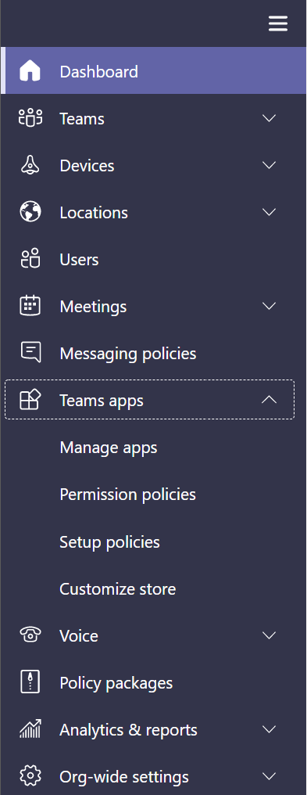
Teams App Management
App are tabs, connectors, bots or any combination of these three, provided by Teams (first-party/default) or by third-party (external Apps)
Located in Teams Admin Center > Teams apps
Manage apps – which apps are allowed and blocked in the tenant
Permission policies – who gets which apps
Setup policies – how apps are made available to users in the Teams app
Customize store – customize organization’s app store in Teams with company branding
Considerations
Managing apps helps in change management (users may not be ready/trained to use apps yet).
Does your organization have any requirements around limiting what first-party (Microsoft) and external (non-Microsoft) apps users can utilize in Team?
How will you assign the policies that will dictate what capabilities different sets of users have?
Who can develop and test apps in your organization?
Avoid users trying to use 3rd party apps which may need additional licensing or configurations.
Notes:
The Teams admin center allows admins to manage the apps that are available to the organization through permissions policies – for example, I can allow users to install all apps, no apps, or anything in between on an app-by-app level

Slide 28

Org-wide (Top Level) App Settings
Located in Teams Admin Center > Teams apps > Manage apps > Org-wide app settings
Options to completely disable third-party or custom apps
Options to automatically load new apps as “allowed” or “blocked” by default
Option to show/hide tailored apps for first-line workers (F licenses)
Considerations
If you turn these options off at the org-wide settings, it means no one can use apps at all in Teams.
Just because you have disabled apps for Teams, doesn’t mean you have disabled the access that app has to your environment!
Tailored apps
Third-party apps
Custom apps
Users with F licenses will get tailored apps pinned on their behalf when they sign in to Teams. Learn more
You can control which third-party apps can be installed for your organization. Learn more
You can develop and upload custom apps as app packages and make them available in your organization's app store. Learn more
Third-party apps
Show tailored apps
On
Interaction with custom apps
On
On
New third-party apps published to store
On
Notes:
Manage apps page is a view into all available apps in your tenant catalog, with the information you need to decide which apps to allow or block across your organization. ​
Use app permission policies, app setup policies, and custom app policies and settings to configure the app experience for specific users in your organization​

Slide 29
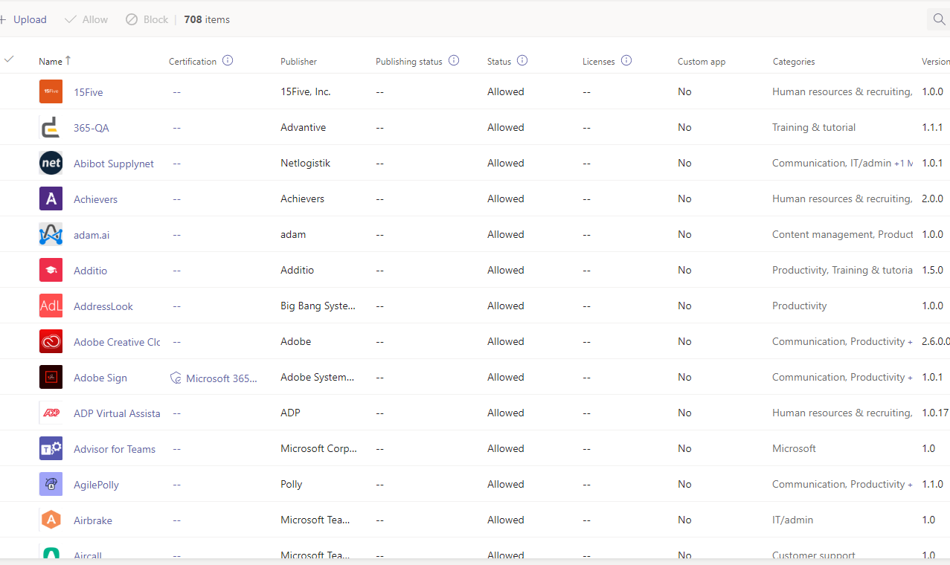
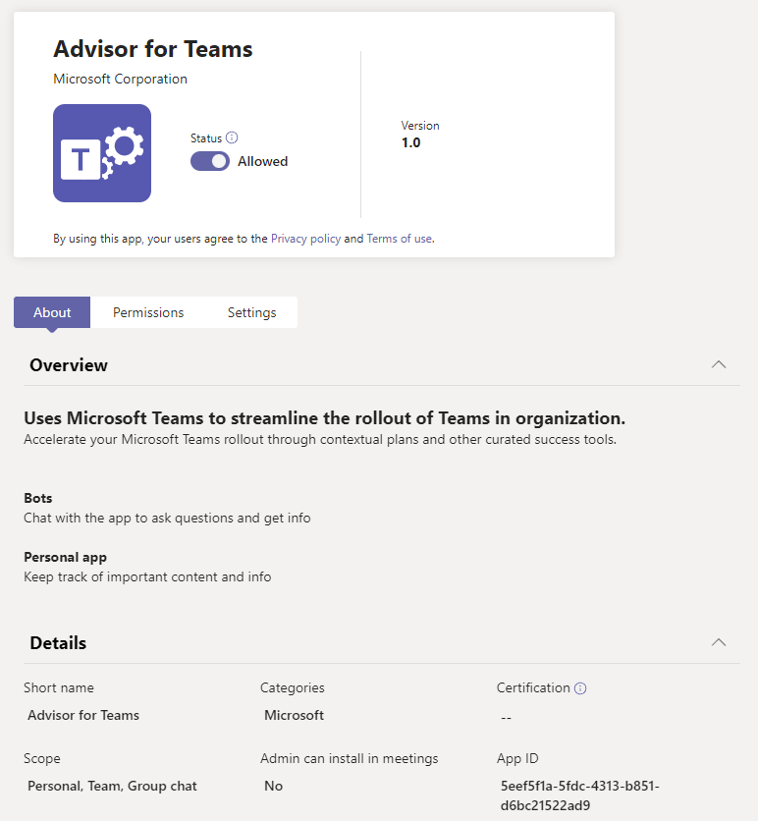
Manage Apps
Located in Teams Admin Center > Teams apps > Manage apps
Status can be set to Allowed or Blocked
Additional details include publisher, certification, category, version, and more
Considerations
Blocking an app at the “Manage apps” level will block that app for all users (even if it is included in a permission policy).
Does the organization want to individually allow or block these (several hundred) apps? Or rather handle it via app permission policies?
Notes:
You can allow or block individual Apps at the org level using the Manage Apps page. When you block an app, all interactions with that app are disabled and the app doesn't appear in Teams for any users in the organization​
Microsoft works with partners to provide the information organizations need to expedite and inform decisions about Teams apps and add-ins they use. The information is supplemented with information from the Microsoft Cloud App Security app catalog and information provided by the developers when they submit their applications.

Slide 30
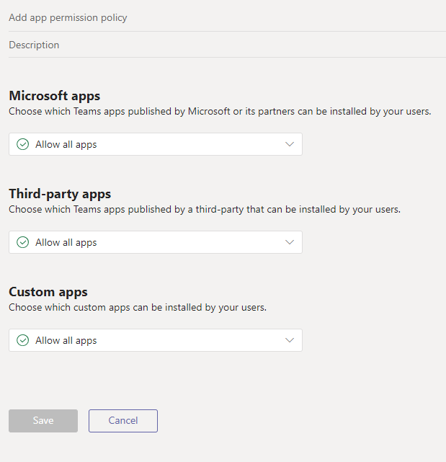
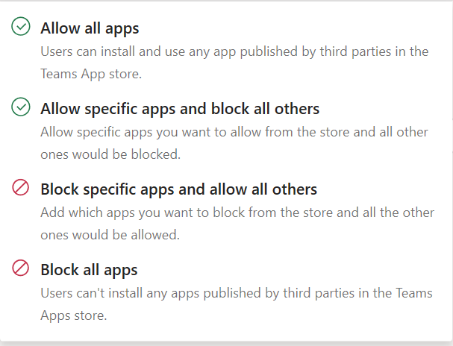
Permission Policies
Located in Teams Admin Center > Teams apps > Permission policies
Microsoft – first party Microsoft apps
Third-party – apps developed by external trusted partners
Custom – apps your organization has built and deployed
Considerations
Does your organization have any requirements around limiting third-party or custom applications?
What about Microsoft applications you are not yet ready to deploy?
Permission policies are assigned on a per-user basis -- How will the organization manage policies for individuals or groups?
Notes:
To create and manage custom apps in Teams, you'll need two tenants: a test tenant for development and a production tenant. Allow all users in the test tenant to upload custom apps. Use App setup policies in production tenant to allow trusted users
Which Microsoft apps will be allowed?-There are very few reasons to not allow all Microsoft apps since theyare integrating Office 365 applications which have the same data-handling, security, and compliancestandards as Microsoft Teams.One exception is Who, which is an app developed by Microsoft but appearsin the third-party catalog because itintegrateswith other services outside of Office.
Which third party apps will be allowed?-This will be mostly answered by the constraints identified in step 1above(details about the app’ssecurity/compliance or the way data istransferred viaspecific app capabilities).KEY RECOMMENDATIONEvery customer should allow third party andcustom apps in org-wide app settings. If administratorswant to block apps (an entirecategoryor specific apps) this should be done with permission policies.KEY RECOMMENDATIONReviewthe security and compliance catalog for third party apps. Mostthird-partyapps in the appstore have a listing with details about the developer, how they handle data, and which compliance standards they meet. View the ADP Virtual Assistantapp profile as an example.
Which custom/tenant apps will be allowed?-Most tenants should allow allcustom appsin the global permission policy. This is because it is easy to control who can create and publish custom apps using an app setup policy. By controlling who can create and publish apps, anything that appears in the company app store will come users who have explicitly been given this ability

Slide 31
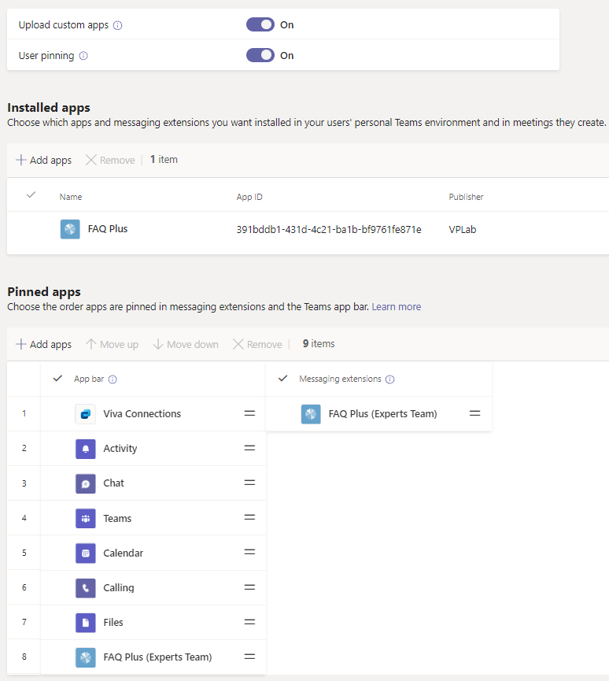
Setup Policies
Located in Teams Admin Center > Teams apps >
Setup policies
“Sideloading” apps and pinning personal apps
Install apps on behalf of users
Organizationally Pinned Apps and Messaging Extensions
Considerations
Is there any need to allow side-loading of external apps (for developers, for business users)?
Pin the apps used frequently within the organization to app navigation bar for users to access the apps easily (desktop screen can show up to 11 apps, mobile – up to 5).
Any apps that can’t fit in the screen move to the overflow (ellipsis on desktop, overflow tray on mobile).
Notes:
Sideloading is how you add an app to Teams by uploading a zip file directly to a team. Sideloading lets you test an app as it's being developed. It also lets you build an app for internal use only and share it with your team without submitting it to the Teams app Catalog in the Office Store.
Allow side loading only if you are developing your own apps

Slide 32
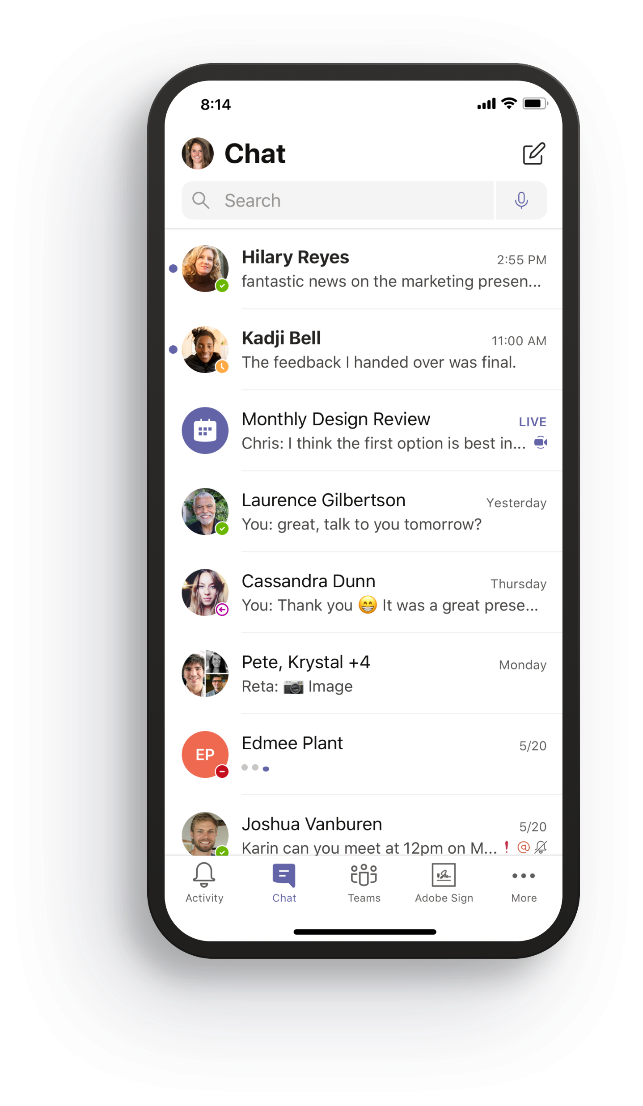
Teams Navigation in Mobile App
Notes:
Setup policies allow you to customize the menu bar on desktop and mobile so that you display tools most relevant to your users.

Slide 33
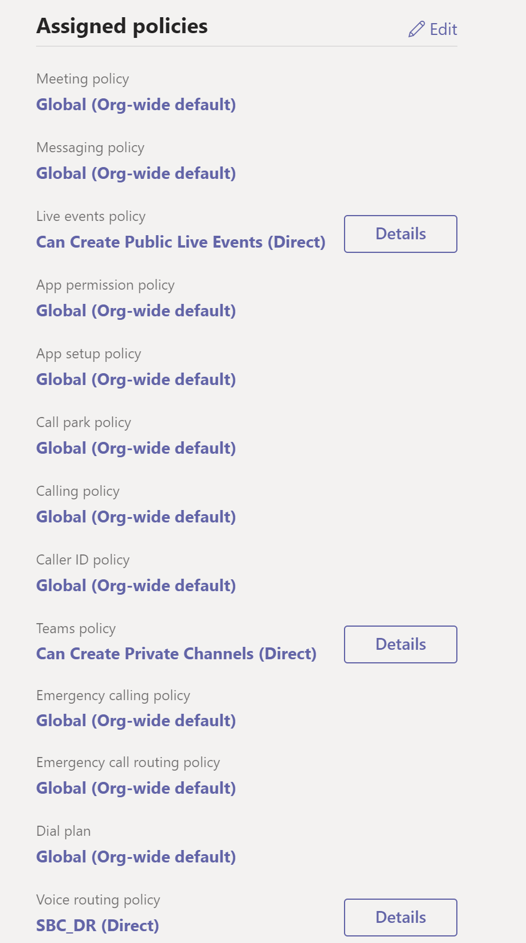
Policy Assignment
Located in Teams Admin Center > Users >
Setup policies
A user can only have one policy at a time (last assigned wins!)
There are no cumulative policy capabilities!
  User A need App 1, User B needs App 2, User C needs App 1 and 2
  This equals 3 policies required!
Considerations
How many policies will you need to achieve business requirements?
Naming convention for Policies (descriptive names, rings for deployment, etc.)?
How will you assign policies and maintain assignment going forward (e.g. new hires, job changes, etc.)?
It may take several hours for policy changes to propagate – plan for 24 to 48 hours.

Slide 34
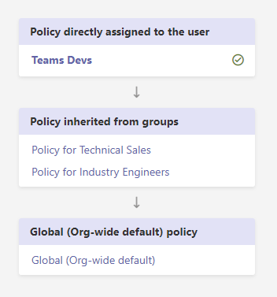
Policy Precedence
If a user is directly assigned a policy (either individually or through a batch assignment), that policy takes precedence.
If a user isn't directly assigned a policy of a given type, the policy assigned to a group that the user is a member of takes precedence
If a user isn't directly assigned a policy or isn't a member of any groups that are assigned a policy, the user gets the global (Org-wide default) policy for that policy type.
app setup policies precedence
Notes:
Source: https://docs.microsoft.com/en-us/MicrosoftTeams/assign-policies
If a user is a member of multiple groups, the policy that has the highest group assignment ranking for the given policy type takes precedence.

Slide 35
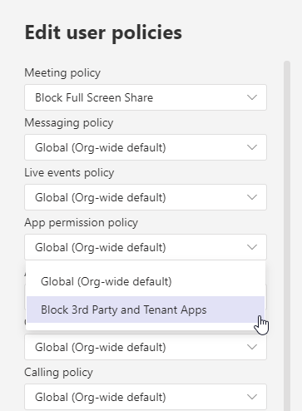
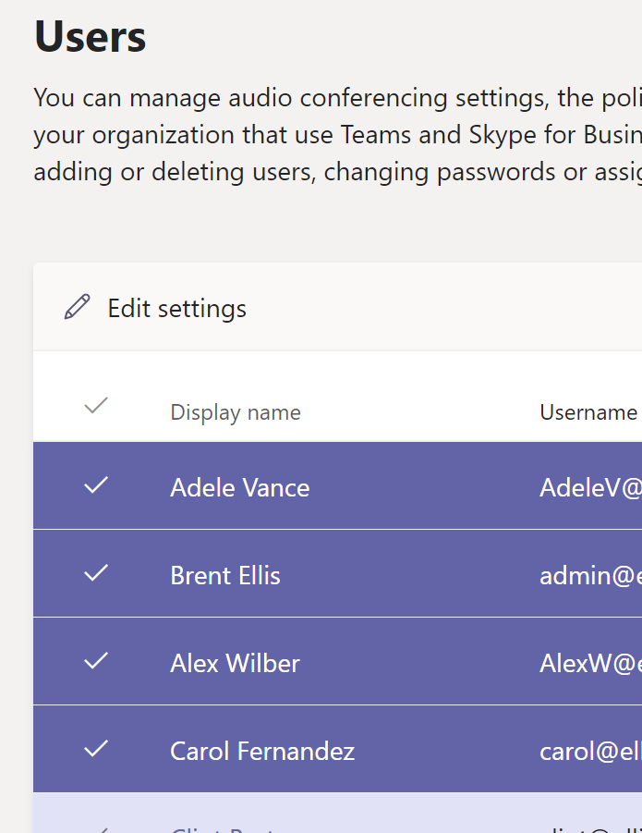
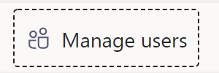
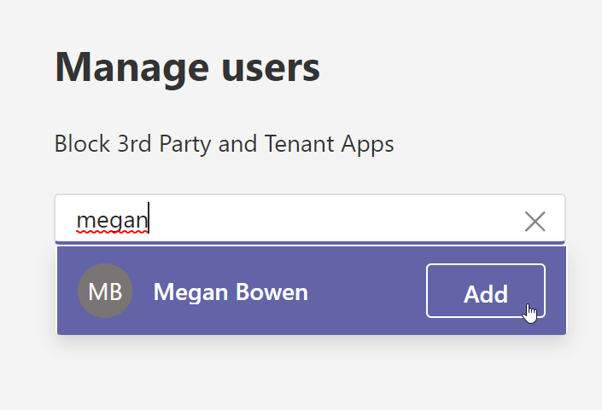
Assigning Policies
Individual User Profile
Where: Teams Admin Center > Users > Select User > Policies
Select Multiple Users
Where: Teams Admin Center > Users > Edit settings
Select multiple users to update policies (limits in how many you can select at a time)
Assign at the Policy
Where: Teams Admin Center > Teams apps > Permission policies or Setup policies > Manage Users
PowerShell Scripting
Individually assign via Powershell using Microsoft Teams module
Grant-CsTeamsAppPermissionPolicy -PolicyName "Policy Name"
-Identity "user@company.com"
Grant-CsTeamsAppSetupPolicy
-PolicyName "Policy Name"
-Identity "user@company.com"
Notes:
https://docs.microsoft.com/en-us/microsoftteams/assign-policies
The point of these slides is to think about the processes customers will have to use to make sure the right people have the right policies. Facilitate a discussion.

Slide 36
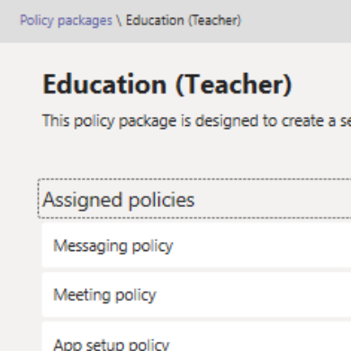
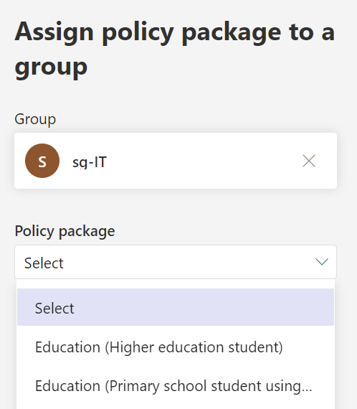
Assigning Policies (2 of 2)
Batch Policy Assignment
One-time assign to a group (array) of users from Teams PowerShell in bulk
Up to 5,000 users in a batch
New-CsBatchPolicyAssignmentOperation
-PolicyType TeamsAppPermissionPolicy
-PolicyName "Policy Name"
-Identity $users_ids
-OperationName "BatchAssign1"
New-CsBatchPolicyAssignmentOperation
-PolicyType TeamsAppSetupPolicy
-PolicyName "Policy Name"
-Identity $users_ids
-OperationName "BatchAssign2"
Assign to Groups
Assign a policy to a group of users, such as a security group or distribution list
Automatically updates
Groups up to 50,000 users
New-CsGroupPolicyAssignment
-GroupId d8ebfa45-0f28-4d2d-9bcc-b158a49e2d17
-PolicyType TeamsAppPermissionPolicy
-PolicyName "Policy Name"
-Rank 1
New-CsGroupPolicyAssignment
-GroupId d8ebfa45-0f28-4d2d-9bcc-b158a49e2d17
-PolicyType TeamsAppSetupPolicy
-PolicyName "Policy Name"
-Rank 3
Policy Packages
Collection of predefined policies and policy settings that you can assign to users who have the same or similar roles in your organization
New-CsBatchPolicyPackageAssignmentOperation
-Identity $user_ids
-PackageName Education_PrimaryStudent
Assign to Groups (UI)
Assign multiple policies to a group of users, such as security group or distribution list
Groups up to 50,000 users
Notes:
https://docs.microsoft.com/en-us/microsoftteams/assign-policies
The point of these slides is to think about the processes customers will have to use to make sure the right people have the right policies. Facilitate a discussion.
Policy Package Assigned to a Group - When you assign the policy package, it's immediately assigned to the group. However, the propagation of the policy assignment to members of the group is performed as a background operation and might take some time, depending on the size of the group.

Slide 37
Custom App Policies and Settings
This table summarizes the custom app policy and settings, how they work together, and their combined effect on controlling who in your organization can upload custom apps to Teams
Org-wide | Team | User | Effect of custom app setting
Off | Off | Off | Interaction with all custom apps is blocked for your organization. Custom apps can't be uploaded by anyone except a Teams Service Admin or a Global admin. You can use PowerShell to remove the custom app.
Off | Off | On | Interaction with all custom apps is blocked for your organization. Custom apps can't be uploaded by anyone except a Teams Service Admin or a Global admin. You can use PowerShell to remove the custom app.
Off | On | Off | Interaction with all custom apps is blocked for your organization. Custom apps can't be uploaded by anyone except a Teams Service Admin or a Global admin. You can use Windows PowerShell to delete custom apps.
Off | On | On | Interaction with all custom apps is blocked for your organization. Custom apps can't be uploaded by anyone except a Teams Service Admin or a Global admin. You can use PowerShell to remove the custom app.
On | Off | Off | The user can't upload custom apps.
On | Off | On | If the user is a team owner, they can upload custom apps to the team. If the user isn't a team owner, they can't upload custom apps to the team. The user can upload custom apps in the personal context.
On | On | Off | The user can't upload custom apps.
On | On | On | The user can upload custom apps to the team, regardless of whether the user is a team owner. The user can upload custom apps in the personal context.
Notes:
https://docs.microsoft.com/en-us/microsoftteams/teams-custom-app-policies-and-settings

Slide 38
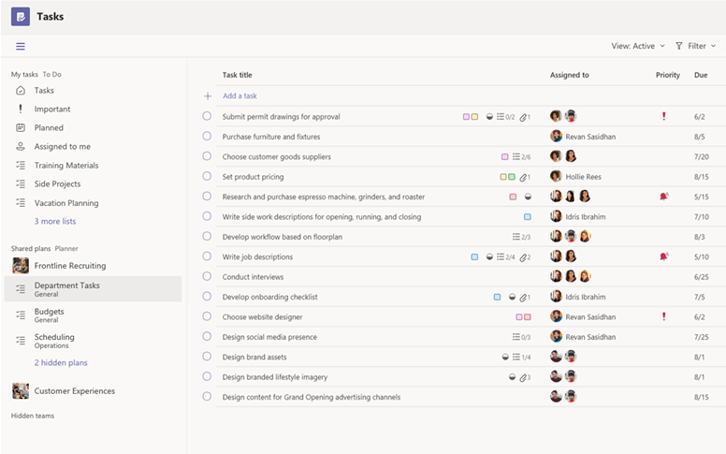
Example: Tasks (Planner)
The Tasks app brings a cohesive task management experience to Microsoft Teams, integrating individual tasks powered by Microsoft To Do and team tasks powered by Planner in one place
Tasks is available as an app and as a tab in a channel
If Tasks is installed on the Teams desktop client, users will also see it on their Teams web and mobile clients
Notes:
https://docs.microsoft.com/en-us/microsoftteams/manage-tasks-app
Emphasis, this is an app that is left rail

Slide 39
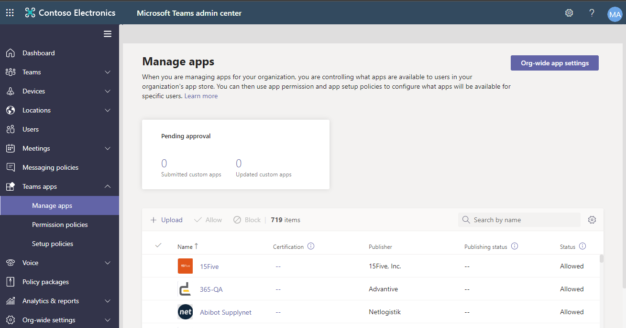
Microsoft Teams App Store
“Manage apps” page in the Microsoft Teams admin center is where you view and manage all Teams apps for your organization’s app store. Here, you can:
View and manage org-level status of apps
View properties of apps
Approve or upload new custom apps to your organization's app store
Block or allow apps at the org level
Purchase services for third-party apps
Track apps usage

Slide 40
Apps in organization’s Teams App Store
Power Platform (Low/No-Code)
Power
Virtual Agents
Power Apps
Power
Automate
Microsoft Apps
Third-Party Apps
Custom Apps
App Templates (Open-source ready)
Process
Automation
Productivity
Company Communicator
FAQ Plus
HR Support
Icebreaker
(40+ Templates)
Employee Services
Approvals & Workflows
Built from Scratch
45+ available
1000+ available
Unlimited possibilities
Bots
Tabs
Microsoft Graph
Messaging extensions

Slide 41
Microsoft 365 App Compliance Program
Mission Statement: Microsoft customers have complete trust in the applications that run their enterprise
  How do we make sure that the 3rd party apps in App Store are safe?
The Microsoft 365 App Compliance Program is a three-tier approach to app security and compliance.

Slide 42
Top 4 myths of using apps in Teams
Allowing third-party apps will create licensing headaches
Apps will access all my confidential files and conversations
Apps will access all my personal information and send spam
It’s inconvenient and messy to uninstall an app after setting it up
A majority of apps used in Teams are free or leverage existing enterprise licenses
Notes:
Jira, ServiceNow, Saleforce – your org may already use these apps and licenses for.

Slide 43
Top 4 myths of using apps in Teams
Allowing third-party apps will create licensing headaches
Apps will access all my confidential files and conversations
Apps will access all my personal information and send spam
It’s inconvenient and messy to uninstall an app after setting it up
Apps can only access files that you explicitly send to that service and they can only read messages when the app is explicitly mentioned in a message.
Notes:
@Mentions the application

Slide 44
Top 4 myths of using apps in Teams
Allowing third-party apps will create licensing headaches
Apps will access all my confidential files and conversations
Apps will access all my personal information and send spam
It’s inconvenient and messy to uninstall an app after setting it up
App developers do get access to very basic personal information but sending spam violates our app store policies and will result in the app getting taken down.

Slide 45
Top 4 myths of using apps in Teams
Allowing third-party apps will create licensing headaches
Apps will access all my confidential files and conversations
Apps will access all my personal information and send spam
It’s inconvenient and messy to uninstall an app after setting it up
Users can uninstall an app personally with two clicks.
Admins can uninstall an app tenant-wide with two clicks.

Slide 46
Managing Third-Party Apps in Teams
Apps used within the organization
What apps do my users rely on?
What do I know about the app developer?
App developer
security & compliance
Internal-approved apps
(procurement & infosec)
What can the app do in Teams?
App capabilities
(bot, tab, messaging extension etc)
App scope
(team/channel, chat, personal)
App permissions
(access to information)
What is the app architecture in Teams?
Microsoft 365 privacy, security, & compliance
Notes:
If I were an IT administrator trying to assess the risk of apps in Teams, here’s what I would do:
Look at the privacy, security, and compliance features within Teams – information barriers, retention policies, conditional access, encryption, and app policies
Analyze the app in question – what capabilities does it have (bot, tab, ME)? what scope does it work in (individual or team)? And what permissions does it ask for (basic personal info and ability to send messages, or more complex?) These three questions help me know what data will leave my corporate network.
Reference information about the developer – what security and compliance standards do they meet? Have they already been through an internal approval (e.g. Azure AD)? If so, they’ve probably been cleared by procurement and infosec.
Listen to what my users need – what business processes rely on this app? How badly will I hamper productivity by blocking this app?
Taking all four of these layers into account (in the context of my org risk tolerance) will allow me to make an educated decision.

Slide 47
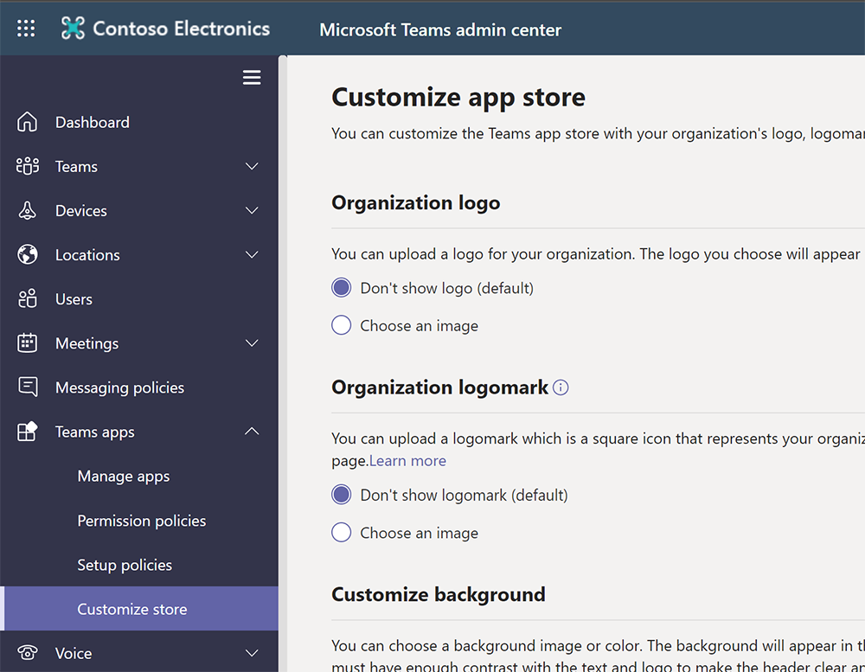
Customizing the app store
Customize your organization logo and logomark
Customize the background colour or image
Customize the text colour of your organization’s name
Notes:
https://docs.microsoft.com/en-gb/MicrosoftTeams/customize-your-app-store

Slide 48
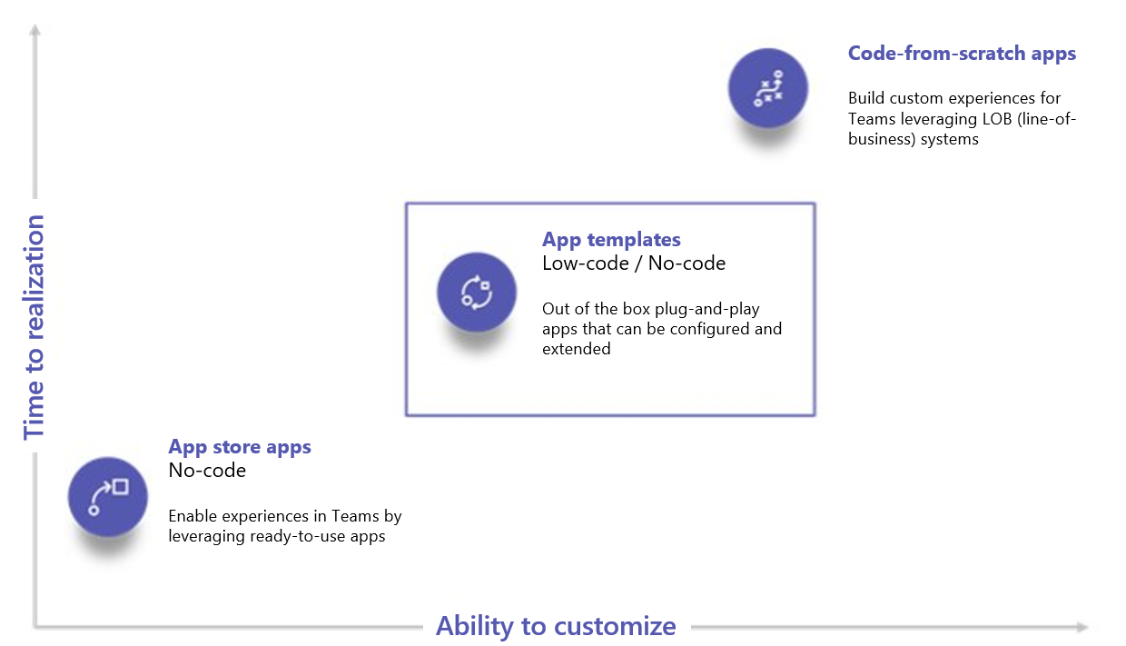
App templates speed up creation of custom apps
Plug-n-play experiences
Community-driven, pre-built Teams apps for common line-of-business scenarios. Minimal configuration needed and low/no coding required.
One-click deployment
Automated experience to deploy the app to your own instance of Azure. Bring the experience to Teams seamlessly.
Secure, configurable, and extensible
Open source so you can own, brand, configure, and extend to your needs.
Full catalog:
https://aka.ms/TeamsAppTemplates
Notes:
App templates are production-ready apps for Microsoft Teams that are community-driven, open-source, and available on GitHub.
Each contains detailed instructions for deploying and installing that app for your organization, providing a ready-to-use app that you can install and begin using immediately.
The complete source code is available as well, so you can explore it in detail, or fork the code and alter it to meet your specific needs.
Key benefits of using app templates
Plug and play experience: All app templates include deployments scripts that will allow you to host all necessary services in Microsoft Azure. No coding is required to deploy the apps.
Production-ready code: The app templates conform to recommended best practices around security and infrastructure, and all community-submitted changes to them are reviewed to
ensure continued conformity.
Customizable and extensible: While all app templates are ready to deploy as they are, the entire code base and deployment scripts are provided so that you can easily customize or
extend them to fit your unique needs.
Detailed documentation and support: All app templates are accompanied by end-to-end documentation on solution architecture, deployment, and configuration steps. The repositories
are monitored as well, so please report any issues you encounter by raising an issue on GitHub.

Slide 49
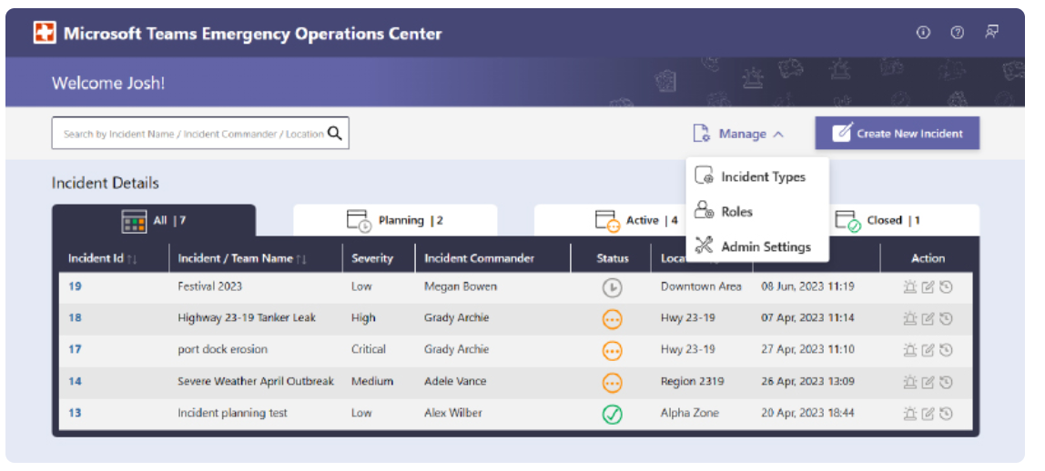
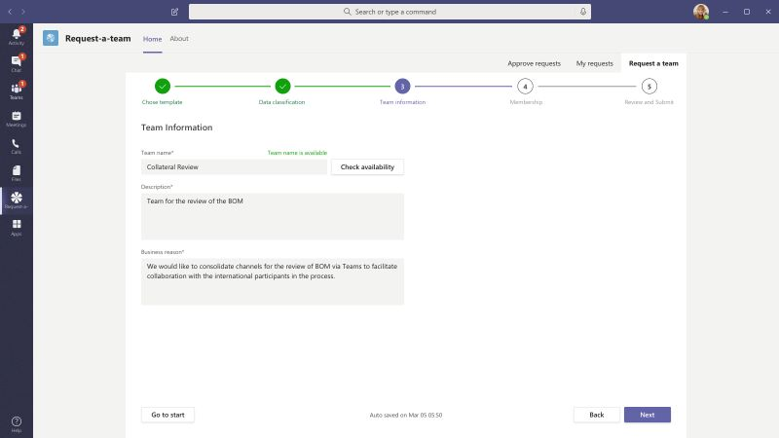
Examples of apps from templates
FAQ Plus
The user can ask the bot a question and the bot responds with an answer if it is contained in the knowledge base. If not, the bot allows the user to submit a query which then gets posted to a pre-configured team of experts who help to provide support by acting upon the notifications from within the team itself.
Request-a-team
  Optimizes new team creation for your enterprise organization. The app supports standardization and best practices when creating new team instances through the integration of a wizard-guided request form, an embedded approval process, a request status dashboard, and automated team builds.

Slide 50
Publishing apps
To the store
Available for all Microsoft Teams customers to use
To a tenant
Available for specific companies, controlled by tenant admins
To a team
For testing purposes, or for apps designed for specific functions and teams
Notes:
Speaker notes:
Once you’ve created a Teams app, there are 3 ways that the app can be published
Store:
Make your app available to the world. Let people know the category of your service, include screenshots and videos and easy to access app details that show off your app’s capabilities and skills.
Tenant:
When your app is designed to support a specific function in your company you can make it easy to find for all your company’s users. We’ve got a great place for your admin to host all your internal apps and they can suggest publicly available apps here too
Team:
When you want to test your app or if it was designed for a specific group of people, you can sideload your app and use it right away.

Slide 51
Publish to your organization's App Store
Use the “Manage apps page” to publish apps that are built specifically for your organization. After you publish a custom app, it's available to users in your organization's app store
Requirements:
Teams service administrator role
There are two ways to publish a custom app to your organization's app store:
Approve a custom app: Use this method if the developer submits the app directly to the Manage apps page using the Teams App Submission API. You can then review and publish (or reject) the app directly from the app details page
Upload an app package: Use this method if the developer sends you the app package in .zip format. You publish the app by uploading the app package

Slide 52
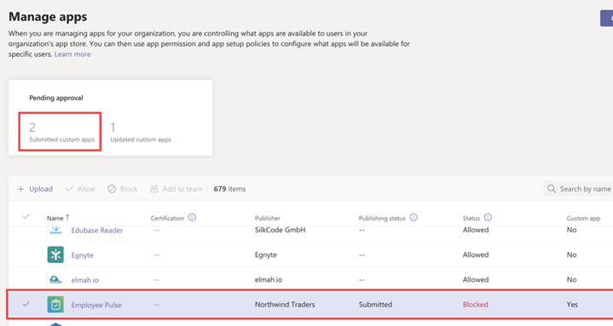
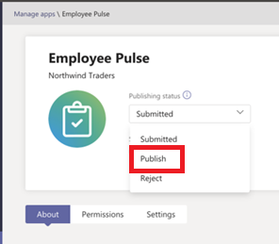
Approve a custom app
  The Pending approvals widget notifies you when a developer submits an app by using the Teams App Submission API
  A newly submitted app is listed with a Publishing status of Submitted and Status of Blocked.
  Go to the app details page to see more information about the app, and then to publish it, set Publishing status to Publish
  You're also notified when a developer submits an update to a custom app. You can then review and publish (or reject) the update on the app details page
Notes:
All app permission policies and app setup policies remain enforced for the updated app.

Slide 53
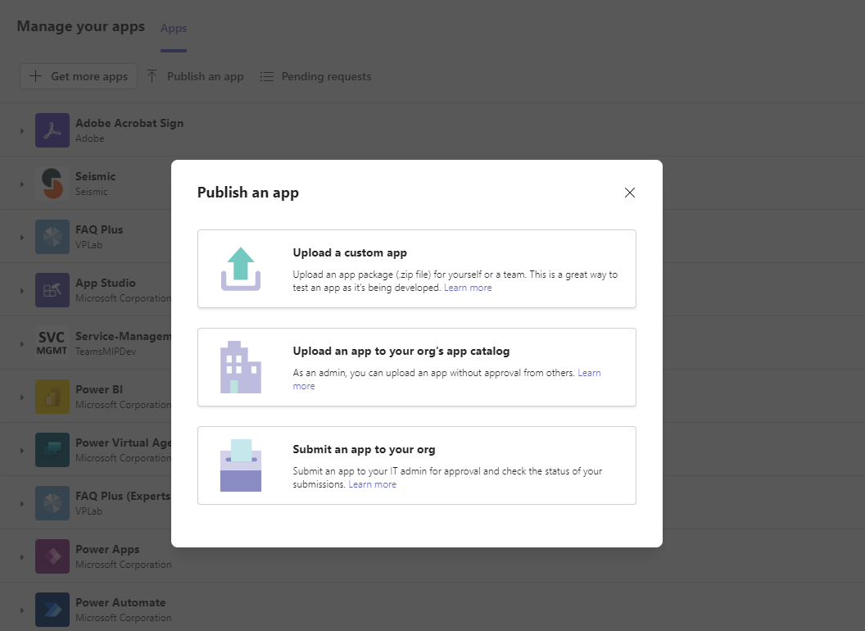
Upload your app directly from Teams client
Use Manage your apps button right in Teams client to publish app using following options:
Upload a custom app
(sideloading must be enabled);
Upload an app to your org’s app catalog (available for admins only);
Submit an app to your org
(submit app package for admin approval);

Slide 54
Teams App security
An app must disclose what data it uses and what the data is used for in its terms of use and privacy policy links.
Resource-specific consent in Microsoft Teams lets team owners give consent to apps to access team data.
Apps may also require other permissions in the tenant. After an app is installed, it may request additional permissions through a consent prompt.
You can configure API permissions and consent in the Azure portal or in the Teams admin center, and retract them at a later point, if that is required.
Notes:
https://docs.microsoft.com/en-us/microsoftteams/app-permissions
Resource-specific consent in Microsoft Teams lets team owners give consent to apps to access team data.
Examples of such access include the ability to read channel messages, create and delete channels, and create and remove channel tabs.
Examples of permissions requested by apps include the ability to read a user's profile, and send an email on behalf of users.
These permissions come from the MS Graph API permission set.

Slide 55
Tabs permissions and considerations
Required permissions
  SEND_AND_RECEIVE_WEB_DATA
Considerations
  The risk profile for a tab is almost identical to that same website running in a browser tab.
  A tab also gets the context in which it's running, including the sign-in name and UPN of the current user, the Azure AD Object ID for the current user, the ID of the Microsoft 365 Group in which it resides (if it's a team), the tenant ID, and the current locale of the user. However, to map these IDs to a user's information, the tab would have to make the user sign in to Azure AD.
Notes:
The permissions listed below in capital letters, for example RECEIVE_MESSAGE and REPLYTO_MESSAGE, don't appear anywhere in the Microsoft Teams developer documentation or the permissions for Microsoft Graph. They're simply a descriptive shorthand.
Optional permissions
None (currently)

Slide 56
Connectors permissions
Required permissions
  POST_MESSAGE_CHANNEL
Optional permissions
  REPLYTO_CONNECTOR_MESSAGE.
  Certain connectors support actionable messages, which allow users to post targeted replies to the connector message, for example by adding a response to a GitHub issue or adding a date to a Trello card.
Notes:
The permissions listed below in capital letters, for example RECEIVE_MESSAGE and REPLYTO_MESSAGE, don't appear anywhere in the Microsoft Teams developer documentation or the permissions for Microsoft Graph. They're simply a descriptive shorthand.
It's not currently possible to know which connectors support actionable messages (REPLYTO_CONNECTOR_MESSAGE permission).

Slide 57
Connectors Considerations
  The system that posts connector messages doesn't know who it's posting to or who receives the messages: no information about the recipient is disclosed.
  No data leaves the corporate network when connector messages are posted to a channel.
  Connectors that support actionable messages (REPLYTO_CONNECTOR_MESSAGE permission) also don't see IP address and referrer information; this information is sent to Microsoft and then routed to HTTP endpoints that were previously registered with Microsoft in the Connectors portal.
  Connector messages can't contain file attachments.
Notes:
The permissions listed below in capital letters, for example RECEIVE_MESSAGE and REPLYTO_MESSAGE, don't appear anywhere in the Microsoft Teams developer documentation or the permissions for Microsoft Graph. They're simply a descriptive shorthand.
Microsoft is the actual recipient, not the tenant; Microsoft does the actual post to the channel.

Slide 58
Connectors Considerations
  Each time a connector is configured for a channel, a unique URL for that connector instance is created. If that connector instance is deleted, the URL can no longer be used.
  The connector instance URL should be treated as secret/confidential: anyone who has that URL can post to it, like an email address. Therefore, there's some risk of spam or links to phishing or malware sites. If that were to happen, team owners can delete the connector instance.
  If the service that sends connector messages were to become compromised and start sending spam/phishing/malware links, a tenant administrator can prevent new connector instances from being created and Microsoft can block them centrally.
Notes:
Microsoft is the actual recipient, not the tenant; Microsoft does the actual post to the channel.

Slide 59
Bots and messaging extensions
Required permissions
  RECEIVE_MESSAGE, REPLYTO_MESSAGE. The bot can receive messages from users and reply to them.
  POST_MESSAGE_USER. After a user has sent a message to a bot, the bot can send the user direct messages (also called proactive messages) at any time.
  GET_CHANNEL_LIST. Bots added to teams can get a list of names and IDs of the channels in a team.
Notes:
The permissions listed below in capital letters, for example RECEIVE_MESSAGE and REPLYTO_MESSAGE, don't appear anywhere in the Microsoft Teams developer documentation or the permissions for Microsoft Graph. They're simply a descriptive shorthand.
Some bots only send messages (POST_MESSAGE_USER). They're called "notification-only" bots, but the term doesn't refer to what a bot is allowed or not allowed to do, it means that the bot doesn't want to expose a conversational experience. Teams uses this field to disable functionality in the UI that would ordinarily be enabled; the bot isn't restricted in what it's allowed to do compared to bots that do expose a conversational experience.

Slide 60
Bots and messaging extensions
Optional permissions
  IDENTITY. When it's used in a channel, the app's bots can access basic identity information of team members (first name, last name, user principal name [UPN], email address); when it's used in a personal or group chat, the bot can access the same information for those users.
  POST_MESSAGE_TEAM. Allows an app's bots to send direct (proactive) messages to any team member at any time, even if the user has never talked to the bot before.
  SEND_FILES, RECEIVE_FILES. Controls whether a bot can send and receive files in personal chat (not yet supported for group chat or channels).
Notes:
The permissions listed below in capital letters, for example RECEIVE_MESSAGE and REPLYTO_MESSAGE, don't appear anywhere in the Microsoft Teams developer documentation or the permissions for Microsoft Graph. They're simply a descriptive shorthand.
App guidelines (and our AppSource review process) require discretion in posting personal chat messages to users (via the POST_MESSAGE_TEAM permission) for valid purposes. In the event of abuse, users can block the bot, tenant admins can block the app, and Microsoft can block bots centrally if necessary.
SEND_FILES, RECEIVE_FILES. Are governed by the supportsFiles Boolean property on the bot object in the manifest.json file for the app.

Slide 61
Bots and messaging extensions considerations
  Bots only have access to teams to which they've been added or to users who have installed them.
  Bots only receive messages in which they're explicitly mentioned by users. This data leaves the corporate network.
  Bots can only reply to conversations in which they're mentioned.
  After a user has conversed with a bot, if the bot stores that user's ID, it can send that user direct messages at any time.
  It is theoretically possible for bot messages to contain links to phishing or malware sites, but bots can be blocked by the user, the tenant admin, or globally by Microsoft.

Slide 62
Bots and messaging extensions considerations
  A bot can retrieve (and might store) very basic identity information for the team members the app has been added to, or for individual users in personal or group chats. To get further information about these users, the bot must require them to sign in to Azure Active Directory (Azure AD).
  Bots can retrieve (and might store) the list of channels in a team; this data leaves the corporate network.
  When a file is sent to a bot, the file leaves the corporate network. Sending and receiving files requires user approval for each file.

Slide 63
Bots and messaging extensions considerations
  By default, bots don't have the ability to act on behalf of the user, but bots can ask users to sign in; as soon as the user signs in, the bot will have an access token with which it can do additional things.
  Bots are informed whenever users are added to or deleted from a team.
  Bots don't see users' IP addresses or other referrer information. All information comes from Microsoft. (There is one exception: if a bot implements its own sign-in experience, the sign-in UI will see users' IP addresses and referrer information.)
  Messaging extensions, on the other hand, do see users' IP addresses and referrer information.
Notes:
Exactly what those additional things are depends on the bot and where the user signs in: a bot is an Azure AD app registered at https://apps.dev.microsoft.com/ and can have its own set of permissions.

Slide 64
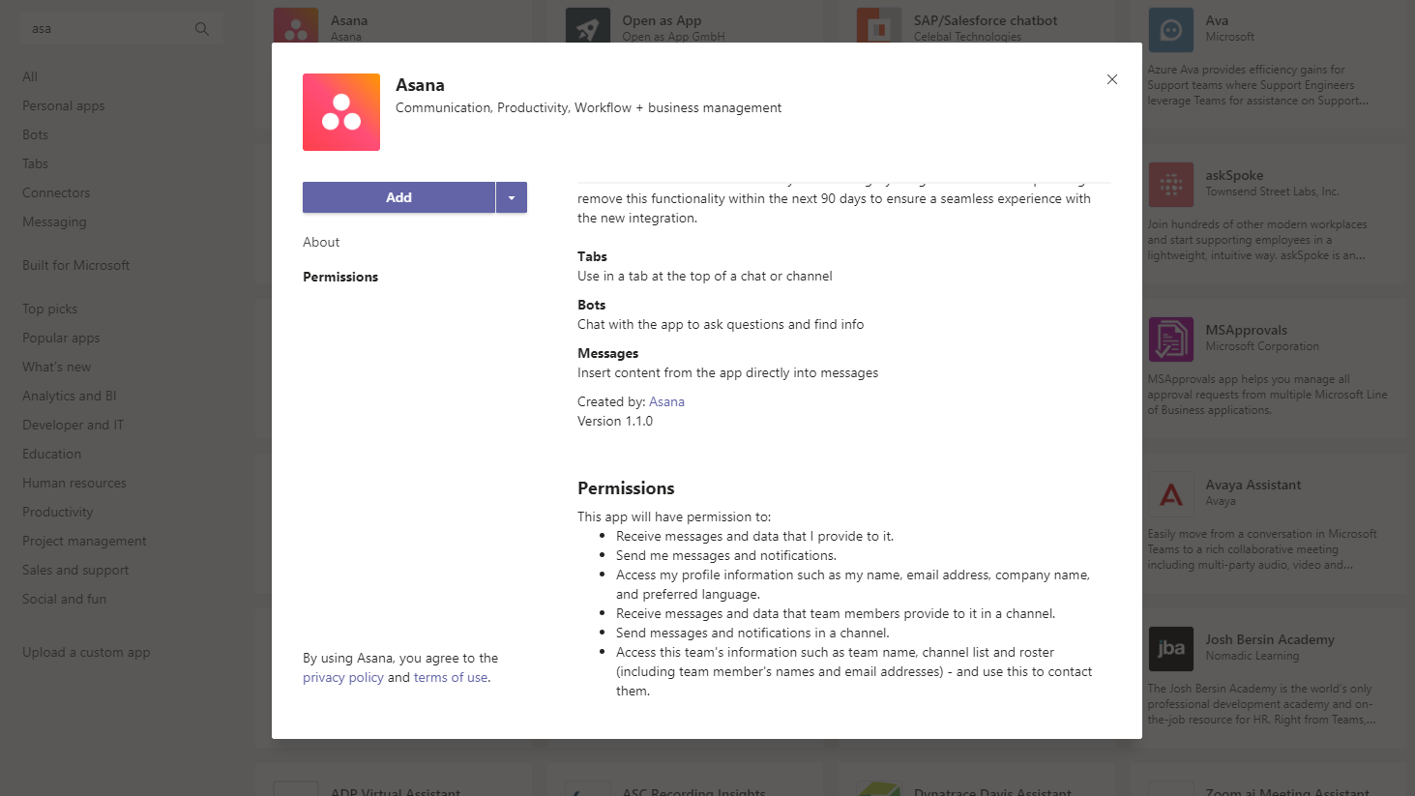
An example of an app’s required permission set
Capabilities
Permissions
Notes:
App capabilities
App permissions

Slide 65
Dataverse for Teams security
  If the app or bot relies on Dataverse for Teams as it’s data platform, access to it’s environment and it’s resources (apps, data) will be restricted to users in the team that the app is installed to.
  For users to access Dataverse for Teams environment apps, bots, and data, they must:
  Be enabled in Azure Active Directory.
  Have an active Microsoft 365 license with a plan that includes Dataverse for Teams.
Notes:
https://docs.microsoft.com/en-us/power-platform/admin/about-teams-environment#user-access-to-project-oakdale-environments

Slide 66
Resource-specific consent in Microsoft Teams
  Resource-specific consent (RSC) in Microsoft Teams lets team owners give consent to apps to access team data. Examples of such access include the ability to read channel messages, create and delete channels, and create and remove channel tabs.
  As an admin, you control whether team owners in your organization can give consent. You configure these settings by using the Azure Active Directory (Azure AD) PowerShell module, or the Azure portal and the Microsoft Teams admin center.

Slide 67
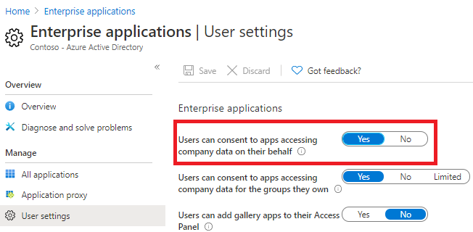
Resource-specific consent: settings in Azure AD
The "Users can consent to apps accessing company data on their behalf" setting
  In the Azure portal, go to Enterprise applications > User settings.
  Under Enterprise applications, set Users can consent to apps accessing company data on their behalf to No or Yes.
You can also manage this setting using PowerShell:
Allow user consent for apps from verified publishers, for selected permissions (preview)
Set-AzureADMSAuthorizationPolicy -Id "authorizationPolicy" -PermissionGrantPolicyIdsAssignedToDefaultUserRole @("microsoft-user-default-low")
Allow user consent for all apps
Set-AzureADMSAuthorizationPolicy ` -Id "authorizationPolicy" ` -PermissionGrantPolicyIdsAssignedToDefaultUserRole @("microsoft-user-default-legacy")
Disable user consent
Set-AzureADMSAuthorizationPolicy ` -Id "authorizationPolicy" ` -PermissionGrantPolicyIdsAssignedToDefaultUserRole @()
Notes:
The "Users can consent to apps accessing company data on their behalf" setting: To enable team owners to give consent, this setting must be set to Yes.

Slide 68
Settings in Teams admin center
  In addition to settings in Azure AD, the following settings from Teams admin center also determine whether a team owner can give consent:
  org-wide app settings on the Manage apps page
  whether an app is blocked or allowed on the Manage apps page
  app permission policy assigned to the team owner
  Note: Changing any of these settings doesn't affect data access for apps that were already granted consent.
Notes:
For example, if you disable third-party apps org-wide or if you block specific apps to prevent team owners from giving consent, these changes don't remove data access that's already been granted.

Slide 69
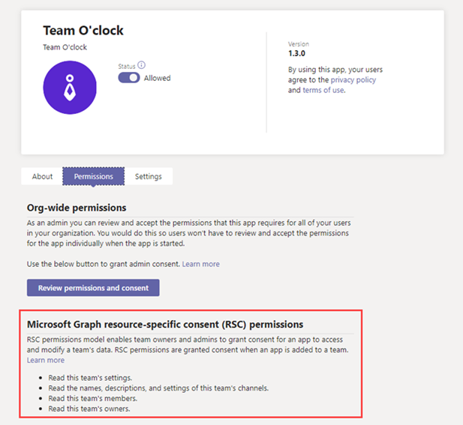
View Resource Specific Consent permissions
  RSC permissions are defined in the app manifest and not in Azure AD.
  You grant consent to RSC permissions when you add the app to a team.
  Global admins and Teams service admins can view RSC permissions for an app on the Permissions tab of the app details page.
Notes:
https://docs.microsoft.com/en-us/microsoftteams/app-permissions-admin-center

Slide 70
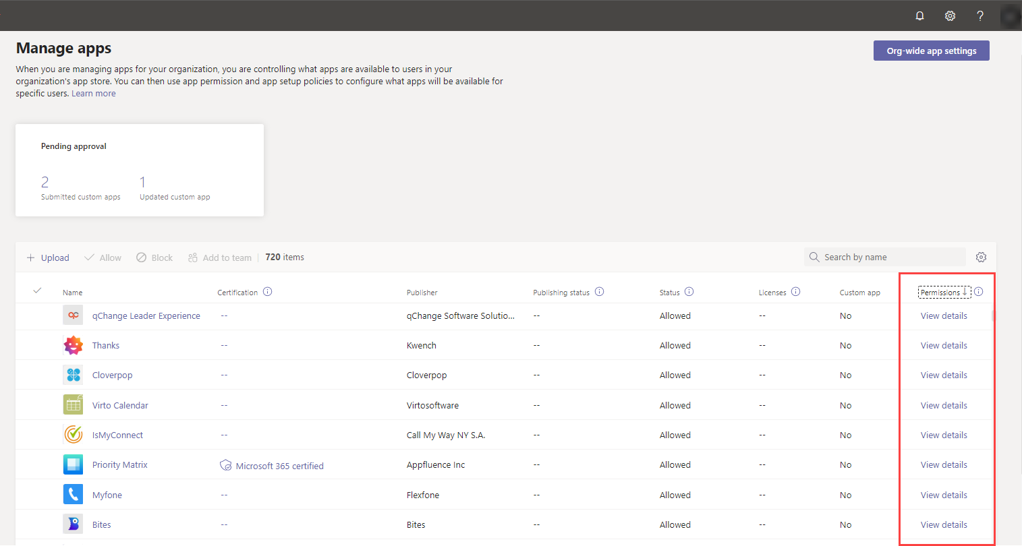
Managing consent in Teams admin center
  If you're a global admin, you can review and grant consent to apps that request permissions on behalf of all users in your organization.
  The Permissions column in the App Store indicates whether an app has permissions that need consent.
Notes:
If you're a global admin, you can review and grant consent to apps that request permissions on behalf of all users in your organization. You do this so that users don't have to review and accept the permissions requested by the app when they start the app. Additionally, depending on the user's consent settings in Azure Active Directory (Azure AD), some users may not be allowed to grant consent to apps that access company data.
You'll see a View details link for each app registered in Azure AD that has permissions that need consent. Keep in mind that this applies only to custom and third-party apps. You won't see this link or need to grant admin consent for apps published by Microsoft.

Slide 71


Managing consent in Teams admin center
To grant org-wide consent to an app, open it’s details from the Manage apps page, select Permissions tab and click “Review permissions and consent”
Review the permissions requested by the app, and, if you agree, click Accept to grant consent.
This requires Global Administrator role
Notes:
The Review permissions and consent option isn't available to Teams service admins and they can't grant org-wide admin consent to apps, but Teams service admins can view the content on the Permissions tab for an app.
For example, a Teams service admin can click the Azure Active Directory link to view app permissions details in the Azure AD portal.

Slide 72

Managing consent in Teams admin center
If consent has been granted to an app by a user or an admin, a message about it will be displayed in the app details
Notes:
If users in your organization are allowed to grant consent and if one or more users granted consent to a particular app, you'll also see the same message
To view details about the app's permissions, click the Azure Active Directory link to go to the app's page in the Azure AD portal.

Slide 73

Enterprise Applications in Azure AD
Review the currently registered apps in your tenant
  In the Azure portal, go to Enterprise applications
  In the list you will see all the applications that were registered within your tenant, including, but not limited to, apps added to Teams
  You can review what permissions the app has gained from admin \ user consent, what users have access to it, and other details regarding each of the registered enterprise applications
Notes:
This can also be configured using PowerShell; https://docs.microsoft.com/en-us/azure/active-directory/manage-apps/configure-user-consent#configure-group-owner-consent-to-apps-accessing-group-data

Slide 74
Uploading custom apps into organization’s App Store
If you upload (sideload) a custom app, that uses resource-specific consent, to your Teams, the app must come from the tenant that it's being installed to.
Global admins are exempted from this restriction, and can upload custom apps from any tenant, either directly to a team or to the tenant App Store.
Notes:
So, the Azure AD app registration must be from this tenant – the one where you are signed in with your Teams client.
https://docs.microsoft.com/en-us/microsoftteams/resource-specific-consent

Slide 75
Why report on apps in Teams?
Security
3rd party apps are not hosted by Microsoft – we need to be aware who holds their data
They have their own privacy policy separate from Microsoft’s
Data could be stored in a different location to your tenant
Visibility
Gain an understanding of the most used apps across your organization
Consider training users on popular apps
Notes:
Microsoft Teams app usage report - Microsoft Teams | Microsoft Docs

Slide 76




The Four Ways Of Reporting On Apps
Teams Admin Center
Unified Audit Log
Defender for Cloud Apps
(former Cloud App Security)
MS Graph API
Out of the box adoption focused reports
User activities logged for audit purposes
Granular per user reporting
Using API

Slide 77

App Reporting - Teams Admin Center
In the left navigation of the admin center at
https://admin.teams.microsoft.com
Click Analytics & reports > Usage reports. On the View reports tab, under Report, select Apps Usage.

Slide 78

View the App Usage report
Under Date range, select a range, and then click Run report.

Slide 79

What the report looks like
Full screen report
Export to Excel
Filter data
Edit columns
Number of users using app
Number of Teams the app is used in
Total instance count of Microsoft and 3rd party apps
Search by app name

Slide 80
Things to note about the report
The Teams Apps usage report can be viewed for trends over the last 7, 30 or 90 days.
Each report has a date for when the report was generated. The reports usually reflect a 24-hour latency from the time an app was opened.

Slide 81

Exporting to Excel
You can export the report to a CSV file for offline analysis.
Click Export to Excel, and then on the Downloads tab, click Download to download the report when it's ready.

Slide 82

What the Excel Report Looks Like
When you view the report in Excel, you'll also see an Id column, which represents the app ID.
A team ID is typically an alphanumeric string. If the Id column shows as \n**, this means that a user requested their information to be deleted.

Slide 83

App Reporting - Microsoft 365 Audit Log
Various app related activities are logged within the Microsoft 365 Audit Log
Go to https://compliance.microsoft.com
In the left pane of the Compliance Center, click Audit
The Audit log search page is displayed.

Slide 84
Microsoft 365 Audit Log Teams App Activities
Friendly Name | Operation | Description
Added bot to team | BotAddedToTeam | A user adds a bot to a team.
Added connector | ConnectorAdded | A user adds a connector to a channel.
Added tab | TabAdded | A user adds a tab to a channel.
Deleted all organization apps | DeletedAllOrganizationApps | Deleted all organization apps from the catalog.
Deleted app | AppDeletedFromCatalog | An app has been deleted from the catalog.
Installed app | AppInstalled | An app was installed.
Performed action on card | PerformedCardAction | A user took action on an adaptive card within a chat. Adaptive cards are typically used by bots to allow the rich display of information and interaction in chats.
Published app | AppPublishedToCatalog | An app was added to the catalog.
Removed bot from team | BotRemovedFromTeam | A user removes a bot from a team.
Removed connector | ConnectorRemoved | A user removes a connector from a channel.
Removed tab | TabRemoved | A user removes a tab from a channel.
Uninstalled app | AppUninstalled | An app was uninstalled.
Updated app | AppUpdatedInCatalog | An app was updated in the catalog.
Updated connector | ConnectorUpdated | A user modified a connector in a channel.
Updated tab | TabUpdated | A user modified a tab in a channel.
Upgraded app | AppUpgraded | An app was upgraded to its latest version in the catalog.
Notes:
Search the audit log for events in Microsoft Teams - https://docs.microsoft.com/en-us/microsoftteams/audit-log-events

Slide 85
Microsoft 365 Audit Log – Things To Note
E5 users’ actions are logged for 365 days
All other license types are kept for 90 days
This data can be fed into a SIEM (Azure Sentinel or 3rd party)
Results can be exported to Excel
Teams Activities can take up to 30 minutes to appear
Consider creating alert policies on important activities
Notes:
Retain time can be increase to 10-year audit log. Needed Advanced Audit and 10-Year Audit Log Retention license.
https://docs.microsoft.com/en-us/microsoft-365/compliance/auditing-solutions-overview?view=o365-worldwide

Slide 86


App reporting - Microsoft Defender for Cloud Apps
Once logged into Microsoft Defender for Cloud Apps (former Cloud App Security) head to the Activity log:
Filter by app to “Microsoft Teams”

Slide 87
App Reporting - Graph API
Whilst not the best way to report on app usage due to limited information available through Graph API, it is possible to get some data using that endpoint.
Beware of potential throttling issues –
Microsoft Graph throttling guidance

Slide 88


Graph API Examples
Retrieve the list of apps installed in the specified team.
List apps published in the Microsoft Teams app catalog. This includes apps from the Microsoft Teams store, as well as apps from your organization's app catalog (the tenant app catalog).
Lists all apps that are specific to your tenant.
Notes:
https://docs.microsoft.com/en-us/graph/api/teamsappinstallation-list?view=graph-rest-1.0&tabs=http
https://docs.microsoft.com/en-us/graph/api/team-list-installedapps?view=graph-rest-1.0&tabs=http
https://docs.microsoft.com/en-us/graph/api/appcatalogs-list-teamsapps?view=graph-rest-1.0&tabs=http

Slide 89

Vprašanja…

