Slide 1
Microsoft Project for the web
Marko Zajc
marko.zajc@microsoft.com
Project Specialist, Microsoft CEE

Slide 2
Agenda
Work, Project, Program or Portfolio management
Microsoft Project and portfolio management solutions
Project for the web
  for individual project managers and teams
  reporting
  as an organization/department PPM solution
  Project for the web Accelerator
  extending the solution
Proejct for the web in enterprise environments
Approach to PPM System implementation
Licensing

Slide 3




Today business face these external trends that impact projects…
73%
80%
41%
25M
Want flexible remote work options to stay¹
of leaders say they plan
to make major changes
to their flexible work policies¹
Of employees are considering leaving their current employer¹
new project professionals needed by 2030 to fill 102 million total project jobs²
1 - 2021 Microsoft WTI Report - March 2021
2 - Talent Gap 2021 Report | PMI
Notes:
Over the past 18-plus months, how and where we work has changed forever.
Data from our latest hybrid work research shows that:
73 percent of employees are saying they want flexible remote work options to stay, and more than 80 percent of leaders say they expect to make major changes to accommodate.
Not only that, but over 40 percent of employees are considering leaving their employer coming out of the pandemic, in a phenomenon now referred to as the Great Reshuffle.
All this comes at a time when PMI estimates that global economy needs 25 million new project professionals by 2030. To close the talent gap, 2.3 million people will need to enter project management-oriented employment (PMOE) every year just to keep up with demand – this includes project managers and all changemakers.

Slide 4




And these project-specific trends which affect project success…
85%
85%
92%
81%
of project teams work in multiple locations in many countries¹
of projects are managed using agile, hybrid, informal, or multi-style methodologies¹
of professionals cite lack of visibility and inefficient processes as the top two project and product management challenges²
of project professionals report their organizations are being impacted by AI technologies.³
1 - 2022 Global Trends in Project Management
2 - Value Stream Management Predictions and Opportunities for 2022 | CIO
3 - AI innovators: Cracking the Code on Project Performance
Notes:
And as how and where we work has changed this change is just one of the challenges to project success.
Under 15% of project teams are working together, in person, in a central office. 85% of project teams work in multiple locations and countries. And 58% of project professionals work remotely.
Only 14% of projects are managed using exclusively waterfall methodologies. 70% of projects are managed using agile, hybrid, or multi-style methodologies. And 17% are managed using no methodology at all.
92% of professionals indicated they currently have significant product development and project management obstacles. When it comes to top challenges for 2022, “lack of visibility throughout the product [and project] lifecycle” and “inefficient processes” were the two top-rated responses.
And the Project Management Institute reports that 81% of project professionals say their organizations are being impacted by AI technologies.

Slide 5
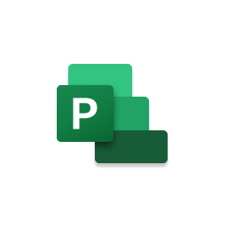




Work and Project management requirements
Vision, Performance, Strategy
Financial Forecasting
Portfolio Roadmaps
Baselines and KPIs
Portfolio Governance
Risk and Issue management
Execute on Strategy
Status Reporting
Portfolio Founding
Capacity planning
Portfolio Insights
Methodology support (Agile, processes, stage-gate models, Prince2, PMI, PM²)
Organizational level
Work Management (scope, cost, deliverables, KPIs, Resources)
Unstructured work
Requests
Asks
Tasks
Ad hoc
Simple
Plan Driven
Phases
Tasks
Milestones
WBS
Gantts
Change Driven
Sprints
Epics
Features
Stories
Tasks
Professional services
Resource management
Invoicing
Expenses
Revenue recognition
Accruals
Planner
Project
Azure DevOps
D365
Collaboration and communication
Teams
Capabilities

Slide 6



Choosing the right project management solution
Project Operations
Deal management
T&E entry and approval
Project costing, pricing, and actuals
Services-centric
Project in Power Apps
Customized forms and views
Custom tables and fields
Automation and integrations
Enterprise,
strategic
Capabilities
Complexity
Project for the web
Dynamic scheduling and Gantt
Sub-tasks and dependencies
Cross-project visibility
Small,
lightweight
Planner
Built on Microsoft 365
Kanban board experience
Familiar task management toolset
Everyday,
task-based
Role
Information
worker
Informal and professional project managers
Project Management Office
Project-centric services business
Notes:
In this session we’re going to focus on Microsoft Planner, Microsoft Project, Project in Power Apps, and Microsoft Dynamics 365 Project Operations. We’ll talk about which use cases are supported by each tool and when to consider “growing up” from one tool to the next.
I’ll give you a brief overview here
Microsoft Planner is a great tool for work and task management for team leads, teams, and information workers.
Built on Microsoft 365 and fully integrated with Microsoft Teams
Kanban board experience
Familiar task management toolset
Microsoft Project is a great tool for project management-oriented information workers. This includes professional PMs as well as what we call informal project managers.
Dynamic scheduling & Gantt view
Sub-tasks and dependencies
Cross-project visibility
Project in Power Apps is the right choice when you need to integrate Microsoft Project into the unique ways your organization and teams work:
Customize forms & views
Add custom tables & fields
Automate workflows & integrate with 3rd-party services
Project Operations gives you the visibility, collaboration, and agility needed to drive success across your project-centric business—from prospects to payments to profits.
Deal management
Time & Expense entry and approval
Project costing, pricing, and actuals

Slide 7
Project for the web
Evolution from traditional solutions Microsoft Project Online and Dynamics PSA
Products are transforming to Project for the web based on Power Platform
  Simple to use scheduling tool
  Power BI report packs
  Power Platform to develop solution
Project Solution Accelerator available
Microsoft is releasing new functionalities continuously

Slide 8

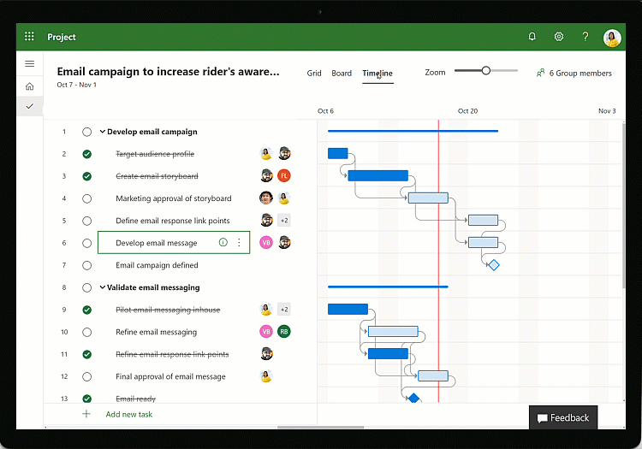
Project for the web as a solution for individual project mangers and teams
Simple & powerful project management for everyone
Collaboration made easy
Intelligent planning (grid view, board view, timeline)
Innovation platform

Slide 9
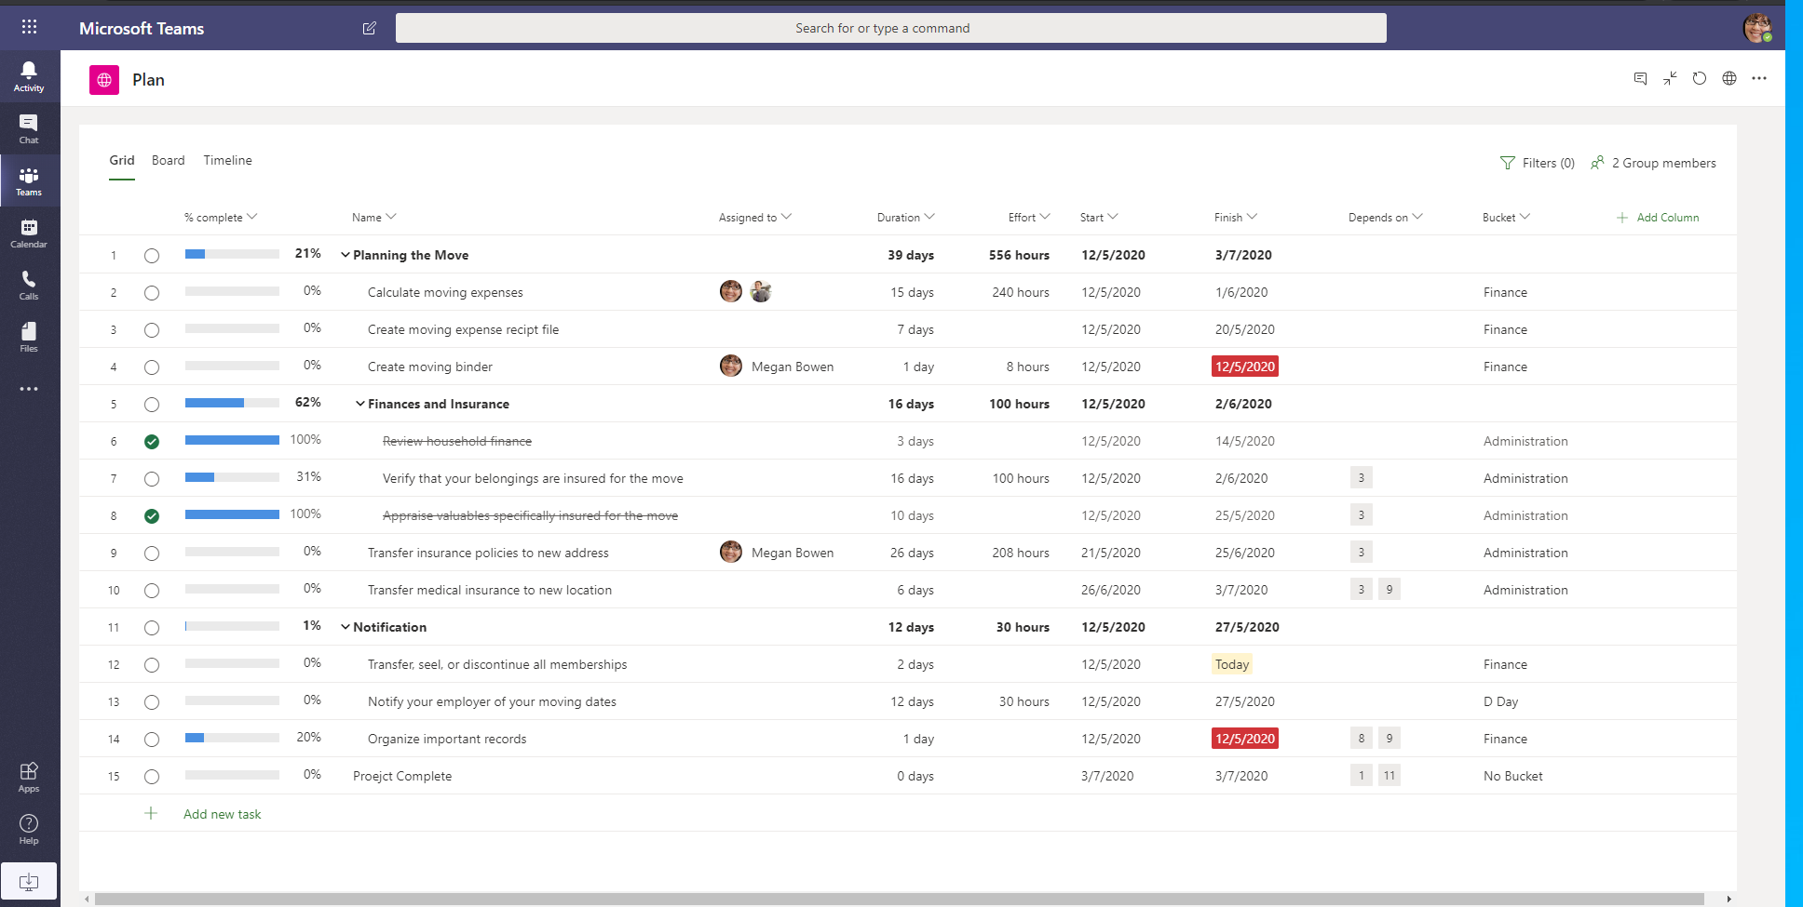
Integration in Microsoft Teams
Microsoft Teams as a central hub
Microsoft Teams as a central Collaboration platform
Power Automate for automation of Processes (ex. Project Teams creation, membership sync)

Slide 10
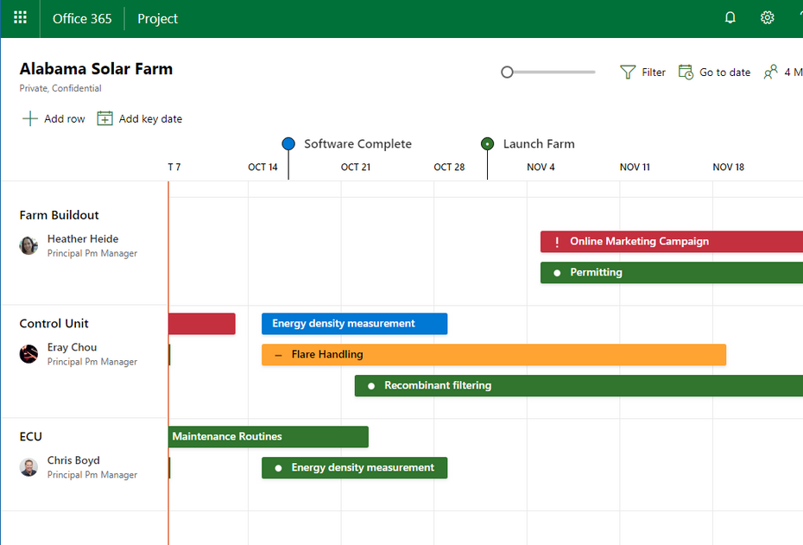
Roadmap
See all projects, from waterfall to agile, in one place
Easily create roadmaps and connect them to existing projects, including those in Project
Online or Azure Boards
Choose the tasks, milestones, and initiatives you want to see
Set the status of Roadmap items independent of the linked project plan
Share roadmaps among other Project Online users
to give everyone the latest status insights
Prioritize projects inside roadmaps to achieve top-down planning

Slide 11
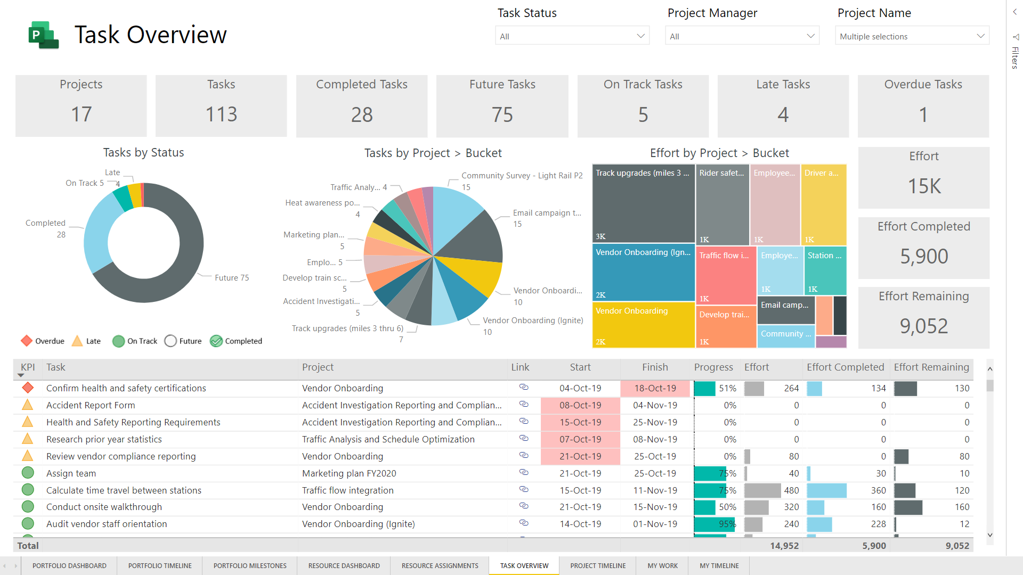
Project for the web - Reporting
Project Manager – Task View
Focuses on detailed tasks across projects
Visuals show count of selected projects and tasks, summary of effort, task details, including KPIs, and more
Report templates available: GitHub - OfficeDev/Project-Power-BI-Templates: Expand Project with a Power BI Template

Slide 12
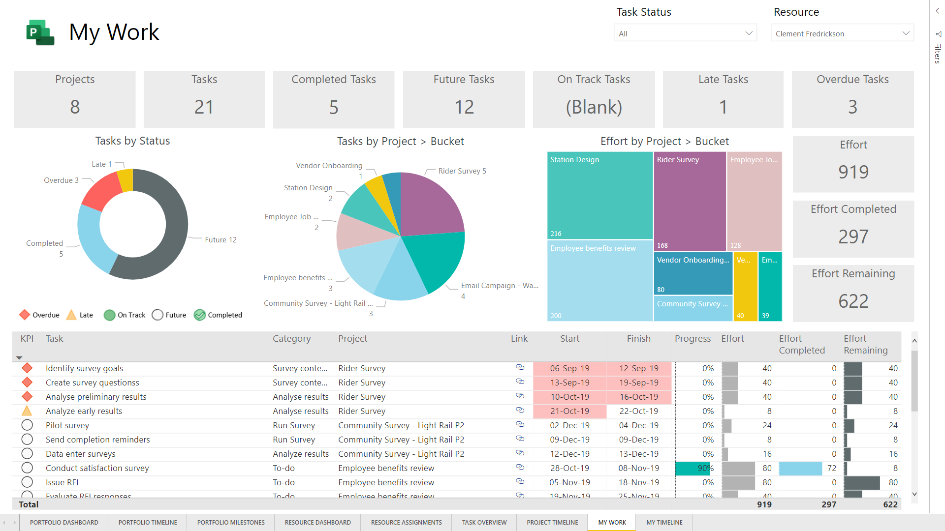
Project for the web - Reporting
Team Member View
Built for team members to see master list of all assigned work across projects
Additional details include total assigned projects, future tasks, overdue tasks, and more

Slide 13
Demo
Project for the Web for individual Project managers and teams
Demo Agenda
Project Home – http://project.microsoft.com
Building and sharing schedule in Project for the web
Integration in Microsoft Teams
Roadmap
Project Reporting – Power BI reports
Where is the data stored?

Slide 14
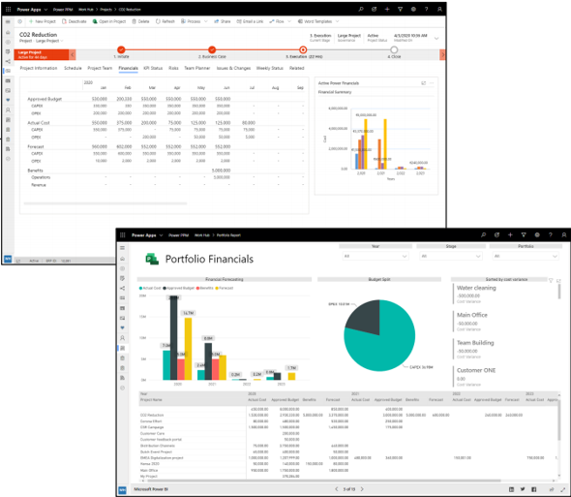
Project for the Web
as a Project and Portfolio management solution

Slide 15
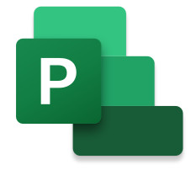


Microsoft Power Platform
One low-code platform that spans Office 365, Dynamics 365, and standalone applications
Analyze. Act. Automate.
Power BI
Business analytics
PowerApps
Application development
Power Automate
Workflow automation
Project for Web
Modern Project
Management solution
Data
connectors
AI Builder
Dataverse

Slide 16
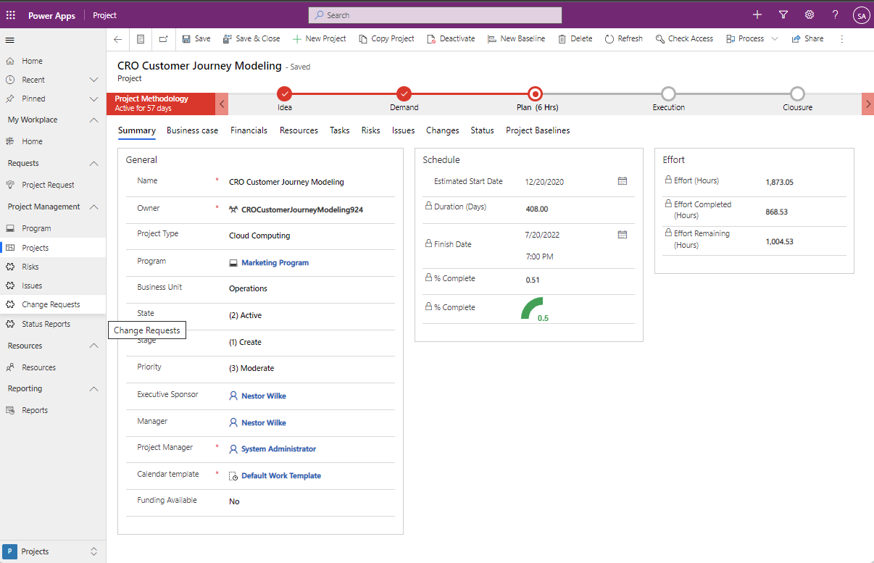
Project for the web Accelerator
Ready to use sample solution
Can be deployed in different environments
Can be extended
Solution: GitHub - OfficeDev/Project-Accelerator: An Accelerator solution for Project for the web

Slide 17
Demo
Project and Portfolio management Solution
Project Solution Accelerator

Slide 18
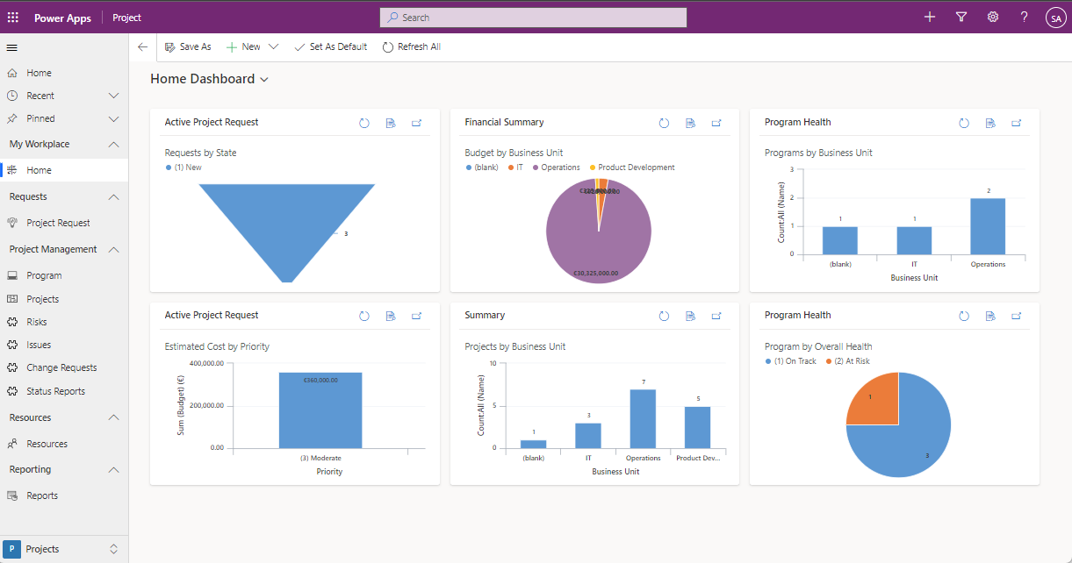
Project for the web - Solution Dashboards

Slide 19
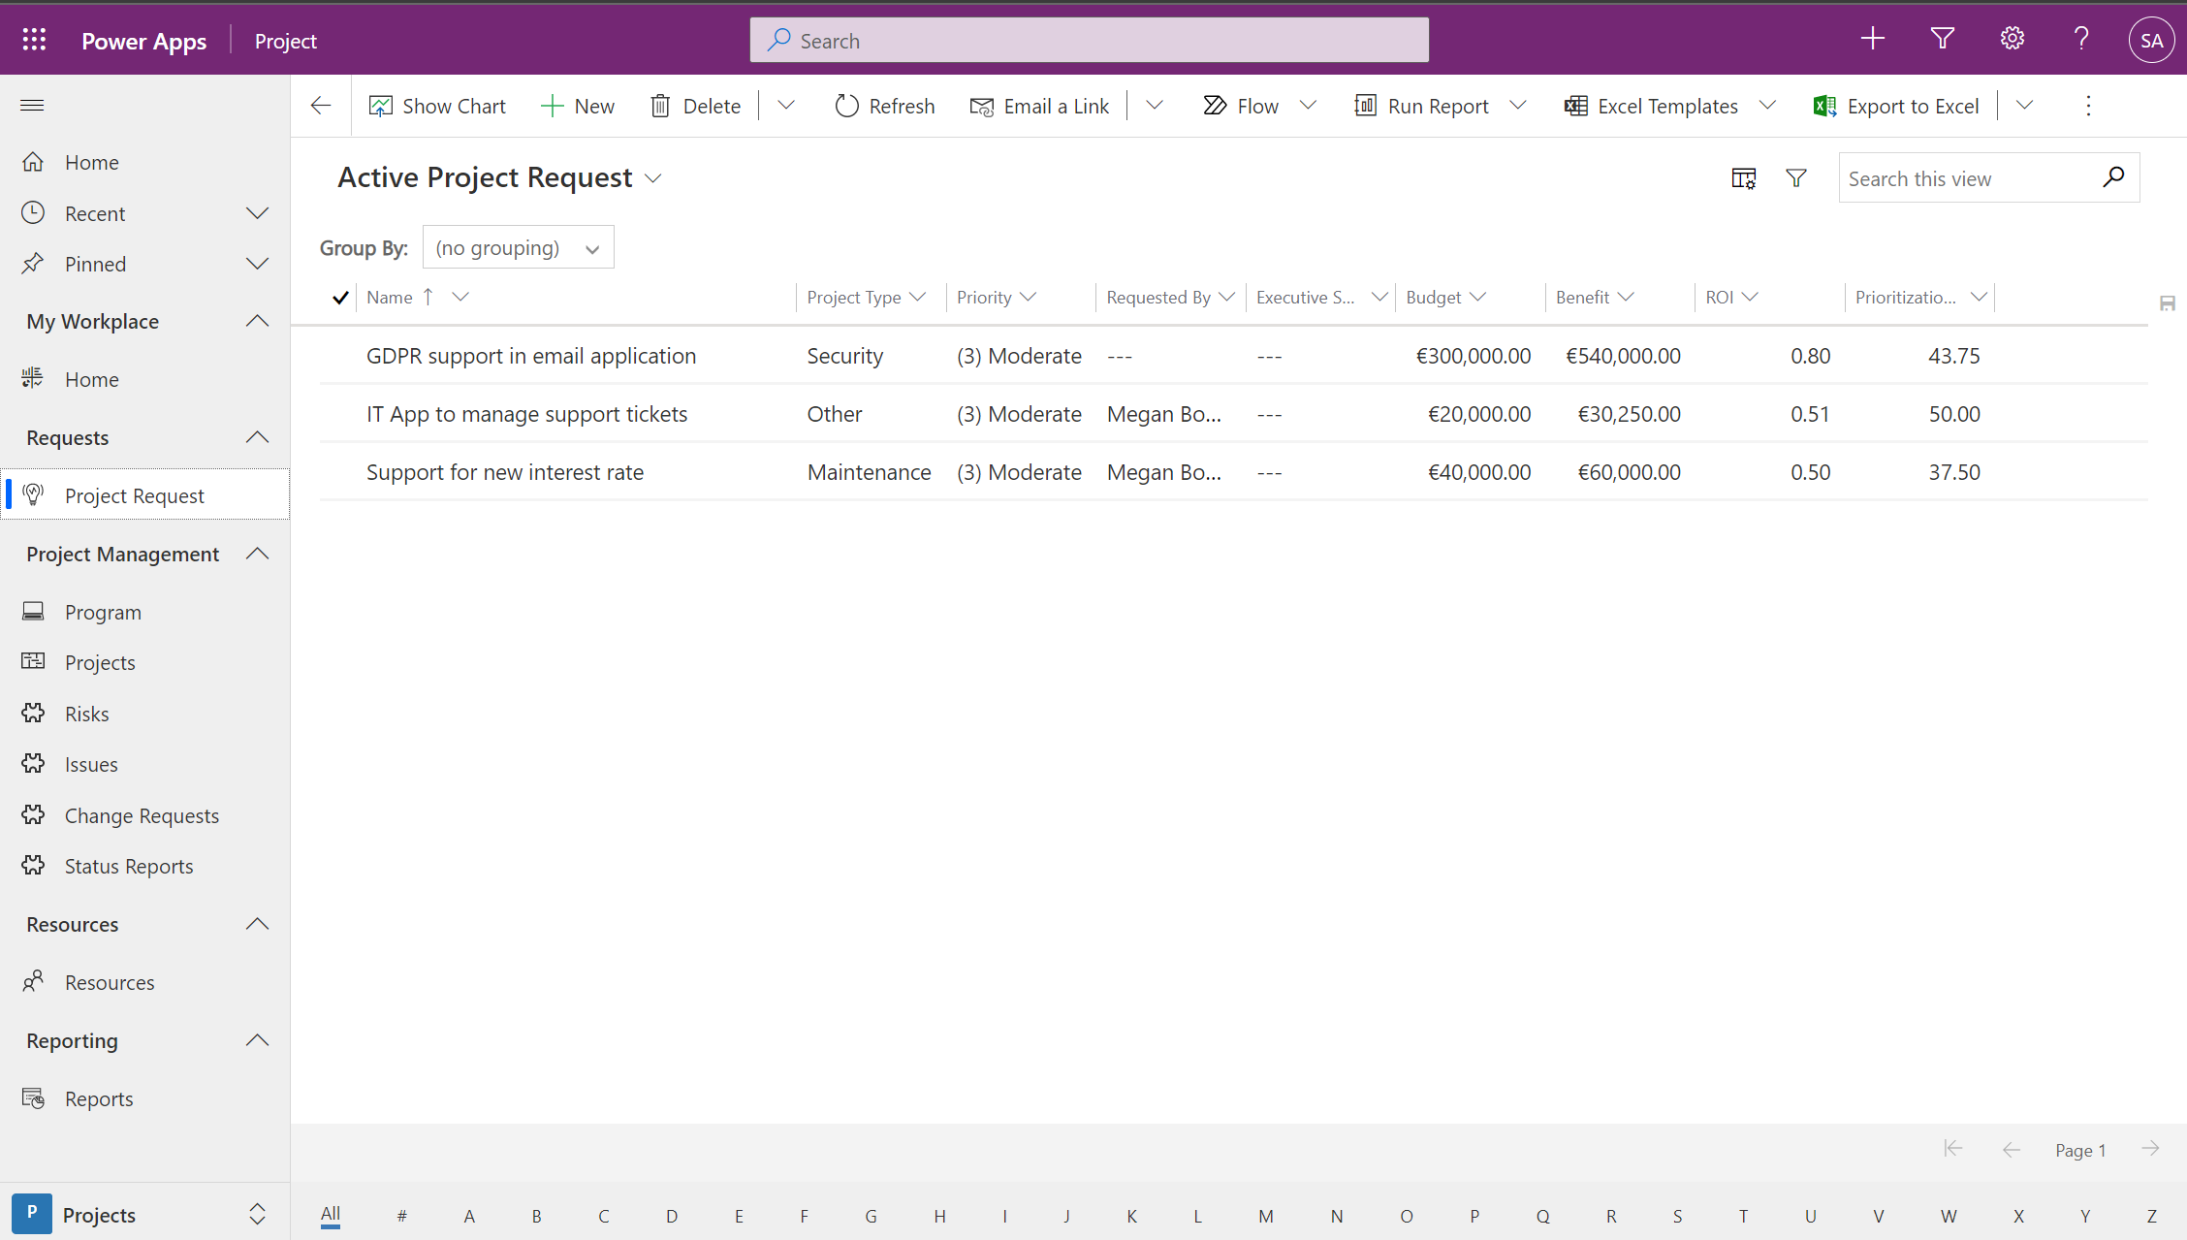
Manage Project requests, Ideas,Innovations

Slide 20
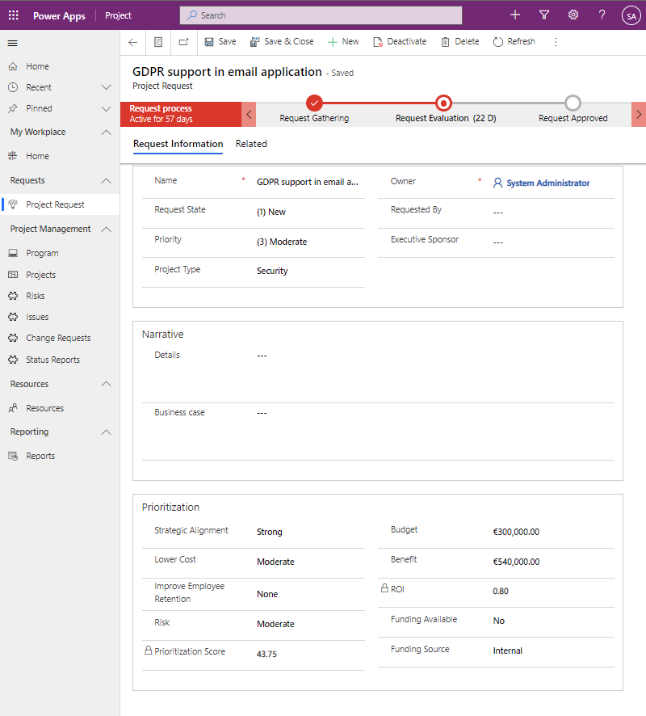
Project Request form

Slide 21
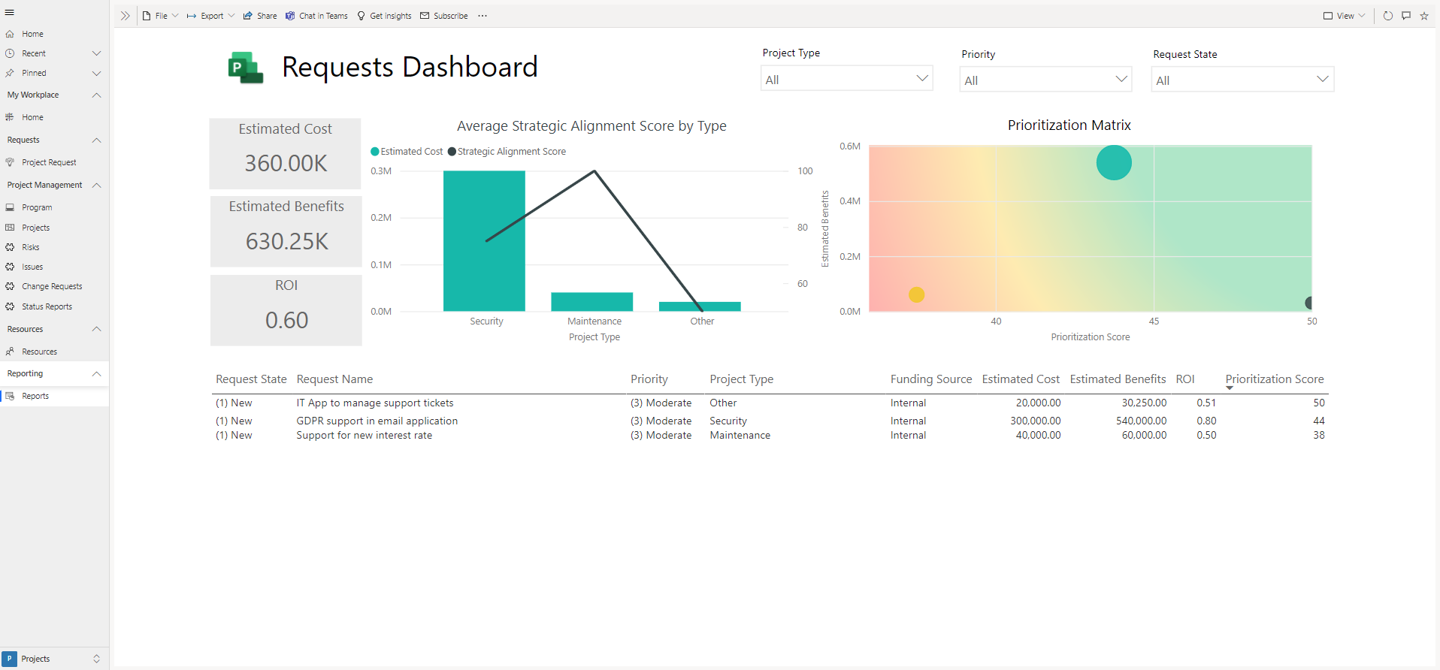
Project Requests reporting

Slide 22
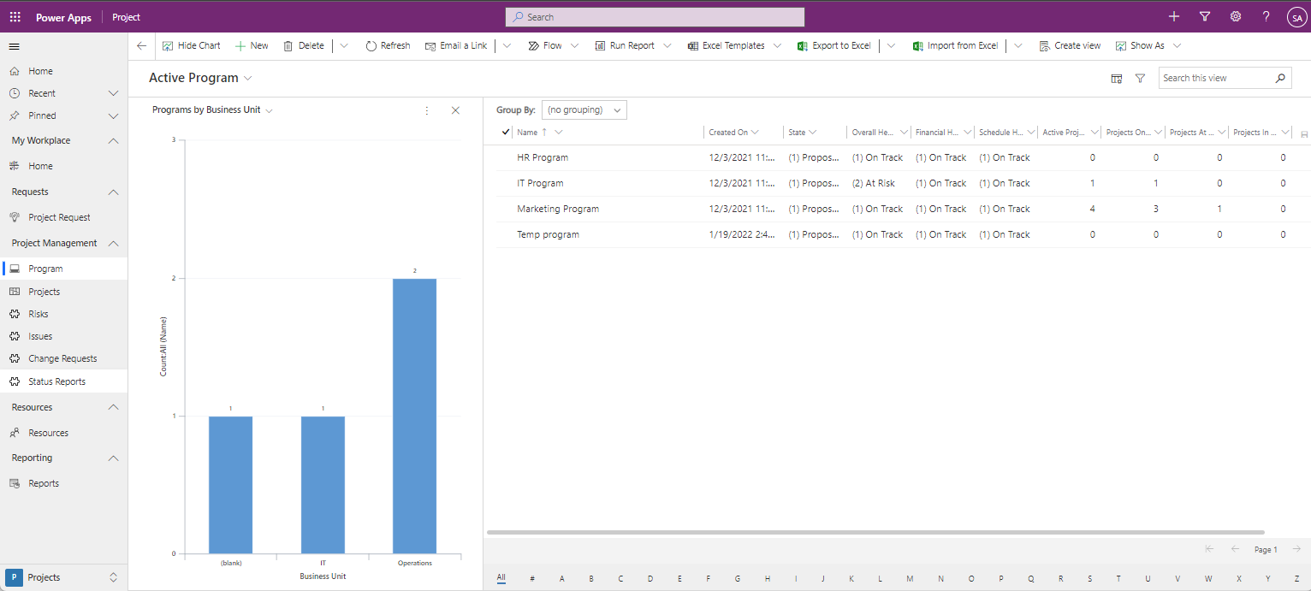
Program management

Slide 23
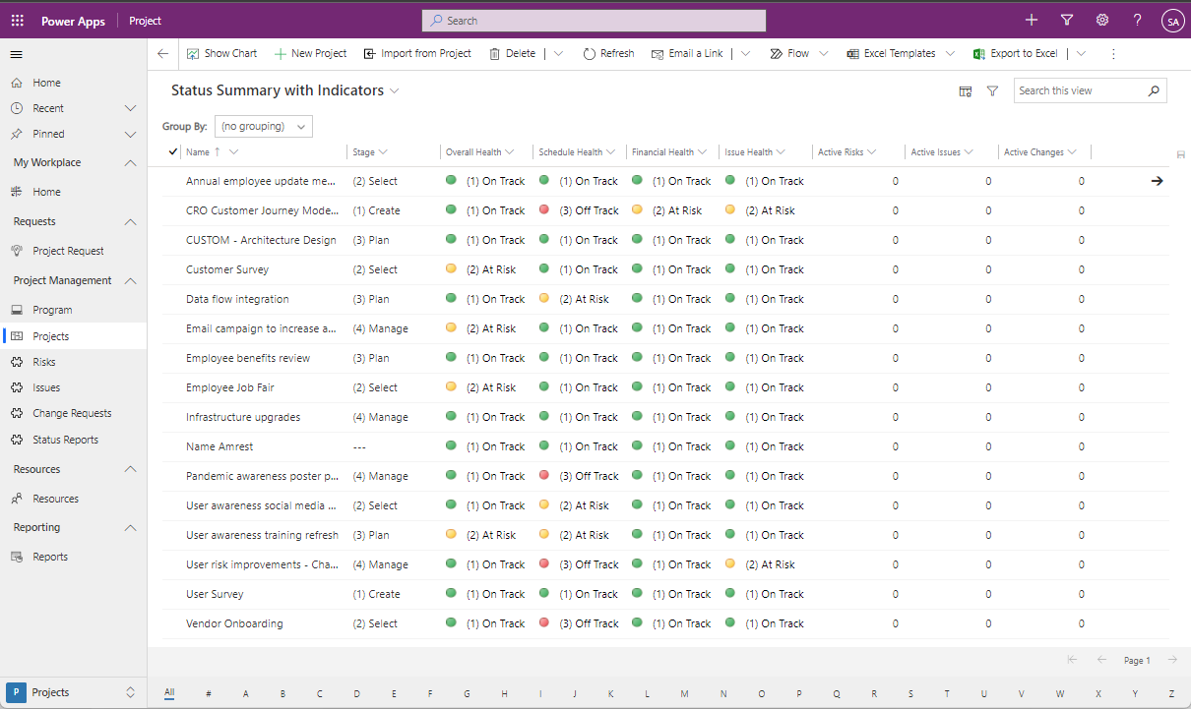
Project management

Slide 24
Project form

Slide 25
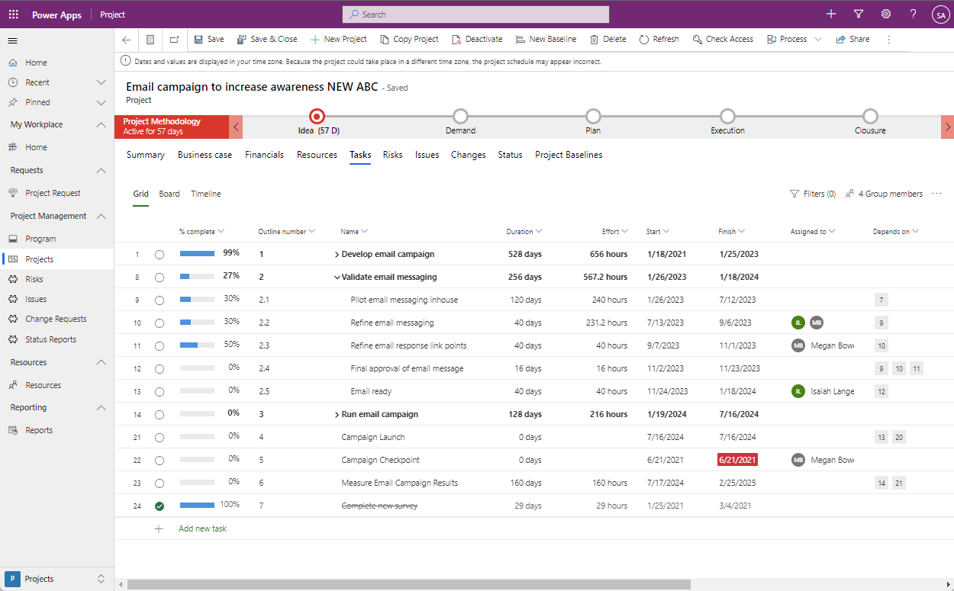
Task management – Grid View

Slide 26
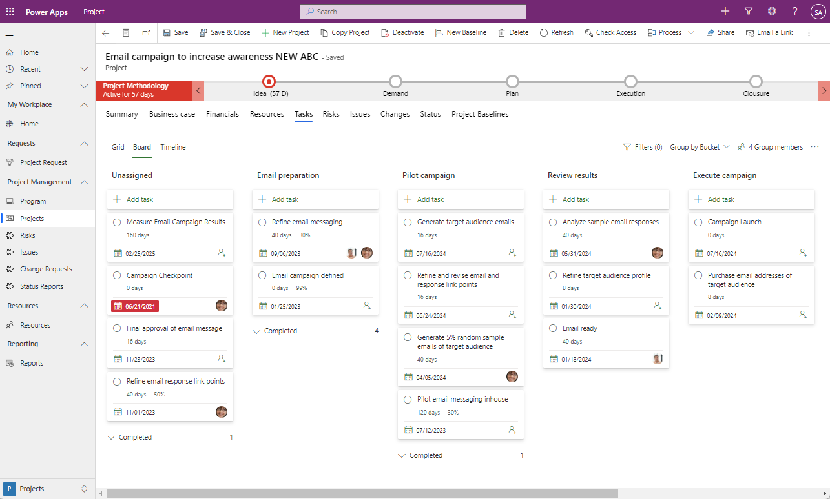
Task management – Board View

Slide 27
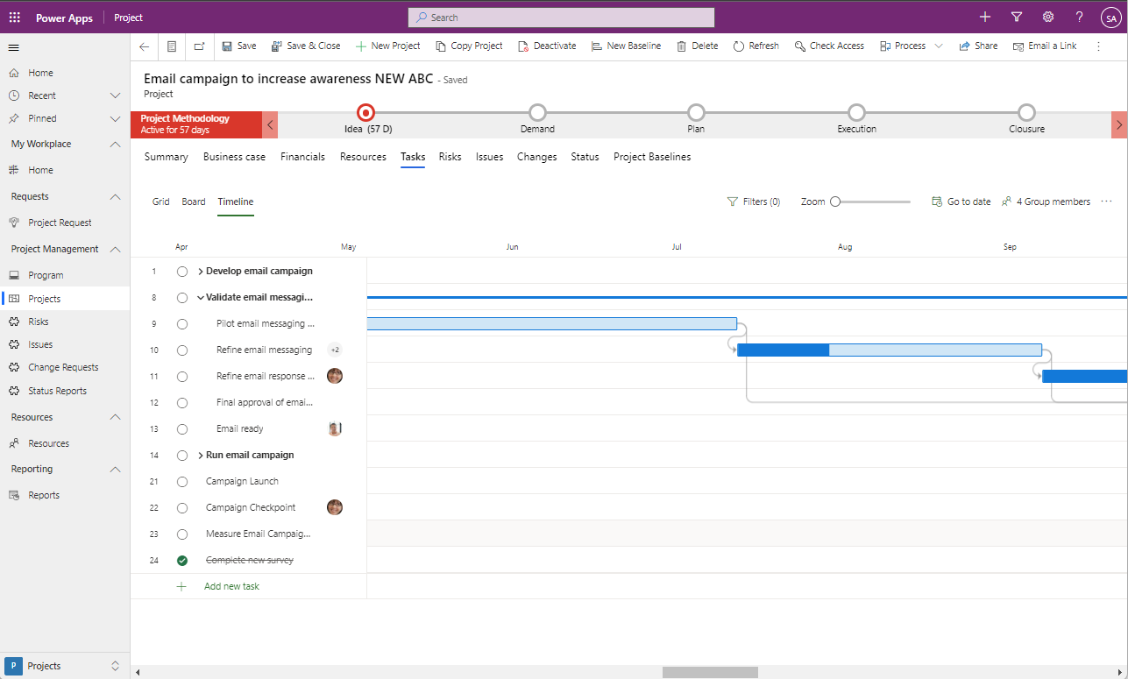
Task management – Timeline View

Slide 28
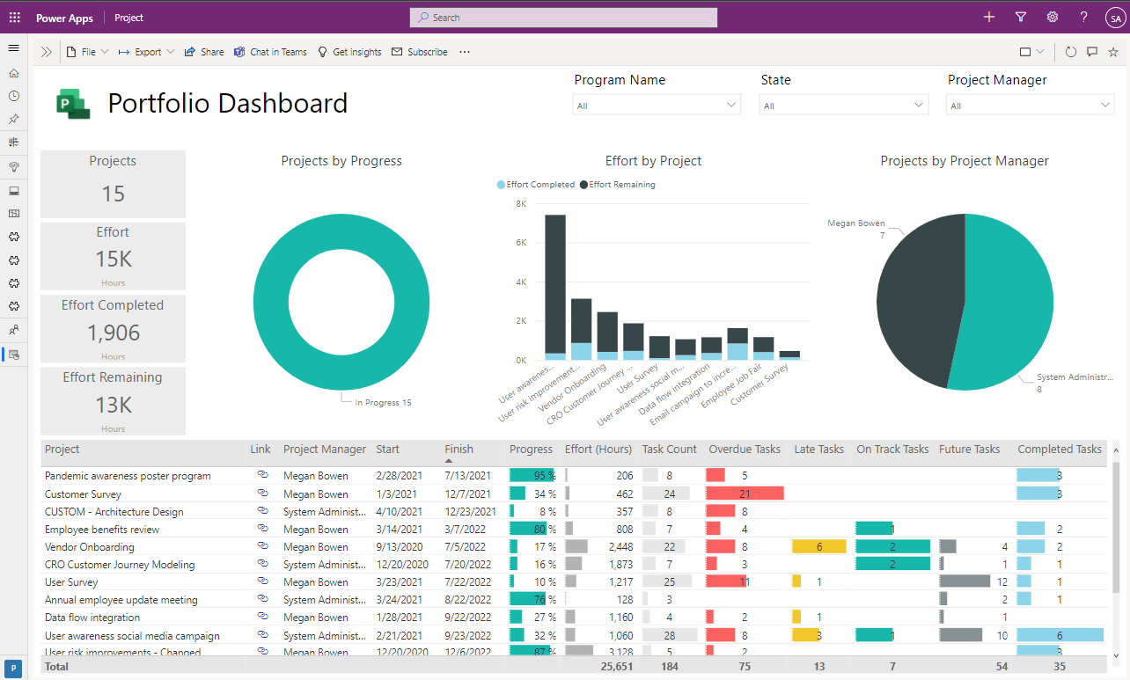
Reports - Portfolio Dashboard

Slide 29
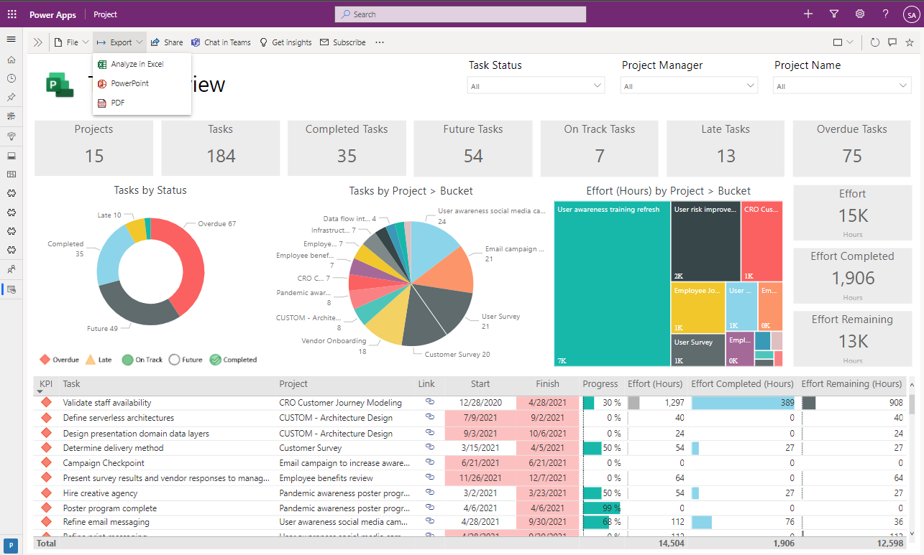
Reports – Task Overview

Slide 30
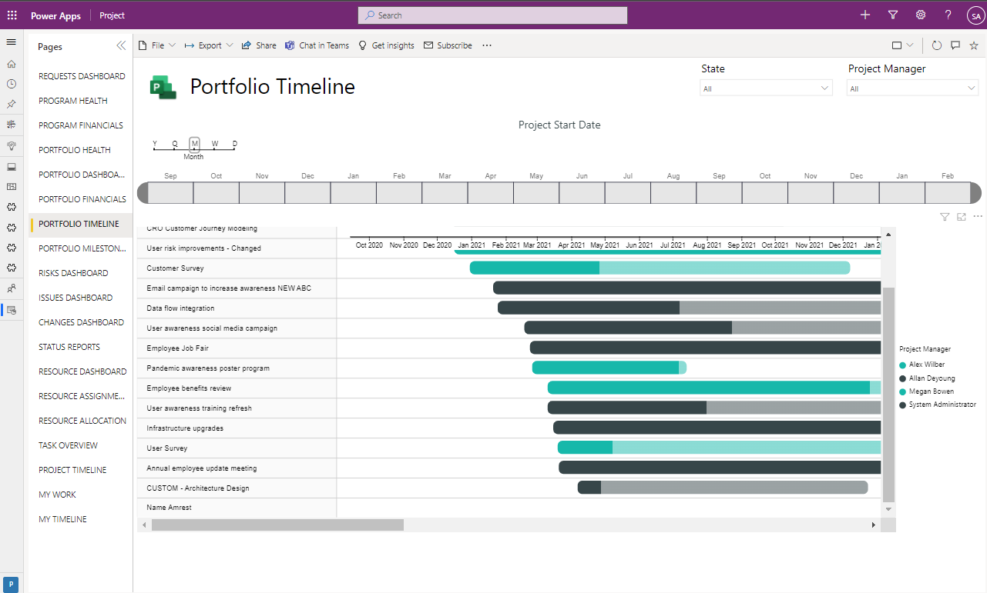
Reports – Portfolio Timeline

Slide 31
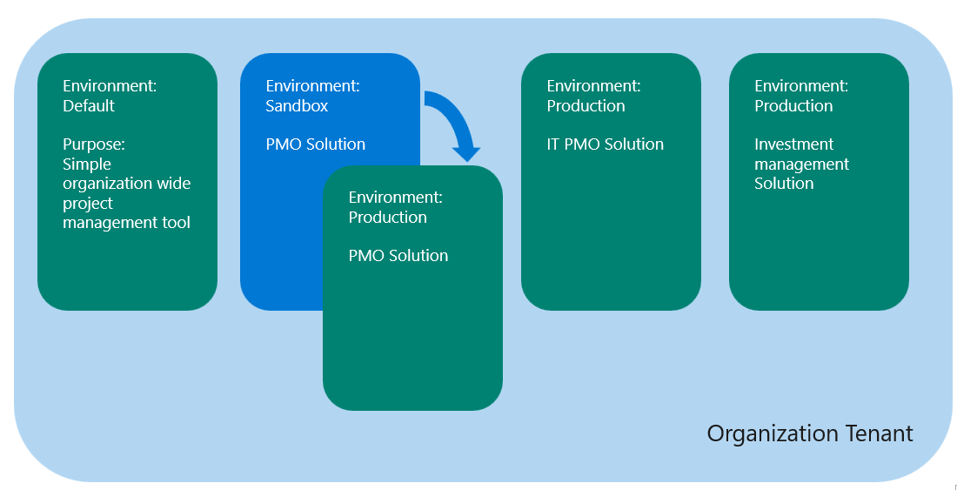
Project for the Web
Setting up project and portfolio management environment(s) in enterprise organizations

Slide 32
Project management needs in Enterprise organizations
Simple organization wide project management tool
Scope
Entire organization
Requirements
Create and manage project schedules
Allocate resources to project tasks
Share the project with the team and stakeholders
Share project plan in Microsoft Teams channels
Collaborate on tasks, documents
Update task assignments by team members (Coming in December)*
View project reports**
Required licenses
Project Plan 1/3 license to create/update project plans
Simple Project and Portfolio management tool (department/group)
Scope
Project Management Office, Investment management, Project Transformation Office
Requirements
Project management process support
Simple Org wide requirements….
Managing Investments, Proejct requests, Portfolio, Programs, Risk, Issues…
Advanced reporting**
Required licenses
Project Plan 1/3 license for data entry/update
Resource management and capacity planning solution (department)
Scope
IT Project Management Office
Requirements
…
Resource Bookings
Capacity planning
Advanced reporting**
Required licenses
Project Plan 1/3/5 license for data entry/update
Advanced Investment, Project and Portfolio management solution
(department level)
Scope
Project Management office, Investment Managemen, Project Transformation Office
Requirements
Simple Project and Portfolio management tool +
Finance management
Integration for ERP, tasks management tools…
Resource management with capacity planning
Time sheeting
Portfolio analytics
Advanced reporting**
Required licenses
Project Plan 1/3/5 license for data entry/data update
Power App licenses
* users with Office license can view schedules, solution data and update resource tasks ** Requires Power BI license

Slide 33
Deploying Project for the web in different environments
Default
Project is automatically provisioned in Default environment when licensed user creates first project on http://project.microsoft.com
+ native MS Teams integration (adding tabs in teams)
+ scheduling on http://project.microsoft.com
+Can be used with trial licenses
https://docs.microsoft.com/en-us/power-platform/admin/environments-overview#the-default-environment
Sandbox
for develop/test/ training/preproduction environments
+ Support for ALM (dev/test/production)
+ control who can access the environment
+ different Project solution for different business units.
+backup/restore
User Interface in PowerApps (not with Project app scheduling on http://project.microsoft.com)
Trial (Subscription based)
to be used only when you would like to test project in non-default environment, and you only have Project trial licenses.
More info on Dataverse trial environments: About trial environments: standard and subscription-based - Power Platform | Microsoft Docs
Developer
Power Apps Developer Plan gives you a free development environment to build and test with Power Apps, Power Automate, and Microsoft Dataverse
Sign up for Power Apps Developer Plan - Power Apps | Microsoft Docs
Production
+for custom Project for the web solution
+ Support for ALM (dev/test/production)
+ control who can access the environment
+ different Project solution for different business unit.
+backup/restore
User interface in PowerApps (not with Project app scheduling on http://project.microsoft.com)
Environments overview - Power Platform | Microsoft Docs
Deploying Project for the web - Project for the web | Microsoft Docs

Slide 34
Project for the web in Enterprise organization – deployment model
Organization Tenant
Environment:
Default
Purpose:
Simple organization wide project management tool
Environment: Sandbox
PMO Solution
Environment: Production
IT PMO Solution
Environment: Production
Investment management Solution
Environment: Production
PMO Solution

Slide 35
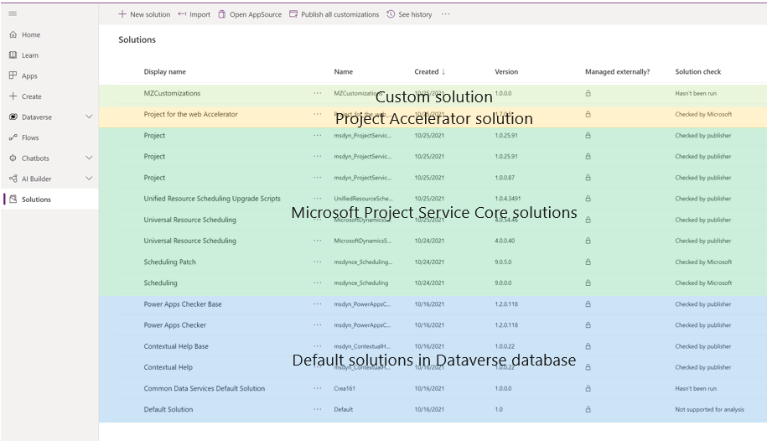
Project for the Web
Customizing Project for the web

Slide 36
Customizing Project for the web – how to begin
Project for the web is a model-driven power app
Plan environments (Default, name environments – Sandbox, production)
Managed/unmanaged customization – managed is preferred
Designer: http://make.powerapps.com
Administration: https://admin.powerplatform.microsoft.com/

Slide 37
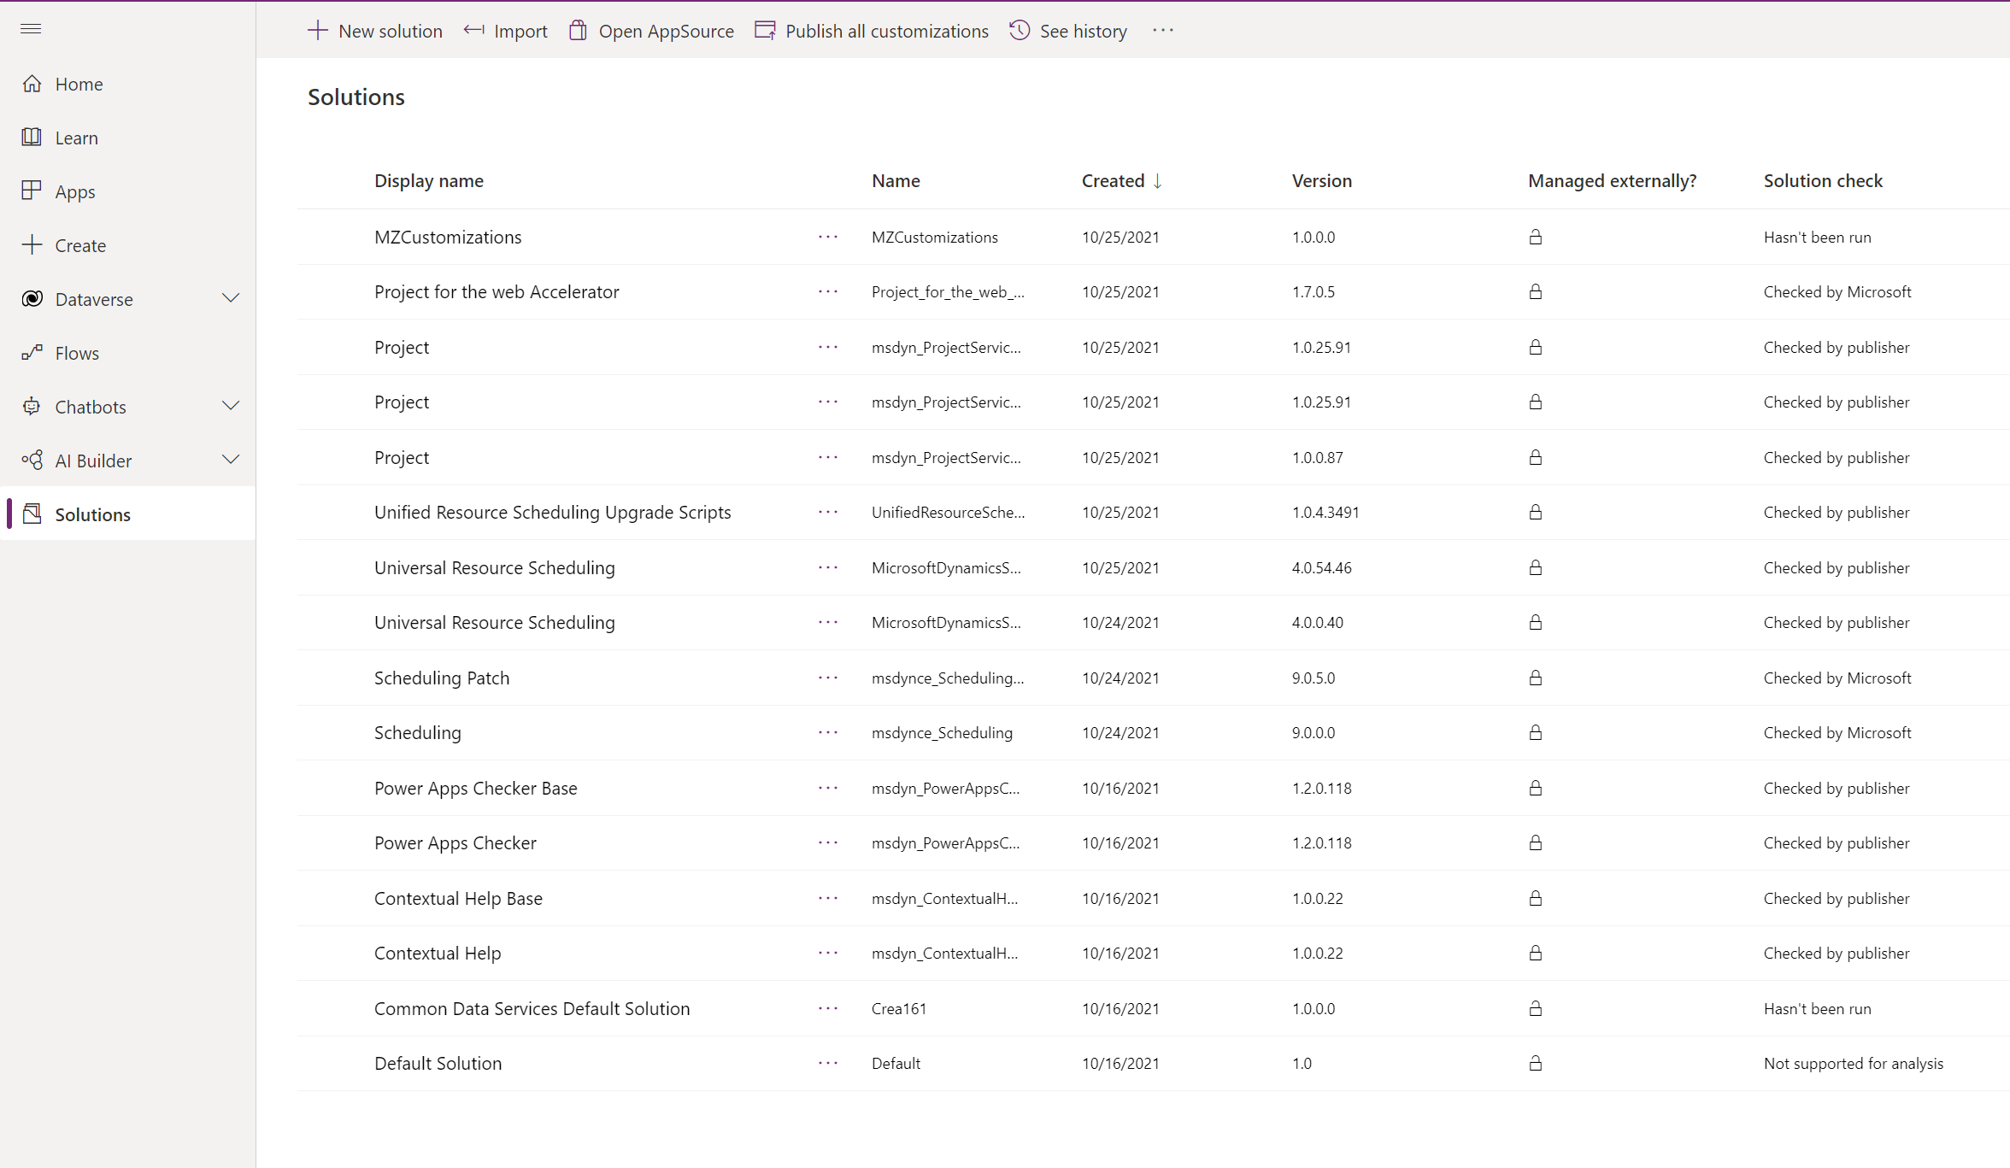
Project for the web custom solution
Power Platform – example of customization layers
Custom solution
Project Accelerator solution
Microsoft Project Service Core solutions
Default solutions in Dataverse database

Slide 38
Demo
Customizing Project for the web
Project Solution Accelerator

Slide 39
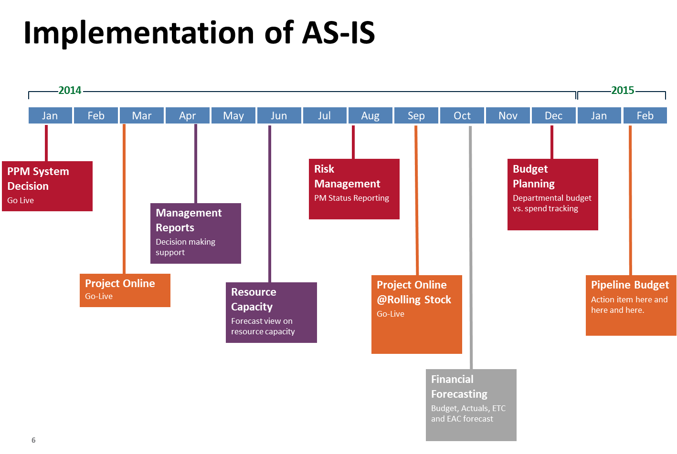
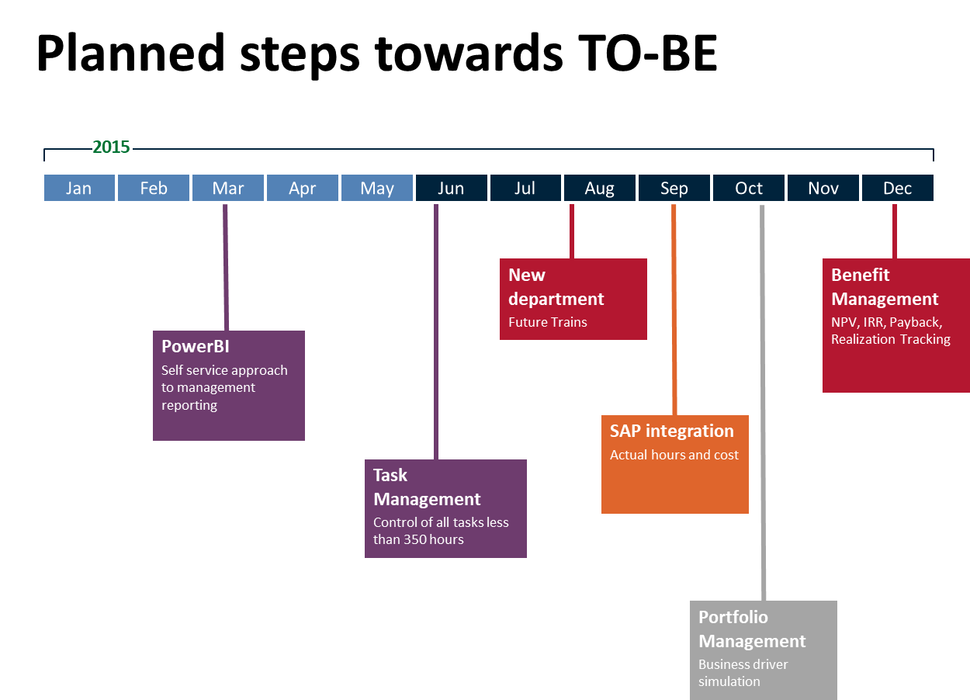
Proposed Approach to the implementation
With an experienced partner
Microsoft Certified Project and Portfolio management partners
Consider phased approach
Example from Project management system implementation

Slide 40
Licensing – Project Management Solution
Project Plan 1
$10
Project for the web
Integration in MS Teams
Power BI Content pack
View Project Roadmaps
Advanced PPM Solution built
on Project for the Web*
Project Online Essentials
Access to Project Online service for
Team member role
Project Plan 3
$30
Project for the web
Integration in MS Teams
Power BI Content pack
Project Roadmaps
Advanced PPM Solution built
on Project for the Web*
Project Online Professional
Access to Project Online service
Project Online Professional desktop client
Project Plan 5
$55
Project for the web
Integration in MS Teams
Power BI Content pack
Project Roadmaps
Advanced PPM Solution built
on Project for the Web*
Project Online Premium
Access to Project Online service
Advanced resource management
Portfolio Analytics
Project Online Professional desktop client
* Details in Microsoft Project Service description
** All plans allow access to Project Server solution for selected roles.

Slide 41
Microsoft Project and Portfolio management Solutions
Project Server
On Premise solution
Based on SharePoint technology
Covering
Portfolio management
Resource management
Project Management
Portfolio analytics
Automatic notifications
Schedule management
(fully integrated with MS Project)
Time sheeting
Reporting
…
Project Online
Cloud Solution
Based on SharePoint Online technology
Covering
Same as Project Server
+ some enhancements
Project for the web
Cloud Solution
Based on PowerApps platform
Microsoft new PPM solution
For simple project management scenarios
Easy to customize
(additional tables, fields,
forms, processes…)

Slide 42
Work and Project management requirements
Vision, Performance, Strategy
Financial Forecasting
Portfolio Roadmaps
Baselines and KPIs
Portfolio Governance
Risk and Issue management
Execute on Strategy
Status Reporting
Portfolio Founding
Capacity planning
Portfolio Insights
Methodology support (processes, stage-gate models, Prince2, PMI, PM²)
Organizational level
Work Management (scope, cost, deliverables, KPIs, Resources)
Unstructured work
Requests
Asks
Tasks
Ad hoc
Simple
Plan Driven
Phases
Tasks
Milestones
WBS
Gantts
Change Driven
Sprints
Epics
Features
Stories
Tasks
Professional services
Resource management
Invoicing
Expenses
Revenue recognition
Accruals
Planner
Project
Azure DevOps
D365
Collaboration and communication
Teams
Capabilities

Slide 43
Hvala za pozornost

