Slide 2
Trening in uporaba velikih jezikovnih modelov v oblaku in "doma"
Marko Kokol

Slide 3
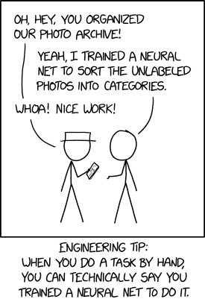
Content
Getting on the same page regarding terminology
Shallow dive into deep neural networks
What are Transformers?
Overview of open-source models (& Huggingface)
Fine-tuning a model
About underserved languages (e. g. Slovenian)
source: xkcd.com

Slide 4
The Fundametnals

Slide 5
AI Model Types by learning mechanism
Discriminative Models: These models are designed to distinguish between different types of data points. They predict a label given an input.
Linear Models, i.e.:
  Logistic Regression
  Support Vector Machines
Non-linear Models:
  Decision Trees
  Random Forest
  Gradient Boosting Machines (e.g., XGBoost, LightGBM)
Deep Learning Models:
  Convolutional Neural Networks (CNN)
  Recurrent Neural Networks (RNN)
  Transformer-based models (e.g., BERT, GPT, T5)
  RetNet based models
Ensemble Methods:
  Bagging (e.g., Bagged Decision Trees)
  Boosting (e.g., AdaBoost)
  Discriminative AI has been successfully used for more than a decade on a wide range of problems in medicine, natural language processing, and other fields.

Slide 6
AI Model Types by learning mechanism
Generative Models: These models are designed to generate new data points that are similar to some given set of input data.
Probabilistic Graphical Models:
  Bayesian Networks
  Hidden Markov Models (HMM)
Generative Adversarial Networks (GANs)
  Deep Convolutional GANs (DCGAN)
  Conditional GANs (cGAN)
  CycleGANs
Variational Autoencoders (VAEs)
Autoregressive Models:
  PixelRNN, PixelCNN
  Transformer-based models (e.g., GPT-3, GPT-4)
  Generative AI came into spotlight with the release of ChatGPT, but has been successfully used for limited problems before that.
  Large Language Models were known to be able to solve a wide set of problems before the release of ChatGPT (such as the Google Palm model).

Slide 7
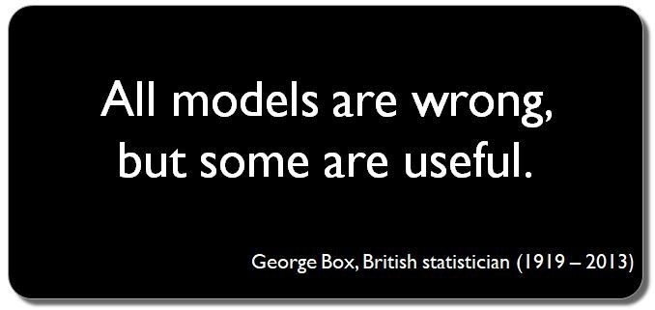
Recurring Themes
AI is often defined as machine behaviour mimicking human intelligence
Turing Test
Different approaches to learning: supervised, semi-supervised and unsupervised
Model: A model, in the context of artificial intelligence and machine learning, refers to a mathematical representation of a real-world process or system, designed to capture patterns or make predictions based on data. It serves as an abstraction that generalizes from observed data to make inferences on unseen data.

Slide 8
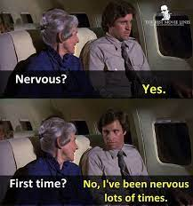
How to use Models?
Use as-is on our own data
Fine-tune on our data that is mostly similar (fine tuning)
Fine-tune on our data that to solve the same fundamental problem on different data (recognize dog breed on model trained to find dogs on pictures)
Reuse existing architecture and train from scratch
Design a completely new architecture
Design a completely new approach

Slide 9
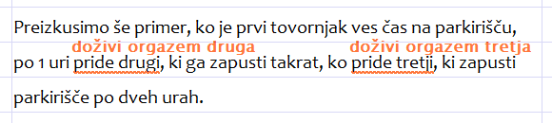
What is so hard about language?
Ambiguity
Metaphors and Similes
Idioms, Phrasal Verbs, Sarcasm, and Irony
World Knowledge, Cultural Context
Syntactic Nuances
Anaphora Resolution
Polysemy
"Let's test another scenario where the first truck is in the parking lot the entire time, after 1 hour the second one arrives, and leaves when the third one comes, which then leaves the parking lot after two hours."
source: Kako Besana včasih ustreli kozla? • Amebis

Slide 10
Turing Test
  Introduced by Alan Turing in 1950, it's a measure of a machine's ability to exhibit intelligent behavior indistinguishable from that of a human.
  A human evaluator interacts with both a machine and a human in separate conversations, typically through text-based communication.
  The machine is considered to have passed the test if the evaluator cannot reliably distinguish which of the two entities is human based solely on their responses.
Passing the test remains controversial:
  In 2014, there were reports that a chatbot named "Eugene Goostman" passed the Turing Test at an event organized at the University of Reading. Eugene was designed to simulate a 13-year-old Ukrainian boy and managed to convince 33% of the human judges that it was a human during a series of five-minute text-based chats.
  Eliza, developed in the 1960s by Joseph Weizenbaum at MIT, was an early chatbot that mimicked human conversation using simple pattern-matching techniques, often giving users the illusion of understanding and empathy. While it showcased the potential for machine-human interaction, it did not pass the Turing Test and primarily highlighted how easily humans can attribute meaning to machine-generated responses.

Slide 11
Major milestones
  Alan Turing's "Computing Machinery and Intelligence" (1950)
  The Dartmouth Workshop (1956)
  Eliza (1966)
  Backpropagation (1980s)
  Deep Blue Beats Garry Kasparov (1997)
  ImageNet Large Scale Visual Recognition Challenge (2012)
  AlphaGo Beats Lee Sedol (2016)
  ChatGPT (2022)

Slide 12
Shallow Dive
Into Deep Neural Networks & Transformers

Slide 13
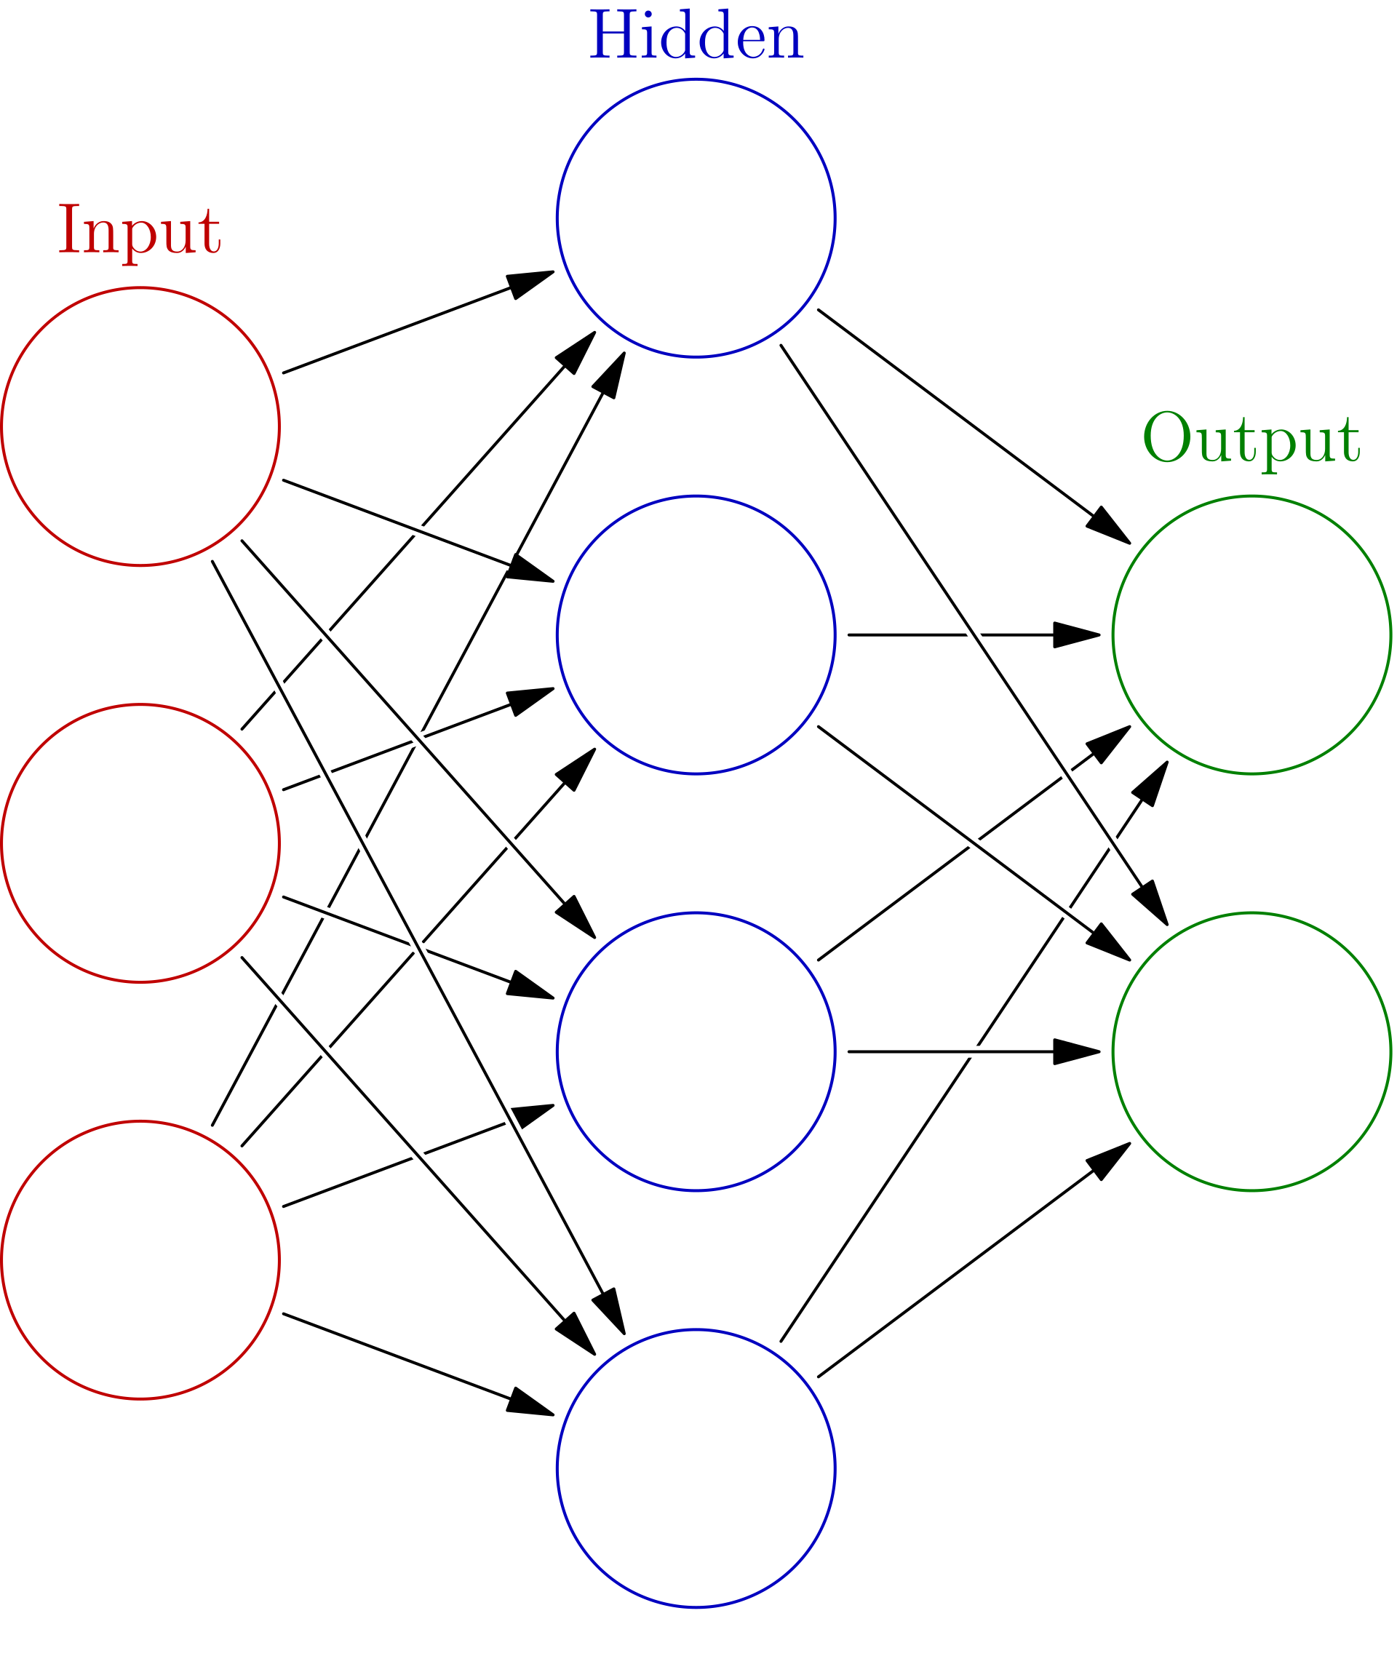
Artificial Neural Networks
  ANNs are computing systems inspired by the structure and functioning of biological neural networks in the human brain.
  The fundamental building blocks of ANNs are "neurons" or "nodes," which process information and transmit it to subsequent layers.
  Composed of multiple layers, including an input layer, one or more hidden layers, and an output layer. Each layer can have numerous neurons.
  Neurons are interconnected, and each connection has a weight, which adjusts during training to optimize the network's output.
  Each neuron processes its input using an activation function (e.g., ReLU, sigmoid, tanh) to introduce non-linearity into the model.
  ANNs learn by adjusting their weights based on a loss function through algorithms like backpropagation and optimization methods such as gradient descent.
source: Wikipedia (Glosser.ca)

Slide 14
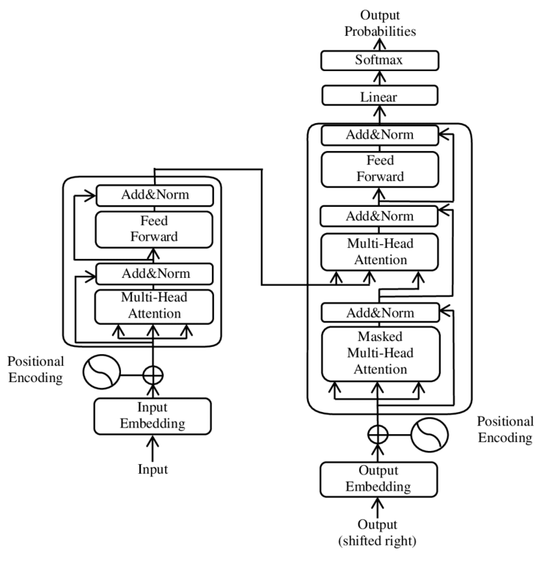
Transformers I
  Self-Attention Mechanism: At its core, Transformers use a mechanism called self-attention, which allows the model to weigh the significance of different parts of an input sequence relative to each other. This mechanism gives the network the ability to focus on different words or parts of the input when producing an output.
  Positional Encoding: Transformers do not have a built-in sense of sequence order (unlike RNNs). To remedy this, positional encodings (often sinusoidal) are added to the embeddings at the input layer, providing the model with positional context.
  Stacked Layers: The Transformer architecture typically consists of multiple stacked layers of self-attention and feed-forward neural networks. This layer-wise repetition is present in both the encoder and the decoder parts for tasks like machine translation.
  Multi-Head Attention: Instead of having a single set of attention weights, Transformers employ multiple sets (or "heads"). This allows the model to focus on different parts of the input simultaneously, capturing various aspects or contexts.
source: DOI:10.1088/1742-6596/1314/1/012186

Slide 15
Transformers II
  Normalization and Feed-forward Layers: After the self-attention layer in each block, there's a layer normalization and a feed-forward neural network. These help in stabilizing the activations and in learning position-wise transformations.
  Encoder-Decoder Structure: For tasks like machine translation, the Transformer uses an encoder to process the source sequence and a decoder to produce the target sequence. Both encoder and decoder have multiple layers with self-attention and feed-forward networks.
  Scalability: One of the standout features of the Transformer is its scalability. Due to the parallel processing nature of the attention mechanism, Transformers can be scaled up effectively, leading to models with billions of parameters like GPT and BERT.
  Masking: For certain tasks, like language modeling, it's essential that the model doesn't "cheat" by looking ahead. Masking ensures that, when predicting a word/token, the model can only use information from previous words/tokens in the sequence.
source: DOI:10.1088/1742-6596/1314/1/012186

Slide 16
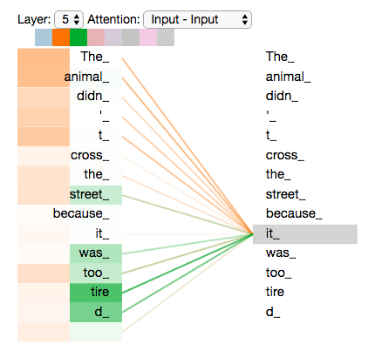
Transformers III
  Multiple approaches to training (LTR, masking)
source: http://jalammar.github.io/illustrated-transformer/

Slide 17
Generative Models
  Mostly based on Transformer architecture
  During pre-training, LLMs aim to predict the next word in a sequence given all the previous words, which is often termed autoregression. The model learns from vast amounts of text to capture patterns, relations, and knowledge present in the data.
  Before processing, text data is tokenized into chunks (could be words, subwords, or characters). This ensures the model can handle varied vocabularies and even learn meaningful representations for parts of words.
  Within transformers, the self-attention mechanism allows each token in the input sequence to focus on different parts of the sequence, capturing long-range dependencies and relations between tokens. This is pivotal for understanding context in a given text.
  While generative LLMs can generate text out-of-the-box after pre-training, they can be further fine-tuned on specific tasks or datasets to generate more task-specific or coherent outputs. This involves training the model on a narrower task with specific data and objectives.

Slide 18
Anatomy of a Typical LLM
  Tokenizer (Dictionary converting words to numbers)
  Embedding (Numbers to vectors)
  Transformer (Position + Attention + Transformation, Encoding)
  Classifier (Encoding to Tokens)
  Normally, an LLM converts a sequence of n words to another shifted sequence of n words:
  I am -> am very
    I am -> 101, 2432 -> [0 1], [1 0] -> [0.3 0.5], [0.2 0.7] -> 2432, 3756 -> am very
  The model outputs the probability for each word in the vocabulary that it is the next word (important later)

Slide 19
What is out there?
Existing Architectures, Models, and Datasets

Slide 20
Open-source Models
A large number of open-source models is available, good starting points:
  LLAMA2 (https://github.com/facebookresearch/llama)
  Huggingface library (https://huggingface.co/docs/hub/models-libraries)
  Good overview: https://github.com/steven2358/awesome-generative-ai
  LICENSING: be careful, some models do not allow commercial use (LLAMA1; LLAMA2 has removed that restriction for most users and use cases)

Slide 21
How do I?
Tools, Starting Points and Common Challenges

Slide 22
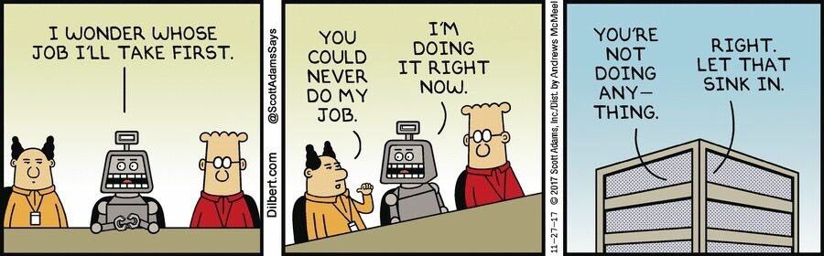
So, How do I?
  Frameworks: PyTorch, TensorFlow, Keras, MXNet, ML.NET
    Additional Frameworks: CUDA (Nvidia), oneAPI (Intel)
  Huggingface:
    Dataset
    Model
  Appropriate Hardware

Slide 23
Hardware
  Main limiting factor is usually the GPU Memory
  Nvidia 4090 vs H100 (3090 vs A100) is in the range of 2k vs 500k
  What you can do, depends on your hardware
  Two common tricks:
    Quantization
    LORA

Slide 24
LORA
  LORA stands for Low-Rank Adaptation of Large Language Models.
  It is a technique that reduces the number of trainable parameters by learning pairs of rank-decomposition matrices while freezing the original weights.
  It can speed up the fine-tuning process and reduce the memory usage without sacrificing model quality or adding inference latency.
  It can be applied to different types of language models such as RoBERTa, DeBERTa, GPT-2, and GPT-3.
  It can also be combined with other techniques such as distillation or pruning to further improve efficiency.
  It is supported by the State-of-the-art Parameter-Efficient Fine-Tuning (PEFT) library by Hugging Face.

Slide 25
Quantization
  Quantization is a process that reduces the precision of numerical values used in neural networks.
  It can reduce the size of the model and the computational cost of inference and training.
  It can also enable running large language models on consumer hardware such as mobile devices or edge devices.
  However, it can also introduce quantization errors that degrade the model performance or accuracy.
  To mitigate this, quantization-aware training or post-training quantization can be used to fine-tune the model with lower precision weights.

Slide 26
Quantization + LORA = QLORA
  QLoRA stands for Quantized Low-Rank Adaptation of Large Language Models.
  It is a technique that combines 4-bit quantization with LORA to reduce the memory usage and computational cost of fine-tuning large language models.
  It can fine-tune a 65B parameter model on a single 48GB GPU while preserving full 16-bit fine-tuning task performance
  see: https://arxiv.org/abs/2305.14314

Slide 27
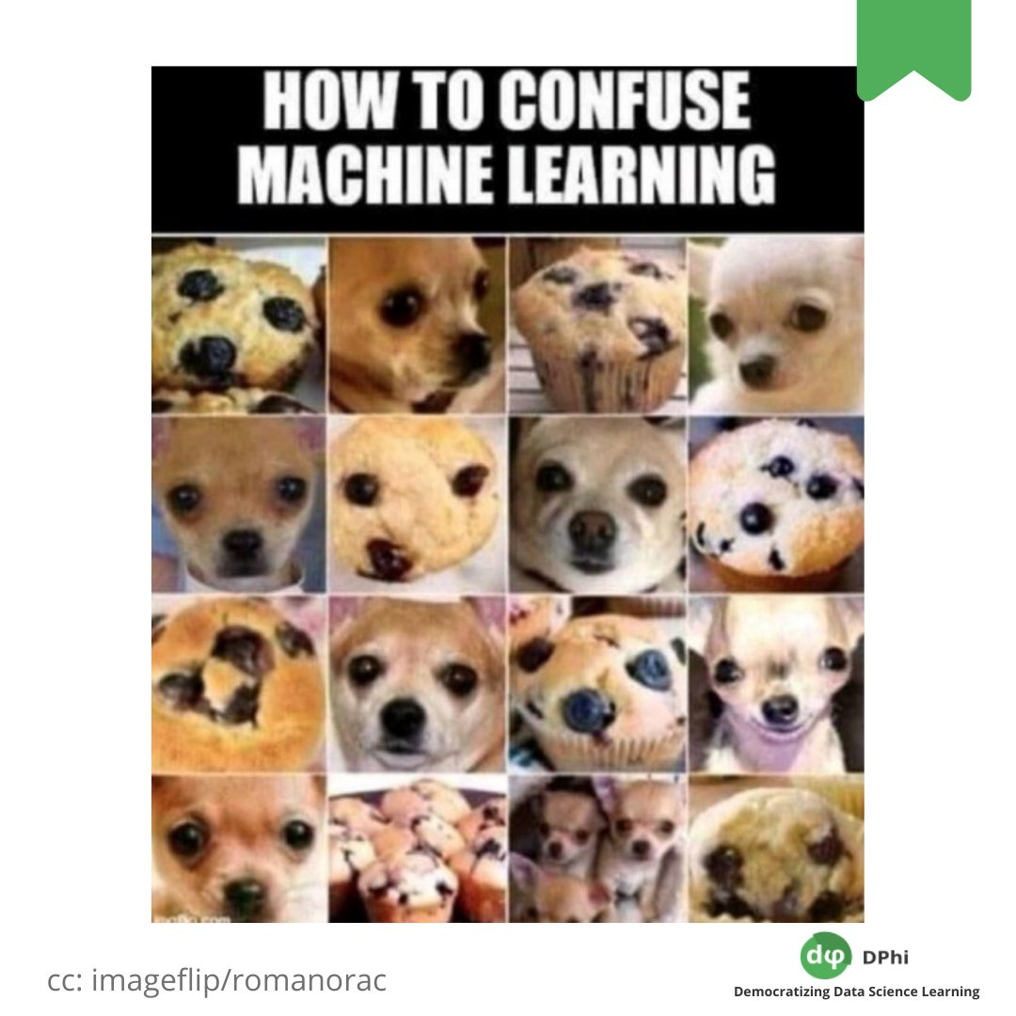
How to use Models?
Use as-is on our own data
Fine-tune on our data that is mostly similar (fine tuning)
Fine-tune on our data that to solve the same fundamental problem on different data (recognize dog breed on model trained to find dogs on pictures)
Reuse existing architecture and train from scratch
Design a completely new architecture
Design a completely new approach

Slide 28
Use Existing model
  Tokenizer
  Model
  Code to generate text
    Remember: the output of the model is the probability for each token in the vocabulary that it is the next token
    Simple approach: take the most likely token
      Drawback: will probably generate repetitive text
    More complex approach: take a random token that has a high enough probability
      Temperature: flatten the probability curve
      Minimum probability: what is the required probability for tokens to be considered

Slide 29
Training & Fine-tuninG
  Tokenizer
  Model
  Dataset
  Training loop
  Training and fine tuning have the same basic requirements
  NOTE: Be sure to read the model documentation. For example some GPT models from Huggingface perform model shifting internally and therefore input=output

Slide 30
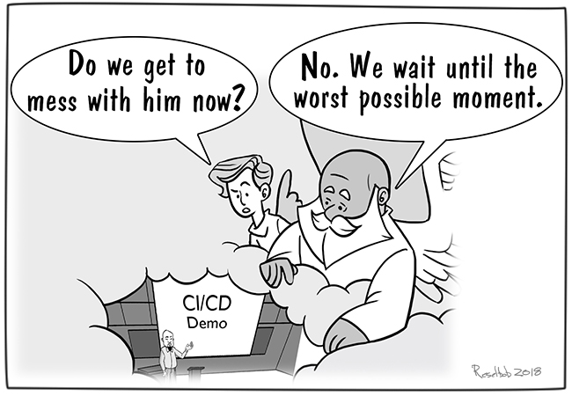
DEMO
Vir slike: In the Hands of the Demo Gods - DevOps.com

Slide 31
Underserved Languages
Supporting Slovenian

Slide 32
Summarized
Currently, no open very large generative LLMs exist for Slovenian
  We are working on changing that
  Clarin.si has datasets you can use to change that yourself, using techniques shown today
  If you have a dataset, you can use the techniques shown to create one
There are BERT based open models available:
  www.slovenscina.eu

Slide 33
Questions?
github.com/klokedm
github.com/klokedm/ntk23_llm

