Slide 1
Kako vzpostaviti QA infrastrukturo in kako nam Microsoft lahko pomaga
Miloš Cigoj
vodja kakovosti
Parsek d.o.o.

Slide 2

18+ let v IT
Desk // Web // Mobile
@CigojMilos
Parsek d.o.o.
17+ let v IT
Enterprise solutions for HC, Insurance, Telco etc.
@parseksolutions
Kdo sem
ČAS
KAKOVOST

Slide 3

„Quality is never an accident; it is always the result of intelligent effort.“
~ John Ruskin
ČAS
DENAR
KAKOVOST

Slide 4
Agenda
Kakovost
Kako „vgraditi“ kakovost
Microsoft QA Tool belt

Slide 5
Upravljanje s kakovostjo

Slide 6
Risk assesment & mitigation
Objectives & Metrics
Standards & Policies
QA & QC Activities
Tools & Techniques
Quality Management
Planning
Assurance
Control
Improvement
Review
Report
Proposals
Continuous Improvement
Test Plan & Test Scenarios
Roles & Responsibilities
Trainings
Process
Communication & Documentation
Reviews & Audits
Monitor & Evaluation
Record & Measure

Slide 7
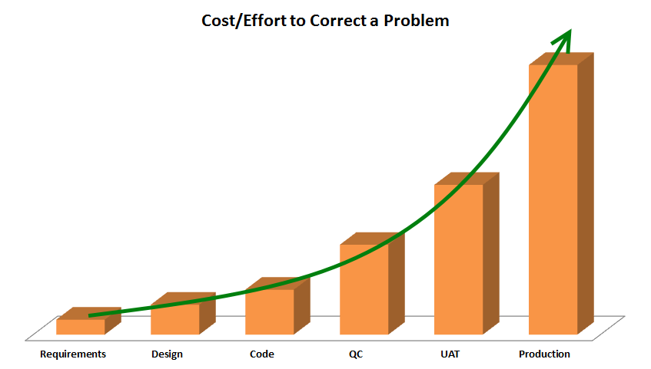
€ / h
vir: Barry W. Boehm; Software Engineering Economics

Slide 8

“Quality is the result of a carefully constructed cultural environment. It has to be the fabric of the organization, not part of the fabric.”
~ Philip B. Crosby
ČAS
KAKOVOST

Slide 9
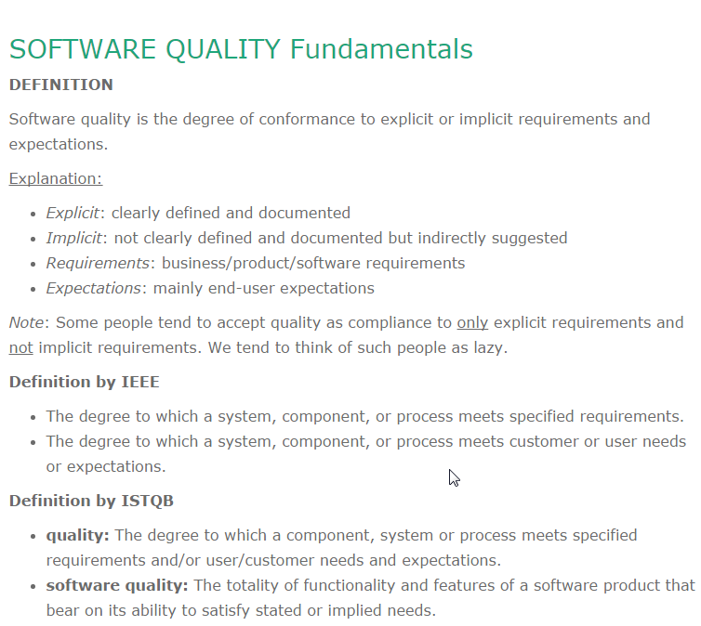
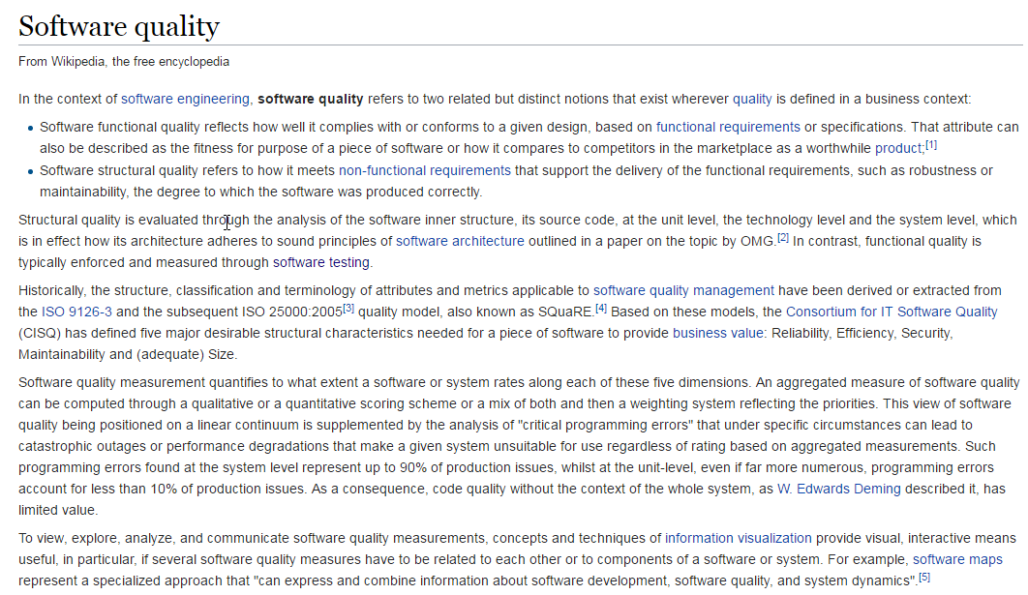
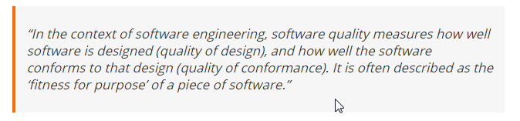
Definicije kakovosti

Slide 10
Kakovost
Ni enoznačne in kratke definicije
Težko oceniti prisotnost kakovosti, ampak odsotnost se hitro prepozna
Kakovost se ne kar zgodi
Enak koncept ima drugačen pomen za različne deležnike
Ocenjuejmo z merjenjem

Slide 11
Vidiki kakovosti

Slide 12





Vidiki kakovosti
RAZVOJNI PROCES
Sponzorji
SW&HW REŠITEV
STRUKTURNA KAKOVOST
IDEJA
KAKOVOST PROCESA
FUNKCIONALNA KAKOVOST
Uporabniki
Razvojna ekipa

Slide 13
Funkcionalna kakovost
Uporabniške zahteve
Malo defektov (varnost, zanesljivost,… )
„Good enough“ performances
Enostavnost uporabe
Dokazana s testiranjem

Slide 14
Strukturna kakovost
Testability →bolj preverljiva→ manj defektov
Maintainability →nižja→več tveganj→bolje prepisati
Efficiency →omejeni viri, bolj je pomembna
Security → sledi vsem varnostnim smernicam
Understability → kompleksna vs berljiva →strma krivulja učenja→bljižnice→težave pri razvoju in vzdrževanju
Resiliance, fault tolerance → kako preživi mejne pogoje?
Scalability, design for the future, …..
Dokazana s pregledi

Slide 15
Procesna kakovost
Roki, proračun, obseg
Ponovljiv & Zanesljiv
T_{DELIVERY} = (T_{PLAN} + T_{DESIGN} + T_{DEVELOP} + T_{BUILD} + T_{DEPLOY} + T_{TEST} + T_{FIX} + T_{RELEASE} + T_{EVALUATE}) / % TRUST
Načrtovanje kakovosti; P-D-C-A
Komunikacija-> pogosta in jasna; register odločitev
Avtomatizacija
Orodja in metodologije

Slide 16



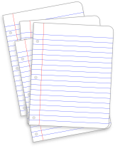


Upravljanje kakovosti
QA infrastruktura
QA Načrt
Testni načrt
Testni scenariji
Postopki & Izobraževanja
Standardi & Pregledi
Dokumentacija & checkliste
CI & CD
Partner QA Management
Upravlajne s konfiguracijami
Politike pregledov kode …
Upravljanje s tveganji
Izbira QC in QA prijemov
Izbor standardov
Razvojni proces
Okolja
Odgovornosti in vloge
Upravljanje s napakami in CR
…
Cikli, intenzivnost in periode
Testiranja
Definiranje načinov testiranja
Izbor orodji in ekipe
Plan komuniciranja
Definicije testnih podatkov
Povezani standardi in dokumenti
….
Seznam scenarijev
Meritve
Poročila

Slide 17
Kaj nam Microsoft nudi?
MS QA Tool belt

Slide 18
Microsoft QA Tool-belt
Team Services
Visual Studio
Azure
Izobraževalni materiali

Slide 19
TS - Upravljanje s procesom in specifikacijami
Agile, SCRUM in CMMI predloge
Fleksibilen (obstajajo različne ekstenzije npr.: ModernRequirements)
Team Rooms
Backlog, Queries, Boards
Epics, Features, PBI, Bug, Impediment
Delivery Plan

Slide 20
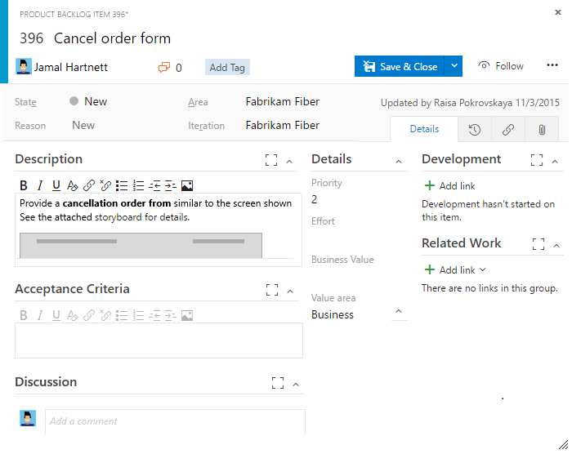
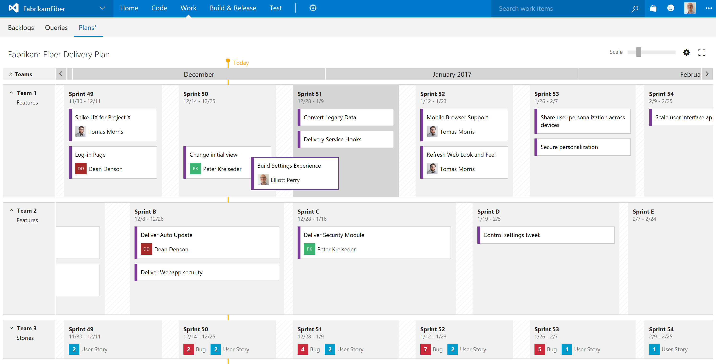
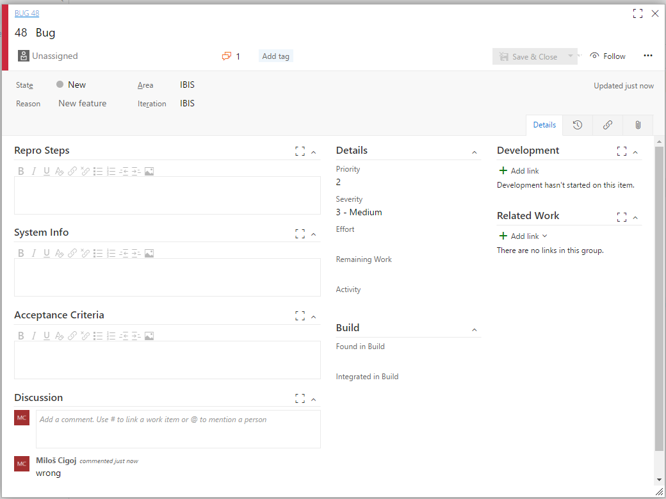
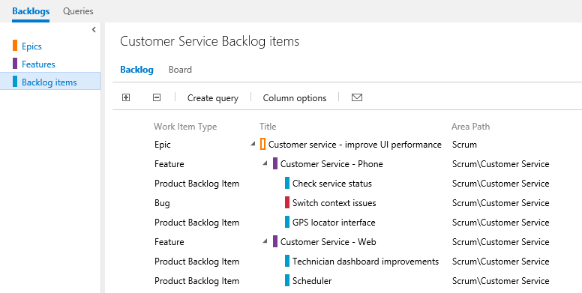

Slide 21
TS - Upravljanje s testiranjem 1/2
Test Management
  Test Center (local)
  Test Hub (web)
Test Hub (manual)
  Planning (iterations,areas, configurations, test plan, test suites)
    Static, query and requirement based Test Suites
  Authoring (Test case)
  Execution (testing support, web runner, desktop runner)
  Tracking

Slide 22
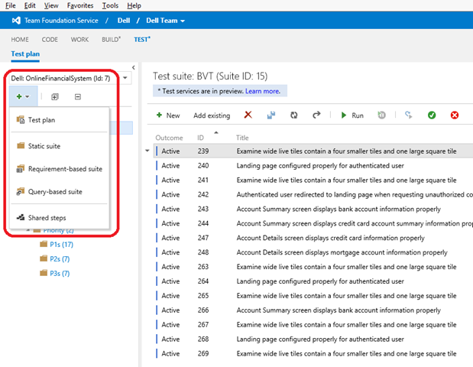
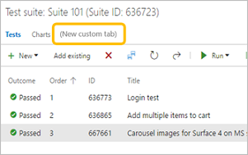
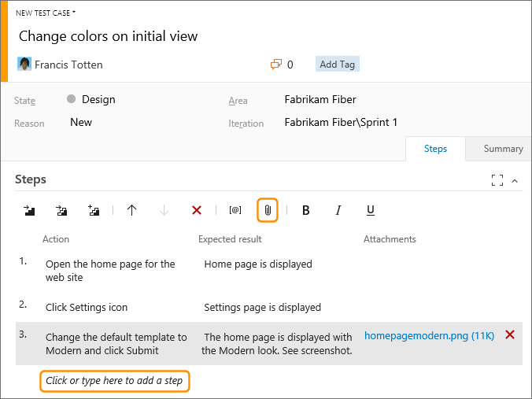
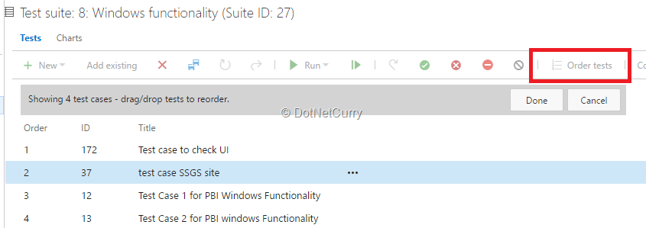

Slide 23
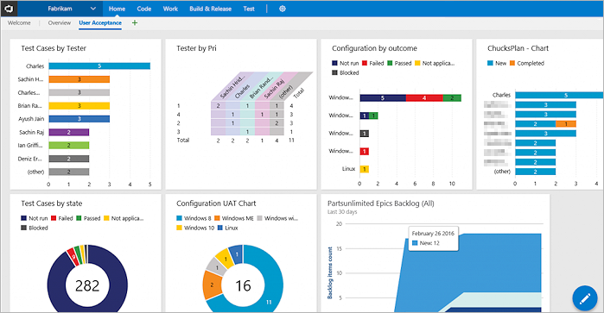
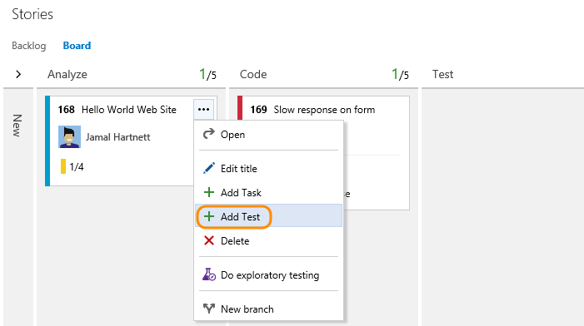
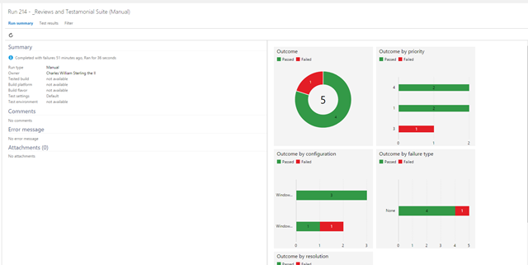

Slide 24
TS - Upravljanje s testiranjem 2/2
CI Tests
  white-box
  Sledljivost (end-to-end)
    Test case
    Requirements
    Result association (no planning done ☺)
  Code Coverage
  Coding Standard
Test & Feedback Tool
  Bug, Task, TC, Discuss
  Recording & Metrics
  End-to-end sledljivost
  Test on a Device (Perfecto)
Load Test
  HTTP Archive
  VS WebTest
  JMeter

Slide 25
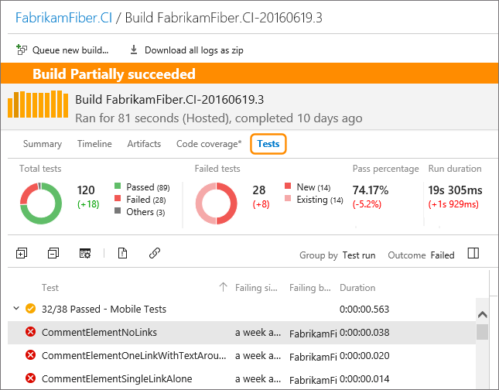
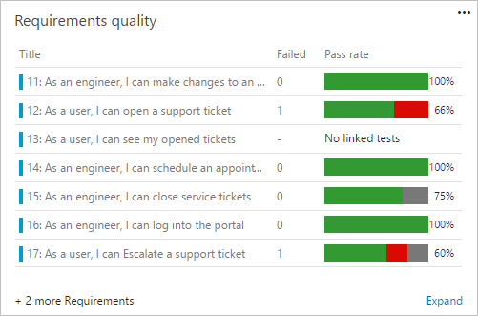

Slide 26
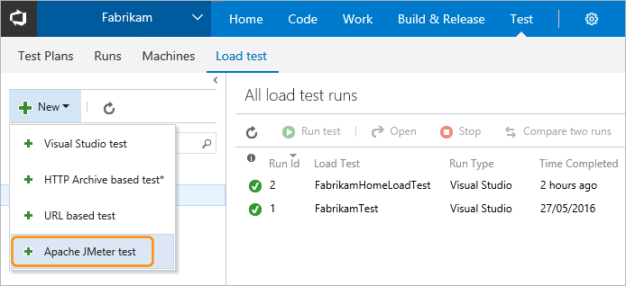
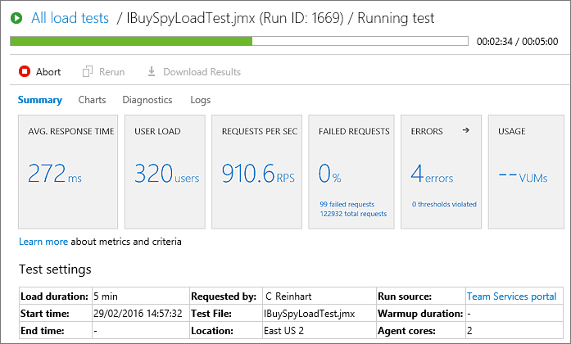

Slide 27
TS - Nadzor nad projektom
Tracking & Reporting
  Dashboards
  Queries
  Exports
  Office integration (Excel & Project)

Slide 28
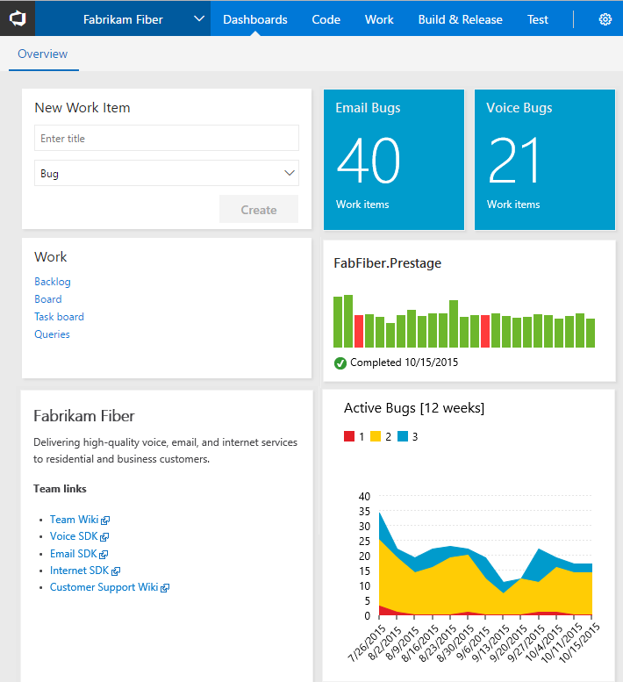
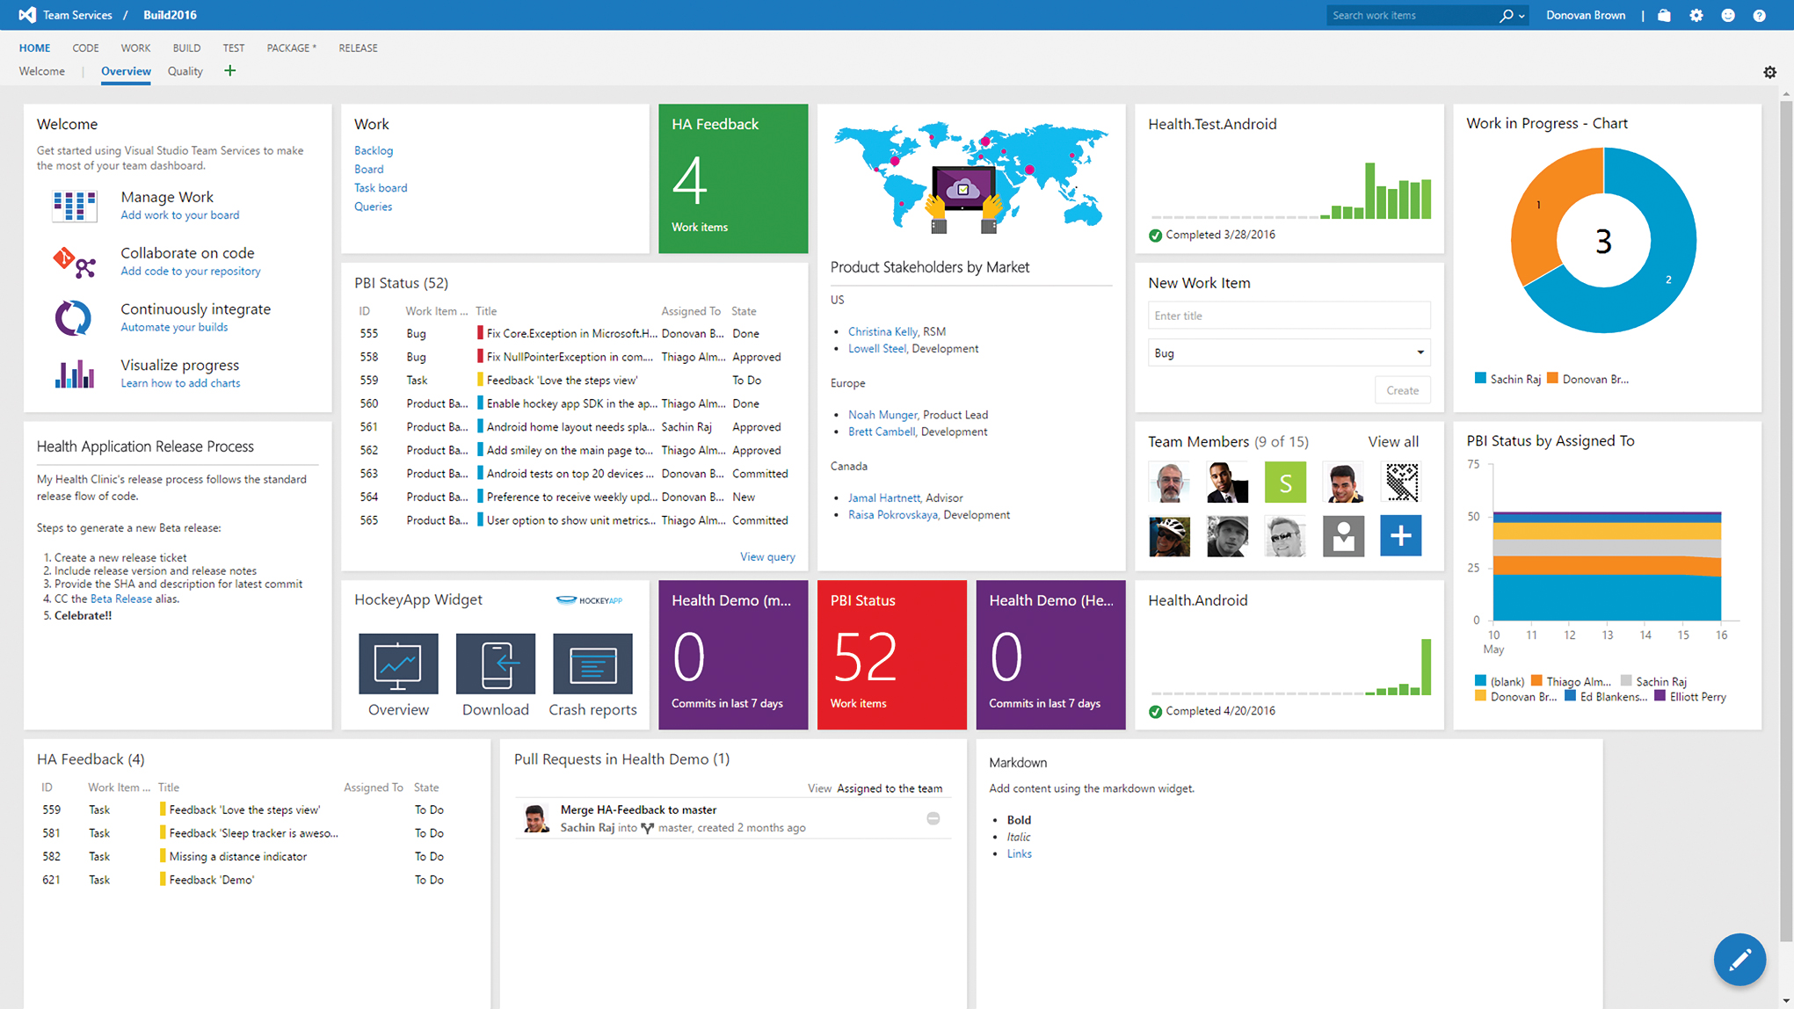

Slide 29
Visual Studio
Politike kakovosti
Podpora avtomatskemu testiranju (Live Unit Testing+++)
Analize (build-in; Ndepend, Resharper, SonarQube, dotCover ….)
Code review / gated checkins
Refactoring
Razširitve
Visual Studio Test Professional

Slide 30
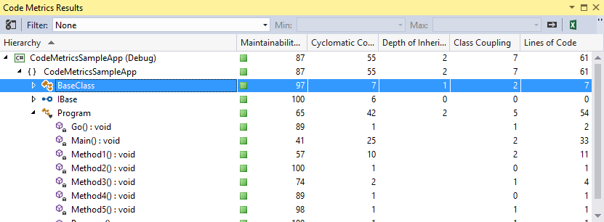
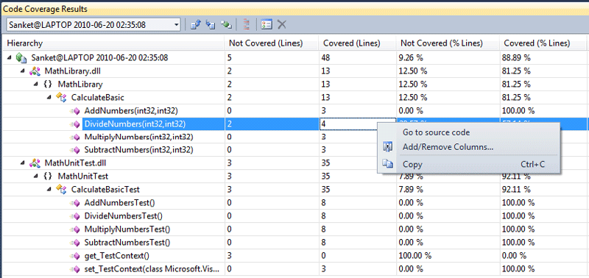
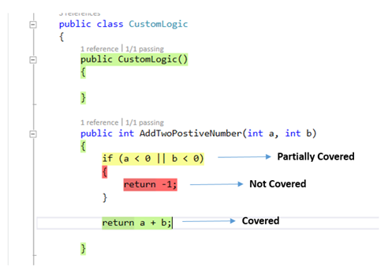

Slide 31
Azure
Azure
  Load Testing
  Azure DevTest Labs
  Application Insights
  Log Analytics
  Operations Management Suite (OMS)
    Log Analytics
    Automation
    Backup & Recovery
    Capacity Forecasting ….

Slide 32
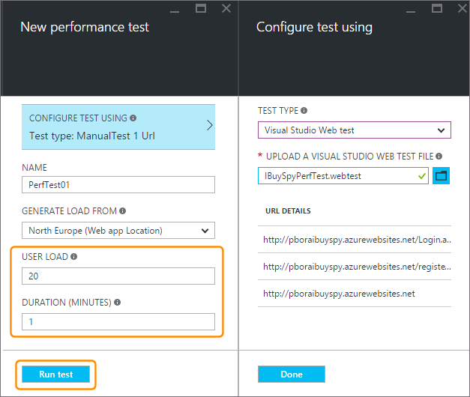
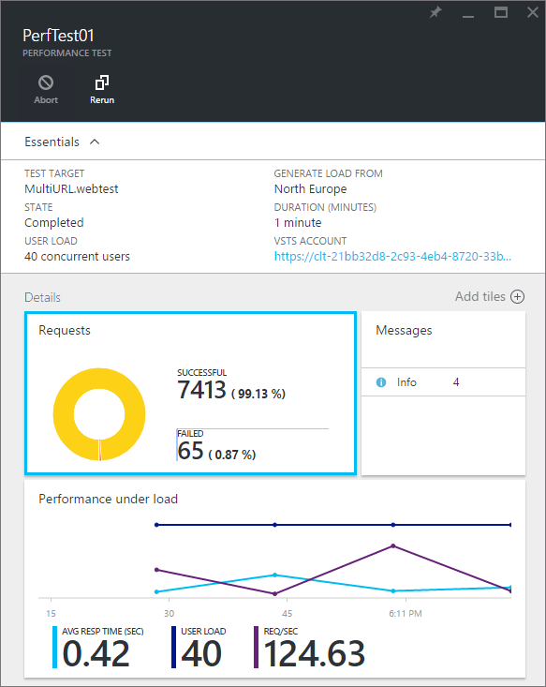
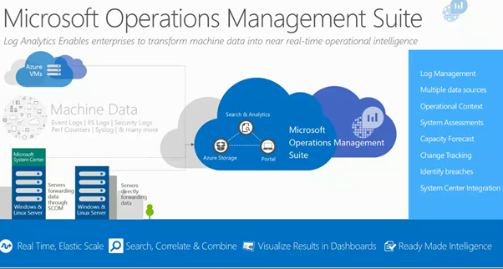

Slide 33
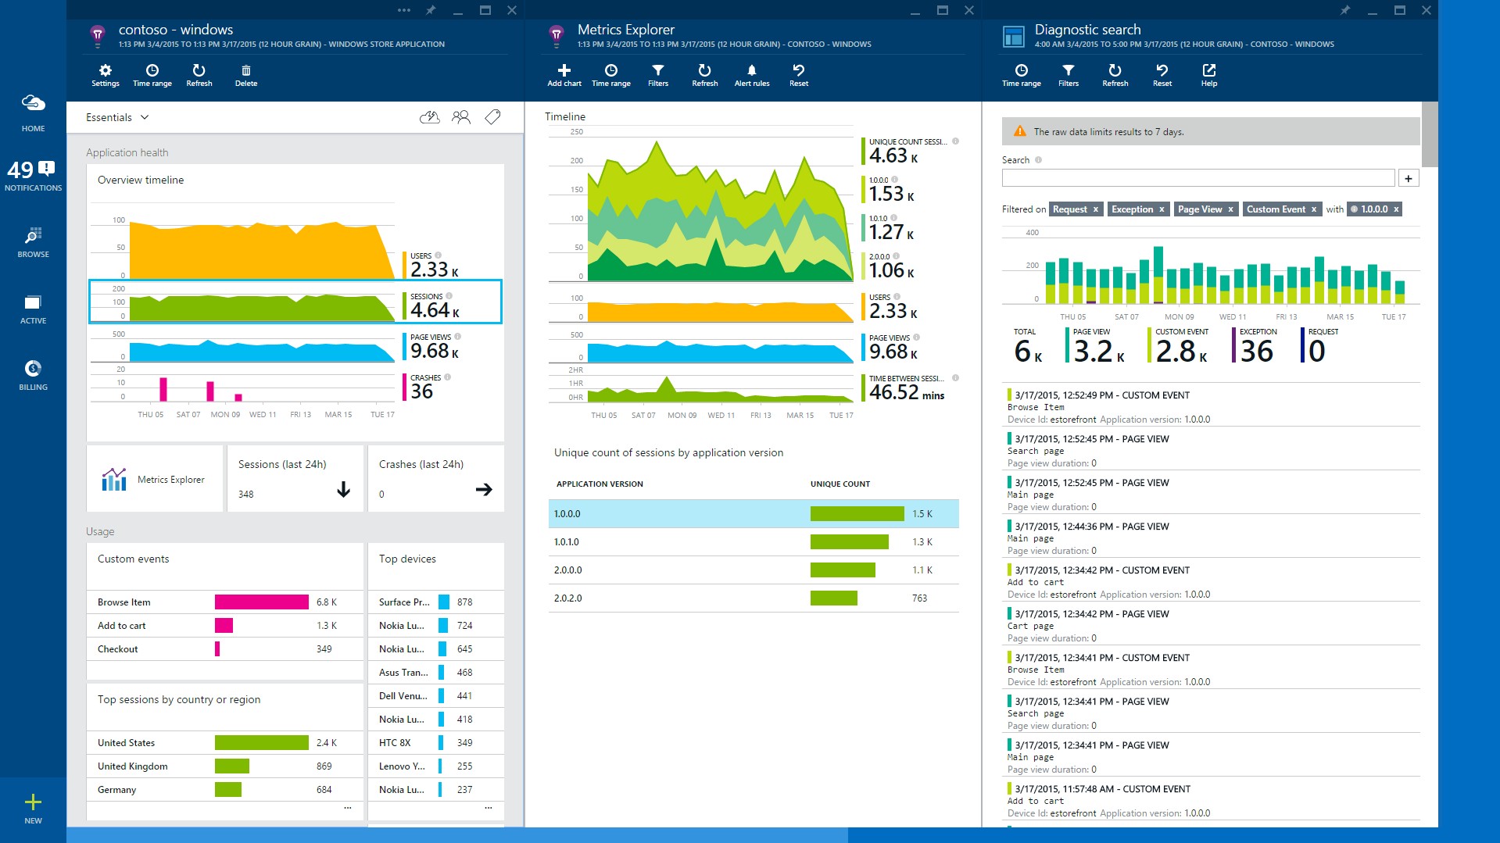

Slide 34
Izobraževanje
Dokumentacija
Blogi
Primeri
Skupnost
Certificiranja

Slide 35
Povzetek
Vidiki kakovosti
Kako uvajamo QA
MS ima rešitve za vse vidike

Slide 36
“Quality has to be caused, not controlled.”
Philip B. Crosby

Slide 37
Viri
Software Engineering Economics
Team Services Dashboards and Reports
Team Services Test
Team Services Testing Tools
Team Services Release Management
Visual Studio Improve Code Quality
Test Management
Application Insights
Log Analytics
Azure DevTest Labs
Test & Feedback Tool
Microsoft Application Lifecycle Management
Test Planning with Test Hub on Visual Studio Online

