Slide 1
The Doctor in the Machine
Anela Husković
Technical Solution Professional for Artificial Intelligence
Microsoft

Slide 2
Artificial intelligence (AI)
Artificial intelligence (AI) is an area of computer science that emphasizes the creation of intelligent machines that work and react like humans.
Artificial intelligence is designed for:
Speech recognition
Learning
Planning
Problem solving
Etc.

Slide 3
AI in health industry
Digital assistants
  Helping doctors with administration
  Peronalized healthcare
Robotics
Diagnostics and treatments
Notes:
Sve se predviđa, od toga gdje je šta u dućanu, do waste managementa, do nečeg trećeg. Sve na temelju collective experienca.
Zašto onda ne bi to koristili i za plemenite svrhe kao št je poboljšanje zdravstvenih usluga, zdravlja općenito, te metoda lječenja

Slide 4
Most common causes of death in the world
Heart disease
Cerebrovascular diseases
Lower respiratory infections (e.g. pneumonia)
HIV/AIDS
Chronic obstructive pulmonary disease
Notes:
Od 10 najcescih uzroka smrti tolko ih je preventabilno, a ti i ti su u porastu. Najcesci je bolest srca
3rd cause of death is preventable
In Microsoft we are doing many projects...

Slide 5
Project HANOVER
Machine reading:
    developing NLP technology for converting text into structured databases, which enables us to build genome-scale knowledge bases by automatically reading millions of biomedical articles.
Cancer decision support:
    collaborating with the Knight Cancer Institute to develop AI technology for cancer precision treatment, with current focus on developing a machine learning approach to personalize drug combinations for Acute Myeloid Leukemia (AML), where treatment hasn't improved in the past three decades.
    https://www.youtube.com/watch?v=ol2OsW3EEn4
Chronic disease management
    long-term goal is to develop AI technology for predictive and preventive personalized medicine to combat the soaring cost in caring for cancer and other chronic diseases, which accounts for nearly 90% of the U.S. healthcare spending.

Slide 6
Project Inner Eye
Machine learning techniques for the automatic delineation of tumors as well as healthy anatomy in 3D radiological images.
This enables:
extraction of targeted radiomics measurements for quantitative radiology
fast radiotherapy planning
precise surgery planning and navigation. In practice, Project InnerEye turns multi- dimensional radiological images into measuring devices.
http://www.youtube.com/watch?v=jaFTXi56bFI&t=3m46s (3:46-5:00)

Slide 7
Demo
Speaker name

Slide 8
Heart Disease Prediction
The data was collected from several locations (Cleveland Clinic Foundation, Hungarian Institute of Cardiology, V.A. Medical Center, University Hospital Zurich).
Training data set used in this experiment consist of the following features:
age, sex, chestpaintype, resting_blood_pressure, serum_cholestrol, fasting_blood_sugar, resting_ecg, max_heart_rate, exercise_induced_angina, st_depression_induced_by_exercise, slope_of_peak_exercise, number_of_major_vessel , thal (results from a thallium heart scan)
Goal is to detect whether the patient has heart disease

Slide 9
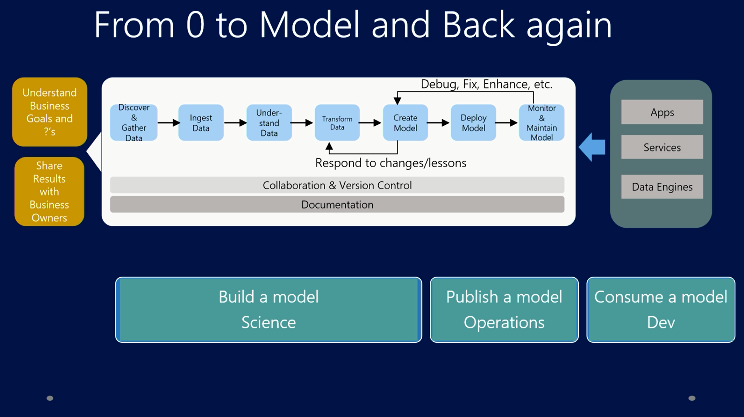
Notes:
9

Slide 10
Epilepsy Care Alliance
  The Epilepsy Care Alliance have harnessed machine learning powered by Microsoft Azure to track patients’ daily activities and detect when they are experiencing a seizure.
  Using Microsoft Band, in conjunction with software on the patient’s mobile phone
  The Alliance are rolling this programme out across Dorset and hope to help around 2,000 patients in the County to manage their condition more effectively and help them to lead fuller lives.
  https://www.youtube.com/watch?time_continue=209&v=9LCnAZWzQhU

Slide 11
THANKS FOR YOUR ATTENTION!
QnA?
Anela.huskovic@microsoft.com

