Slide 1
Klasifikacija in skrb za vsebino dokumenta namesto nas?
Tadej Bajc, ADD d.o.o.
Andrej Feldin, CETIS d.d.

Slide 2
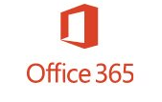


Microsoft 365
Transform your workplace with a complete, intelligent solution bringing together Office 365, Windows 10 and Enterprise Mobility + Security.

Slide 3
Identity synchronization
Azure AD Connect
Integrating your on-premises directories with Azure AD makes your users more productive by providing a common identity for accessing both cloud and on-premises resources.
Pass-through authentication
Pass-through authentication is one of the Azure authentication methods that allows for users to use a single set of credentials to access both on-premises resources, and resources in the cloud such as Office 365, or other SaaS applications

Slide 4
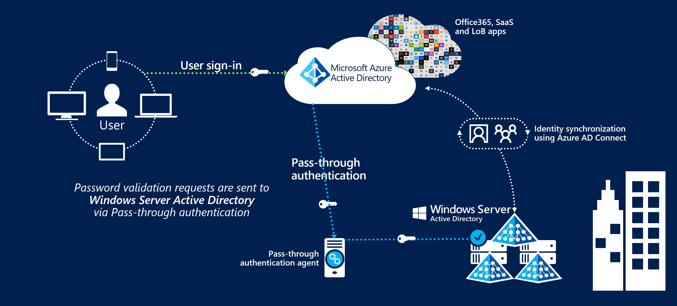
Pass-through authentication

Slide 5
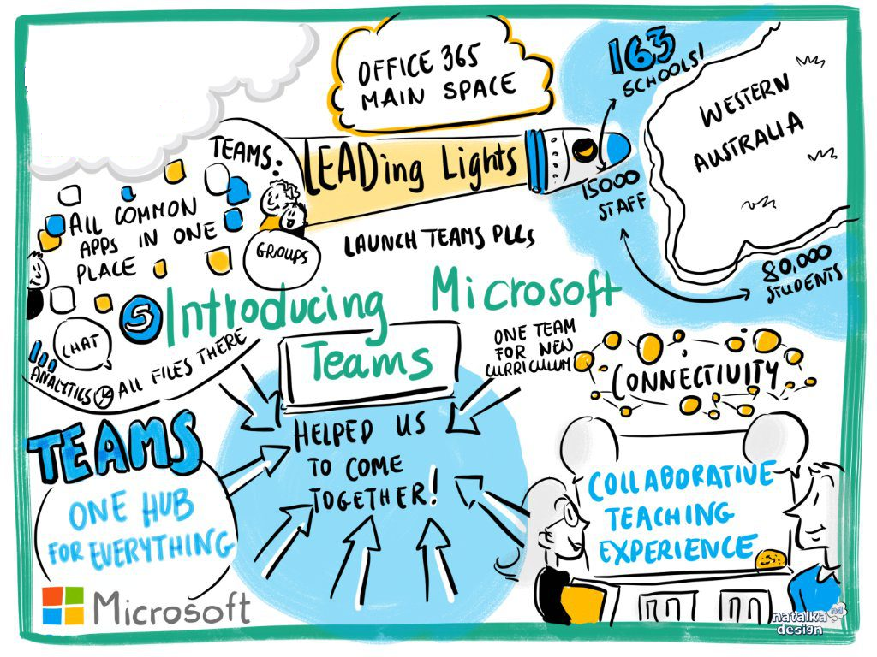
Communication
Email usage
Instant message
Data usage
SharePoint
One Drive For Business
Windows File Server

Slide 6

Protection
O365 Advanced Threat Protection
Data Loss Prevention
Azure Information Protection
Mobile Device Management (Intune)

Slide 7
O365 Advanced Threat Protection
Safe Attachment
Anti-phishing policies
Safe Links
Attack Simulator
Automated investigation and response capabilities
Real time report

Slide 8
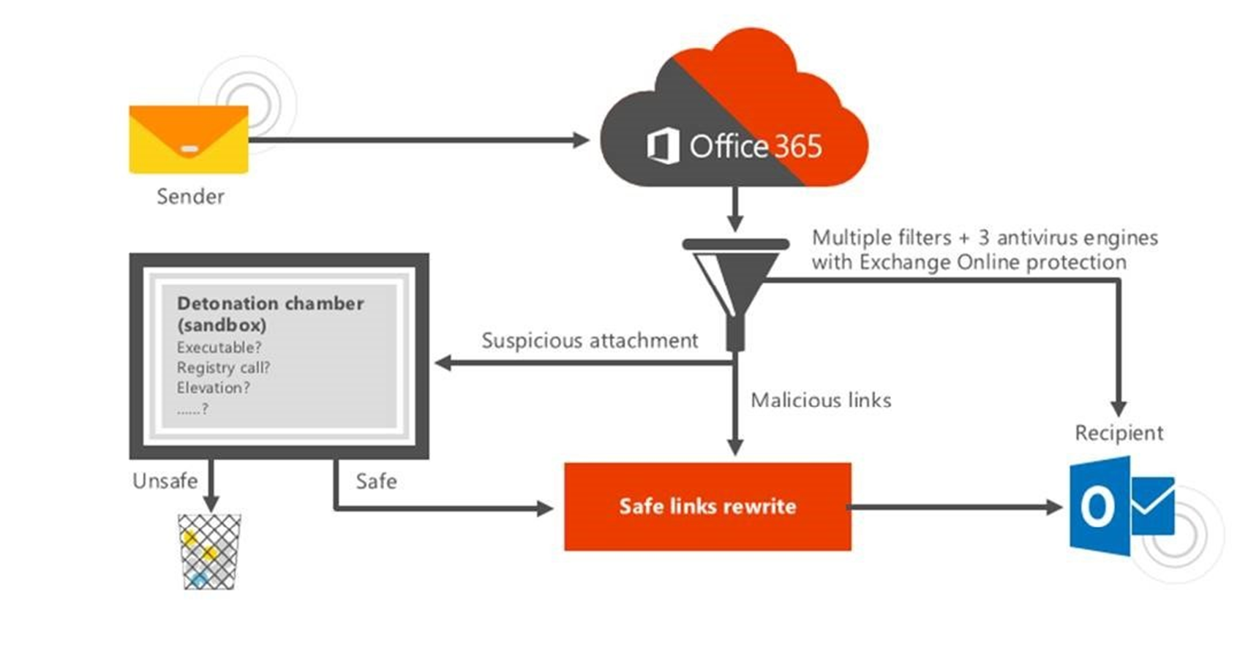
O365 Advanced Threat Protection

Slide 9
Data Loss Prevention
Identify sensitive information across many locations
Prevent the accidental sharing of sensitive information
Monitor and protect sensitive information
Help users learn
View DLP reports

Slide 10


Slide 11





Azure Information Protection
Azure Information Protection (AIP) is a cloud-based solution that helps an organization to classify and optionally, protect its documents and emails by applying labels.

Slide 12
Classify your data based on sensitivity
Data's level of sensitivity is often classified based on varying levels of importance or confidentiality, which then correlates to the security measures put in place to protect each classification level. Content-based classification inspects and interprets files looking for sensitive information.

Slide 13
Protect your data at all times
Protect data in cold, transited state or on destination site – ensuring it remains protected regardless of where it’s stored or who it’s shared with.

Slide 14
Add visibility and control
I know when you open my document, and I can limit or revoke the access! Administrators can use powerful logging and reporting to monitor, analyze and reason over data.

Slide 15
Collaborate more securely with others
All shared data can be securely shared with or with out user interaction. Define who can access data, what they can do with it.

Slide 16
Deployment and management flexibility
Protect your data whether it’s stored in the cloud or in on-prem infrastructure. Flexibility to choose how your encryption keys are managed; Azure key store, HYOK or BYOK options.

Slide 17
AIP Implementation Approach
Setting up Azure Information Protection is a phased approach in an organization to identify sensitive information and define security and controls on data.
Discover Sensitive Data
This first step to protect your data is to have a better understanding of your data and where the data is stored. Configure rules to discover sensitive data.
Classify and Label data
Data can be classified based on content, context, and source, either automatically based on defined policies or manually by users.
Protect and Control Data
Documents can be encrypted. Authentication requirements and definitions of use rights can be added to data. Users can track activities on shared files and revoke access in cases of unexpected activity.
Monitor and Remediate Data
Gain visibility to data and apply controls to protect your data across the organization.

Slide 19

Licensing

Slide 20
Microsoft 365
A complete, intelligent solution, including Office 365, Windows 10, and Enterprise Mobility + Security, that empowers everyone to be creative and work together, securely.
Microsoft 365 Enterprise
Includes Office 365 Enterprise, Windows 10 Enterprise, and Enterprise Mobility + Security and is offered in two plans - Microsoft 365 E3 and Microsoft 365 E5. Both plans provide customers with a comprehensive set of productivity and security capabilities, while Microsoft 365 E5 provides the latest and most advanced innovations in security, compliance, analytics and collaboration.
Microsoft 365 Business
Is an integrated solution that brings together the best-in-class productivity tools, security and device management capabilities for small to medium-sized businesses. Microsoft 365 Business is designed for customers that are ready to move to cloud-based productivity and collaboration and are interested in maintaining a proactive stance to help protect data on both company and employee-owned devices.
Microsoft 365 Education
Includes Office 365, Windows 10, Enterprise Mobility + Security, and Minecraft: Education Edition to empower educators to unlock creativity, promote teamwork, and provide a simple and safe experience in a single, affordable solution built for education.

Slide 21
Azure Information Protection for Office 365
Microsoft Azure Information Protection is included in the Office 365 Enterprise E3 and above plans.
Azure Information Protection Premium P1
Provides additional rights to use the on-premises connectors, track and revoke shared documents, and enable users to manually classify and label documents.
Note: Also part of Microsoft Enterprise Mobility + Security E3, Microsoft 365 E3 and Microsoft 365 Business..
Azure Information Protection Premium P2
Builds on Azure Information Protection Premium P1 with automated and recommended classification, labeling, and protection, with policy-based rules and Hold Your Own Key (HYOK) configurations that span Azure Rights Management and Active Directory Rights Management..
Note: Also part of Enterprise Mobility + Security E5 and Microsoft 365 E5.

Slide 22
Azure Information Protection for Office 365
Microsoft Azure Information Protection is included in the Office 365 Enterprise E3 and above plans.
Azure Information Protection Premium P1
Provides additional rights to use the on-premises connectors, track and revoke shared documents, and enable users to manually classify and label documents.
Note: Also part of Microsoft Enterprise Mobility + Security E3, Microsoft 365 E3 and Microsoft 365 Business..
Azure Information Protection Premium P2
Builds on Azure Information Protection Premium P1 with automated and recommended classification, labeling, and protection, with policy-based rules and Hold Your Own Key (HYOK) configurations that span Azure Rights Management and Active Directory Rights Management..
Note: Also part of Enterprise Mobility + Security E5 and Microsoft 365 E5.

Slide 23
ADD poslovni zajtrki
24/05/2019 - Connected Intelligence
Microsoft & ADD & Iconics – rešitve za avtomatizacijo procesov (AI, IoT, BI).
29/05/2019 - Netwrix
Auditing sistema.
04/06/2019 - Modern Azure Analytical Platform
Celovita analitična platforma v oblaku.
12/06/2019 - Pyramid Analyitics 2018
Pyramid Analytics je celovit analitični operacijski sistem (Analytical OS).
19/06/2019 - Cloudera – from EDGE to AI
Big data platforma za analitiko ogromnih količin podatkov, napredno analitiko, ...
04/07/2019 - Kepion
Podpora za poslovne procese planiranja, napovedovanja ter izdelavo proračuna.
Vsi ADD dogodki so brezplačni (dodatne informacije na www.add.si).

Slide 24
Questions

