Slide 2
Operations Management Suite (OMS) v 60 min
Andrej Kašnik, Microsoft
Robert Potočnik, Microsoft

Slide 3
Agenda
Pregled paketa OMS
Rešitev Log Analytics
Implementacija
Zmožnosti skozi demo

Slide 4
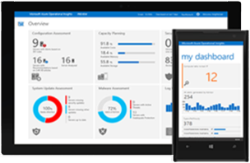
Operations Management and Security
Insight & Analytics
Gain visibility across workloads
Automation & Control
Enable consistent control and compliance
Security & Compliance
Respond faster to security threats
On-premises datacenter
Public and hosted clouds
Azure or AWS
Protection & Recovery
Ensure availability of apps and data

Slide 5


Fast troubleshoot and auto remediate
Simple and unified experience
Gain immediate insight

Slide 6



Simple and unified experience
Challenges
Individual
monitoring
Platform and
Application
monitoring tool
Network
monitoring tool
Individual
monitoring
Security
analysis tool
Individual
monitoring
On premises datacenter
Application data
Platform data
Network data
Security data
Individual
monitoring
Hosters

Slide 7
Simple and unified experience
Solution
Individual
monitoring
Platform and
Application
monitoring
Platform and
Application
monitoring tool
IT Operational excellence
Network
monitoring tool
Individual
monitoring
Security
analysis tool
Security
analysis
Network
monitoring
Individual
monitoring
Application data
Platform data
Network data
Security data
Individual
monitoring
Hosters
Notes:
Problem: Challenging to gain a unified experience as an IT admin due to multiple tools for different clouds and platforms, residing in distributed locations and services.
Solution: Single pane of control to gain insight across multiple different sources and solutions.

Slide 8

UNIFIED EXPERIENCE
COLLECT AND INDEX DATA
SEARCH AND INVESTIGATE
CORRELATE AND ANALYZE
VISUALIZE AND REPORT
MONITOR AND ALERT
Single platform for overall management
Single pane of control for log analytics, automation, back up, site recovery and security
Unified experience to manage your resources in public, private cloud as well as traditional datacenters

Slide 9





UNIFIED EXPERIENCE
COLLECT AND INDEX DATA
SEARCH AND INVESTIGATE
CORRELATE AND ANALYZE
VISUALIZE AND REPORT
MONITOR AND ALERT
Windows agents
Log Analytics
Automation
Site Recovery
Backup
SCOM
Linux / FluentD
Operations Management Suite
REST Collection API
Sample list of log/metrics that OMS collects:
Custom Application/Infra logs
Windows event logs
Window performance counters
Security Event Logs
IIS Logs
ETW logs
Azure Diagnostics
SaaS services
O365
Azure Storage /
Azure Diagnostics
Event Hub
Log Stash

Slide 10
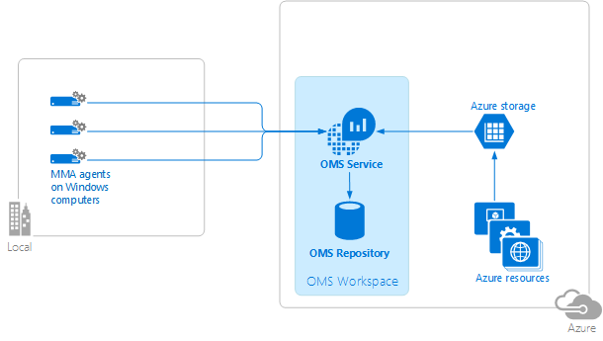
UNIFIED EXPERIENCE
COLLECT AND INDEX DATA
SEARCH AND INVESTIGATE
CORRELATE AND ANALYZE
VISUALIZE AND REPORT
MONITOR AND ALERT
Windows agents
Operations Management Suite
Connect to Windows computers in your on-premises infrastructure directly to OMS workspaces by using a customized version of the Microsoft Monitoring Agent (MMA).
https://azure.microsoft.com/en-us/documentation/articles/log-analytics-windows-agents/

Slide 11
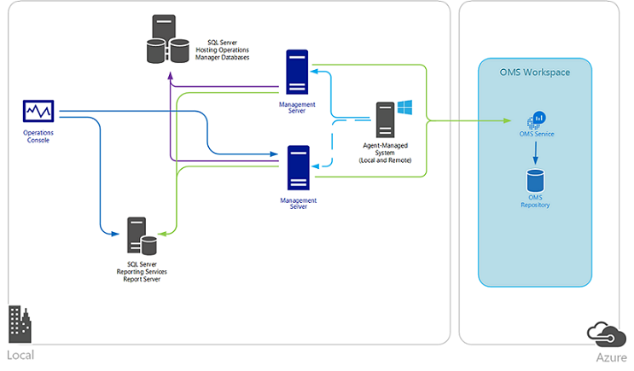
UNIFIED EXPERIENCE
COLLECT AND INDEX DATA
SEARCH AND INVESTIGATE
CORRELATE AND ANALYZE
VISUALIZE AND REPORT
MONITOR AND ALERT
SCOM
SCOM
Operations Management Suite
Integrate Operations Manager with your OMS workspace to:
Continue monitoring the health of your IT services with Operations Manager
Maintain integration with your ITSM solutions supporting incident and problem management
Manage the lifecycle of agents deployed to on-premises and public cloud IaaS virtual machines that you monitor with Operations Manager

Slide 12
UNIFIED EXPERIENCE
COLLECT AND INDEX DATA
SEARCH AND INVESTIGATE
CORRELATE AND ANALYZE
VISUALIZE AND REPORT
MONITOR AND ALERT
Linux / FluentD
Operations Management Suite
Collect and act on data generated from Linux computers. Adding data collected from Linux to OMS allows you to manage Linux systems and container solutions like Docker regardless of where your computers are located—virtually anywhere.
Upload data (HTTPS)
omsagent (FluentD)
syslog
OMS Service
Firewall/proxy
OMI Server
(CIM Server)
Nagios
Operating System
Providers
Apache
Zabbix
MySQL
Containers
Docker
omsconfig (DSC)
Pull configuration
(https)
PS DSC
Linux Computer

Slide 13







UNIFIED EXPERIENCE
COLLECT AND INDEX DATA
SEARCH AND INVESTIGATE
CORRELATE AND ANALYZE
VISUALIZE AND REPORT
MONITOR AND ALERT
Linux / FluentD
Operations Management Suite
Supported Linux platform
6.x 32/64-bit
7.x 32/64-bit
8.x 32/64-bit
5.x 32/64-bit
6.x 32/64-bit
7.x 64-bit
5.x 32/64-bit
6.x 32/64-bit
7.x 64-bit
2013.09 – 2015.09
12.x 32/64-bit
14.x 32/64-bit
15.x 32/64-bit
16.x 32/64-bit
alpha
beta
stable
10.x 32/64-bit
11.x 32/64-bit
12.x 64-bit
5.x 32/64-bit
6.x 32/64-bit
7.x 64-bit

Slide 14
UNIFIED EXPERIENCE
COLLECT AND INDEX DATA
SEARCH AND INVESTIGATE
CORRELATE AND ANALYZE
VISUALIZE AND REPORT
MONITOR AND ALERT
REST Collection API
Operations Management Suite
Leverage REST collection API to ingest custom data to Operations Management Suite
Post json document to HTTPS endpoint
  Ensure json is flattened and not nested
$json = @"
[{ "slot_ID“ : 12345,
"ID“ : "5cdad72f-c848-4df0-8aaa-ffe033e75d57",
"availability_Value": 100,
"measurement_Name“ : "last_one_hour",
"duration“ : 3600,
"ExecutionTime“ : "2016-05-12T20:00:00.625Z"
},
{ … }]
"@
Authenticated using workspace key to hash content
API
Log Search API Create, manage and run searches Alert API Create and manage alerts
Powershell
Log Analytics cmdlets Nouns ComputerGroup IntelligencePacks (solutions) LinkTargets SavedSearch SavedSearchResults StorageInsights Workspace WorkspaceManagementGroups WorkspaceSharedKeys WorkspaceUsage
Notes:
OMS Linux agent (Syslog using fluentd and collectd)
https://blogs.technet.microsoft.com/msoms/2016/05/12/syslog-collection-in-operations-management-suite/
Use collectd to bring metrics into OMS Log Analytics
https://blogs.technet.microsoft.com/msoms/2016/07/14/bring-your-custom-collectd-metrics-into-the-oms-log-analytics-platform/
Linux and Docker management
https://blogs.technet.microsoft.com/momteam/2015/11/03/announcing-linux-docker-container-management-with-oms/
Monitor VMWare using OMS Log Analytics (custom logs)
https://blogs.technet.microsoft.com/msoms/2016/06/15/monitor-vmware-using-oms-log-analytics/
HTTP Ingestion API
Documentation
https://onedrive.live.com/redir?resid=E6DDF48D2F1DA0EB!7047&authkey=!AEjZIm-nLuLvzgU&ithint=folder%2cdocx
Use your favorite language
Client-side bindings for c#, .NET, node js, Powershell, python
Custom data into OMS Log Analytics
https://blogs.technet.microsoft.com/msoms/2016/07/21/bring-your-custom-json-data-to-log-analytics-oms-with-twitter-data-example/

Slide 15
UNIFIED EXPERIENCE
COLLECT AND INDEX DATA
SEARCH AND INVESTIGATE
CORRELATE AND ANALYZE
VISUALIZE AND REPORT
MONITOR AND ALERT
Leverage existing management platform
Do not rip and replace by leveraging your management platform such as System Center, Zabbix or Nagios
Operations Management Suite Gateway to connect with isolated environment

Slide 16
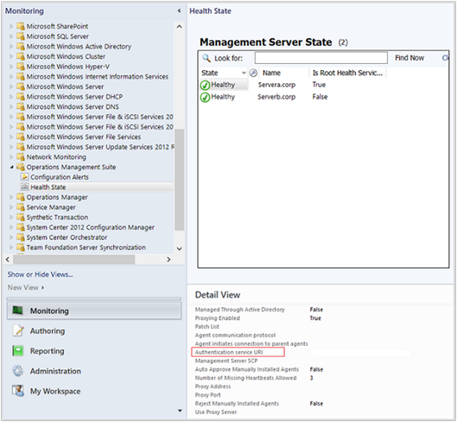
UNIFIED EXPERIENCE
COLLECT AND INDEX DATA
SEARCH AND INVESTIGATE
CORRELATE AND ANALYZE
VISUALIZE AND REPORT
MONITOR AND ALERT
Collect alerts from Operations Manager
To collect alerts from Operations Manager, you will need to
On the Operations Management Suite Onboarding Wizard: associate with your OMS subscription
If you have more than one workspace, select the workspace you want to register with the Operations Manager management group from the drop-down list, and then click Next.
https://azure.microsoft.com/en-us/documentation/articles/log-analytics-om-agents/

Slide 17
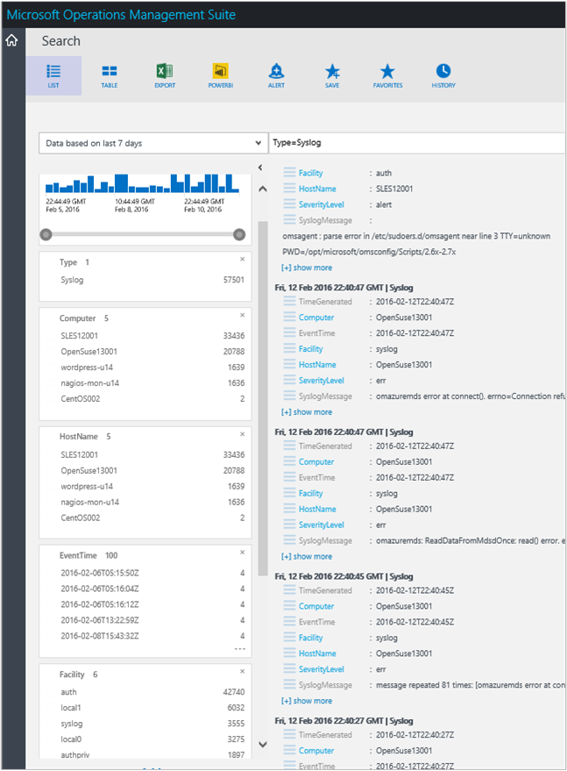
UNIFIED EXPERIENCE
COLLECT AND INDEX DATA
SEARCH AND INVESTIGATE
CORRELATE AND ANALYZE
VISUALIZE AND REPORT
MONITOR AND ALERT
Collect alerts from Nagios and Zabbix
To collect alerts from Nagios and Zabbix, you will need to
Grant the user omsagent read access to the Nagios log file
Modify the omsagent.confconfiguration file (/etc/opt/microsoft/omsagent/conf/omsagent.conf).
Restart the omsagent daemon
https://azure.microsoft.com/en-us/documentation/articles/log-analytics-linux-agents/

Slide 18
UNIFIED EXPERIENCE
COLLECT AND INDEX DATA
SEARCH AND INVESTIGATE
CORRELATE AND ANALYZE
VISUALIZE AND REPORT
MONITOR AND ALERT
Access anywhere with a consistent user experience
Control from anywhere with iOS, Android and Windows Phone.
Consistent user interface across Operations Management Suite and Azure services

Slide 19
Fast troubleshoot and auto remediate
Simple and unified experience
Gain immediate insight

Slide 20
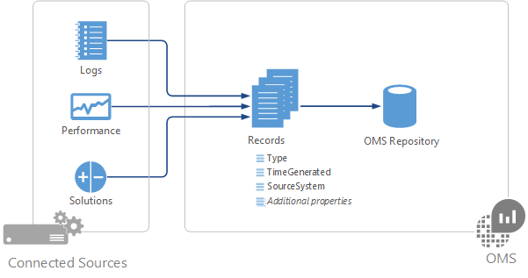
UNIFIED EXPERIENCE
COLLECT AND INDEX DATA
SEARCH AND INVESTIGATE
CORRELATE AND ANALYZE
VISUALIZE AND REPORT
MONITOR AND ALERT
Automatic data selection and collection
Log Analytics collects data from the Connected Sources in your OMS workspace and stores it in OMS repository. The data that is collected from each is defined by the Data Sources that you configure. Data in the OMS repository is stored as a set of records. Each data source creates records of a particular type with each type having its own set of properties
https://azure.microsoft.com/en-us/documentation/articles/log-analytics-data-sources/

Slide 21
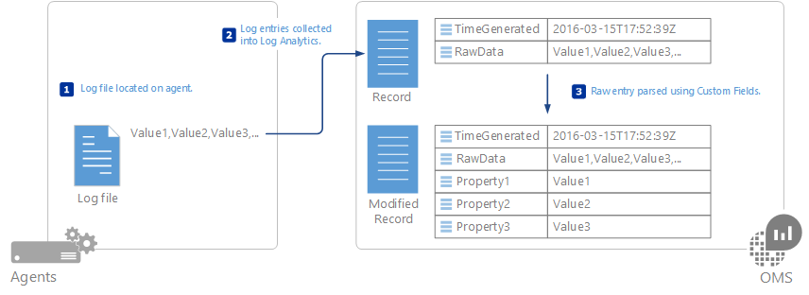
UNIFIED EXPERIENCE
COLLECT AND INDEX DATA
SEARCH AND INVESTIGATE
CORRELATE AND ANALYZE
VISUALIZE AND REPORT
MONITOR AND ALERT
Custom log collection
Logs data source in Log Analytics allows you to collect events from text files on both Windows and Linux computers. Many applications log information to text files instead of standard logging services such as Windows Event log or Syslog. Once collected, you can parse each record in the log into individual fields using the Custom Fields feature of Log Analytics.
https://azure.microsoft.com/en-us/documentation/articles/log-analytics-data-sources-custom-logs/

Slide 22
UNIFIED EXPERIENCE
COLLECT AND INDEX DATA
SEARCH AND INVESTIGATE
CORRELATE AND ANALYZE
VISUALIZE AND REPORT
MONITOR AND ALERT
Experienced sources of insight
Single source of truth, gathering data from public cloud, private cloud, traditional datacenters
Correlate and analyze through Knowledge obtained by the trusted source such as product team, support team, MSIT, Digital Crime Unit

Slide 23
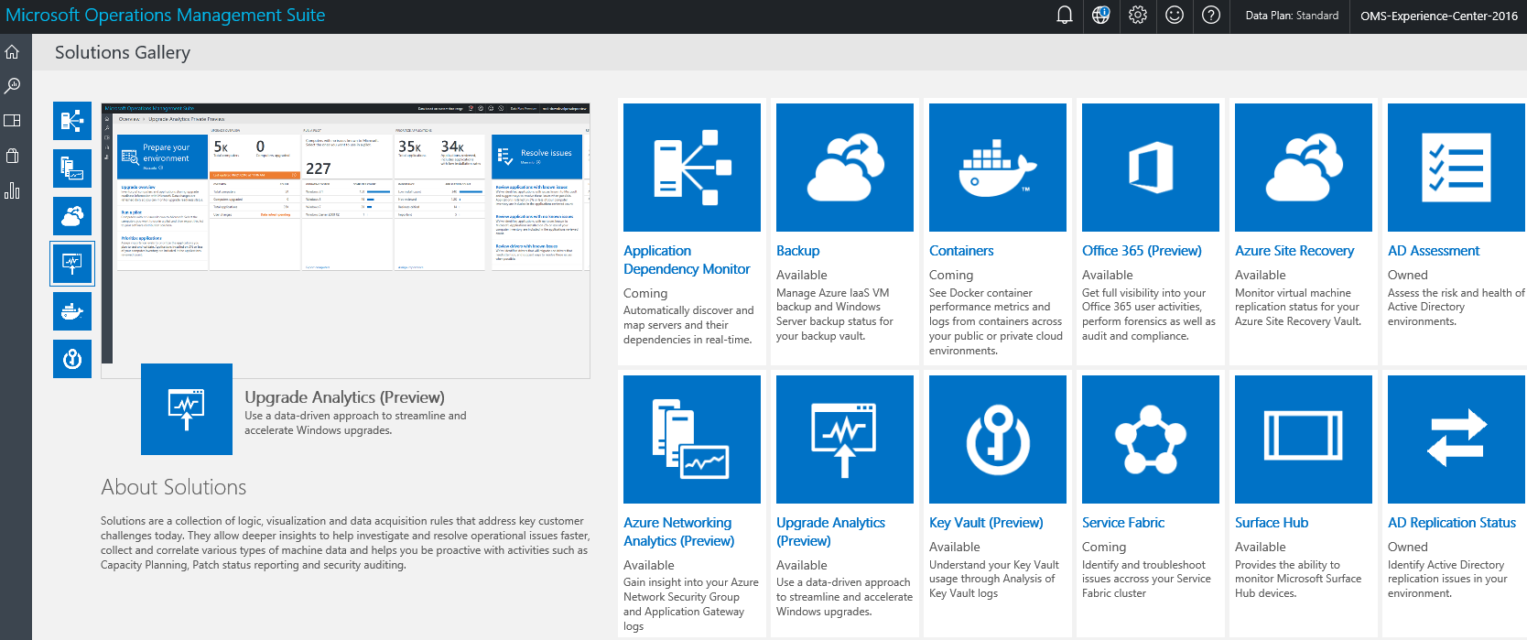
UNIFIED EXPERIENCE
COLLECT AND INDEX DATA
SEARCH AND INVESTIGATE
CORRELATE AND ANALYZE
VISUALIZE AND REPORT
MONITOR AND ALERT
Solutions
Log Analytics solutions are a collection of logic, visualization and data acquisition rules that provide metrics pivoted around a particular problem area.
https://azure.microsoft.com/en-us/documentation/articles/log-analytics-add-solutions/

Slide 24
Solutions demo
AD, SQL Assessment
Security & Audit
Service Map
Change tracking
Network Performance Monitor

Slide 25
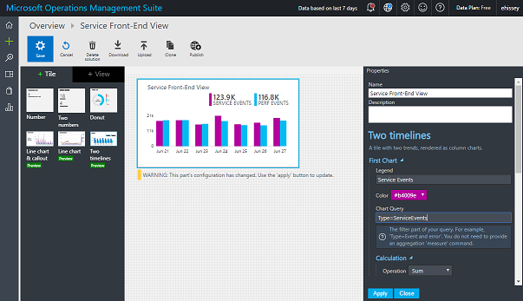
UNIFIED EXPERIENCE
COLLECT AND INDEX DATA
SEARCH AND INVESTIGATE
CORRELATE AND ANALYZE
VISUALIZE AND REPORT
MONITOR AND ALERT
View designer
Create visual tiles based on searches
Assemble tiles on a dashboard
View Designer editing Overview Tile to show custom service’s front-end custom events and performance data
Notes:
Visualize your data your way
https://blogs.technet.microsoft.com/msoms/2016/06/30/oms-view-designer-visualize-your-data-your-way/
Use OMS View Designer for SQL Server monitoring
https://blogs.technet.microsoft.com/msoms/2016/07/22/use-oms-view-designer-for-sql-server-monitoring/
Customize your metrics chart visualization in OMS
https://blogs.technet.microsoft.com/msoms/2016/07/25/customize-your-metrics-chart-visualization-in-oms/

Slide 26
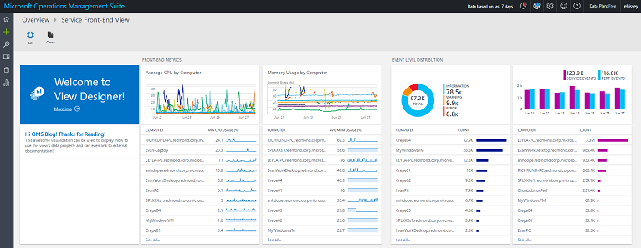
UNIFIED EXPERIENCE
COLLECT AND INDEX DATA
SEARCH AND INVESTIGATE
CORRELATE AND ANALYZE
VISUALIZE AND REPORT
MONITOR AND ALERT
View designer
Create visual tiles based on searches
Assemble tiles on a dashboard
Complete with metrics visualized in line charts, distributions of event levels for my service, and the amount of data getting for both types of events. Each visualization can drill down into OMS Log search.
Notes:
Visualize your data your way
https://blogs.technet.microsoft.com/msoms/2016/06/30/oms-view-designer-visualize-your-data-your-way/
Use OMS View Designer for SQL Server monitoring
https://blogs.technet.microsoft.com/msoms/2016/07/22/use-oms-view-designer-for-sql-server-monitoring/
Customize your metrics chart visualization in OMS
https://blogs.technet.microsoft.com/msoms/2016/07/25/customize-your-metrics-chart-visualization-in-oms/

Slide 27
Automated remediation demo
Notes:
Automated shutdown every VM with outbound malicious traffic…
MaliciousIP=* AND (RemoteIPCountry=* OR MaliciousIPCountry=*) AND (((Type=WireData AND Direction=Outbound) OR (Type=WindowsFirewall AND CommunicationDirection=SEND) OR (Type=CommonSecurityLog AND CommunicationDirection=Outbound)) OR (Type=W3CIISLog OR Type=DnsEvents OR (Type = WireData AND Direction!= Outbound) OR (Type=WindowsFirewall AND CommunicationDirection!=SEND) OR (Type = CommonSecurityLog AND CommunicationDirection!= Outbound)))

Slide 28
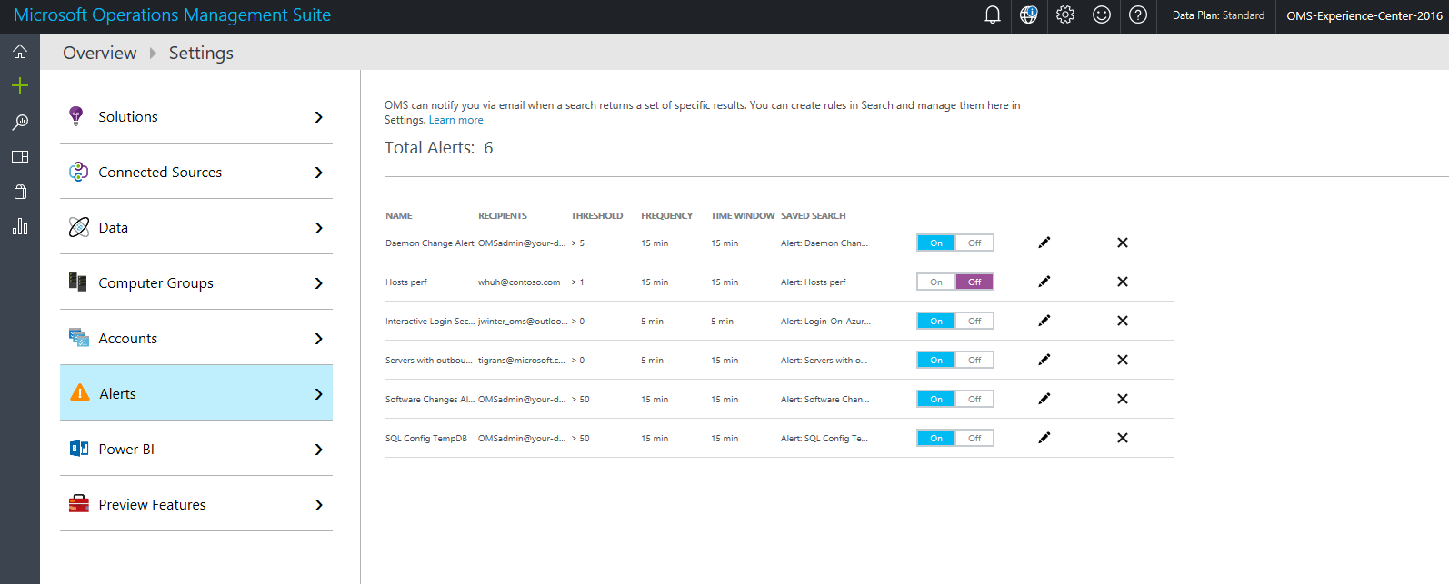
UNIFIED EXPERIENCE
COLLECT AND INDEX DATA
SEARCH AND INVESTIGATE
CORRELATE AND ANALYZE
VISUALIZE AND REPORT
MONITOR AND ALERT
Auto remediate based on alerts
Automate your task based on community gallery

Slide 29
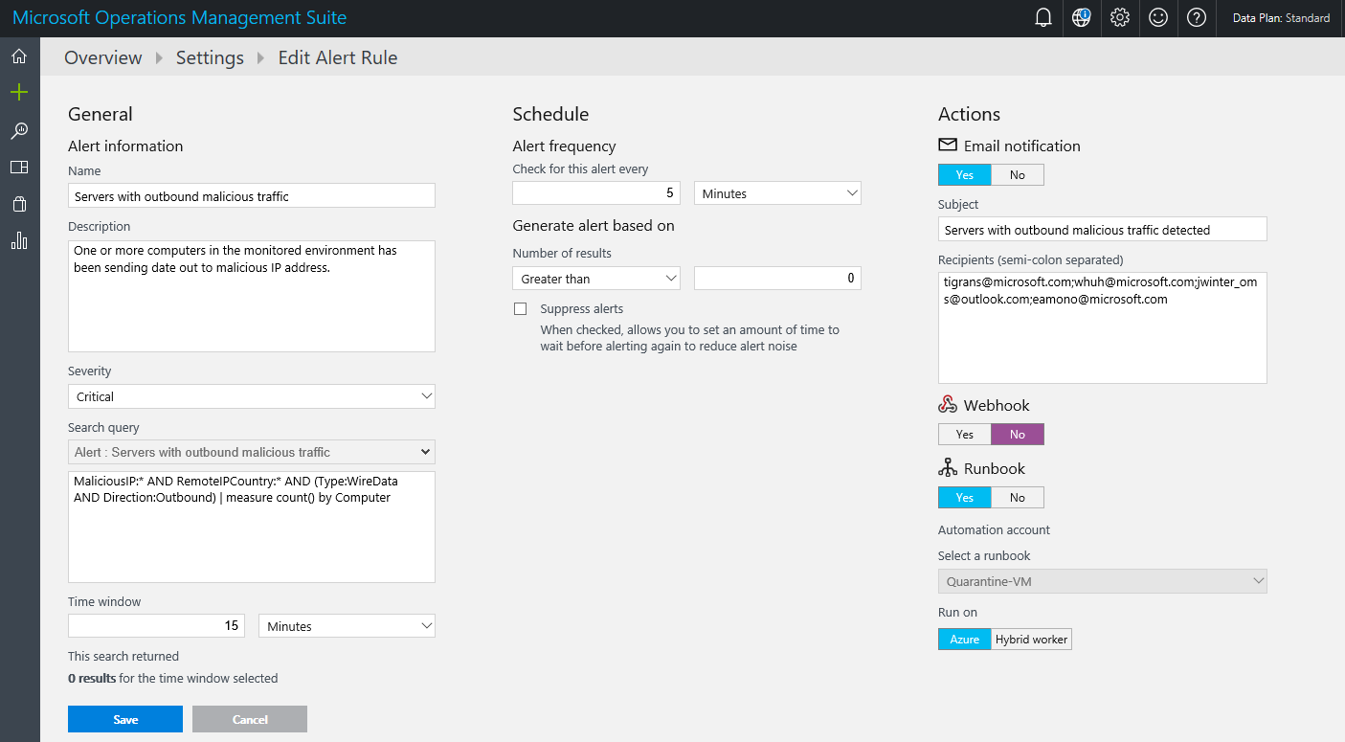
UNIFIED EXPERIENCE
COLLECT AND INDEX DATA
SEARCH AND INVESTIGATE
CORRELATE AND ANALYZE
VISUALIZE AND REPORT
MONITOR AND ALERT
Auto remediate based on alerts
Setup alert rule to trigger automated task

Slide 30
OMS Licensing Placemat
Pay-as-you-go
(Can use monetary commit)
Suites – requires annual pre-commitment
(Separate transaction from monetary commit)
Service | Price (per month)
Insight & Analytics (includes Log Analytics) | $15/ node
Automation & Control | $10/ node
Security & Compliance or Azure Security Center | $15/ node
Backup | $10/ node
Site Recovery – E2E | $16/ node
Site Recovery – E2A | $25/ node
Log Analytics | $2.3 per GB
Automation | $0.002 per min
Suite | Price (per month)
Insight & Analytics suite Insight & Analytics SCOM | $15/ node
Automation & Control suite Automation & Control SCCM & Orchestrator | $10/ node
Security & Compliance suite Azure Security Center or OMS Security & Compliance | $15/ node
Protection & Recovery suite Backup Site Recovery – E2E & E2A VMM & DPM | $30/ node
Suite | Price (per month)
OMS E1 Insight & Analytics Automation & Control All of System Center | $20/ node
OMS E2 Insight & Analytics Automation & Control Security & Compliance Backup Site Recovery – E2E & E2A All of System Center | $35/ node
Any data charges associated with Backup and Site Recovery are charged separately at regular Azure storage rates
Data ingested for all other services in OMS include 1 month of retention at no additional charge. Retention of data for longer then a month is charged at $0.10/GB/month
(All prices are monthly prices without any customer discounts)
Notes:
What is a node?
System Center is included as subscription rights

Slide 31
Related sessions
Sreda, 14:30 - OMS: Kako vam lahko oblak pomaga pri nadzoru vašega IKT sistema
Sreda, 15:45 - Customizing OMS searches and dashboards

Slide 32
Text layout (without bullet points)
Main topic 1: size 36pt
  Size 28pt for second level
    Size 24pt for third level
      Size 22pt for fourth level
        Size 22 for fifth level

Slide 33
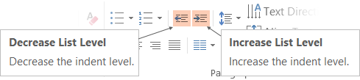
Adjusting list levels
Main topic 1: size 36pt
  Size 28pt for second level
    Size 24pt for third level
      Size 22pt for fourth level
        Size 22 for fifth level

Slide 34
Bullet points layout with subtitle
Subtitle is smaller in the same text block
Example of a bulleted slide with a subhead
  Set the slide title to “Sentence case”
  Set subheads to “Sentence case”
Hyperlink style
  www.microsoft.com

Slide 35
Photo layout 1

Slide 36
Demo
Speaker name

Slide 37
Video

Slide 38
Section title

Slide 39
Table
 | Column 1 | Column 2 | Column 3 | Column 4 | Column 5 | Column 6 | Column 7
Row 1 | 17% | 12% | 11% | 19% | 11% | 14% | 15%
Row 2 | 78% | 61% | 36% | 25% | 15% | 12% | 2%
Row 3 | 24% | 18% | 18% | 21% | 9% | 15% | 8%
Row 4 | 64% | 46% | 41% | 47% | 26% | 26% | 14%
Row 5 | 63% | 46% | 44% | 50% | 28% | 39% | 35%
Row 6 | 4% | 2% | 2% | 4% | 1% | 2% | 1%
Row 7 | 11% | 5% | 5% | 9% | 3% | 4% | 2%
Row 8 | 11% | 5% | 5% | 9% | 3% | 6% | 5%

Slide 40

Clean and modern
80 want to try it again
89 would purchase it
68 are indifferent
77 totally love it

Slide 41
Pie chart

