Slide 1
SCCM in hybrid world
Predrag Jelesijević
Microsoft

Slide 2
What is SCCM?
Microsoft System Center Configuration Manager (SCCM) is a Microsoft product that enables administrators to manage the deployment and security of devices and applications across an enterprise.
SCCM is part of the Microsoft System Center systems management suite.

Slide 3
SCCM features
Application delivery PC, Mac, UNIX/Linux management Virtual desktop management Endpoint Protection Compliance and settings management Software update management Power Management OS deployment Client health and monitoring Asset Intelligence Inventory Integration with Microsoft Intune | Windows 10 Current Branch/Current Branch for Business support Continuous support of new Windows 10 features More frequent and easier Configuration Manager updates Management of Windows 10 via on-premises MDM Unified end-user portal Ability to run Configuration Manager in Azure Virtual Machines Larger scale Windows 10 Long-Term Servicing Branch (July 2015) support

Slide 4
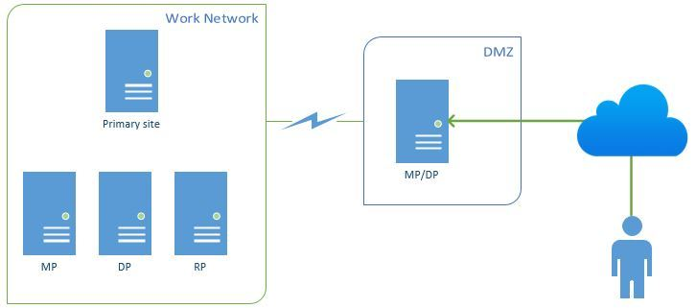
Rare to see:
Internet based clients
Working, but limited. Not supported is:
  Client deployment over the Internet - push installation
  Automatic site assignment.
  Wake-on-LAN.
  Operating system deployment. However, you can deploy task sequences that do not deploy an operating system
  Remote control.
  Software deployment to users
  Additionally, Internet-based client management does not support roaming. Roaming enables clients to always find the closest distribution points to download content.

Slide 5
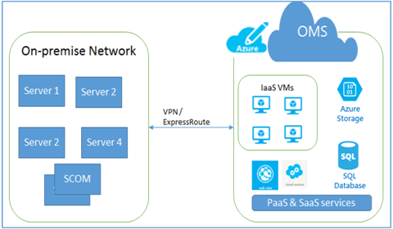
Hybrid infrastructure

Slide 6
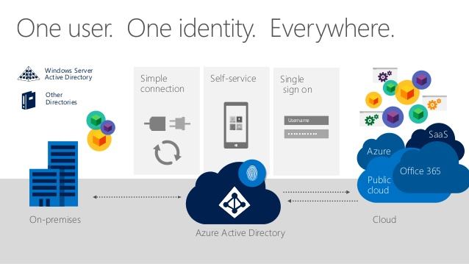
Hybrid identity

Slide 7
SCCM Cloud Services
(1706 and above)
Cloud Management: This service enables the site and clients to authenticate by using Azure AD.
OMS Connector: Connect to Operations Management Suite (OMS).
Upgrade Readiness Connector: Connect to Windows Analytics Upgrade Readiness. View client upgrade compatibility data.
Microsoft Store for Business: Connect to the Microsoft Store for Business. Get store apps for your organization that you can deploy with Configuration Manager.

Slide 8
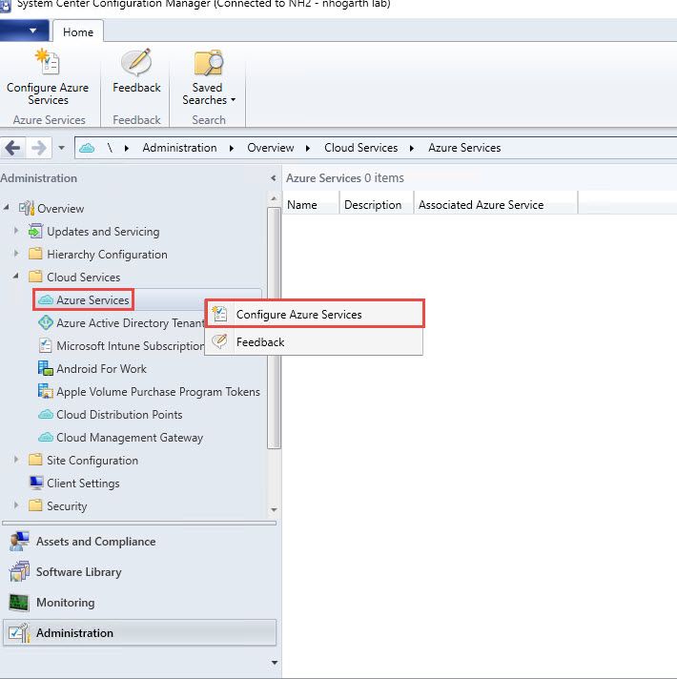
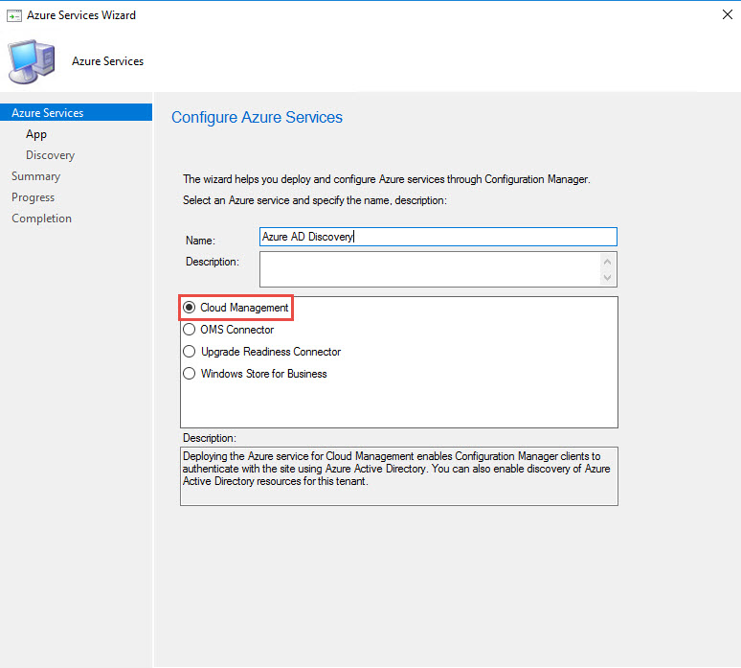
SCCM Cloud Management
Allow connection to multiple public cloud tenants
Can be deployed as WebApp or Native App – AD App
In one Azure AD we can create only one object
This is first step before deploy any other cloud services !!!!
Allow you to enable and configure discovery of AAD objects !
Install SCCM client to not AD domain joined computer without certificate !

Slide 9
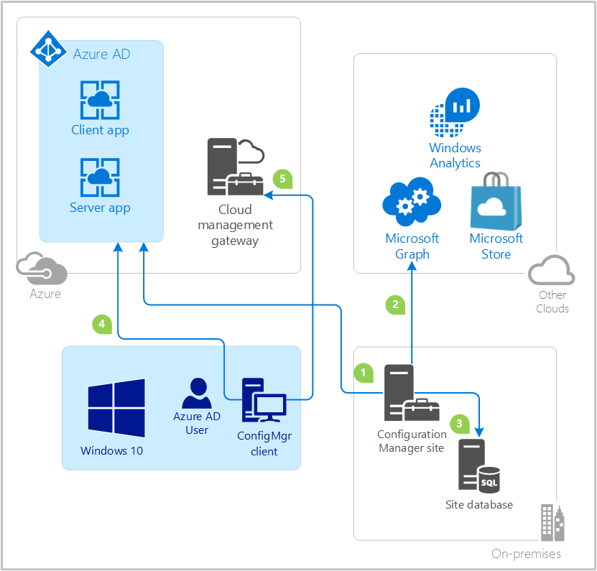
How discovery works

Slide 10
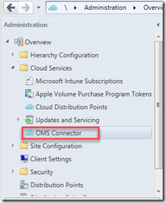
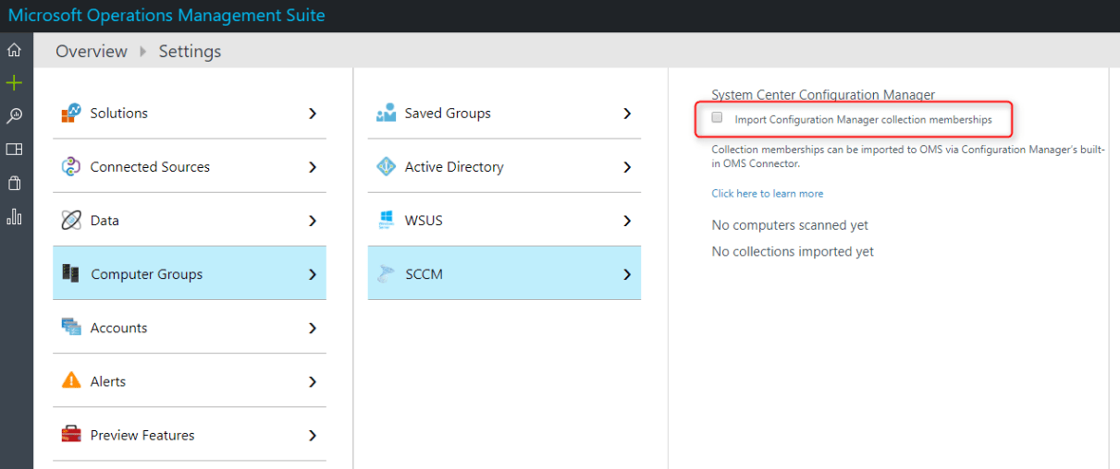
OMS Connector
(There is difference 1706vs1702)
import ConfigMgr device collections into OMS as computer groups
This makes data from the SCCM environment visible in the Operations Management Suite
Simplify update process for cloud located servers

Slide 11
Cloud-based distribution point
SCCM distribution point that is hosted in Microsoft Azure – as Service
As standard DP:
You manage cloud-based distribution points individually or as members of distribution point groups.
You can use a cloud-based distribution point as a fallback content location.
You receive support for both intranet and Internet-based clients.
Additionally:
Content that is sent to a cloud-based distribution point is encrypted by Configuration Manager before Configuration Manager sends it to Azure.
In Azure, you can manually scale the cloud service to meet changing demands for content requests by clients, without the requirement to install and provision additional distribution points.
The cloud-based distribution point supports the download of content by clients that are configured for Windows BranchCache.

Slide 12
Cloud-based distribution point
What we need to be careful about:
You cannot use a cloud-based distribution point for PXE or multicast-enabled deployments.
Clients are not offered a cloud-based distribution point as a content location for a task sequence that is deployed by using the deployment option Download content locally when needed by running task sequence. However, task sequences that are deployed by using the deployment option of Download all content locally before starting task sequence can use a cloud-based distribution point as a valid content location.
A cloud-based distribution point does not support packages that run from the distribution point. All content must be downloaded by the client and then run locally.
A cloud-based distribution point does not support streaming applications by using Application Virtualization or similar programs.
A cloud-based distribution point does not support prestaged content. The distribution manager of the primary site that manages the distribution point transfers all content to the distribution point.
A cloud-based distribution point cannot be configured as a pull-distribution point.
Software update packages supported > 1702

Slide 13
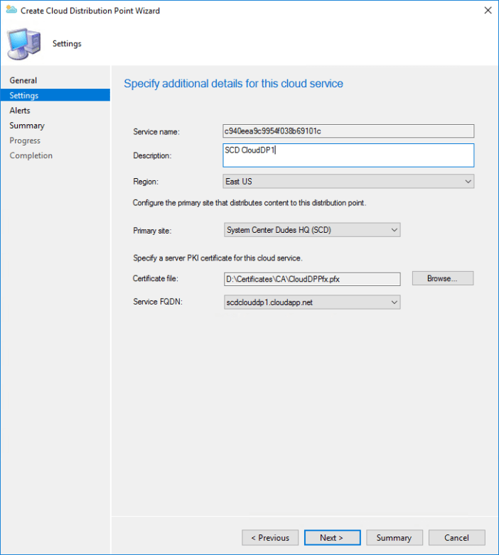
Cloud-based distribution point
How to deploy
Add management certificate
Deploy service from SCCM – wait 30 min
Configure DNS resolution
Activate using Client Settings

Slide 14
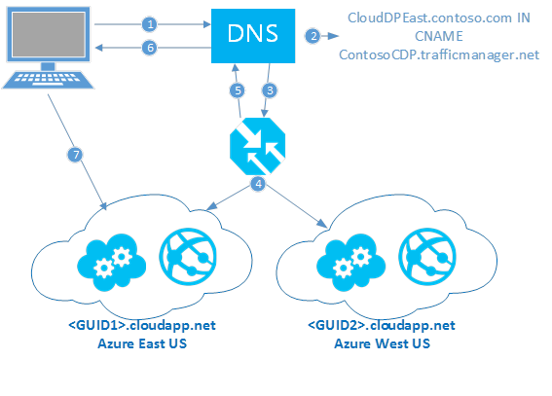
Cloud-based distribution point
Example - Behind traffic manager

Slide 15
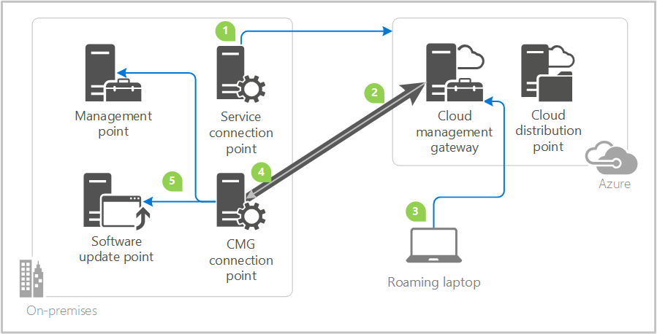
Cloud Management Gateway
Starting from 1610 in prerelease – 1802 release

Slide 16
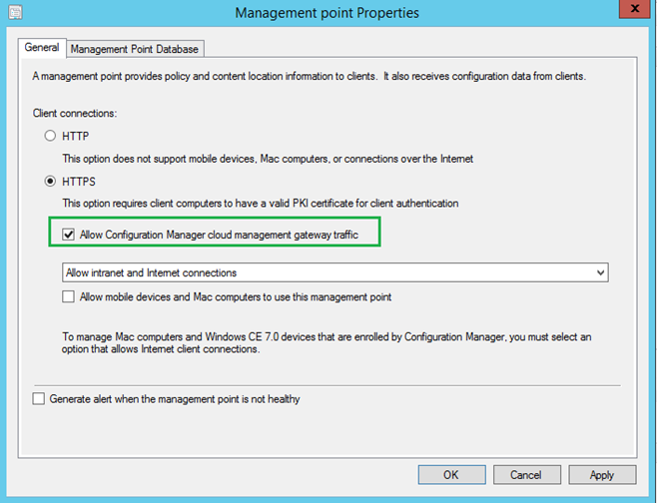
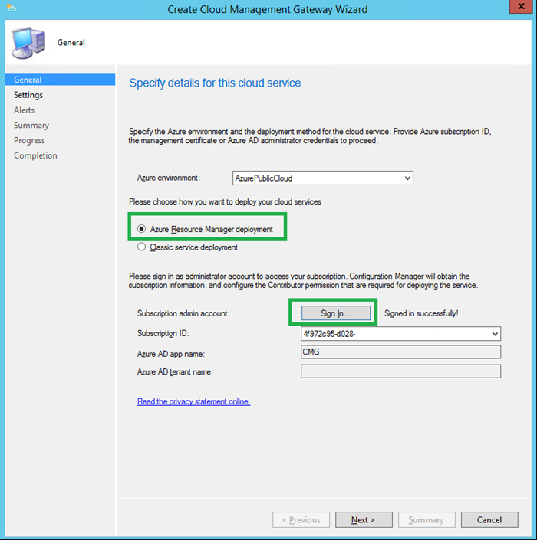
Cloud Management Gateway
How to deploy
The client machines will receive CMG connection info which can be verified by the following registry key – HKEY_LOCAL_MACHINE\SOFTWARE\Microsoft\SMS\Client\Internet Facing

Slide 17
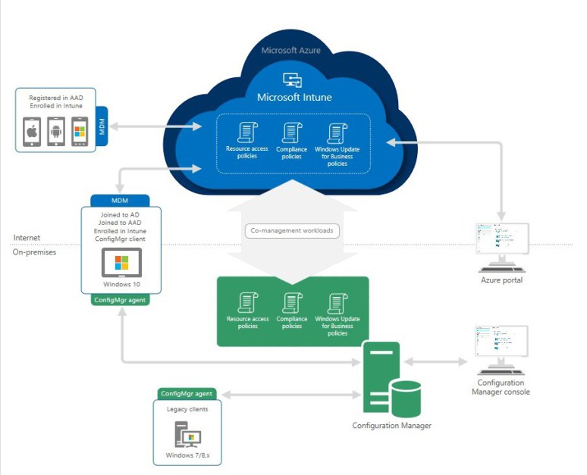
SCCM & Intune

Slide 18
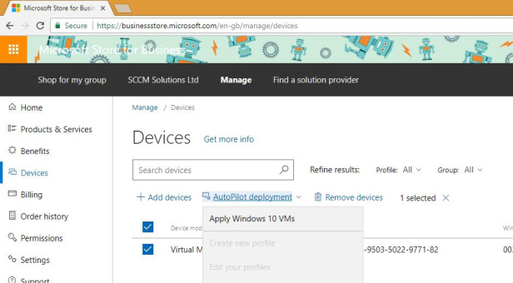
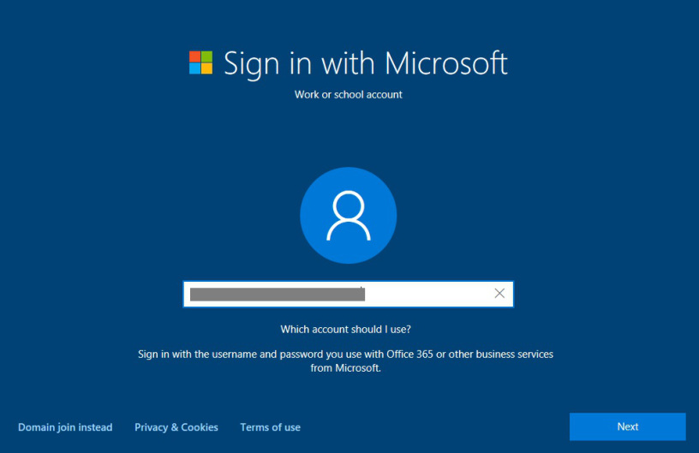
Windows AutoPilot
Windows Autopilot is a cloud-based service that does not require any special infrastructure. Here’s a typical OSD scenario using Windows Autopilot:
SysAdmin creates device profile(s)
Sysadmin registers the device(s) with the Windows Autopilot service
SysAdmin assigns a profile to the device(s)
Device is booted by end user
Device is connected to network (any Network – home, work, public)
User provides enterprise credentials, Language and Keyboard settings
Device self configures based on assigned profiles
If the organization uses Intune additional polices and applications may be delivered to the device

Slide 19
Goal is that we do not need to know where is user!

Slide 20
Thank you!

