Slide 2
Data Science in Power BI
Dejan Sarka
From: Business Analytics Using Power BI and Excel by
Dejan Sarka
Jernej Rihar
Klemen Vončina

Slide 3

Introduction
Dejan Sarka
  ~40 years of experience
  Data Platform MVP Alumni, MCT
  20 books
  20+ courses
  Focus:
    SQL Server
    Data science
    Data quality
    Data modeling

Slide 4
Agenda
Analytics in visuals
Advanced visuals
R and Python data sources
R and Python visuals
R and Python in Power Query
Custom visuals

Slide 5
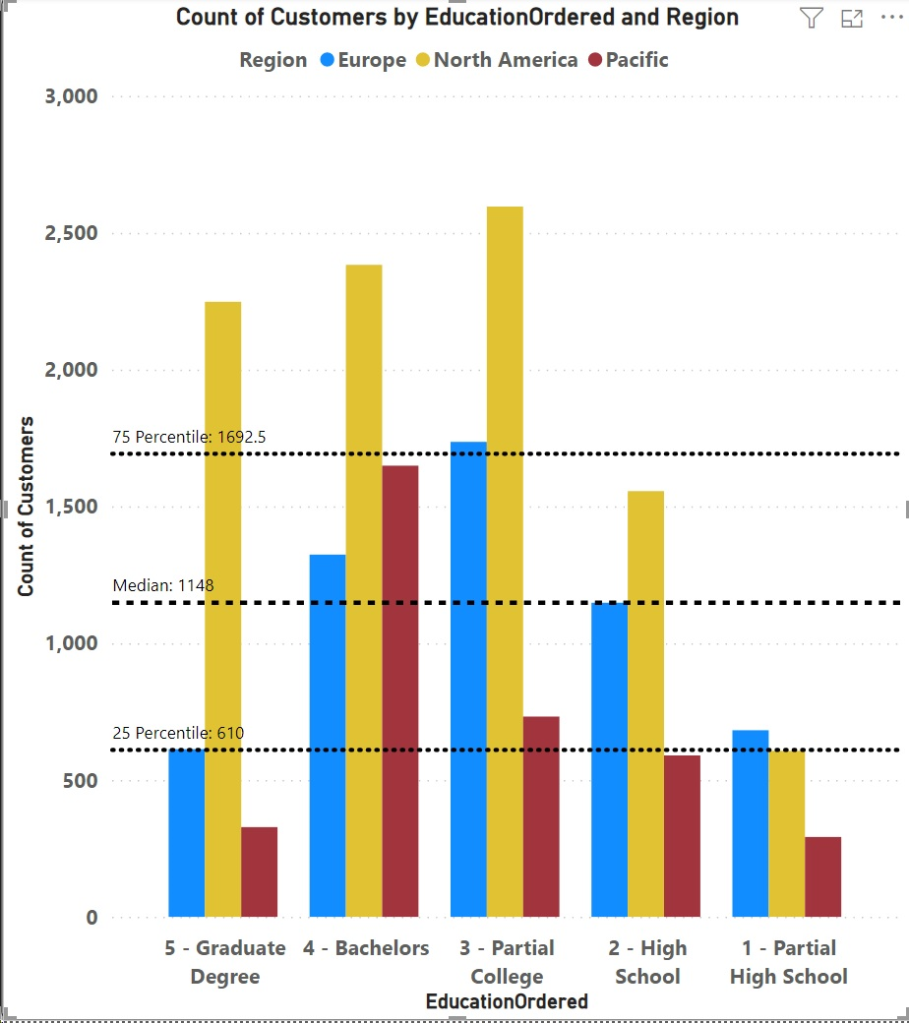
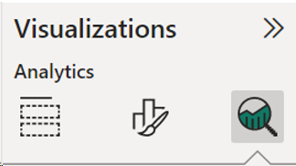
PBI Visuals Analytics
Many visuals have analytics features
  X-Axis constant line
  Y-Axis constant line
  Min line
  Max line
  Average line
  Median line
  Percentile line

Slide 6
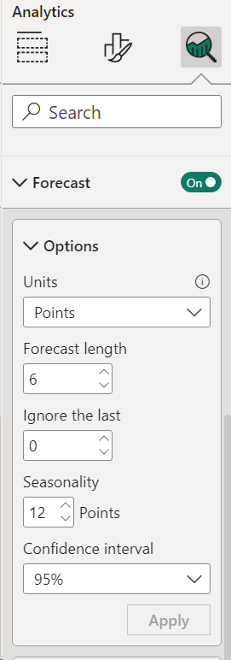
PBI Visuals Advanced Analytics
In a Scatter chart, you can add:
  Trend line – linear regression
  Symmetry shading and Ratio line
    Points to the left of the ratio line favor the y-axis measure more than overall, and points to the right favor the x-axis more
    For symmetry shading, must have equal scale
In a Line chart, you can add a forecast
  Specify number of time points to forecast
  Can specify seasonality

Slide 7
Clustering in Core Power BI Visuals
Scatterplot – cluster cases based on two input variables
Table – up to 15 input variables
The technique not really revealed, but it is most likely the k-means method
  Stephen Zielke, PhD: Cluster Analysis in Power BI
  Based on the scikit-learn cluster comparison example

Slide 8
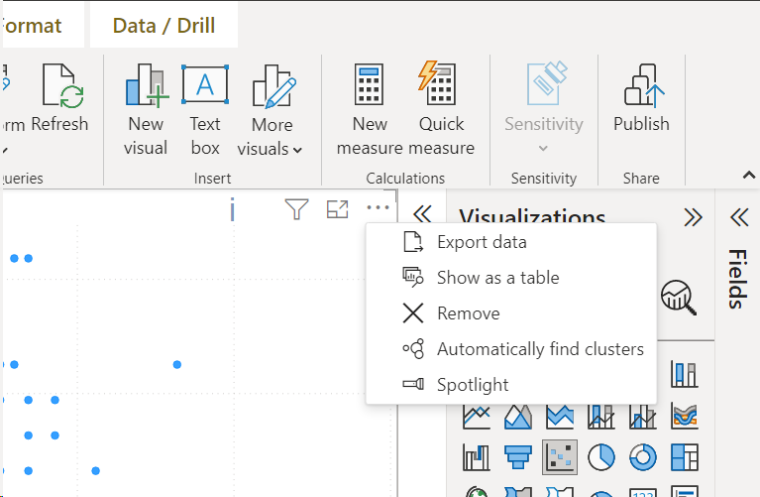
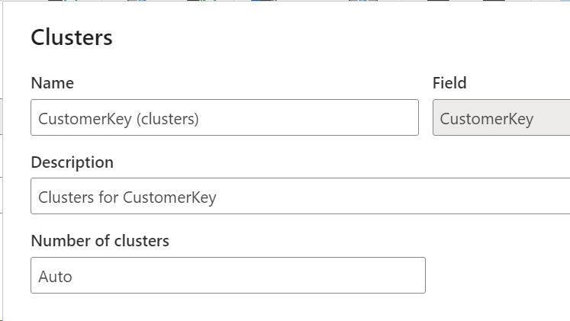
PBI Visuals Clustering
Use the More options (...) button in the visual
Seems that the algorithm prefers a bigger number of clusters

Slide 9
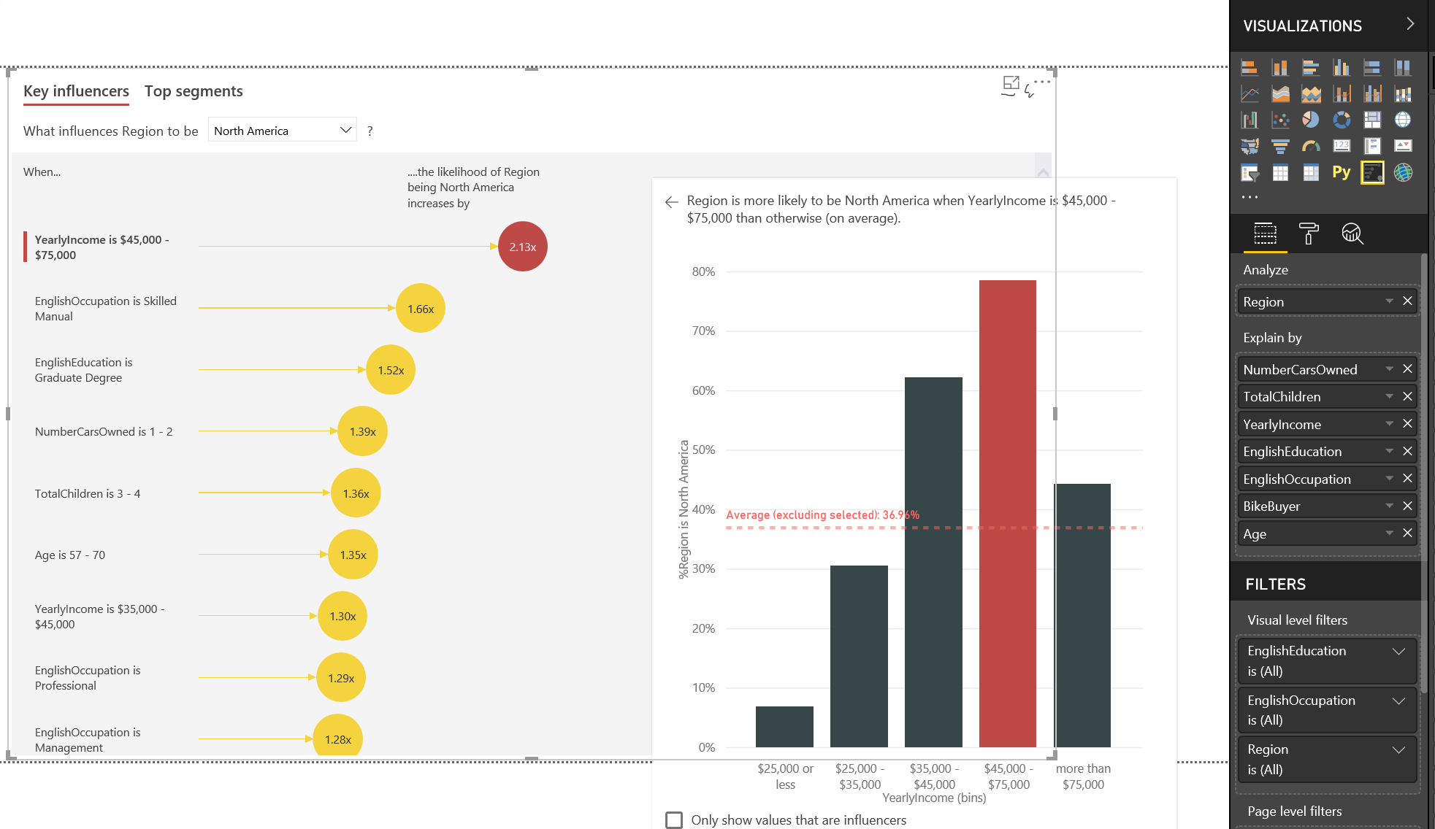
PBI Advanced Visuals
Decomposition tree – manual decision trees
Key influencers – uses logistic regression

Slide 10
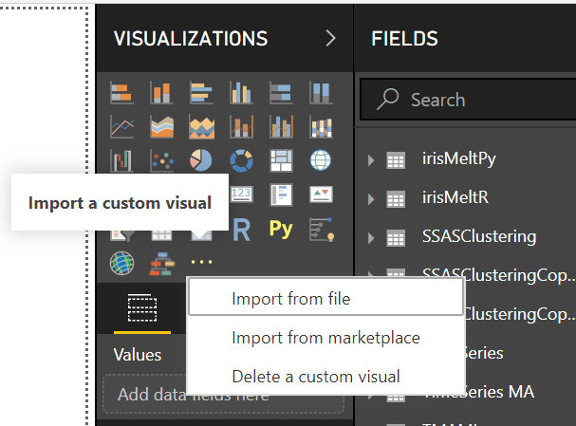
Using Custom Visuals
Import the visual from the marketplace or from a downloaded file
Enable custom visuals
Check the prerequisites for the visual
  E.g., R engine, with a list of packages installed

Slide 11
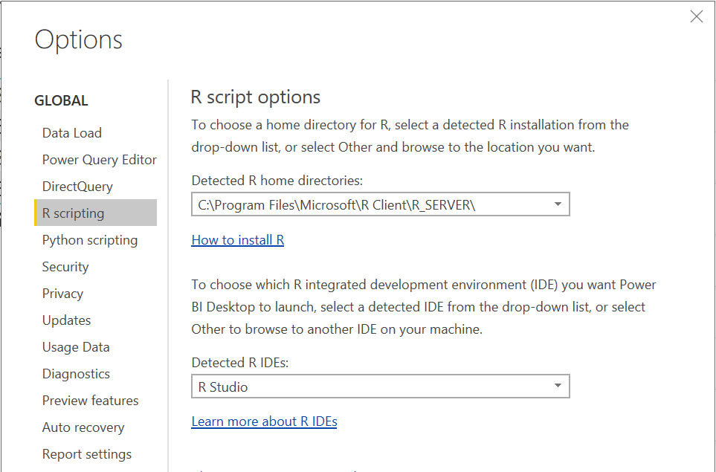
Using R and Python in Power BI
Use R and Python scripts for data sources, inside visuals, or in Power Query
  Or call R and Python from T-SQL
Set up the scripting options – the engine and the IDE

Slide 12
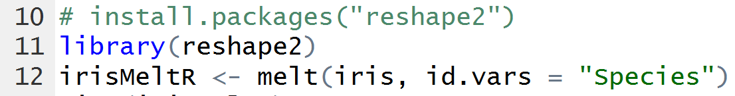
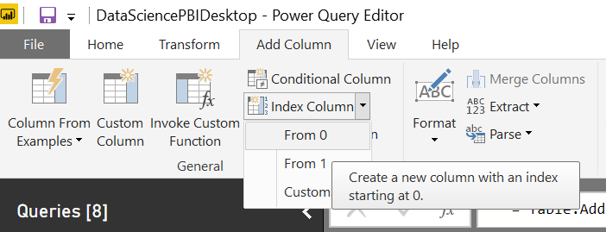
R and Python Data Sources
Install all packages you need in advance
Load necessary libraries
Must return one or more data frames
  Might need to add an index to maintain original rows

Slide 13
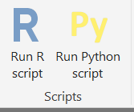
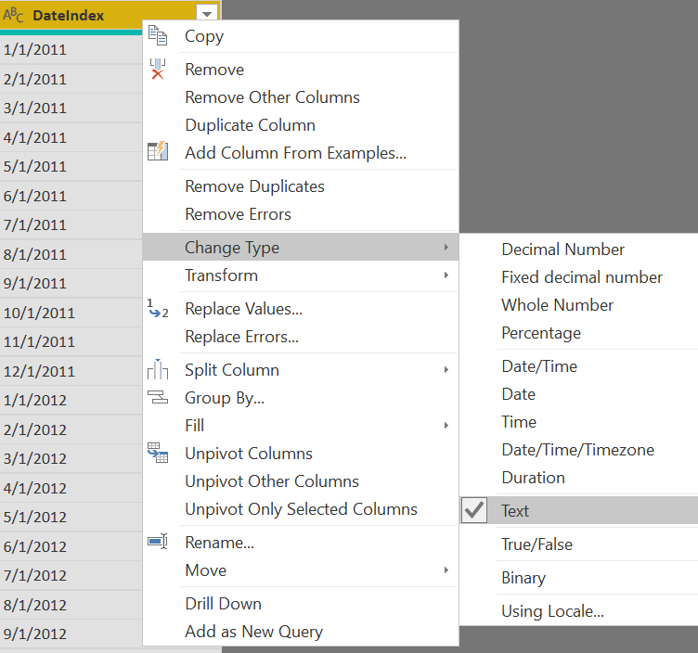
R and Python Transformations
Use R.Execute or Python.Execute
Must return a data frame (output <- dataset)
Might have to deal with data type clashes
  E.g., change dates to text for Python

Slide 14
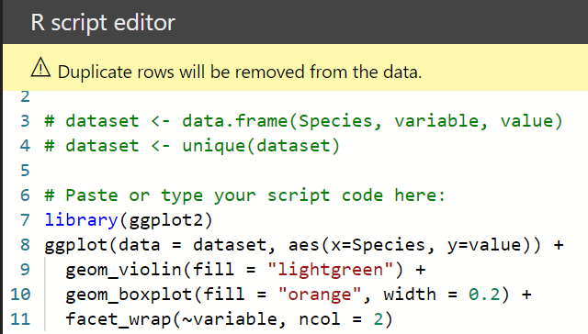
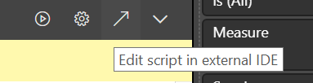
R and Python Visuals
Install all packages you need in advance
  Load necessary libraries
Select the columns you need in the visual
  Probably you need a key as well
Refer to the dataframe called dataset
Can use external IDE

Slide 15
This is not school, but we love to get grades. Please fill out our
questoineers and leave us your feedback. You may even win some
cool rewards.
Learn more at Kompas Xnet courses:
Microsoft Power BI Data Analyst, 11.12 - 13.12.2023
Designing and Implementing a Data Science Solution on Azure, 23.10 - 26.10.2023

