Slide 2
Windows Local Administrator Password Solution - LAPS
Matija Vrtačnik – Docentric d.o.o.
Notes:
Se predstaviš in od kje prihajaš + izkušnje do sedaj , omeniš tudi Enterprise okolje 7000+ zaposlenih!

Slide 3
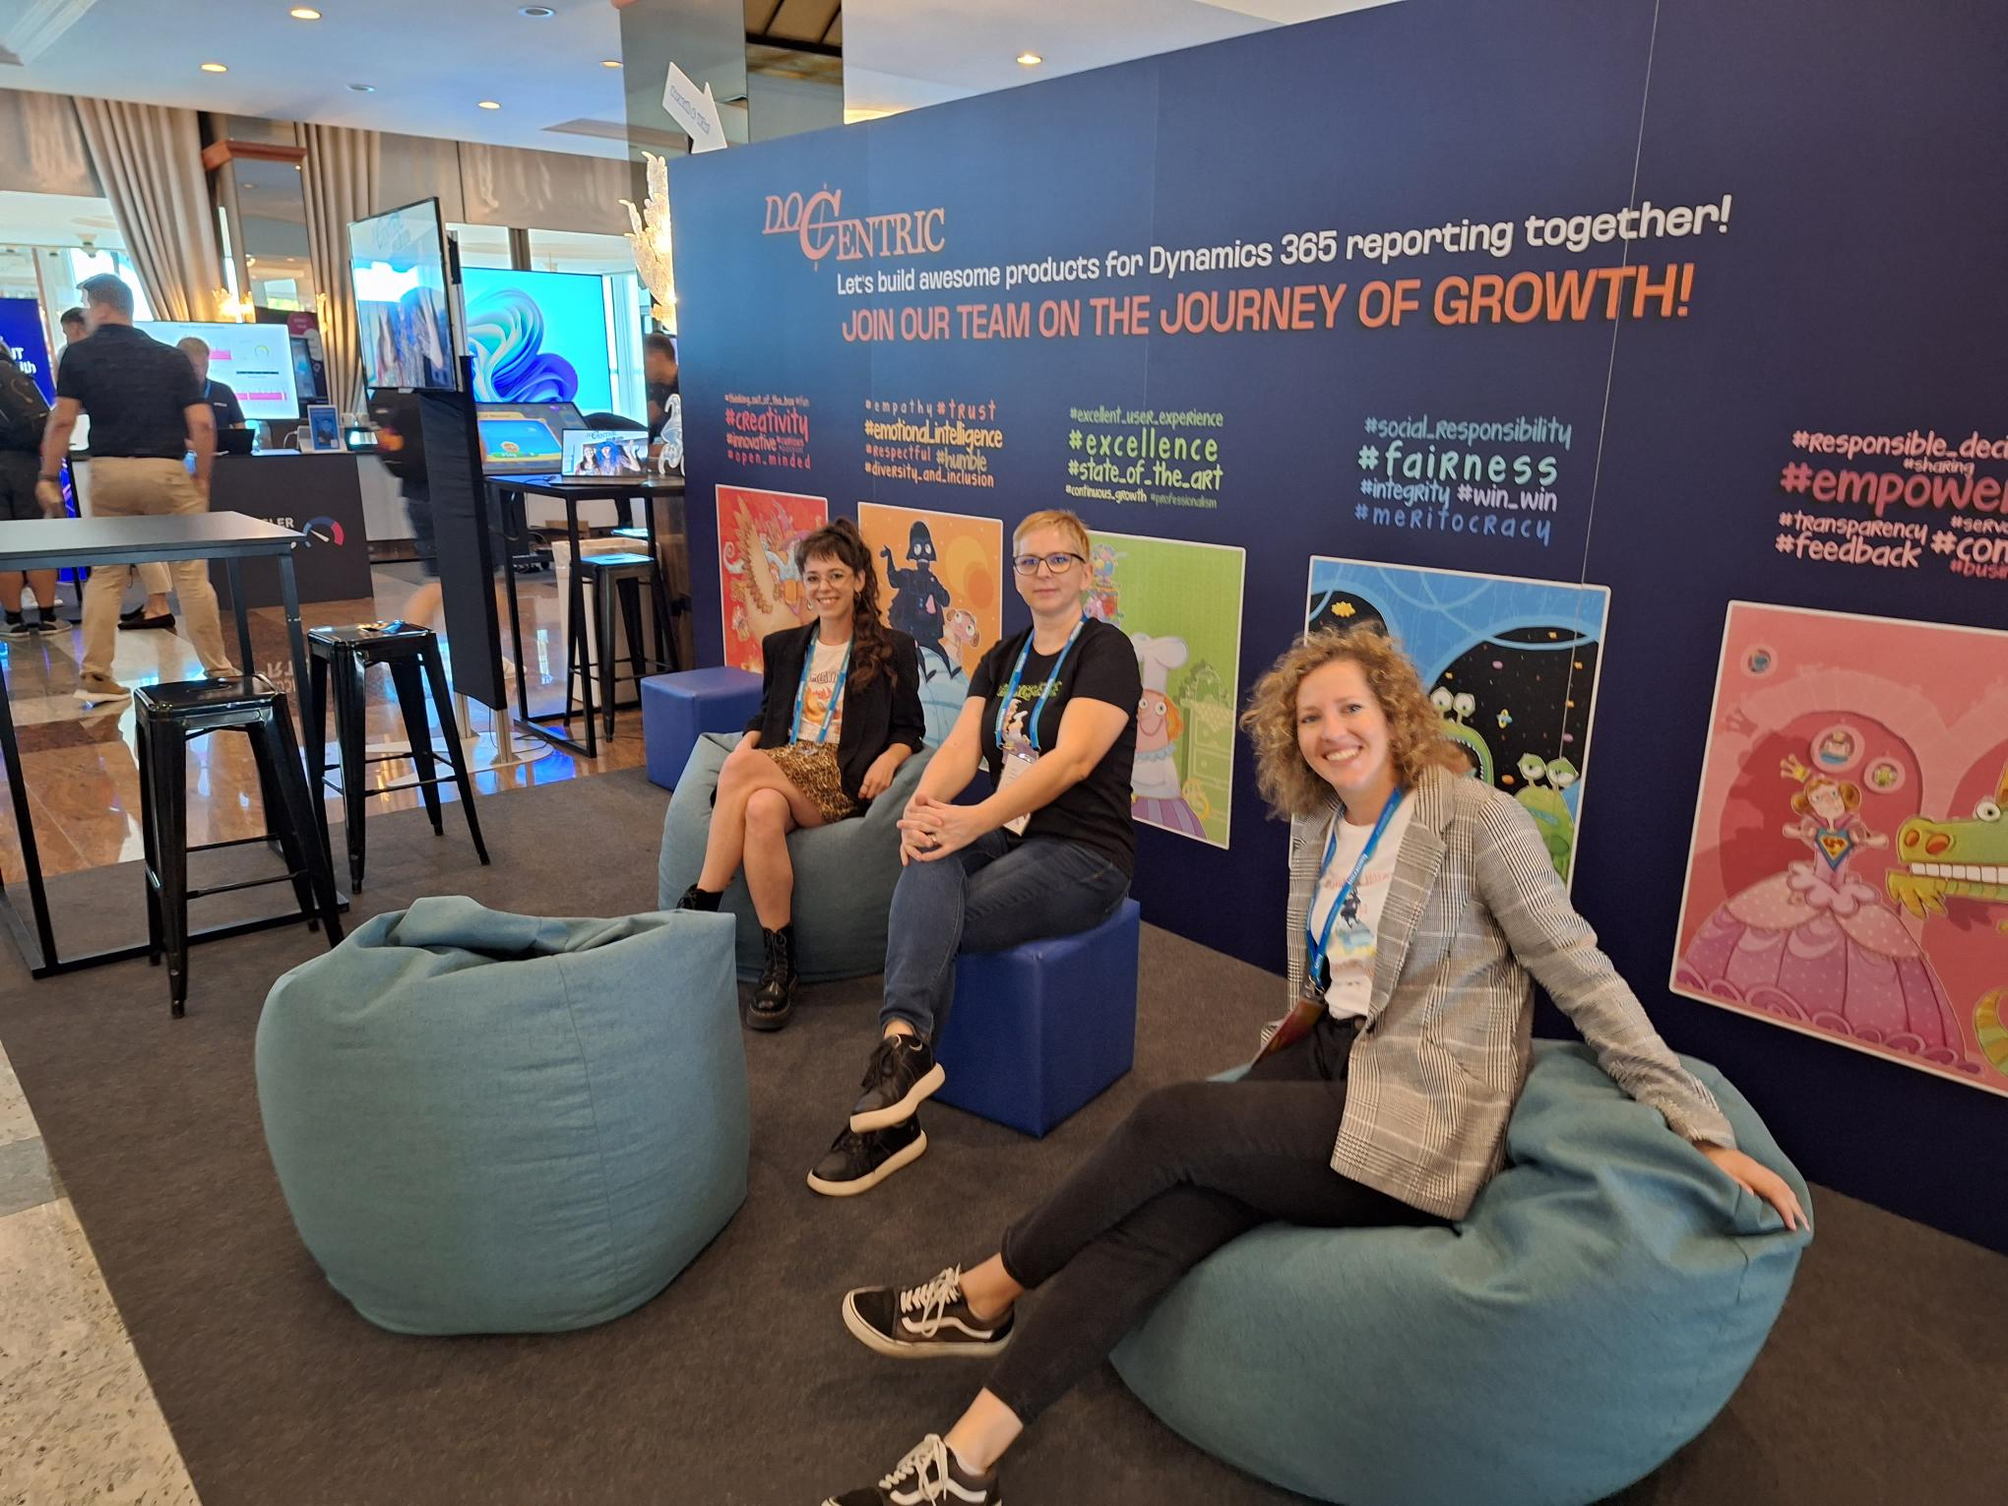
About me:
MATIJA VRTAČNIK
  Over 15+ years of experience with Microsoft products
  Working with hybrid environments: AD DS, PKI, Hyper-V, O365, Azure…

Slide 4
Agenda:
Benefits of using Windows LAPS
Local Administrator on Windows OS Server/Client
Legacy LAPS vs Windows LAPS
AD DS, AZURE AD JOIN, Hybrid, Registered
Installation and Configuration of Windows LAPS Onpremise (DEMO)
Installation and Configuration of Windows LAPS AZ AD (DEMO)
Migration scenarios from Legacy LAPS to Windows LAPS
Troubleshooting Windows LAPS
KB5020282 - Account lockout available for built-in local administrator (October 11, 2022)
GPO Refresh policy

Slide 5
BENEFITS OF USING WINDOWS LAPS
Protection against pass-the-hash and lateral-traversal attacks
Improved security for remote help desk scenarios
Ability to sign in to and recover devices that are otherwise inaccessible
A fine-grained security model (access control lists and optional password encryption) for securing passwords that are stored in Windows Server Active Directory
Support for the Azure role-based access control model for securing passwords that are stored in Azure Active Directory
Notes:
Lateralno prečni napadi
AZ P2, CAPS, PIM…

Slide 6
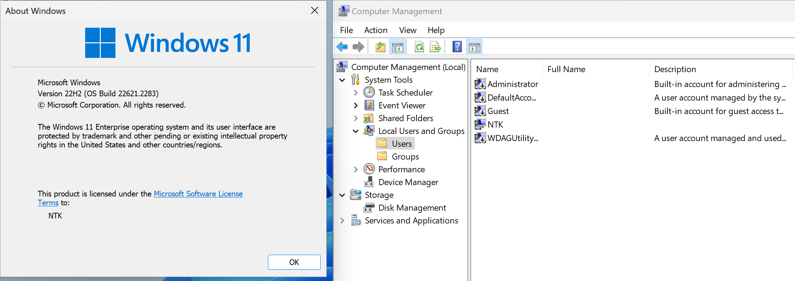
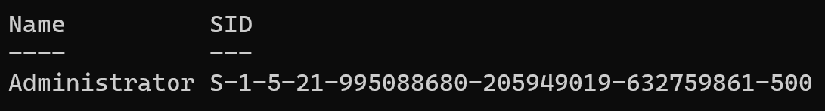
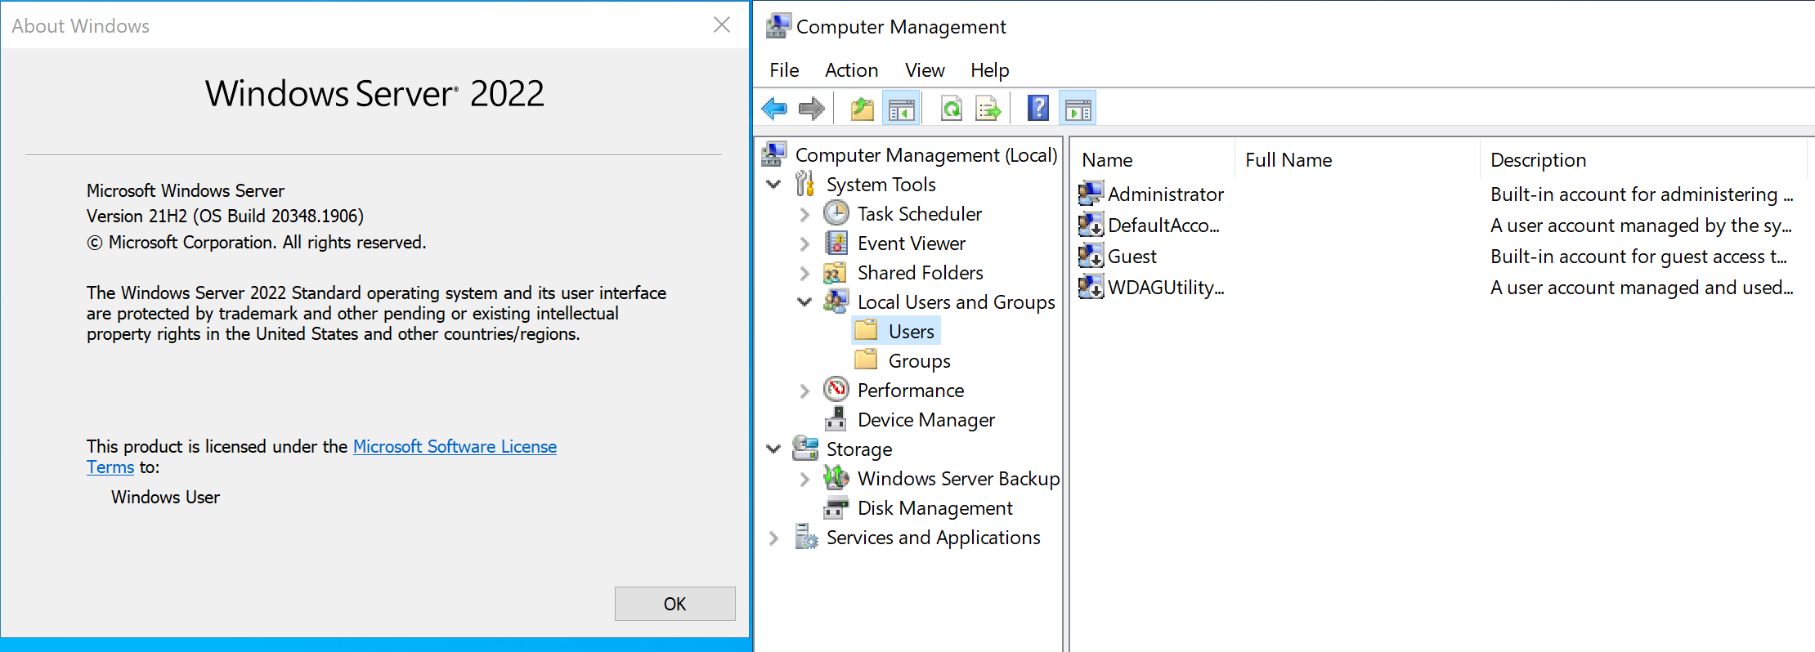
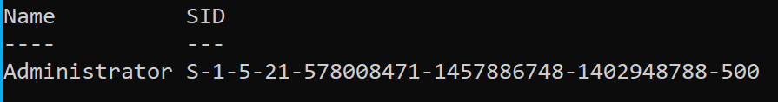
LOCAL ADMINISTRATOR
Notes:
Zakaj se pogovarjamo v LAPSU?
Zato ker vsak Windows operacijski sistem, neglede na to ali je klient ali pa server ima by default Administrator account!
Even when the Administrator account is disabled, you are not prevented from logging on as Administrator in Safe mode.
Get-LocalUser -Name 'Administrator' | Select-Object Name, SID
CMD or PS:
net user administrator /active:no
lusrmgr.msc

Slide 7
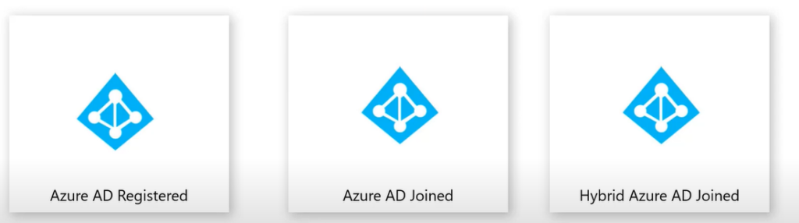
AZURE AD REGISTERED, AZURE AD JONED, HYBRID…
Notes:
Kako so danes lahko klienti in strežniki povezani v AD?
Zakaj je pomembno razumeti tip registracije je predvsem zaradi pravilne implementacije Windows LAPSa!
Hybrid Azure AD Joined is for:
corporate owned and managed devices
Authenticated using a corporate user id that exists at local AD & on AAD.
Authentication can be done using both: On-Prem AD & Azure AD.
Azure AD Joined is for
Corporate owned and managed devices
Authenticated using a corporate id that exists on Azure AD
Authentication is only through AAD.
AAD Registed Device is for
Personally owned corporate enabled
Authentication to the device is with a local id or personal cloud id
Authentication to corporate resources using a user id on AAD.
###############################################################
Azure AD Registered:
Registered to Azure AD without requiring organizational account to sign in to the device
Commonly occurs when signing into corporate resources with Azure AD credentials
Azure AD Joined:
Joined only to Azure AD requiring organizational account to sign in to the device
Commonly occurs through OOBE or through local admin join via Access Work or School settings
Hybrid Azure AD Joined:
Joined to on-premises AD and Azure AD requiring organizational account to sign in to the device.
Commonly occurs through AD connect configuration

Slide 8
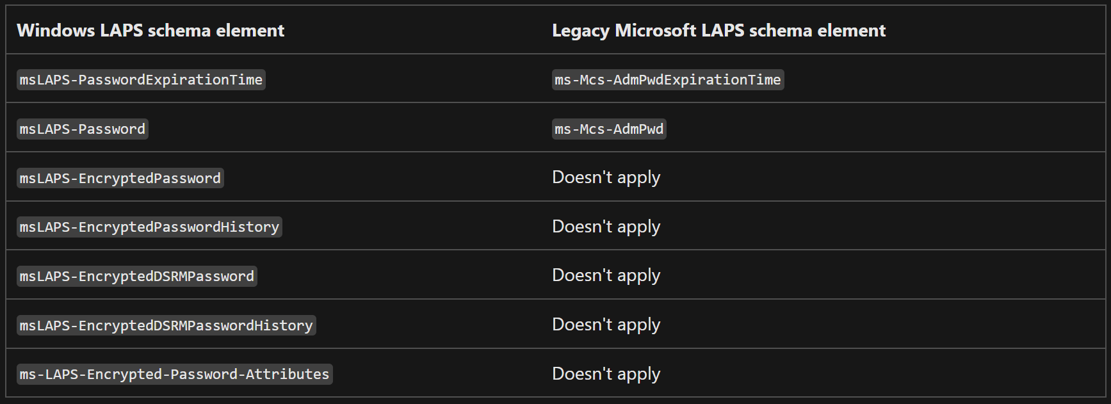
LEGACY LAPS vs WINDOWS LAPS
Encrypted passwords: 2016 domain functional level!
Notes:
Najlažje je narediti primerjavo Legacy LAPSa vs Windows LAPS glede na shemo, kjer se lepo vidi kaj je novega.
Poleg tega, kar vidimo je podprto tudi zapisovanje Gesel v AZ AD, kar prej ni bilo mogoče. MS priporoča zapisovanje gesel v AZ AD, vendar je konfiguracija potrebna prilagoditvi glede na scenarij podjetja!
Windows LAPS je sedaj integriran on del OSa z Aprilskimi popravki 2023! Ni več potrebe po namestitivi in deployu MSIjev!
Password encryption: Adds another layer of security to password protection.
Password history: Gives you the ability to log back into restored backup images.
Directory Services Restore Mode (DSRM) password backups: Secures your domain controllers by rotating critical recovery passwords on a regular basis.
Emulation mode: Useful if you want to continue using Legacy LAPS policy settings and tools while preparing to migrate to Windows LAPS.
Automatic rotation: Automatically rotate the password after the account is used.
If the legacy client-side extension and the corresponding registry entry are present on a PC, Windows LAPS automatically runs in emulation mode.

Slide 9
WINDOWS LAPS NEW FEATURES
Password encryption
Password history
Directory Services Restore Mode (DSRM) password backups
Emulation mode
Automatic rotation
Rich policy management: GPO+CSP
On-demand Windows LAPS account password rotation*
Dedicated event log
New PowerShell module
*Intune portal
Notes:
Najlažje je narediti primerjavo Legacy LAPSa vs Windows LAPS glede na shemo, kjer se lepo vidi kaj je novega.
Poleg tega, kar vidimo je podprto tudi zapisovanje Gesel v AZ AD, kar prej ni bilo mogoče. MS priporoča zapisovanje gesel v AZ AD, vendar je konfiguracija potrebna prilagoditvi glede na scenarij podjetja!
Windows LAPS je sedaj integriran on del OSa z Aprilskimi popravki 2023! Ni več potrebe po namestitivi in deployu MSIjev!
Password encryption: Adds another layer of security to password protection.
Password history: Gives you the ability to log back into restored backup images.
Directory Services Restore Mode (DSRM) password backups: Secures your domain controllers by rotating critical recovery passwords on a regular basis.
Emulation mode: Useful if you want to continue using Legacy LAPS policy settings and tools while preparing to migrate to Windows LAPS.
Automatic rotation: Automatically rotate the password after the account is used.
The following features are available for use in both Azure Active Directory and on-premises Active Directory scenarios:
Rich policy management: Policy management is now available via both Group Policy and Configuration Service Provider (CSP).
On-demand Windows LAPS account password rotation: You can now rotate Windows LAPS password on-demand using the Intune portal. This is useful in responding to a potential breach.
Dedicated event log: Enables improved diagnostics and data logging.
New PowerShell module: Adds improved management capabilities. For example, you can now rotate the password on demand using the new Reset-LapsPassword cmdlet.
Hybrid-joined devices: Now fully supported.

Slide 10
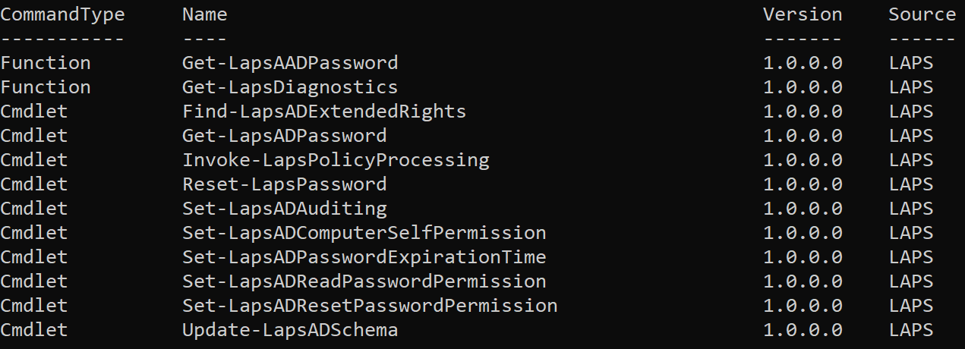
POWERSHELL MODULE
Notes:
Najlažje je narediti primerjavo Legacy LAPSa vs Windows LAPS glede na shemo, kjer se lepo vidi kaj je novega.
Poleg tega, kar vidimo je podprto tudi zapisovanje Gesel v AZ AD, kar prej ni bilo mogoče. MS priporoča zapisovanje gesel v AZ AD, vendar je konfiguracija potrebna prilagoditvi glede na scenarij podjetja!
Windows LAPS je sedaj integriran on del OSa z Aprilskimi popravki 2023! Ni več potrebe po namestitivi in deployu MSIjev!
Password encryption: Adds another layer of security to password protection.
Password history: Gives you the ability to log back into restored backup images.
Directory Services Restore Mode (DSRM) password backups: Secures your domain controllers by rotating critical recovery passwords on a regular basis.
Emulation mode: Useful if you want to continue using Legacy LAPS policy settings and tools while preparing to migrate to Windows LAPS.
Automatic rotation: Automatically rotate the password after the account is used.
The following features are available for use in both Azure Active Directory and on-premises Active Directory scenarios:
Rich policy management: Policy management is now available via both Group Policy and Configuration Service Provider (CSP).
On-demand Windows LAPS account password rotation: You can now rotate Windows LAPS password on-demand using the Intune portal. This is useful in responding to a potential breach.
Dedicated event log: Enables improved diagnostics and data logging.
New PowerShell module: Adds improved management capabilities. For example, you can now rotate the password on demand using the new Reset-LapsPassword cmdlet.
Hybrid-joined devices: Now fully supported.

Slide 11
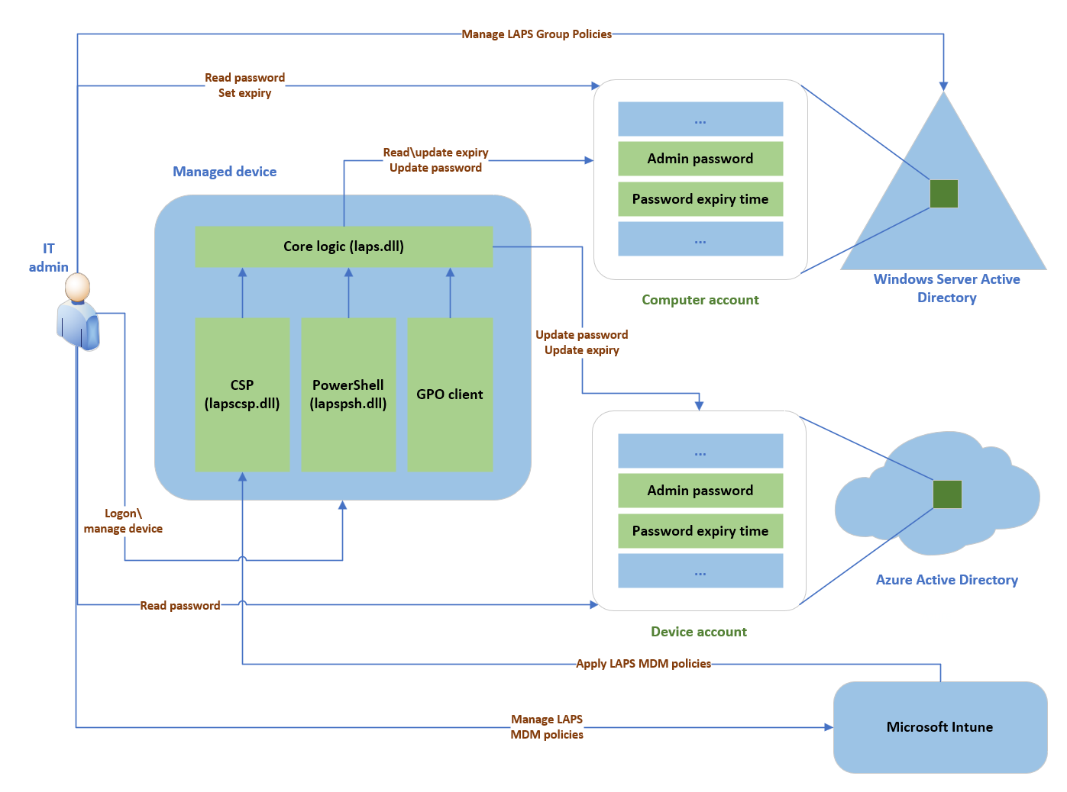
WINDOWS LAPS ARHITECTURE
Notes:
IT admin: Represents collectively the various IT admin roles that might be involved in a Windows LAPS deployment. The IT admin roles are involved with policy configuration, expiration or retrieval of stored passwords, and interacting with managed devices.
Managed device: Represents an Azure Active Directory-joined or Windows Server Active Directory-joined device on which you want to manage a local administrator account. The feature is composed of a few key binaries: laps.dll for core logic, lapscsp.dll for configuration service provider (CSP) logic, and lapspsh.dll for PowerShell cmdlet logic. You also can configure Windows LAPS by using Group Policy. Windows LAPS responds to Group Policy Object (GPO) change notifications. The managed device can be a Windows Server Active Directory domain controller and be configured to back up Directory Services Repair Mode (DSRM) account passwords.
Windows Server Active Directory: An on-premises Windows Server Active Directory deployment.
Azure Active Directory: An Azure Active Directory deployment running in the cloud.
Microsoft Intune The preferred Microsoft device policy management solution, also running in the cloud.

Slide 12
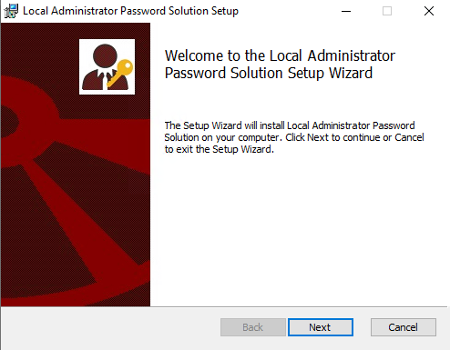
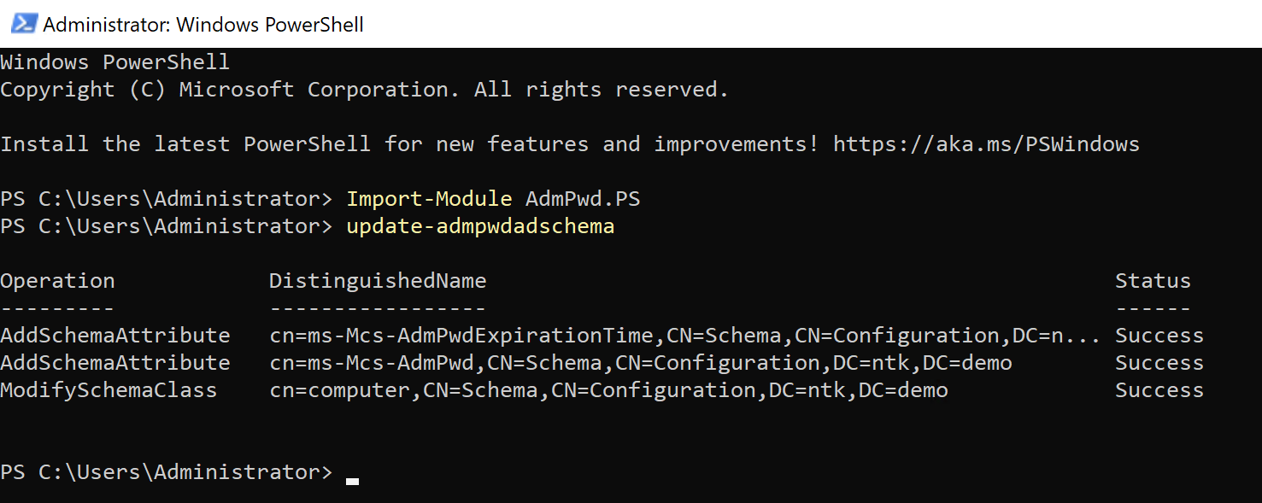
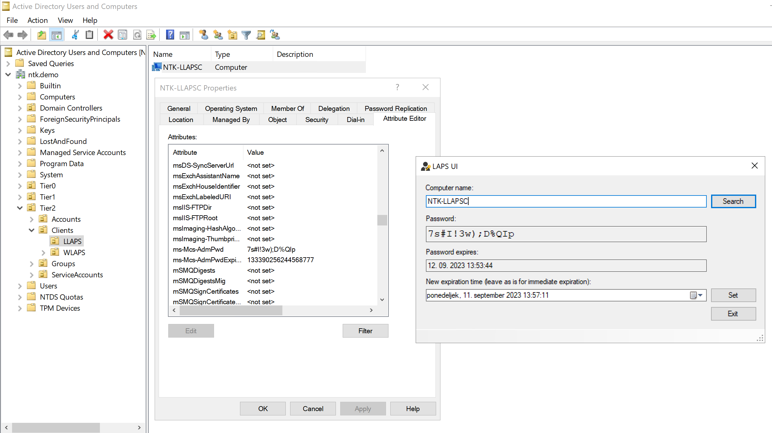
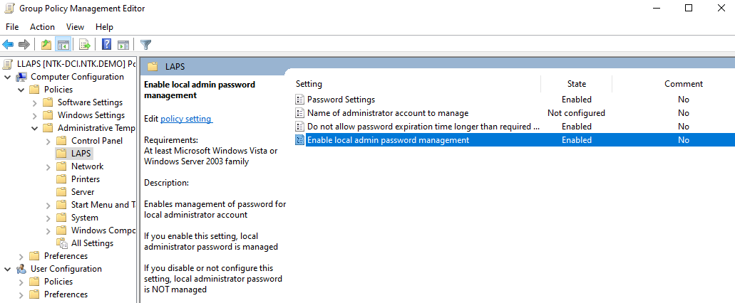

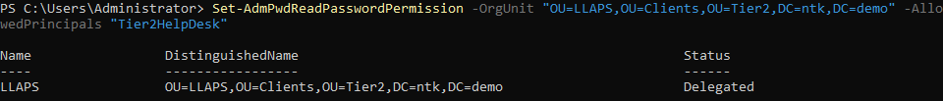
LEGACY LAPS
Notes:
Postopek namestitve
Inštalacija,
Shema,
Delegacija na OU,
Kopiranje ADML, ADMX v central store
GPO+vezava na OU
GUI preverjanje za geslo, če se ni pojavilo troubleshooting

Slide 13
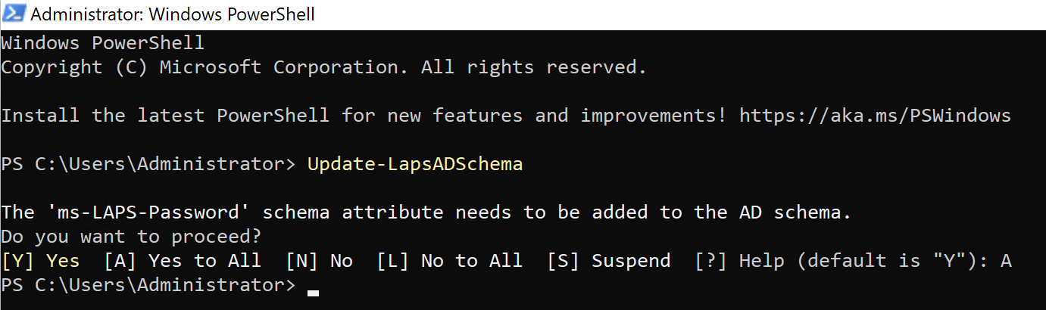
WINDOWS LAPS - Windows Server Active Directory
LAPS password encryption – 2016 Domain Functional Level and up
Update the Windows Server Active Directory schema
GPO Central Store, manually copy the Windows LAPS Group Policy template files to the central store.
  C:\Windows\PolicyDefinitions to your central store :\\ntk.demo\SYSVOL\ntk.demo\policies\PolicyDefinitions
Notes:
Namestitev popravkov Aprilskih ali kasnejših Cumulative updejtov na DCje, ostale strežnike ter kliente

Slide 14
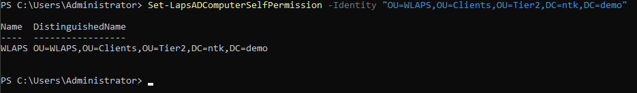
WINDOWS LAPS - Windows Server Active Directory
Assign device self-write permissions/Grant the managed device permission to update its password
MS priporočilo “root of the domain”
Notes:
Namestitev popravkov Aprilskih ali kasnejših Cumulative updejtov na DCje, ostale strežnike ter kliente

Slide 15
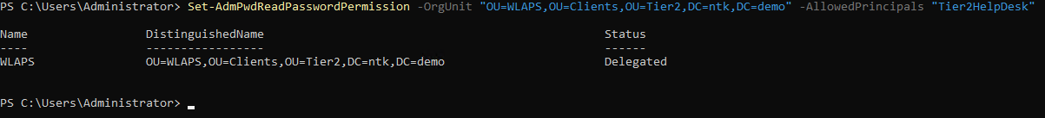
WINDOWS LAPS - Windows Server Active Directory
Configure the appropriate AD permissions for password expiration and password retrieval
Default “Domain Admins”
Notes:
Namestitev popravkov Aprilskih ali kasnejših Cumulative updejtov na DCje, ostale strežnike ter kliente

Slide 16
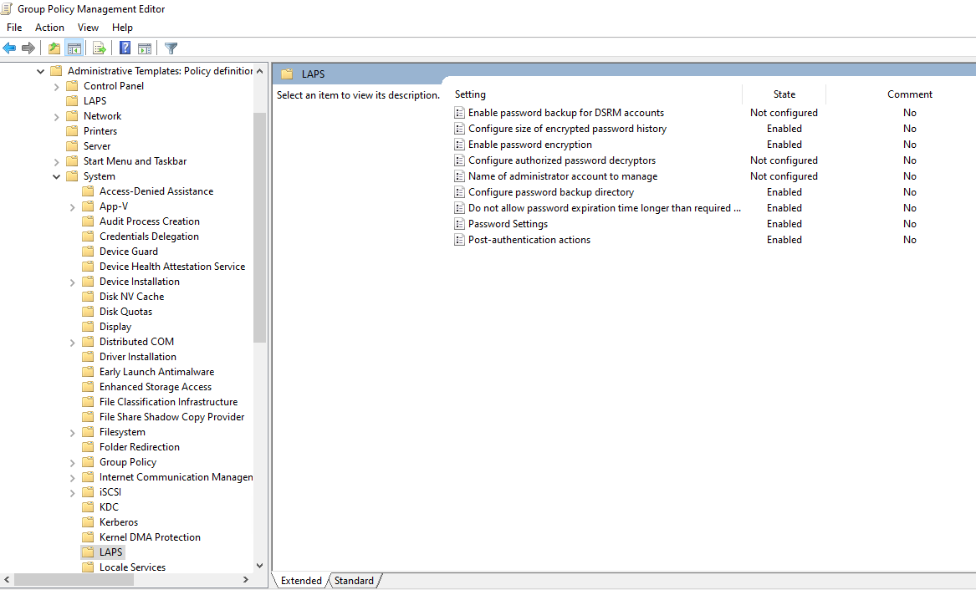
WINDOWS LAPS - Windows Server Active Directory
GPO - Configure device policy
Notes:
Namestitev popravkov Aprilskih ali kasnejših Cumulative updejtov na DCje, ostale strežnike ter kliente

Slide 17
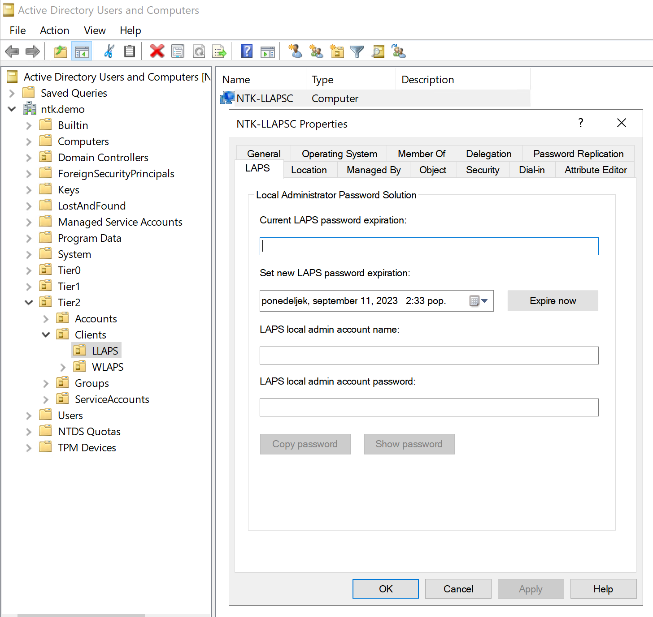
Retrieve a password from Windows Server Active Directory
AD DS LAPS TAB or PS Get-LapsADPassword
Notes:
Namestitev popravkov Aprilskih ali kasnejših Cumulative updejtov na DCje, ostale strežnike ter kliente

Slide 18
Installation and Configuration of Windows LAPS AZ AD
Windows Local Administrator Password Solution in Microsoft Entra ID (preview)
Enable LAPS in the Azure AD device settings
Configure device policy (Intune-Configuration Service Provider (CSP))
Retrieve a password from Azure Active Directory
  Azure AD portal or Intune portal
  PowerShell cmdlet (Get-LapsAADPassword)
    Global Administrator
    Intune Administrator
    Cloud device administrator
OS Deployment: Windows LAPS is always "on"!!!
As soon as a Windows LAPS policy is applied to the device, Windows LAPS immediately begins to enforce the policy.
Notes:
Če ni Intuna lahko nastavilo Local Group Policy
Za Hibrid je lahko tudi GPO
Windows LAPS processes the currently active policy on a periodic basis (every hour). To avoid waiting after you apply the policy, you can run the Invoke-LapsPolicyProcessing PowerShell cmdlet.
LAPS is always "on". As soon as a Windows LAPS policy is applied to the device, Windows LAPS immediately begins to enforce the policy. This behavior can cause disruptions if at some point your OS deployment workflow involves domain-joining a device into an OU with an enabled Windows LAPS policy. If the Windows LAPS policy targets the same local account that the deployment workflow is logged in with, the resultant immediate modification of the local account password will likely break the workflow (for example after a reboot during automatic sign-in).
The first technique to mitigate this issue is to use a clean "staging" Organizational Unit (OU). A staging OU is considered a temporary home for the device's account that applies a bare minimum set of required policies, and shouldn't apply a Windows LAPS policy. Only at the conclusion of the OS deployment workflow is the device's account is moved to its final destination OU. Microsoft recommends the use of a clean staging OU as a generic best practice.
Get started with Windows LAPS and Azure Active Directory | Microsoft Learn

Slide 19
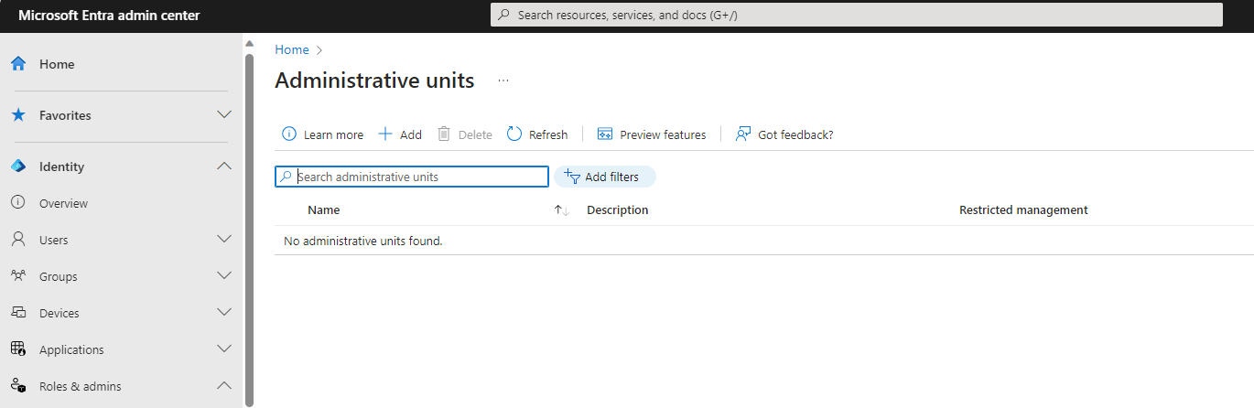
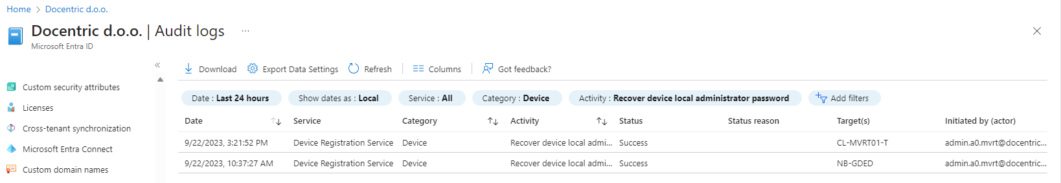
Installation and Configuration of Windows LAPS AZ AD
We can create custom role with permissions:
Microsoft.directory/deviceLocalCredentials/password/read
Audit logs Entra ID:
Notes:
Če ni Intuna lahko nastavilo Local Group Policy
Za Hibrid je lahko tudi GPO
Windows LAPS processes the currently active policy on a periodic basis (every hour). To avoid waiting after you apply the policy, you can run the Invoke-LapsPolicyProcessing PowerShell cmdlet.
LAPS is always "on". As soon as a Windows LAPS policy is applied to the device, Windows LAPS immediately begins to enforce the policy. This behavior can cause disruptions if at some point your OS deployment workflow involves domain-joining a device into an OU with an enabled Windows LAPS policy. If the Windows LAPS policy targets the same local account that the deployment workflow is logged in with, the resultant immediate modification of the local account password will likely break the workflow (for example after a reboot during automatic sign-in).
The first technique to mitigate this issue is to use a clean "staging" Organizational Unit (OU). A staging OU is considered a temporary home for the device's account that applies a bare minimum set of required policies, and shouldn't apply a Windows LAPS policy. Only at the conclusion of the OS deployment workflow is the device's account is moved to its final destination OU. Microsoft recommends the use of a clean staging OU as a generic best practice.
Get started with Windows LAPS and Azure Active Directory | Microsoft Learn

Slide 20
Migration scenarios from legacy LAPS to Windows LAPS
Two basic approaches:
  Immediate transition approach
    Disable\remove the legacy LAPS policy
    Create and apply a Windows LAPS policy
    Monitor the managed device to confirm a successful transition
    Remove the legacy LAPS software
  Transient side-by-side coexistence approach
    Configure the managed device with a second local account
    Create and apply a Windows LAPS policy
    Monitor the managed device to confirm a successful application of the Windows LAPS policy
    Disable\remove the legacy LAPS policy
    Remove the legacy LAPS software
    Remove the extra account
Notes:
Če ni Intuna lahko nastavilo Local Group Policy
Za Hibrid je lahko tudi GPO
Windows LAPS processes the currently active policy on a periodic basis (every hour). To avoid waiting after you apply the policy, you can run the Invoke-LapsPolicyProcessing PowerShell cmdlet.
LAPS is always "on". As soon as a Windows LAPS policy is applied to the device, Windows LAPS immediately begins to enforce the policy. This behavior can cause disruptions if at some point your OS deployment workflow involves domain-joining a device into an OU with an enabled Windows LAPS policy. If the Windows LAPS policy targets the same local account that the deployment workflow is logged in with, the resultant immediate modification of the local account password will likely break the workflow (for example after a reboot during automatic sign-in).
The first technique to mitigate this issue is to use a clean "staging" Organizational Unit (OU). A staging OU is considered a temporary home for the device's account that applies a bare minimum set of required policies, and shouldn't apply a Windows LAPS policy. Only at the conclusion of the OS deployment workflow is the device's account is moved to its final destination OU. Microsoft recommends the use of a clean staging OU as a generic best practice.
Get started with Windows LAPS and Azure Active Directory | Microsoft Learn

Slide 21
Troubleshooting Windows LAPS
Dedicated event log channel
  Applications and Services > Logs > Microsoft > Windows > LAPS > Operational
  Diagnostic report with PowerShell: Get-LapsDiagnostics
Notes:
Če ni Intuna lahko nastavilo Local Group Policy
Za Hibrid je lahko tudi GPO
Windows LAPS processes the currently active policy on a periodic basis (every hour). To avoid waiting after you apply the policy, you can run the Invoke-LapsPolicyProcessing PowerShell cmdlet.
LAPS is always "on". As soon as a Windows LAPS policy is applied to the device, Windows LAPS immediately begins to enforce the policy. This behavior can cause disruptions if at some point your OS deployment workflow involves domain-joining a device into an OU with an enabled Windows LAPS policy. If the Windows LAPS policy targets the same local account that the deployment workflow is logged in with, the resultant immediate modification of the local account password will likely break the workflow (for example after a reboot during automatic sign-in).
The first technique to mitigate this issue is to use a clean "staging" Organizational Unit (OU). A staging OU is considered a temporary home for the device's account that applies a bare minimum set of required policies, and shouldn't apply a Windows LAPS policy. Only at the conclusion of the OS deployment workflow is the device's account is moved to its final destination OU. Microsoft recommends the use of a clean staging OU as a generic best practice.
Get started with Windows LAPS and Azure Active Directory | Microsoft Learn

Slide 22
Most common mistakes
Update-LapsADSchema – The user has insufficient access rights.
Update-LapsADSchema is not recognized.
Error – Local admin password solution is not enabled for this tenant
For client related errors Event Log is your friend!
Windows LAPS troubleshooting guidance - Windows Server | Microsoft Learn
Notes:
Če ni Intuna lahko nastavilo Local Group Policy
Za Hibrid je lahko tudi GPO
Windows LAPS processes the currently active policy on a periodic basis (every hour). To avoid waiting after you apply the policy, you can run the Invoke-LapsPolicyProcessing PowerShell cmdlet.
LAPS is always "on". As soon as a Windows LAPS policy is applied to the device, Windows LAPS immediately begins to enforce the policy. This behavior can cause disruptions if at some point your OS deployment workflow involves domain-joining a device into an OU with an enabled Windows LAPS policy. If the Windows LAPS policy targets the same local account that the deployment workflow is logged in with, the resultant immediate modification of the local account password will likely break the workflow (for example after a reboot during automatic sign-in).
The first technique to mitigate this issue is to use a clean "staging" Organizational Unit (OU). A staging OU is considered a temporary home for the device's account that applies a bare minimum set of required policies, and shouldn't apply a Windows LAPS policy. Only at the conclusion of the OS deployment workflow is the device's account is moved to its final destination OU. Microsoft recommends the use of a clean staging OU as a generic best practice.
Get started with Windows LAPS and Azure Active Directory | Microsoft Learn

Slide 23
Q&A

