Slide 1
The secret behind building a ready-to-go Intranet
Biserka Cvetkovska
Agitavit Solutions d.o.o.

Slide 2

Biserka Cvetkovska
@biserka_
http://biserkacvetkovska.com
biserka.cvetkovska@agitavit.com

Slide 3

A ready-to-go Intranet

Slide 4
Why a ready-to-go Intranet?
Reducing the time needed for planning, development and deployment of custom Intranet portals
Reducing risks and costs
Dedication to what matters the most
  Great content
  Collaboration
  Proper resourcing
  User adoption

Slide 5
Crucial features when developing a ready-to-go Intranet
Easily maintainable solution
A hybrid solution
Clean, customizable and easily adaptable responsive design
Must enable content classification and tagging
Must encourage collaboration and communication

Slide 6
Easily maintainable solution

Slide 7



Solution structure & component implementation
A solution consisted of multiple client-side components
Component == Web part
Component implementation
  TypeScript + React in combination with
    SharePoint REST API
    SharePoint Search REST API

Slide 8
Technologies & languages used
Typescript
  A superset of JavaScript that offers:
    Type checking
    Class declarations and modularity
    Better tooling
    Interoperability
React
  A client-side framework that is:
    Lightweight, solely concentrated on the view
    Easy to use
    Easy to learn

Slide 9
A hybrid solution

Slide 10
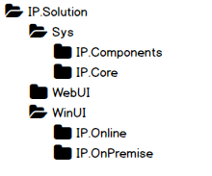


Component implementation
Every functionality must work in both environments
Every component must be configurable

Slide 11
Clean, customizable and easily adaptable responsive design

Slide 12
Do-s and don’t-s when styling
OOB SharePoint styling mechanisms must be used
  Themes
  Composed looks
Setting the following properties in all components must be avoided
  font-size, font-family
  color, background-color, border-color
  width, height
Custom master pages are not recommended

Slide 13

Responsive components
Office UI Fabric
  Responsive grid layout
  Office look and feel without custom CSS
  Tons of ready-to-use React components

Slide 14
Content classification and tagging

Slide 15
Metadata, metadata, metadata …
Metadata fields should be available on all items
  Documents, list items, news, announcements, applications, links, etc.
Benefits
  Boost Search capabilities
  Find important information easier and faster

Slide 16
Content type hierarchy …
OOB SharePoint Content Type
Agitavit Base Content Type
Agitavit Custom Content Type
General Keywords
Content Type
Responsible Persons

Slide 17
Collaboration and communication

Slide 18

Tools
Discussion lists
Blogs
Team Sites + Yammer
Likes
Comments

Slide 19
Demo
Biserka Cvetkovska

Slide 20
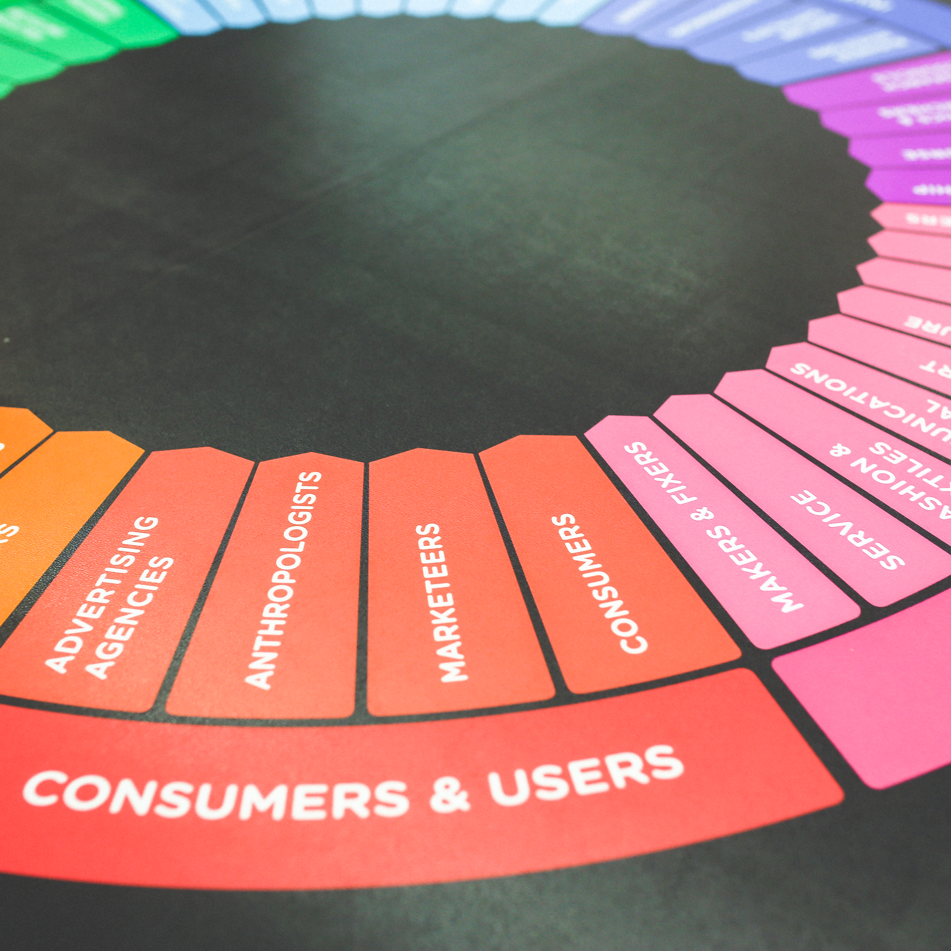
User adoption

Slide 21
How to increase user adoption?
Training sessions / workshops
Social collaboration (comments, likes, Yammer, …)
Maintain content
Implement analytics and measure (Google Analytics, PIWIK)
Build an easy to use feedback form
Simple, clean and user-friendly design
Internal marketing

Slide 22
Questions?

Slide 23
Biserka Cvetkovska
@biserka_
http://biserkacvetkovska.com
biserka.cvetkovska@agitavit.com

