Slide 2
What has happened?
Igor Pavleković
Partner Technology Strategist - Microsoft
Igor.pavlekovic@microsoft.com
www.linkedin.com/in/igorpavlekovic

Slide 3

DEFINITIONS

Slide 4
Service incident?
An event or series of events that typically causes multiple customers to have a degraded experience with one or more of Microsoft cloud services. Those incidents are effectively unplanned downtime – including outages impacting availability, performance degradation impacting users, and problems interfering with service administration/management
Scheduled downtime?
Period of downtime related to network, hardware or Service maintenance or upgrades. Notice about it is scheduled at least 5 days prior the event
Downtime?
It is defined for each service in the Service Specific Terms. Except Microsoft Azure Services, downtime does not include Scheduled Downtime
Online services terms SLA

Slide 5
Microsoft 365 Dynamics 365

Slide 6
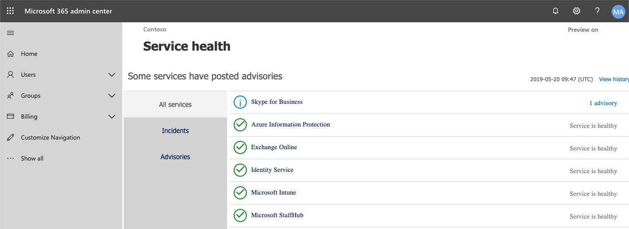
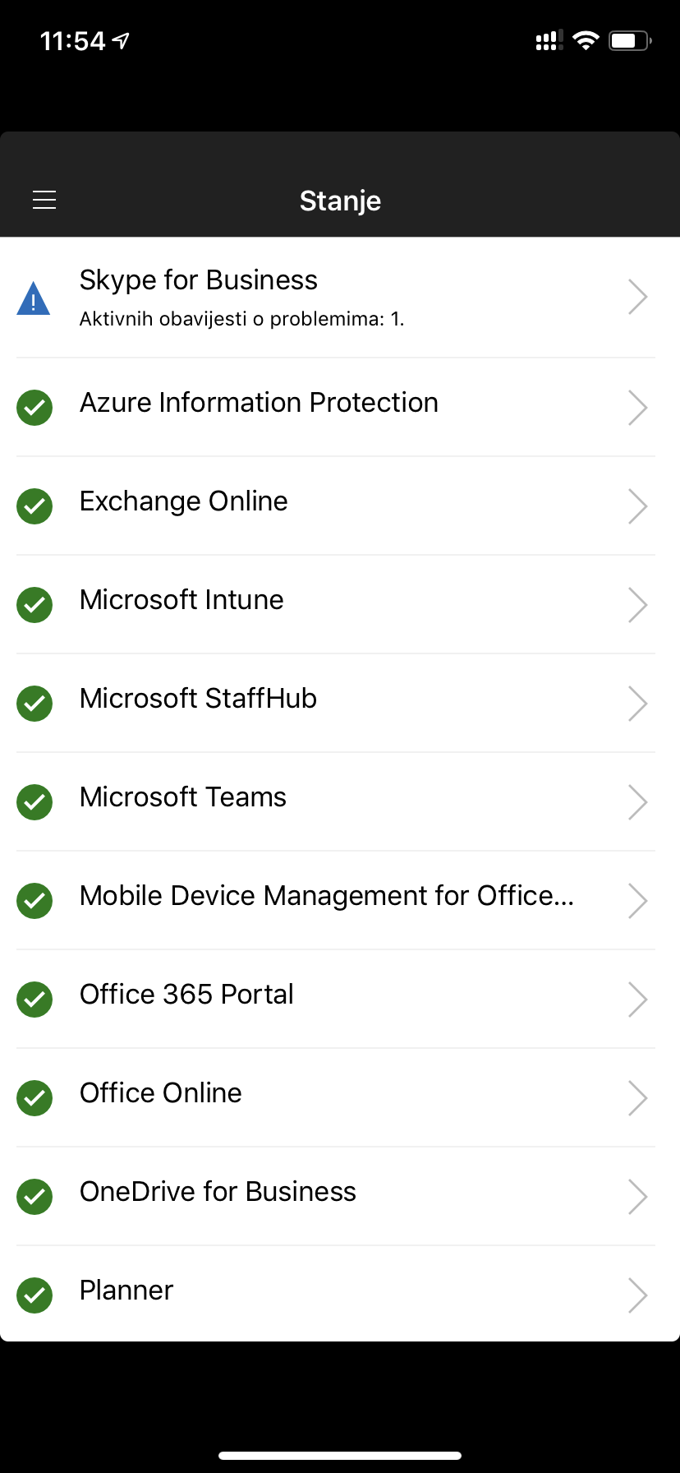
Before an incident
Get familiar with Service Health in M365 Admin Center
Install and configure M365 Admin mobile app to be notified about issues on the go
(you could use service communication API)
Subscribe @MSFT365Status on Twitter
Do not use status.office.com!

Slide 7
During an incident
Review M365 Admin Center for updates about incident
If you can’t access M365 Admin Center – check status.office.com or follow twitter @MSFT365Status
If your impact/issue don’t match the incident (or if it persists after mitigation) contact support

Slide 8
After an incident
Investigate Post Incident Review – 48hrs after incident (initial) and final in 5 days
Know your SLA!
  if eligible, request Service Credit – by the end of the next calendar month
  Example of EXO downtime definition: Any period of time when users are unable to send or receive email with Outlook Web Access. There is no Scheduled Downtime for this service.
Update your Incident Response Plan accordingly
2019 | Q1 | 99,97%
2018 | Q4 | 99,98%
2018 | Q3 | 99,97%
2018 | Q2 | 99,98%
2018 | Q1 | 99,99%
2017 | Q4 | 99,99%
2017 | Q3 | 99,98%
2017 | Q2 | 99,97%
2017 | Q1 | 99,99%
 | AVERAGE | 99,98%

Slide 9
Azure

Slide 10
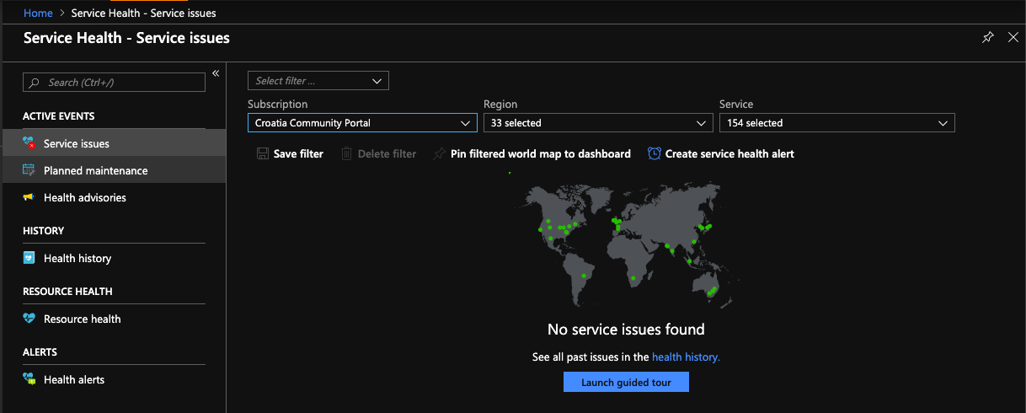
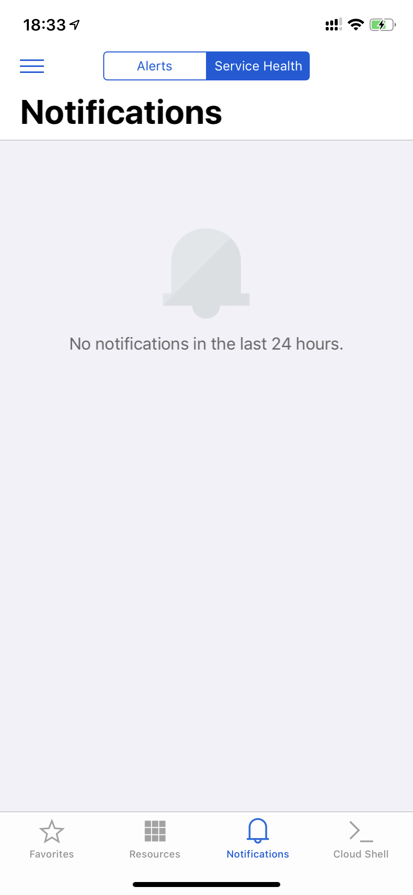
Before an incident
Understand resilience and ensure that all your critical services are architected for high availability
Get yourself familiar with Azure Service Health
Configure Service Health alerts to notify you about any issues – by e-mail, SMS, webhook, etc.
Install and use Azure Mobile App
Follow @AzureSupport on Twitter
Do not use status.azure.com!

Slide 11
During an incident
Review Azure Service Healt in Azure Portal
If you can’t access Azure portal – check status.azure.com or follow twitter @AzureSupport
If your impact/issue don’t match the incident (or if it persists after mitigation) contact support

Slide 12
After an incident
Investigate Service Issue Summary
Know your SLA!
  if eligible, request Service Credit – within next two months
Example of VM Single Instance downtime definition: is the total accumulated minutes that are part of Minutes in the Month that have no Virtual Machine Connectivity (bi-directional network traffic between the Virtual Machine and other IP addresses using TCP or UDP network protocols in which the Virtual Machine is configured for allowed traffic. The IP addresses can be IP addresses in the same Cloud Service as the Virtual Machine, IP addresses within the same virtual network as the Virtual Machine or public, routable IP addresses )
Update your Incident Response Plan accordingly
    Services uptime for Azure is available by request to customers with NDA in place

Slide 13
Internal in MS

Slide 14
Who is taking care of you?
Technical Account Manager – if you have Premier or Unified Support
  Account Technology Strategist (for Enterprise customers) or Partner Technology Strategist (for partners)
    Account Executive (for Enterprise customers) or Partner Development Manager (for partners)
What tools are we using?
two internal tools (one for Azure and other for M365/D365) – they copy statuses from health dashboards.
we can use them to subscribe to e-mail notifications about incident status updates for specific customers (by tenant or subscription ID)

Slide 15
I know someone locally in Microsoft office and I will call for help?
Please make aware your TAM/ATS/PTS/AE/PDM about issue that you have. If it’s not a well-known incident, it would be wiser to call support to report issue first (OK, TAM is exception to this)
During issue, we can provide moral support, but unfortunately, we won’t be able to provide any additional information (as we don’t have it)
I’m looking at DownDetector and it says there are some issues, but everything works fine for me?
That’s perfectly normal as we have services in different regions and geo locations, or maybe your tenant is not affected
Please, always look for official Health status pages to see personalized information about your environment

Slide 16
How can Permier/Unified support help me?
You have dedicated Technical Account Manager who is in charge for you through issue resolution process
This support covers different services, not only cloud-based services
Your TAM will work with you on building Major Incident Response Plan
It can include Azure Rapid Response option if you have super-trooper critical systems running in Azure
What if I still have questions about incident after Root Cause Analysis/Post Incident Review is published?
If this question is not in domain of resolving any technical issues, please contact your Microsoft contact (TAM/ATS/PTS/AE/PDM) and we will raise this topic and seek for additional clarification

Slide 18
Thank you!
Igor Pavleković
Partner Technology Strategist - Microsoft
Igor.pavlekovic@microsoft.com
www.linkedin.com/in/igorpavlekovic

