Slide 2
SharePoint 2019 vs SharePoint Online:
Kaj je novega in kje so problemi
Gašper Rupnik | Kompas Xnet d.o.o.
Notes:
Lepo pozdravljeni na NT konferenci, na mojem predavanju, kjer bomo govorili o najnovejših tehnologijah in funkcionalnostih, ki nam jih ponuja Microsoft v SharePoint svetu.
In sicer na on-prem strani imamo tu SharePoint 2019, na cloud strani pa SharePoint Online.
Pogledali si bomo, kaj je novega in kje so problemi v primerjavi s tem, kar že poznamo od prej iz starejših verzij.

Slide 3

About me
Gašper Rupnik
Kompas Xnet d.o.o.
Lead Developer, Trainer
MCSA, MCSD, MCT
https://rasper87.wordpress.com/

Slide 4
Cloud Born Release
SharePoint and OneDrive cloud code base
Mid 2018
SharePoint Server 2016
SharePoint Server 2019
a.k.a. “perpetual release”
Notes:
Potrebno je vedeti, da je že od verzije 2016 le ta pobrana iz SharePoint cloud verzije SharePointa, kjer so izvzeti iz njega featurei, ki so cloud-only dependent (dostop do Microsoft Grapha, od začetka dostop do PowerAppsov, Flow-a itd)
SharePoint 2019 je bil vzet iz clouda sredi leta 2018, torej pomeni, da vsebuje featuree, ki so bili v cloudu razviti in stestirani do takrat (kateri so tej, si bomo pogledali v nadaljevanju).
Ob tem velja omeniti tudi to, da je SharePoint Server 2019 v t.i. Perpetual release verziji.

Slide 5
What means “perpetual release”?
TROY
Like Windows 10
  Based on updates: Creators Update, Fall Creators Update, Redstone 4, etc.
Updates and new feature releases based on Feature Packs
No more major releases or “new versions”
“Perpetual license” means 2019 will be the last license keys
Notes:
To pomeni, da naj od sedaj naprej nebi bilo več nobenih novih verzij, novih major releasov, tako kot to že poznamo na Windows 10.
Vse bo dodajano kot Feature Packsi, tej naj bi bili tudi drugače zastavljeni in poenostavljeni, kar pomeni, da naj nebi bilo z njimi več takih težav oz dolgotrajnih postopkov, kot jih verjetno že poznate do sedaj.

Slide 6

Modern SharePoint
Notes:
Torej kaj nam novi SharePoint prinaša?
Veliko. Kličemo ga lahko Modern SharePoint, ker dejansko so naredili velik preskok na temu, da stvar izgleda končno moderno in jo tako lahko tudi tretiramo, uporabljamo oz razširjamo.

Slide 7



SharePoint Server 2019 “Perpetual release”
Built on the foundational release of SharePoint 2016
Brings you closer to the cloud
Brings the cloud closer to you
Notes:
Še vedno je v ozadju v osnovi SharePoint 2016.
Če si gremo ogledat SharePoint 2019 hive folder, lahko vidimo, da je struktura folderjev in vsega v njih enaka, kot jo poznamo že od nekdaj -> osnova je torej enaka, na temu stvari dograjujejo oz dodelujejo.
Vse nove zadeve, ki so prišle z modernim SharePointom so postavljene v nov folder Next
C:\Program Files\Common Files\microsoft shared\Web Server Extensions\16\TEMPLATE\LAYOUTS\Next
Kjer najdete ogromno JS in ostalih fajlov, ki vse zadeve skupaj predstavljajo modern client-side sharepoint, zgrajen na osnovi React frameworka ter typescript jezika.
Ob tem je potrebno vedeti, da sta si Online ter On-prem verziji skozi le bolj blizu.

Slide 8
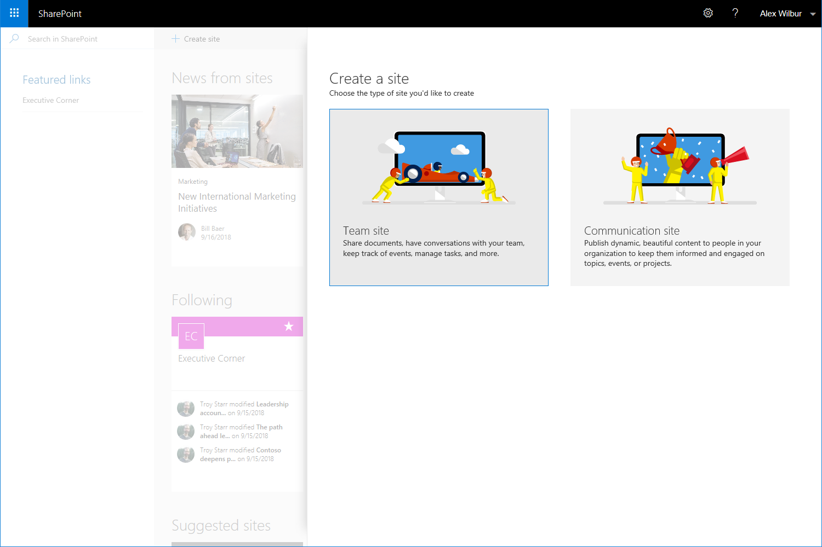
Site Creation
Simple site creation experience for Team and Communication sites
Create sites in seconds
  OneDrive personal sites
  Modern Team sites
  Communication sites
Notes:
Torej kaj je novega:
Pohitreno kreiranje novih site collectionov, ki so ustvarjeni praktično v sekundi -> torej ni več počasnega kreiranja SC, kot ga poznamo iz starih SharePoint verzijah.
Ob tem je potrebno tudi vedeti, da modern SharePoint ne priporoča več kreiranja subsitov, ampak zgolj sitecollectione, sitecollectione pa povezuješ med sabo v hierarhijo preko hub sitov, kar si bomo pogledali kasneje v primeru.

Slide 9
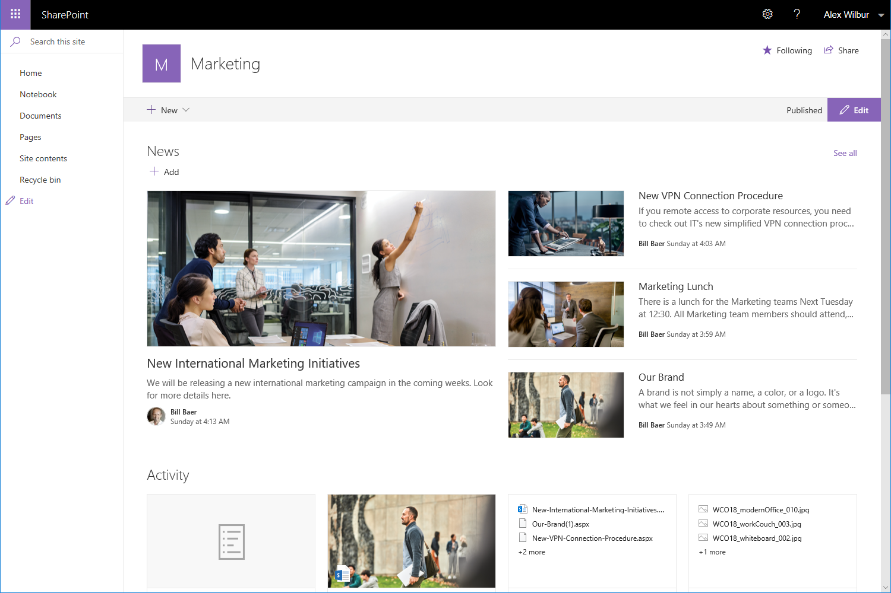
Modern Team sites
Updated lists, libraries, pages, and news
Fast, mobile ready, and customizable experience
Notes:
Trenutno imamo tako v SharePoint 2019 kot SharePoint Online na voljo team site template, modern responsive design, zgrajen z zadnjimi client-side tehnologijami.
Team site so namenjeni za teame znotraj vašega podjetja, kamor odlagate dokumente, si ogledate dogodke v koledarju, novice itd.

Slide 10
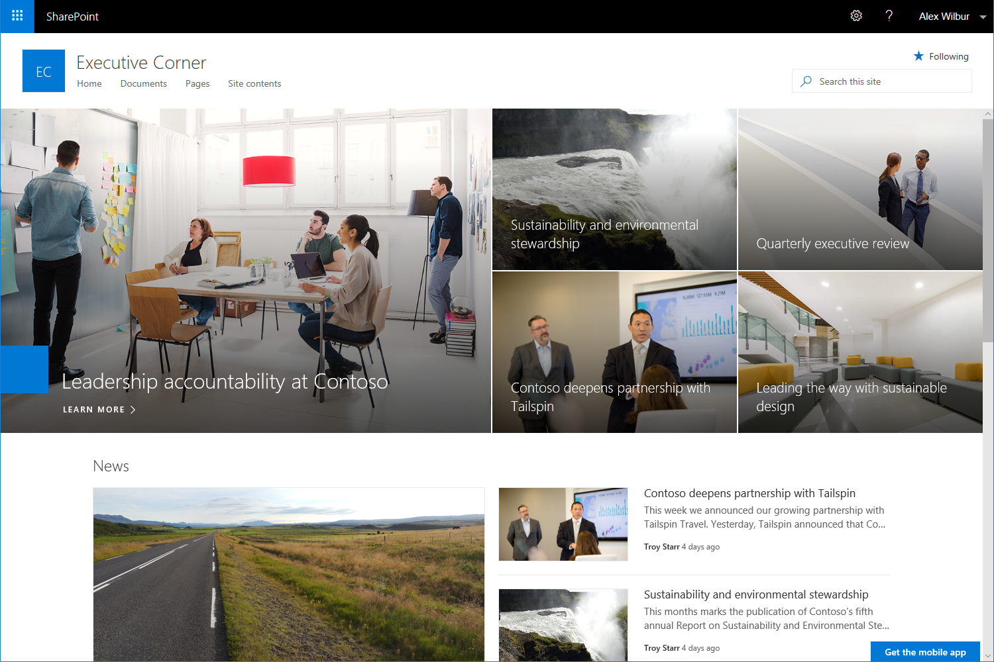
Communication Sites
Beautiful, dynamic site to reach broad audience
Keep your organization informed and engaged
Notes:
Drug template, za katerega veljajo enake stvari, so Communication Sites, ki so bolj namenjeni predstavitvi podjetja

Slide 11
Building blocks of your Intranet
Hub sites
Team sites
Communication sites
A communication site
or team site
Created by users or admins
Created by admins
Created by users or admins
Navigation
Theme and logo
Search scope
News and activity rollup
Notes:
Naslednji tip strani so Hub Sites, ki pa so trenutno na voljo samo v SharePoint Online.
Namenjeni so temu, da lahko z njimi povežeš različne team in communication sites v neko hierarhijo -> torej tako, da bodo spadali pod isti hub site (hub site je torej parent vseh teh povezanih sitov).
Na hub situ definiraš temo, logo, navigacijo, ki bodo podedovani na vse povezane strani.
Hub site potem predstavlja tudi search scope, scope novic in aktivnosti.

Slide 12
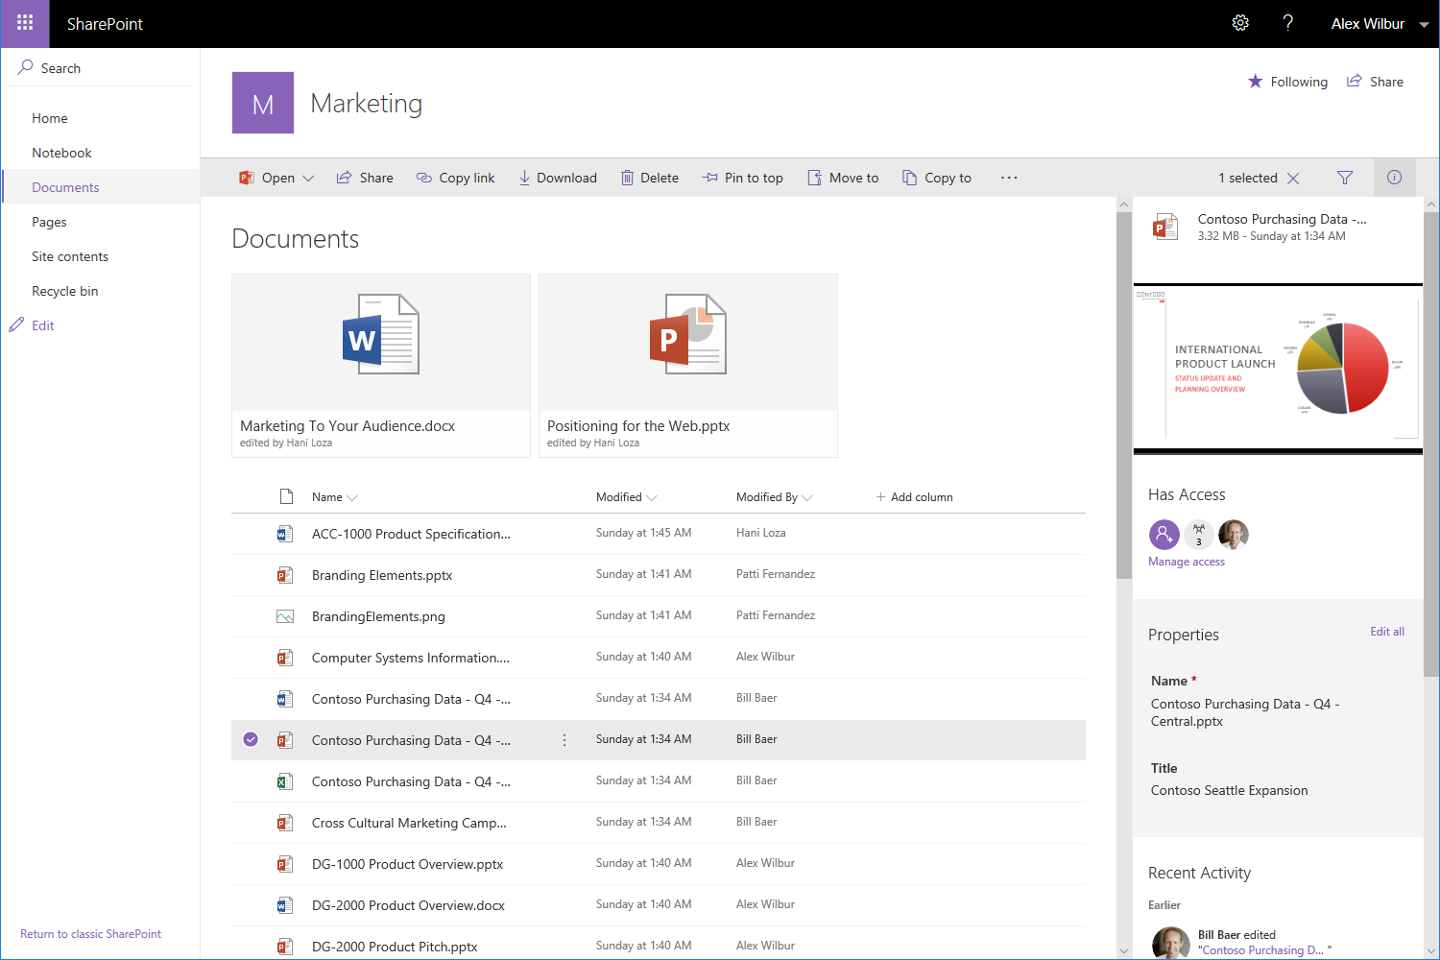
Modern Libraries
Updated, responsive UI
Aligned with UI fabric of OneDrive
Modern sharing experience
Optimized for light weight structure and process
Notes:
Tako na 2019 kot online so na voljo tudi nove modern libraries, kjer je posodobljen responsive UI design, enak kot jih poznamo z vsemi ostalimi produkti v o365.

Slide 13
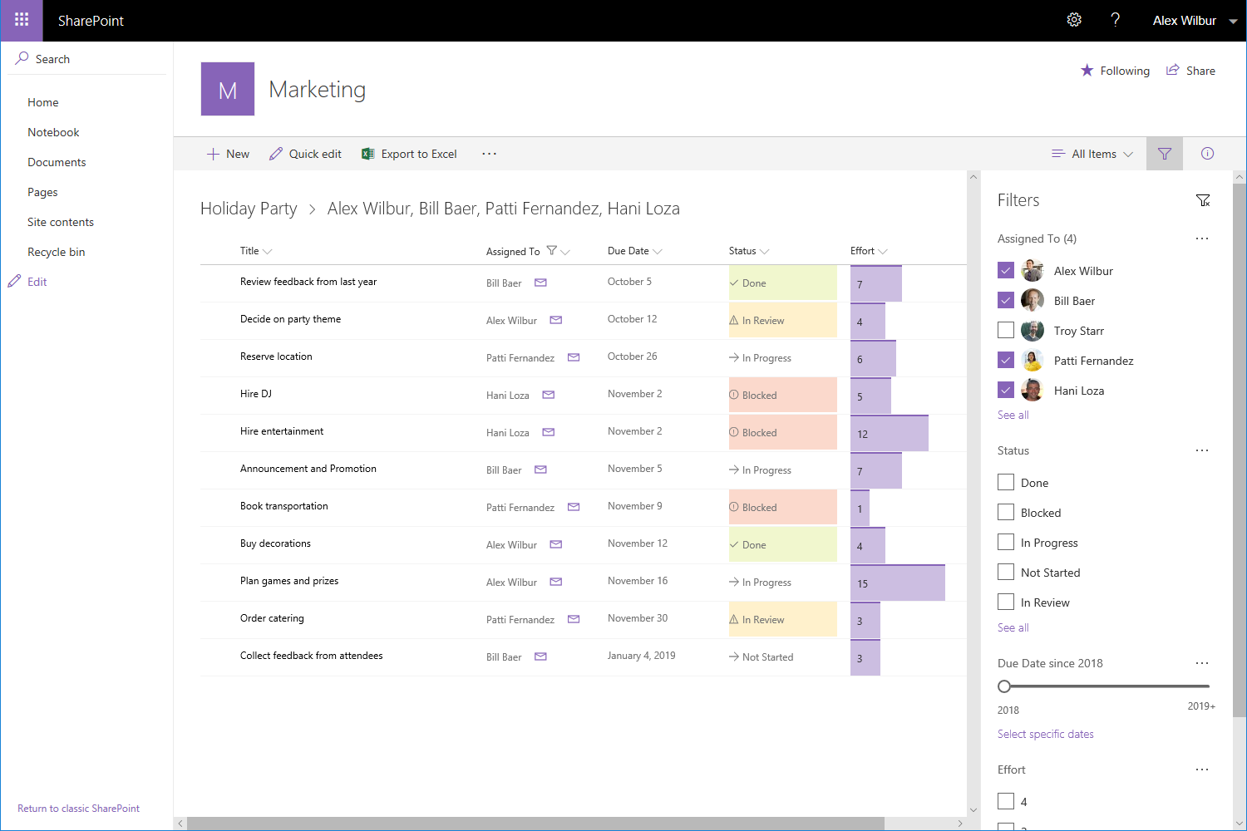
Modern Lists
Add columns and rows with ease
Simplified filtering experience
Format columns with JSON
Details pane gives you more information without leaving the list view
Notes:
Prenovljeni so bili t.i. Modern listsi, kjer je poenostavljeno upravljanje le njih, filtriranje, dodajanje novih vrstic, formatiranje stolpcev ali vrstic

Slide 14
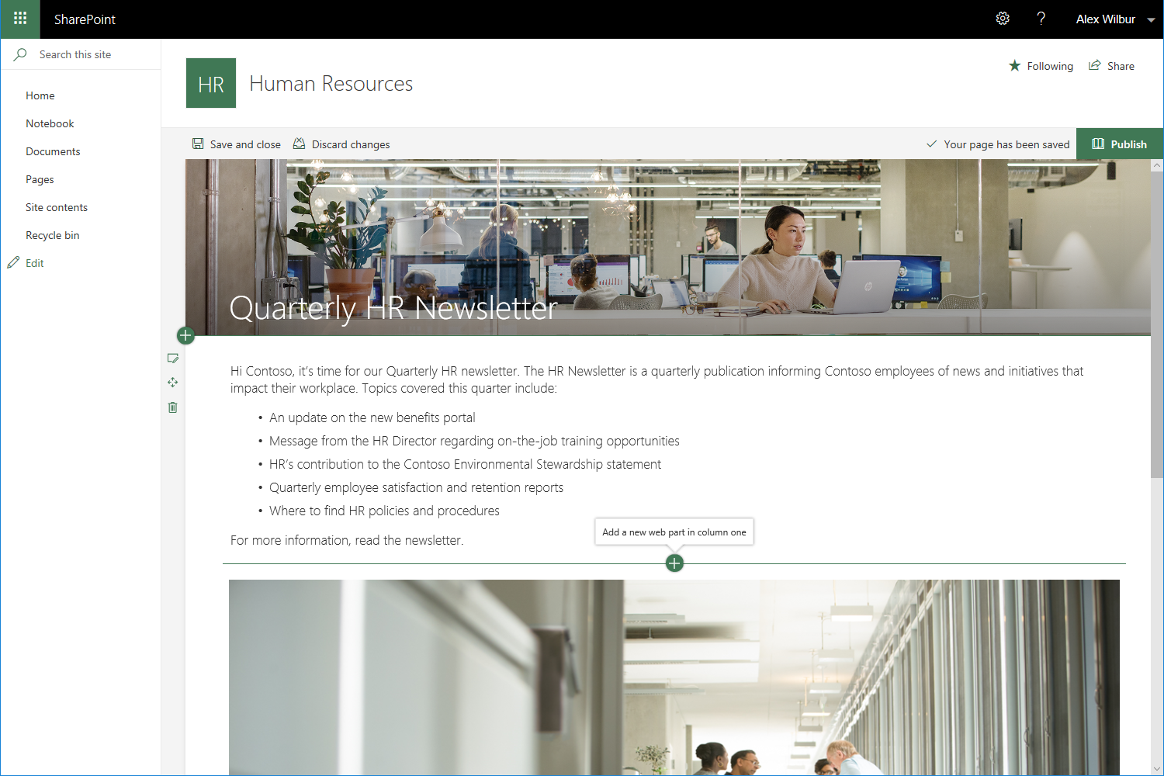
Modern Pages
Beautiful pages made easy
Rich authoring
Modern web parts for your modern SharePoint
Notes:
Poenostavljeno kreiranje novic, strani, inline editing, moderni web parti v SharePoint itd.

Slide 15
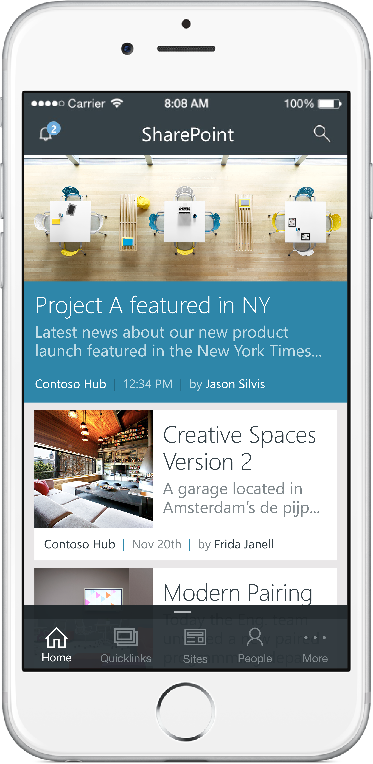
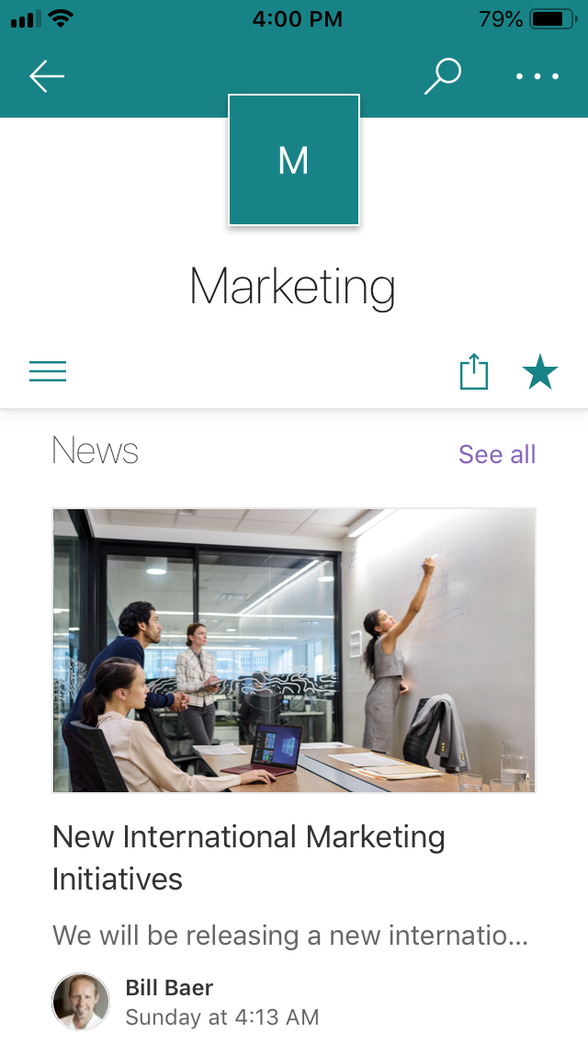
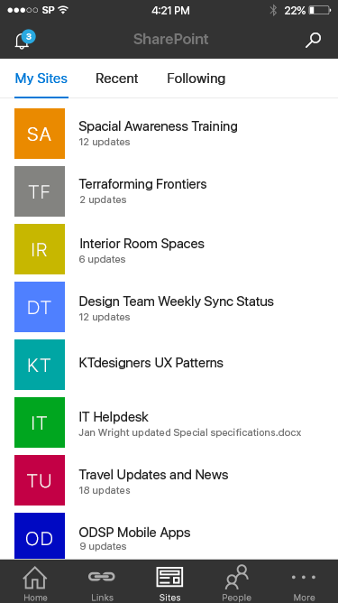
Mobile
Beautiful sites on every device
Get SharePoint on the go with the SharePoint Mobile App
Notes:
Vse skupaj je responsive, mobile friendly.

Slide 16
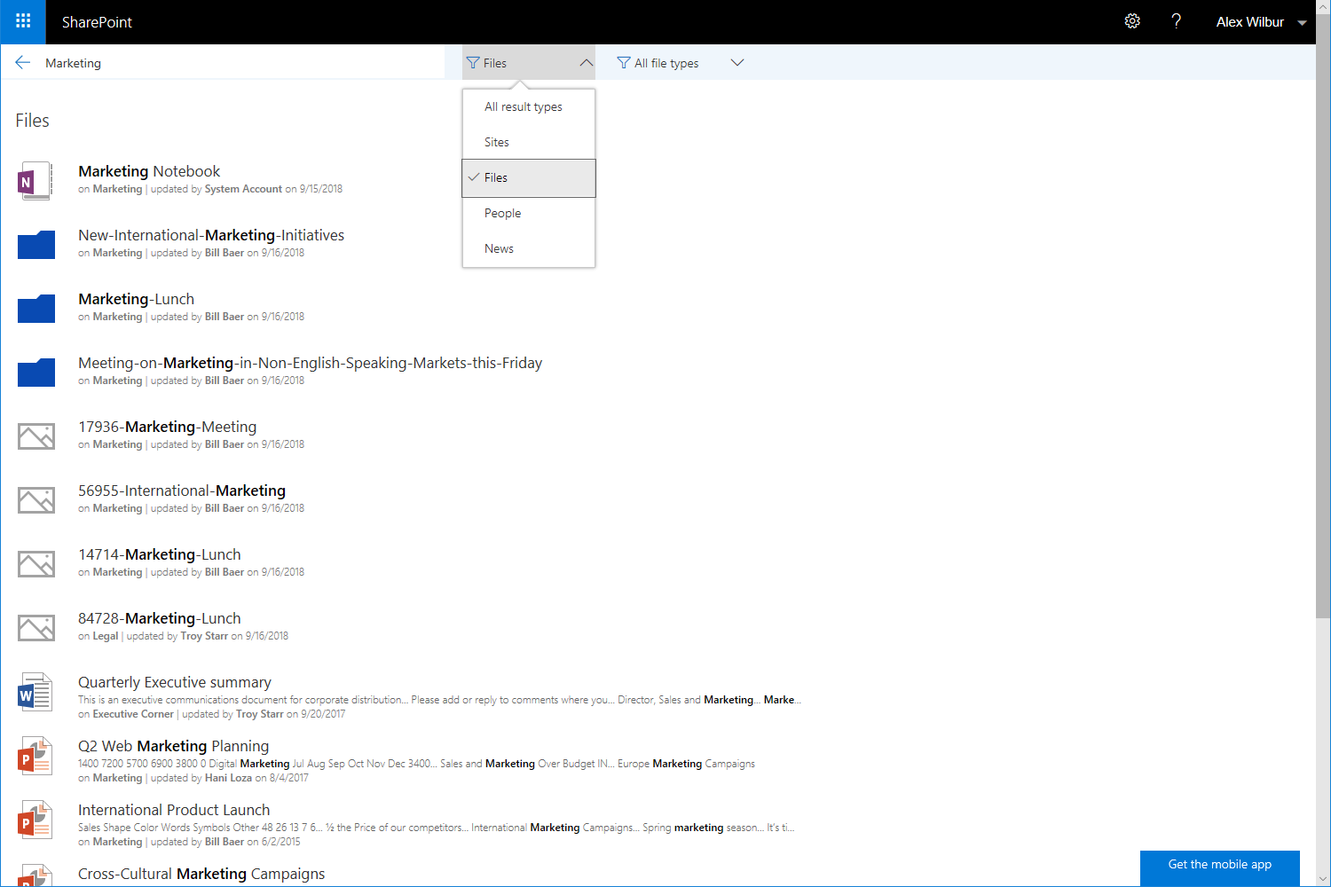
Search
Modern search experience
Type ahead contextual results in search box
Modern search result page for SharePoint Home and Site search
Improved language detection
Notes:
Nov je seveda tudi Modern Search experience

Slide 17
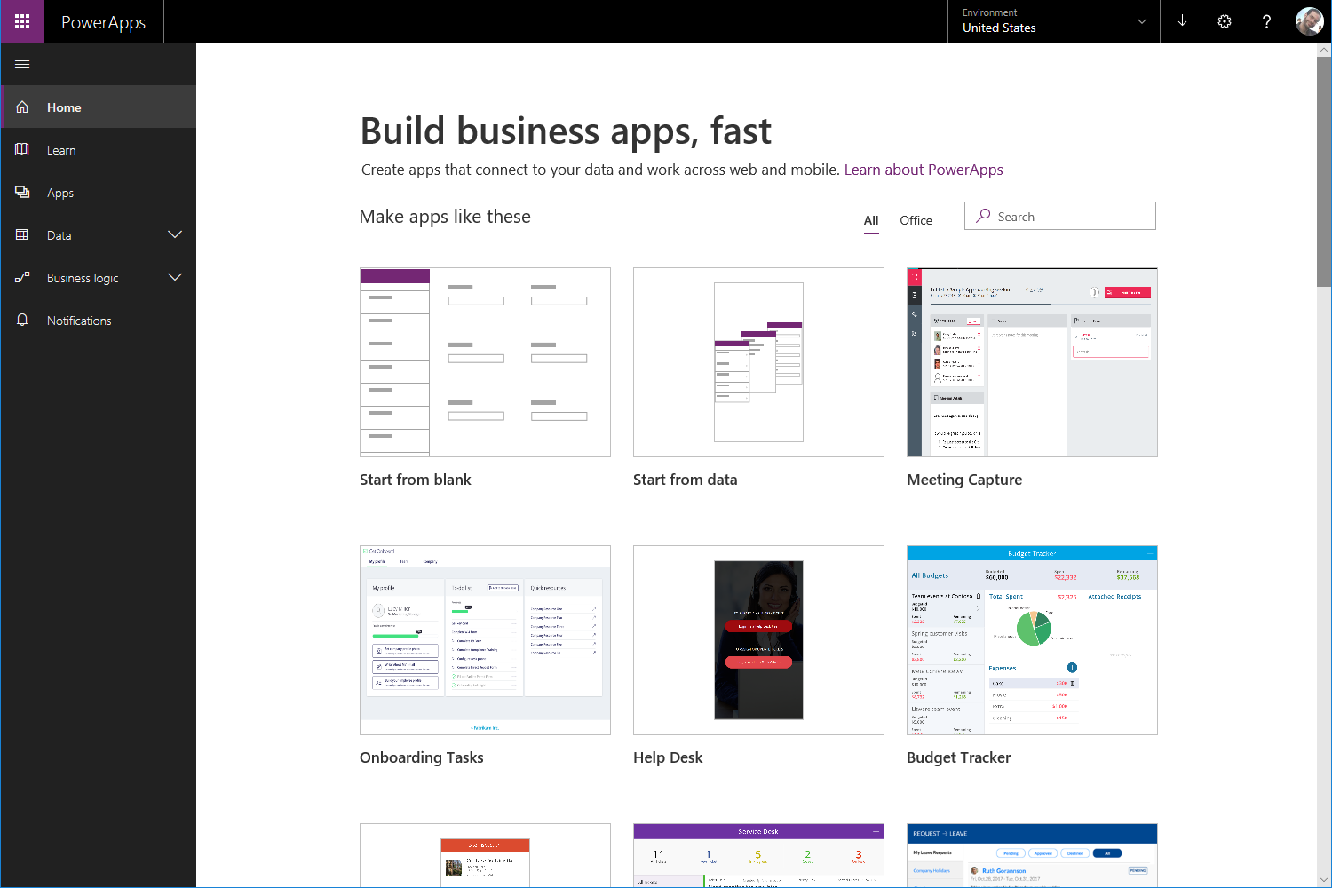
Workflow Support
Connectivity from PowerApps and Flow services to SharePoint 2019 using data gateway
Continued support for SharePoint 2010 and 2013 workflows
Notes:
Prav tako je bil izdelan nov Workflow manager, ki podpira tudi stare 2010 in 2013 workflowe ter možnost povezave na PowerAppse in Flow s on-prem Sharepointom 2019 preko data gatewaya.

Slide 18
Developer Value

Slide 19
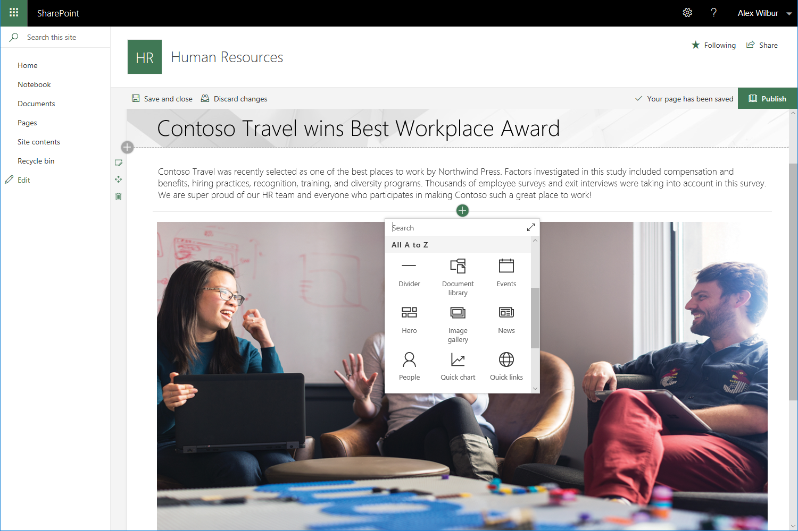
SharePoint Framework
Build custom lightweight and mobile ready client-side web parts
Extend SharePoint experiences within modern web page and libraries using Extensions
Automate business processes using webhooks
Notes:
S perspektive developerja je bil razvit SharePoint Framework, ki omogoča izdelavo mobile ready client-side web partov, s katerimi lahko razširimo experience na SharePointu s svojimi funkcionalnostmi itd.

Slide 20
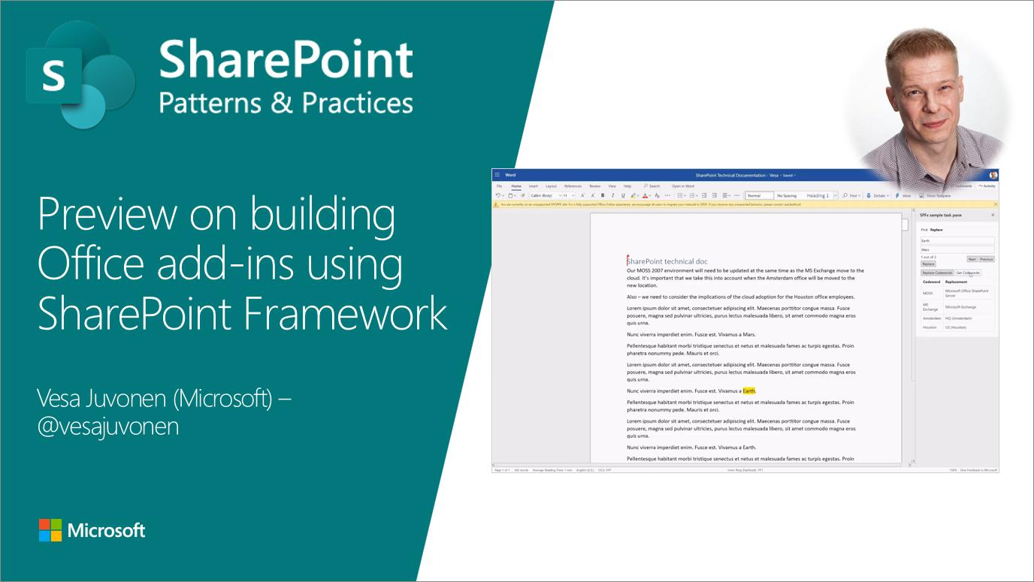

Slide 21
IT
Value

Slide 22
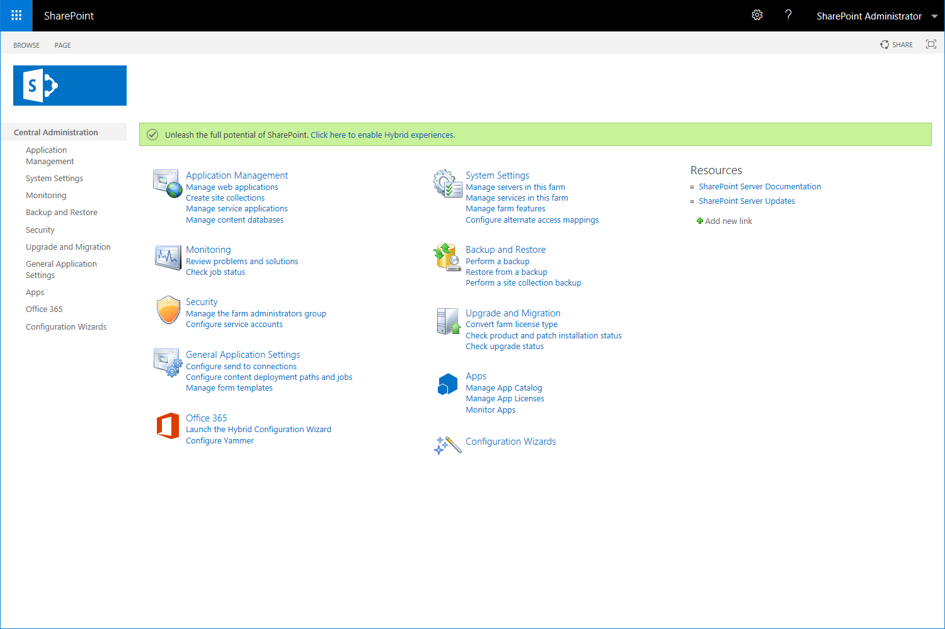
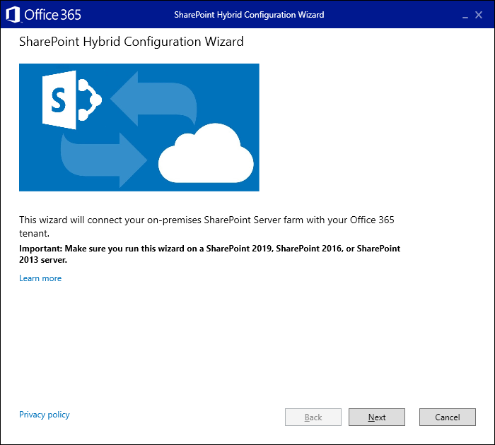
SharePoint Hybrid
Hybrid made easy
Launch the Hybrid Configuration Wizard directly from Central Administration
Notes:
Iz IT perspektive je bil poenostavljena postavitev hibrida

Slide 23
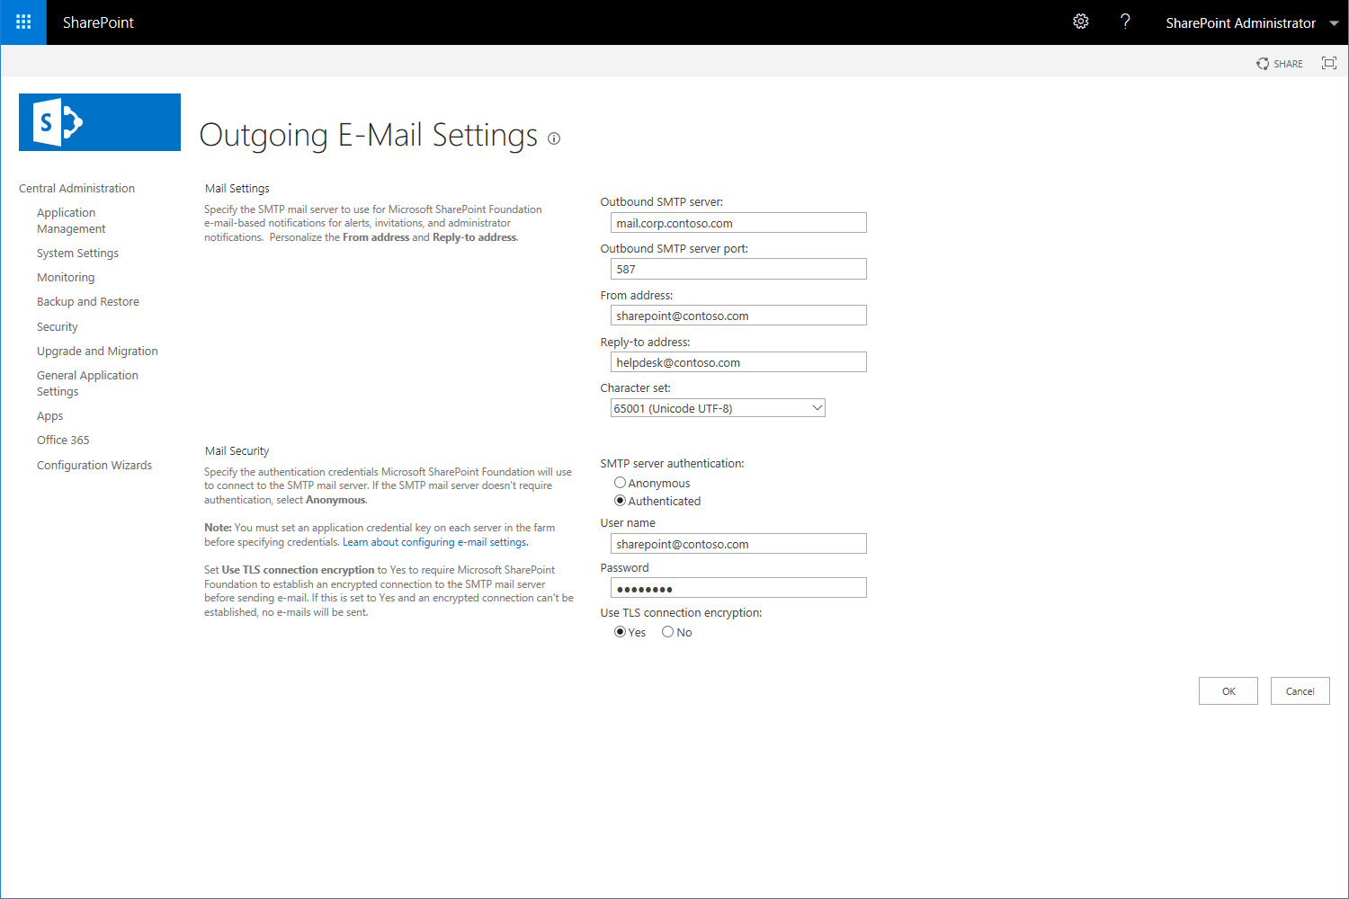
SMTP Server Authentication
SharePoint can now authenticate to your SMTP email servers
  No more anonymous relays just for SharePoint
Notes:
SMTP končno potema autenticated, ne več anonymous

Slide 24
Infrastructure Improvements
Expand supported characters
  # and % in file and folder names
Long URL path
  400 Characters for MAXURL
Recycle Bin recovery improvements
  Recover your content deleted by others from your recycle bin
Performance improvements
  Up to 25% file I/O performance improvements
Modernize IIS integration
  Remove IIS6 dependencies by switching to modern IIS APIs
Notes:
v imenih folderjev lahko dodamo posebne znake
Dalši URL path
Boljši koš
Boljše performance
Pobrane proč IIS6 dependencies

Slide 25
SharePoint 2019 Deprecations
Deprecated features
Access Services 2010 & 2013
Aggregated Newsfeed
Custom help
InfoPath Client / InfoPath Services
Lists web service
Machine Translation service
PerformancePoint Services
SharePoint Designer
Site Mailbox
Site Manager
Removed features
Automatic mode in incoming email
Code-based sandbox solutions
Digest authentication
Multi-tenancy
Silverlight rendering in PerformancePoint Services and Visio Services
SQL Reporting Services integrated mode
Power Pivot
Power View
Notes:
Kaj je bilo odstranjeno, kaj je deprecated

Slide 26
Software Requirements
Windows Servers
Database Servers
Windows Server 2016
SQL Server 2016
Windows Server 2019
SQL Server 2017

Slide 27
2019 vs Online
Notes:
Poglejmo si, kakšne so trenutne razlike med 2019 in Online SharePointom

Slide 28
SharePoint 2019 vs SharePoint Online
SharePoint 2019
Almost all developer features from SP 2016
PowerApps & Flow support with On-premises data gateway
Event receivers, Timer jobs
Custom Site Definitions, Custom Site Provisioning
Custom Server Side code
A lot of missing modern SharePoint features (likes on news, modern design, modern news etc.)
SharePoint Online
PowerApps & Flow support
Hub sites only for SharePoint Online
MS Flow + Azure
PnP Provisioning Engine
MS Graph
A lot of new features first
New central administration
Notes:
Na SharePointu 2019 imamo na voljo skoraj vse developer feature oz tehnike, ki jih poznamo že iz SharePoint 2016 (torej kreiranje seznamov, web templatov, content typov, columnsov, web partov, event receiverjev, timer jobov itd) -> torej vse zadeve, ki smo jih lahko dodali preko WSP solutiona.
Na SharePoint Online tega nimamo.
Na SharePoint online imamo za to na voljo cel kup novih funkcionalnostih, ki so jih razvili za to, da lažje premostimo to izgubo.
Namesto InfoPatha je bil razvit oz se razvija PowerApps, ki ga lahko uporabljamo tudi na 2019. Namesto starega in zelo slabega workflow 2010 in 2013 so razvili Flow, ki ga lahko tudi uporabljamo na 2019. Ima sicer še par slabosti, ampak niso kritične.
Samo na SharePoint Online imamo Hub sites.
Na SharePoint 2019 imamo Event receiverje, kar na Online rešimo v kombinaciji z MS Flow + Azure.
Namesto timer jobov na online uporabimo Azure funkcije oz Azure jobe.
Namesto Custom Site definicij oz web templatov imamo na online zelo močno orodje PnP Provisioning Engine, ki si ga bomo na kratko danes tudi pogledali.
Na 2019 imamo možnost pisanja Server Side kode. Sicer imamo to možnost tudi na Online, ampak je ta server side koda lahko samo remote, spet na azure.
Na Online imamo končno tudi nova centralna administacija, ki je ravno tako moderna -> ni še v celoti prenesena.
Slabost je da imamo na 2019 še veliko manjkajočih modern SharePoint featurejev, ki jih poznamo iz Online, saj je trenutna verzija SP2019 pobrana iz Online verzije sredi leta 2018, kar pomeni, da veliko stvari, ki jih je bilo od takrat razvitih na Online, tu še ni -> teh stvari pa ni malo. SharePoint se v zadnjem dobrem letu razvija zelo hitro.

Slide 29
Demos

Slide 30
What’s new,
What’s next

Slide 31
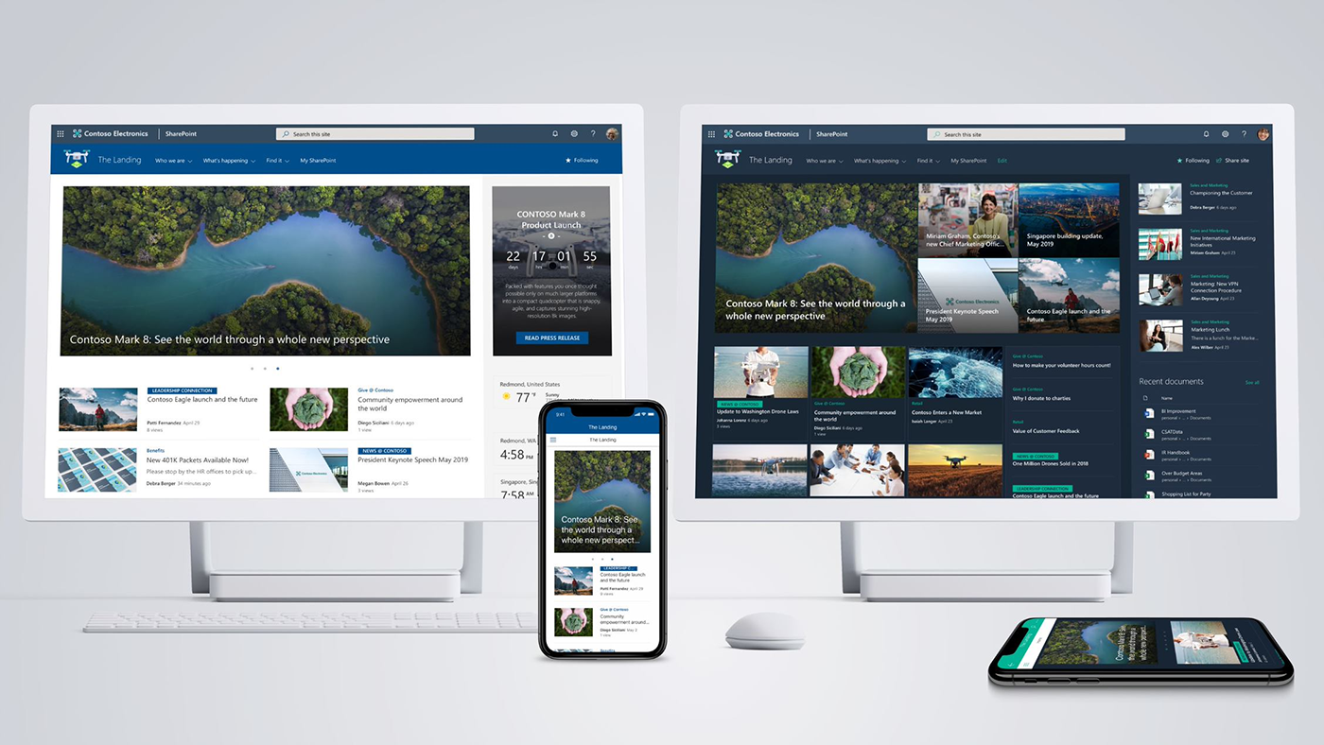
SharePoint Home Sites
TROY

Slide 32
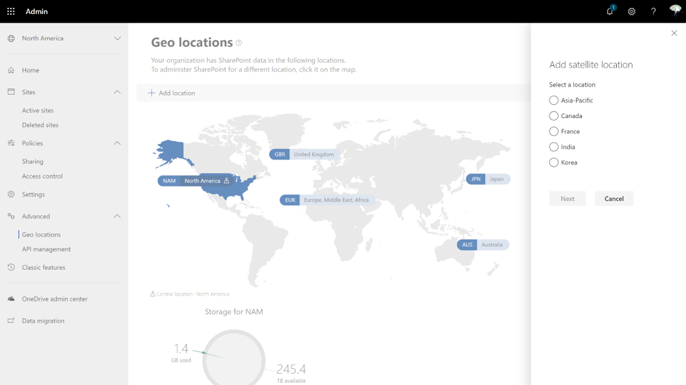
Multi-geo
TROY

Slide 33
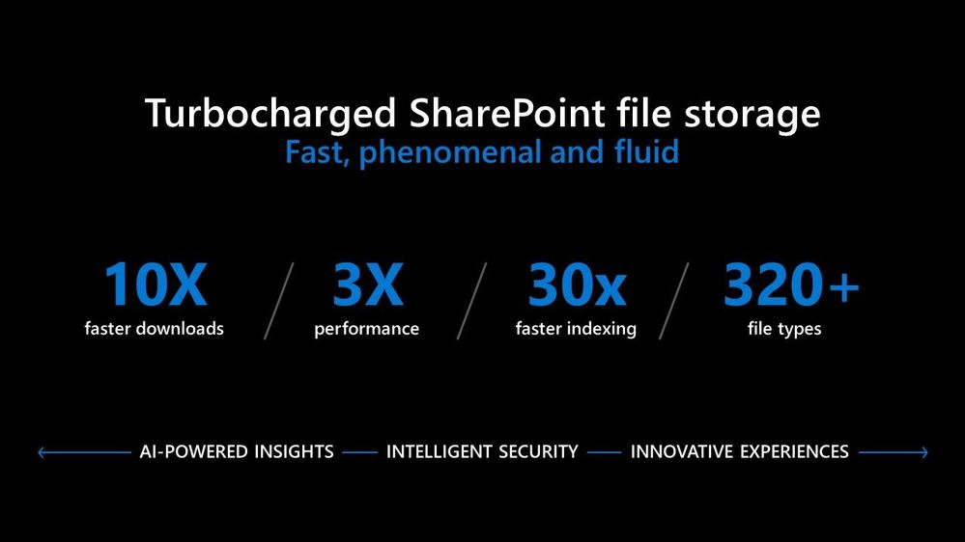
Turbocharged SharePoint file storage

Slide 34
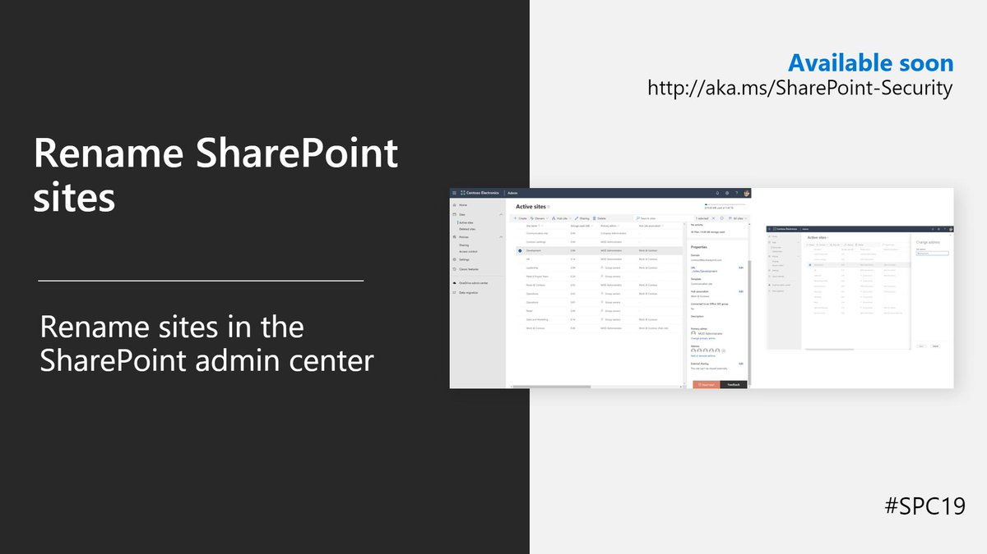
Rename SharePoint sites and change the URL

Slide 35
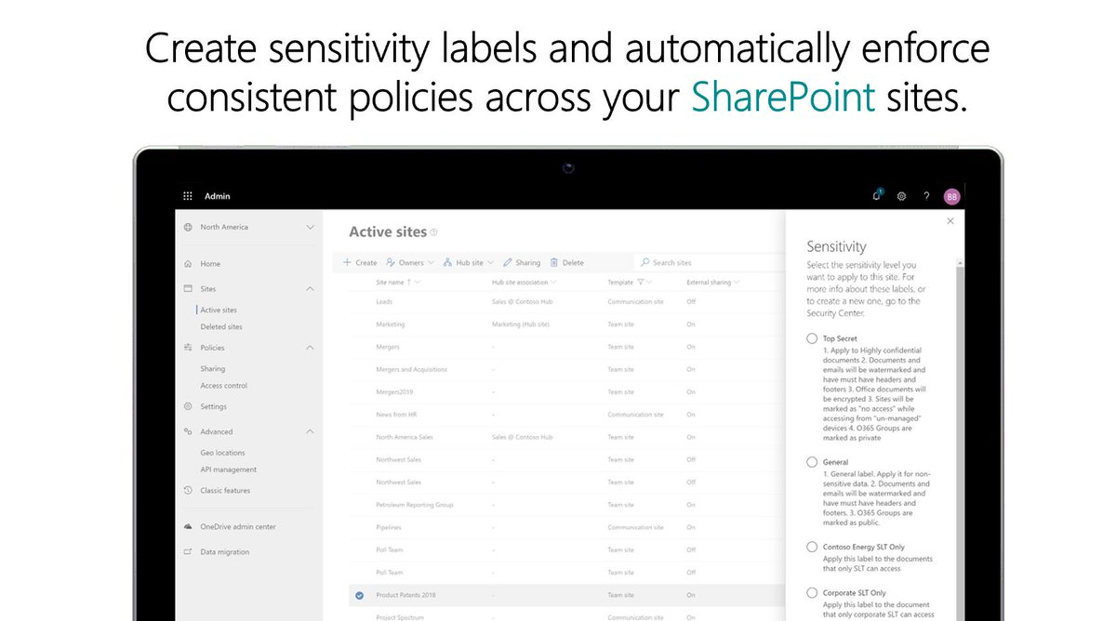

Slide 36
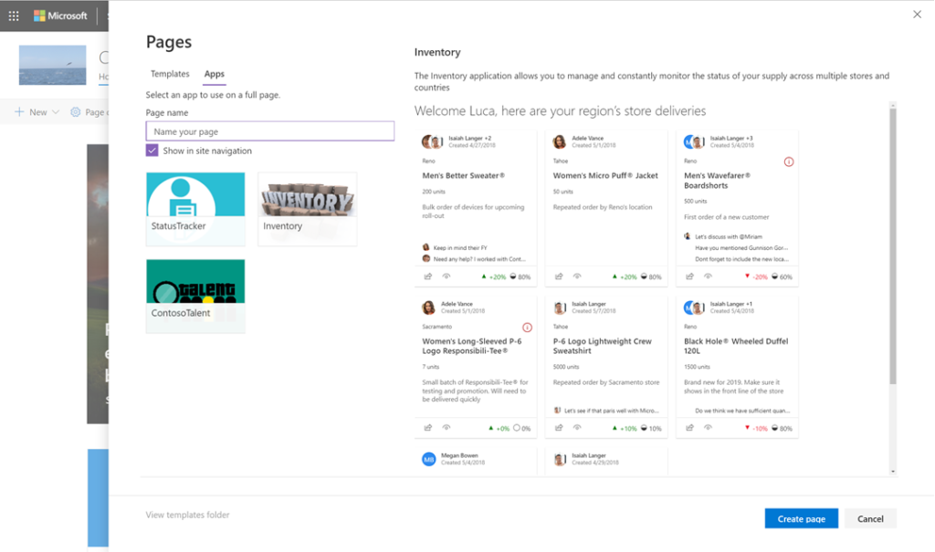
SPFx 1.8 – Application Pages

Slide 37
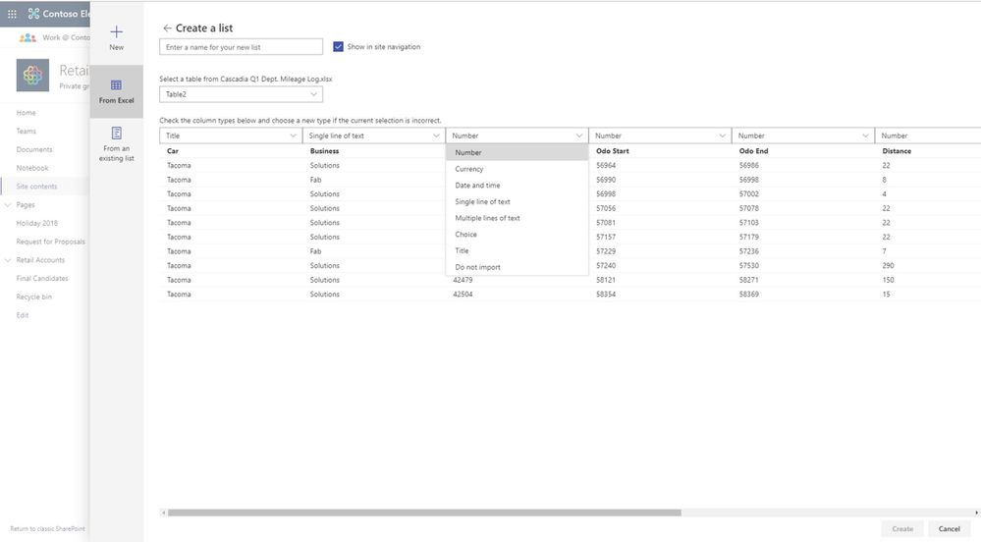
Create List from Excel

Slide 38
What to choose?

Slide 39
When to Choose Sharepoint Online?
TROY
For organizations looking to build a scalable and fault-tolerant SharePoint farm
Most recent updates & features from Microsoft
Notes:
Če hočeš skalabilnost in farmo brez napak / težav, potem izberi Online
Pa seveda če hočeš dobit vedno zadnje update

Slide 40
When to Choose Sharepoint On-Premise?
TROY
For organizations with high-security standards,
Customization requirements,
Seeking for more storage than Microsoft offers
Notes:
On-Premise
Za org z višjimi security standardi -> če pač nočeš v cloud
Requirementi po večjih customizacijah, čeprav lahko 99% stvari narediš tudi v cloudu, samo na drugačne način, ne več tako old way
Če rabiš več storagea

Slide 41
Links

Slide 42
Links
SharePoint Look Book: http://aka.ms/sharepointlookbook
SharePoint Online Provisioning Service: http://aka.ms/spprovisioning
SharePoint Starter Kit: https://github.com/SharePoint/sp-starter-kit
PnP Provisioning Engine: https://docs.microsoft.com/en-us/sharepoint/dev/solution-guidance/pnp-remote-provisioning
Microsoft Graph Toolkit: https://github.com/microsoftgraph/microsoft-graph-toolkit

Slide 43
?

Slide 44
MS300 Deploying Microsoft 365 Teamwork 7.-11.10. 2019
MS 301 Deploying SharePoint Server Hybrid 26.-30.8.2019
SharePoint Online Power User 26.-29.8.2019
SharePoint Online for Administrators 2.-4.9.2019
Programming in C# with Microsoft Visual Studio 17.-21.6.2019
Programming in HTML5 with JavaScript and CSS3 8.-12.7.2019
Več na https://www.kompas-xnet.si

Slide 45
10. Thrive konferenca
Termin: 12. - 13. november 2019
Lokacija: Hotel Jama - Postojnska Jama, Slovenija
Info: https://www.thriveconf.com
Več na https://www.kompas-xnet.si
Notes:
Do 31.5. 30% popust (zgodnje prijave)

