Slide 1
Windows without windows...
First steps…. Remote Management… Windows Admin Center
By Matjaž Žnidar

Slide 2
Remote management till now
Server Config tool
Remote server administration tools (RSAT)
PowerShell

Slide 3
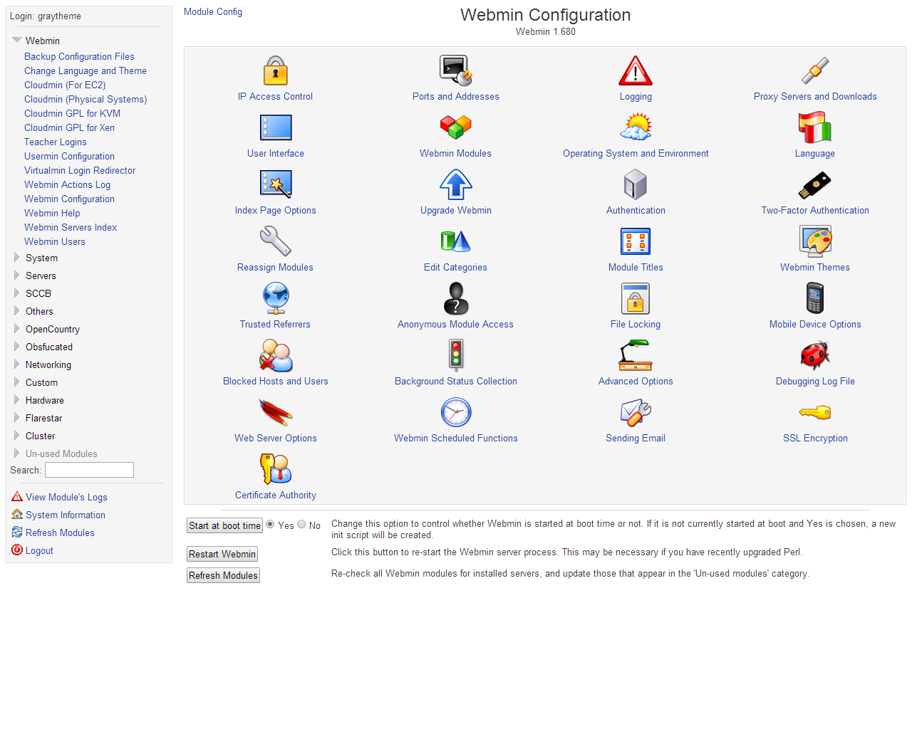
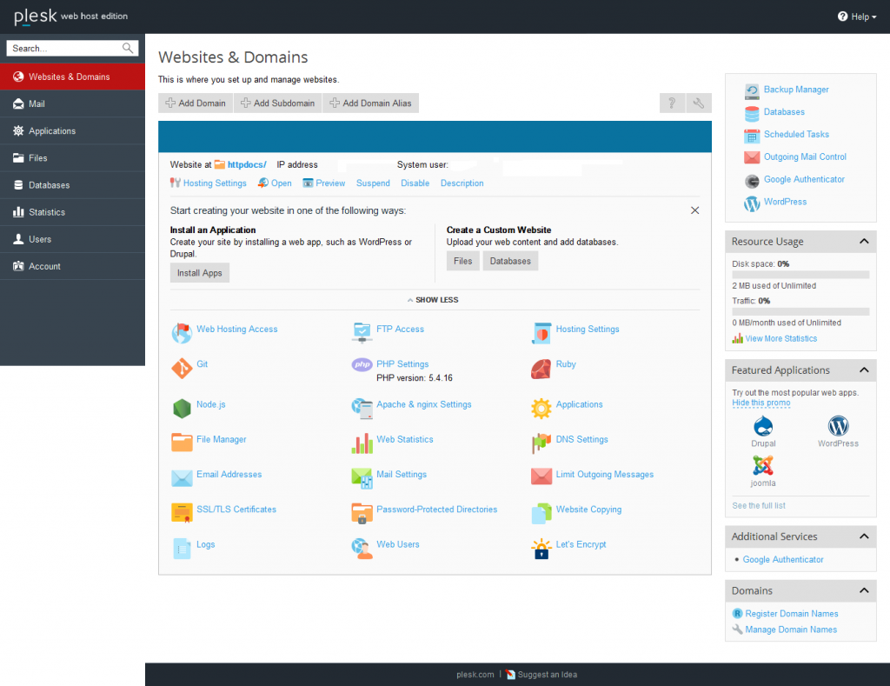
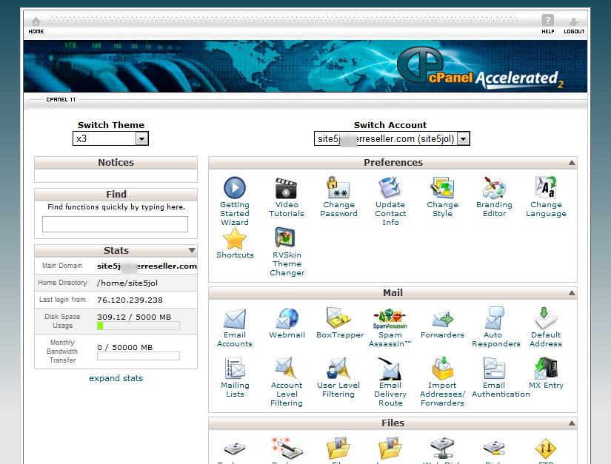
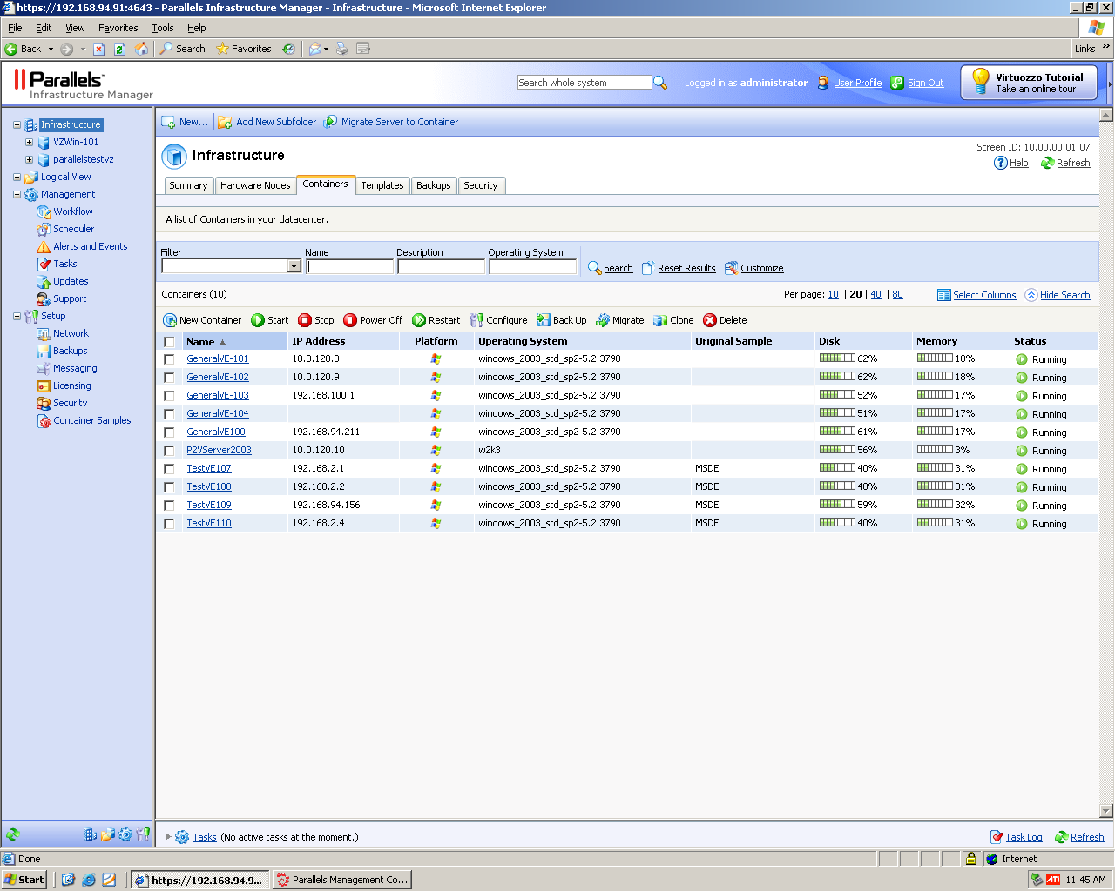
Do we know some Web based management tools?

Slide 4
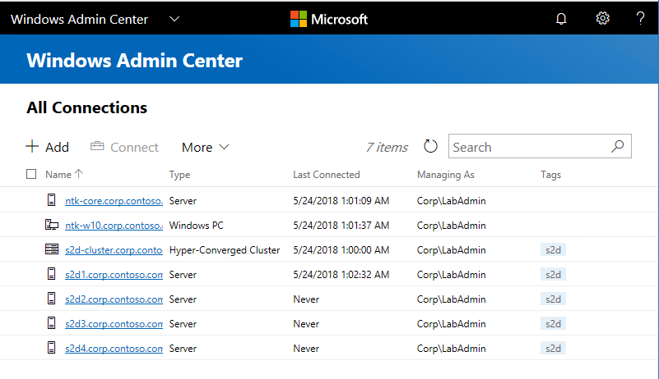
Windows Admin Center (Honolulu project)

Slide 5
Demo
Windows Admin Center

Slide 6
What can you do in Windows Admin Center 1/2
Change computer name and domain
Manage certificates
Manage devices and update drivers
View and filter Event Logs
Manage files
Change Firewall settings
Manage local users and groups

Slide 7
What can you do in Windows Admin Center 2/2
Change network, registry and install/remove roles & features
Remotely connect to PowerShell and Remote Desktop
Manage and install Widows updates
Manage Cluster network, nodes, roles and other resources
Manage S2D cluster (those with 2018-04 CU installed and newer
Much more to come in very fast pace!!!

Slide 8
Few facts about Windows Admin Center
You can manage Servers and Clients
You can use different user for each managed machine
Managed machines need to have PowerShell 5.1 installed
New features are being added on monthly basis
There are 3rd party addons being added
You need to have only one port opened for management
It is HTML 5 based and runs on modern browsers only
Installation is less then 40MB
Cost → nothing, 0€, nada, nič

Slide 9
How to proceed with Windows Server CORE
Go and start using PowerShell (e.g. mva.ms )
Implement your first Windows Server Core (you can use aka.ms/WSLab )
Learn some more PowerShell
Get info from several servers at once
Automate repetitive tasks and stop loosing time
Invest gained time to learn something new
There are several conferences and community events available, where you can learn new and interesting “stuff” (e.g. ExpertsLive.eu, SloWug.si, Cancel.si...)

Slide 10
Few words about me
Follow me on Twitter → @MatjazZnidar
Visit my blog → https://m-12.net
Mail me → matjaz@m-12.net
Stay curious and never stop learning!!
Thank you

