Slide 1
Azure track:
Virtualni Datacenter
Tomaž Čebul, Microsoft
Robert Potočnik, Microsoft
Andrej Kašnik, Microsoft
Matjaž Perpar, Microsoft
Peter Zdovc, Span

Slide 2
Azure Track
Azure track - Pregled oz. “Moj drugi PC je Azure”
Azure track - Arhitektura navideznega podatkovnega centra
Azure track - Vzpostavljanje infrastructure in storitev (Deployment)
Azure track - Upravljanje z infrastrukturo in storitvami (Hybrid Cloud Management)
Azure track - Najaktualnejši scenariji uporabe (Workloads)
Azure track - Pogled v prihodnost (Future view)

Slide 3

Agenda
Looking back
VDC architecture patterns
VDC “infrastructure” components

Slide 4
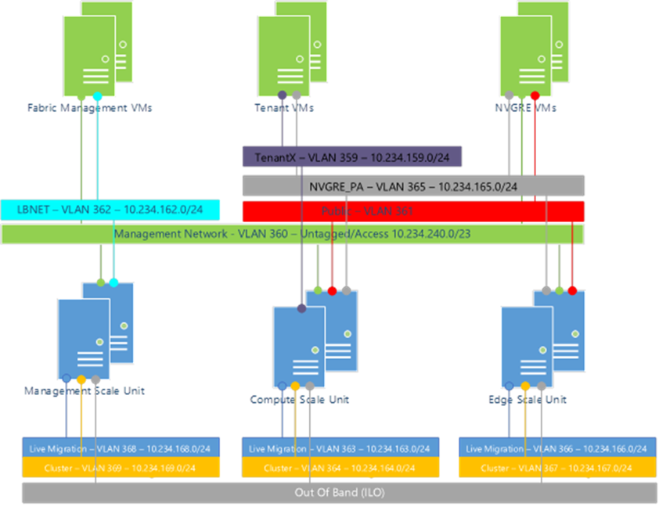
Once upon a time…

Slide 5
…and then this happened.

Slide 6
Span of controls between Microsoft and Customer
You manage
Managed
by Microsoft

Slide 7
Spectrum of control and trust
Maximum
CONTROL
Outsourced TRUST
IaaS
PaaS
SaaS
Isolated VMs
Trusted Execution Environment
SQL Transparent Encryption, Azure Services in a VNet
Customer Lockbox
Azure Active Directory, Azure Key Vault
Underlying trusted platform
Azure Control Plane, Just in Time Access, Monitoring, Audit and Reporting

Slide 8
MSM applied to IT’s position in the modern enterprise
Traditional Enterprise
Modern Enterprise
Business Unit
Service Consumer
Developers & functional application owners
BIZDEVOPS teams
IT as partner
(Cloud Competence Center, Setup BizDevOps / AzureFoundation)
It as middlemen for service strategy, design, transition, and operation
IT Department
IT as broker
(Remaining IT functions e.g. procurement, billing, compliance)
Hosting/Cloud Provider

Slide 9
Goal: Give customers a familiar reference point
What do large enterprise customers desire?
Reduction in costs to reproduce in Azure the isolation, security policy, and audit model they have today
Mature tools that identify Azure workload suitability, one-time costs, and operational costs
Allow developers to do their work independent of central IT overhead while conforming to policies
Virtual Datacenter deliverables:
Develop tooling that automates the Azure deployment of isolation & policy for sophisticated Enterprises
Package suggested practices, tools, and models that support Azure migration decision making
Integrate with Microsoft Developer Tools to enable governed applications and CI/CD pipeline
Integrate with Microsoft Operations Management Suite

Slide 10
A retrospective: How we got here…
    Cloud is great for individual workloads
    Leads to many isolated workloads
    We can get more efficient
    We can apply an isolation policy
    We can make the cloud more analogous to your datacenters
  Common Components:
    Infrastructure
    Perimeter Networks
    Security Policy
    Monitoring

Slide 11



The Azure enterprise scaffold
Azure Resource policy
& audit
Azure scaffold
Naming standards
Resource tags
Resource locks
Pillars
Resource groups
Azure automation
Core
Foundation
Role-based access controls
Azure Security Center
Subscriptions
Account/enterprise agreement
aka.ms/Azure/Scaffold

Slide 12
The foundation – Enterprise enrollment
…and departments, accounts, and most importantly—subscriptions.
Enterprise enrollment
You may be tempted to skip or shorten this step! DON’T!
The repercussions are lasting and will impact your satisfaction with Azure

Department A
Department B
Account A
Account B
Account C
Subscription 1
Subscription 2
Subscription 3
Subscription 4
Finance/Business
  Concerned with how
  costs can be monitored, rolled up, and ultimately
  correctly allocated
Security/Risk Mgmt.
  Concerned about everything …but mostly looking to ensure that appropriate controls are in place
Technology Pro
  Concerned with how they will manage the growth and where
  to put resources

Slide 13
Subscriptions are the cornerstone
…Determine the model you will follow before anything else!
Technical requirements
App
Business requirements
Lifecycle
Security requirements
Dept.
Scalability requirements

Slide 14
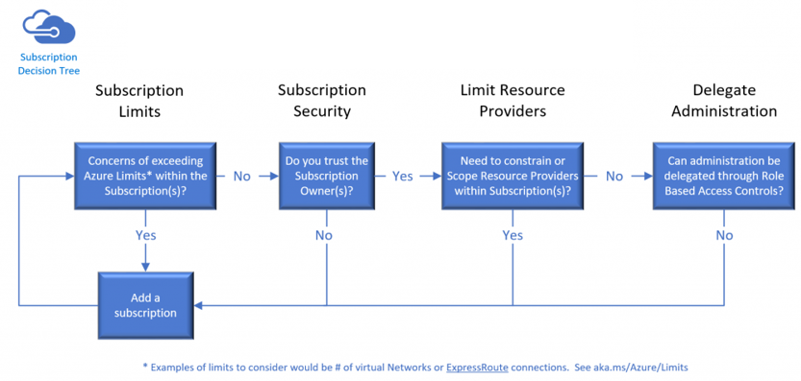
Subscription principles
Subscriptions are…
  The first top level container you create
  Equipped to support RBAC delegation
  A billing unit
  Logical limits of scale
Considerations
  Subscriptions do not cost anything
  Each subscription has its own admins, although a single account can be an admin in multiple subscriptions
  Subscriptions are global
  Start with “Can we do this with one?”
  Then justify adding more
aka.ms/Azure/Subscriptions aka.ms/Azure/Limits

Slide 15
Containers and resources
Subscription is the top-level container
Create resource groups in the subscription
Place resources within the resource groups

Slide 16
Azure Governance layers
Functional
Business Division
Geographic
Functional
Enterprise
Enterprise
Enterprise
Enterprise
Departments
[optional]
Finance
Marketing
Auto
Aerospace
North America
Europe
Accounts
Adi Krishnan
Ted Bear
Grace Ma
Joe Smith
Jane Doe
Lin Chi
Subscriptions
Project 1 Dev
Project 1 Test
Production Websites
Application 1
Application 2
Application 3
Project 1
Project 2
Project 3

Slide 17
Subscription considerations
Management approach
  Single team or distributed
  RBAC
  Separation of Duties
Security requirements
  Data or network security
  Environments - Sandbox, Dev, Test, UAT, Pre-Prod, Prod
  Compliance standards, Least Privilege
Connectivity requirements
  Single point of ingress?
  Multiple regions?
Application requirements
  Data flow
  Compliance

Slide 18
Multiple subscriptions = Complexity
Purpose and objectives
  Multiple Azure subscriptions mean:
    Duplicate provisioning and management: IP Address space, network circuits, gateways, VNets, Subnets, NSGs, routing
    More connectivity to manage
    More security to manage
    More identities to manage
    Potentially more ExpressRoute circuits to buy
  Multiple subscriptions are going to happen nevertheless—design for it as N+1 aka.ms/Azure/Subscriptions
Resource Groups
vs

Slide 19
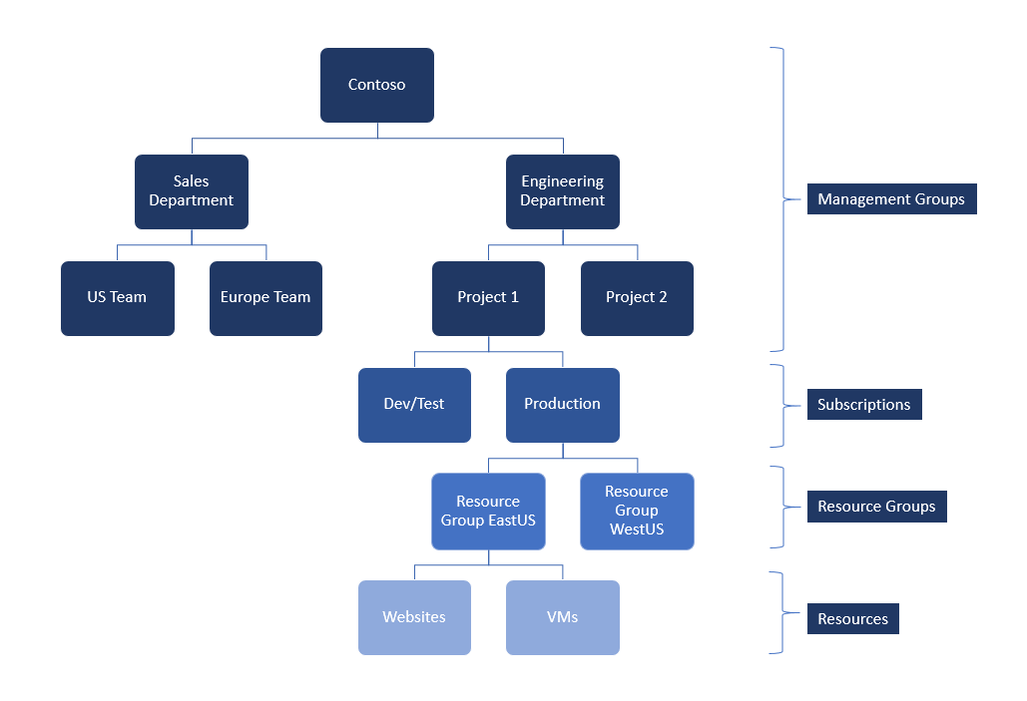
Azure Management Groups
Private Preview
Purpose
  Organize Multiple Azure subscriptions
    Manage
      Access
      Policy
      Costs
      Compliance
  Trust with Azure AD
    Trust a single Azure AD Tenant
    NOTE: Policies are NOT enforced across directories
  aka.ms/Azure/MgtGroups
  Check link for current status

Slide 20
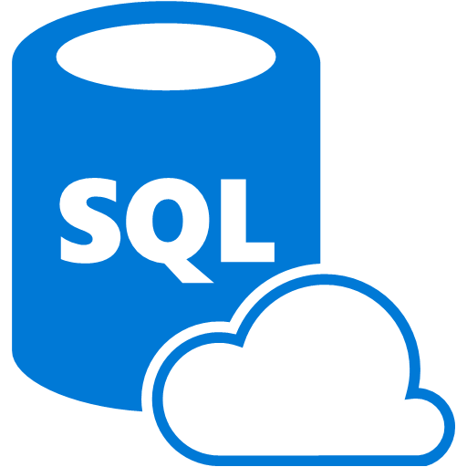



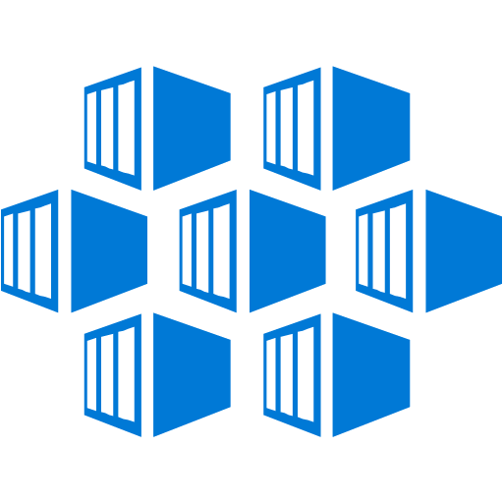
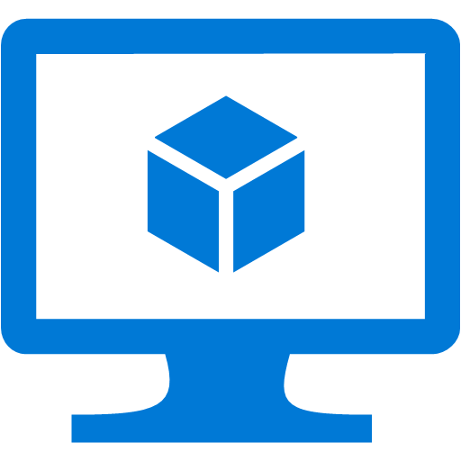

The pillars – Naming standards
Allow easier identification of resources in the Portal,
logs, etc.
Allows easier breakout of data in Dashboards and Billing
Enables scripting and automation by having standard conventions
Enables Microsoft
to better help the customer! (not having
100 subscriptions
named Microsoft
Azure Enterprise)
https://docs.microsoft.com/en-us/azure/architecture/best-practices/naming-conventions

Slide 21
The pillars – Azure Resource Manager policies
…enable you to address many concerns.
Finance/Business
  How can I be notified when costly resources are created?
  How can I ensure that new resources are identified with common information like “Cost Center?”
{
"if" : {
<condition> | <logical operator>
},
"then" : {
"effect" : "deny | audit | append“
}
}
Security/Risk Mgmt.
How do I ensure we don’t violate data sovereignty rules?
How can I find out when resources are created so I can verify they follow our Security Policies?
Technology Pro
How can ensure my subscriptions have only allowed resources?
Can I make sure developers follow our established naming conventions?
https://docs.microsoft.com/en-us/azure/azure-policy/azure-policy-introduction

Slide 22

The core – Resource groups, tags, and RBAC
Finance/Business
Need to be able to break out costs by various dimensions such as customer, cost center, environment
Technology Pro
Wants to maximize the use of a subscription (multiple apps)
Wants to know who owns certain resources
Wants to deploy and manage apps as a unit
Security/Risk Mgmt.
  Want to ensure that those with “need” have access to resources
  Want to design for “least privilege access” to ensure that the access is appropriate to the role
Create roles with appropriate permissions
Resources in a RG should be tagged as needed
Always Tag!
Owner
Dept.
Environment
Best practices on using Resource Tags: https://docs.microsoft.com/en-us/azure/azure-resource-manager/resource-group-using-tags
Custom RBAC Roles: https://docs.microsoft.com/en-us/azure/role-based-access-control/custom-roles

Slide 23
The core – Res. locks, automation, Security Ctr.
Finance/Business
Not much to make
finance happy here, but hey, what can you do?
From the business POV, these capabilities increase stability and availability
Smart use of automation allows business to be more flexible to demand
Technology Pro
Ensures stability of subscriptions by locking key resources from deletion or modification
Allow Technology Pros
to create libraries of
reusable code to manage their environments
Ensure that new resources aren’t accidently exposing the company’s information
Security/Risk Mgmt.
Gives the security and risk management teams the ability to see where they are vulnerable and how to address

Slide 24
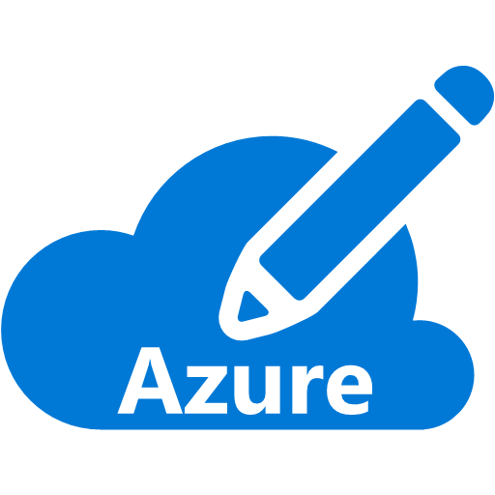



The Gooey Center – Core Network
Technology Pro
Ensures that when resources are deployed, owners won’t inadvertently open up vulnerability
By setting up Network and security first, you can have a solid starting point
Will work with “VNET Peering” capability
Security/Risk Mgmt.
Enables a core set of initial NSG rules to be enabled BEFORE workloads are deployed providing a
secure foundation
Provides a separation
of internally focused
workloads and externally focused workloads
Allows for additional appliances in the environment for additional protection
Internal VNET
Subnet 1
Subnet 2
External VNET
Subnet 1
Subnet 2

Slide 25
Azure Resource Manager
Describe
Deploy
Control
Resource group
Azure Resource Manager
Azure Resource Manager
App
Database
Compute
Network
Storage
Microsoft Azure Stack
Microsoft Azure
aka.ms/Azure/ARM

Slide 26
Resource Providers
Resource providers are the API interfaces
Resource providers must be registered against a subscription before you can create resources
Subscription Owners automatically register resource provider as a resource
it provisioned
User that does not have subscription owner rights cannot provision an Azure resource until the resource provider is registered
To register Microsoft Resource Providers in a subscription:
Select-AzureRmSubscription -Subscriptionname $SubscriptionName
$providers = @(Get-AzureRMResourceProvider -ListAvailable | Where
ProviderNamespace -Match Microsoft)
foreach ($provider in $providers) {
Register-AzureRmResourceProvider -ProviderNamespace
$provider.ProviderNamespace

Slide 27
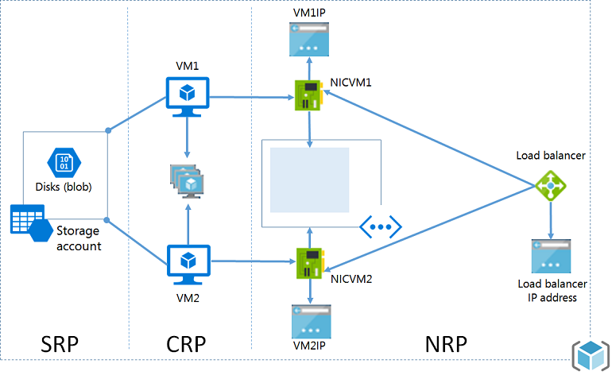
Azure Resource Manager
ARM with Resource Providers

Slide 28
Resource groups
Tightly coupled containers of multiple resources of similar or different types
Azure resources contained should
have the same lifecycle
Every resource *must* exist in one
and only one resource group
Resource groups can span regions
Nesting of resource groups not supported
Only Subscription Owners can create resource groups
RESOU
R
CE G
R
OUP

Slide 29
Resource group lifecycle
Question:
  Should these resources be in the same group or a different one?

Slide 30
Role-based access control
Users
Authentication
& authorization
Groups
Azure Resources
in resource groups
Service Principals
Azure Active Directory
Azure Subscription

Slide 31
Key RBAC concepts
Role definitions
  Describes the set of permissions
  (e.g. read actions)
  Can be used in multiple assignments
Role assignments
  Associate role definitions with an identity (e.g. user/group) at a scope (e.g. resource group)
  Always inherited – subscription assignments apply to all resources

Slide 32
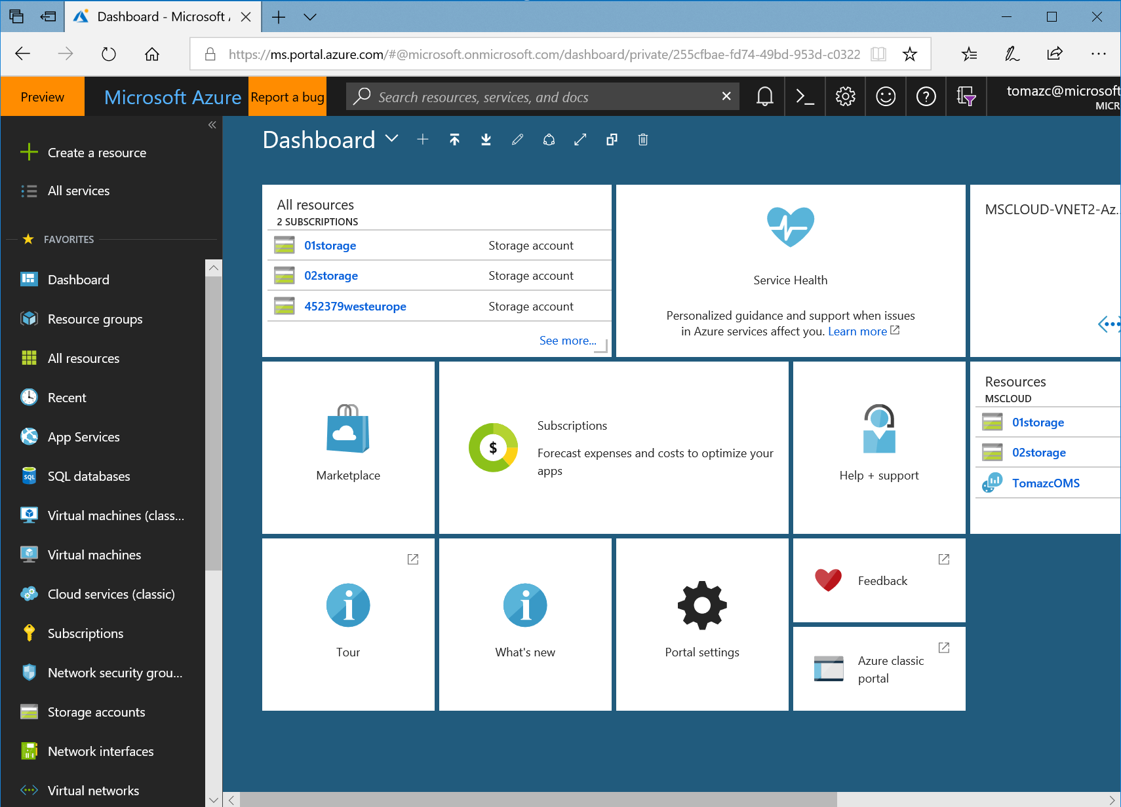
Least privilege as a model
Goal
  Users can do the tasks their job requires, but no more than that
Best practices
  Use the portal and ARM API
  Assign the built-in role first
  Follow least privileges
  Use resource groups

Slide 33
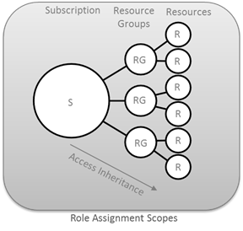
ARM hierarchy and RBAC roles
ARM provides a more granular RBAC model for assigning administrative rights at the resource level.
Owner
Can perform all management operations for a resource and its child resources including access management and granting access to others.
Contributor
Can perform all management operations for a resource including create and delete resources.
A contributor cannot grant access to other.
Reader
Has read-only access to a resource and its child resources. A reader cannot read secrets.

Slide 34
RBAC

Slide 35
RBAC – Granular scopes
/subscriptions/{id}/resourceGroups/{name}/providers/…/sites/{site}
subscription level – grants permissions to all resources in the sub
resource group level – grants permissions to all resources in the group
resource level – grants permissions to the specific resource

Slide 36
Roles for Azure subscription resources
Three primary roles:
  Owner, Contributor, Reader
  Permissions on all Azure resources
40+ resource-specific roles:
  Website Contributor, Virtual Machine Contributor, etc.
  Permissions scoped to resources and actions typically required by customers
  Will add more as new Azure resources come online
Custom roles:
  Allow customers to take existing actions and create a custom RBAC role
  Role must be loaded into each subscription
https://docs.microsoft.com/en-us/azure/active-directory/role-based-access-built-in-roles

Slide 37
Custom roles
Enhanced flexibility
Assignable to users, groups, or services
at different scopes
Can be shared across multiple subscriptions in the
same tenant

Slide 38
Assigning resource-specific roles
Requirements
  Map existing organizational roles (web, DB…) to their cloud solutions
  Many Azure resources that work together are peers in the same resource group
    Virtual Machine and storage account, web app, and AppInsights
  To fully manage a resource, a user may also need to manage its related peers
Best practice
  Assign resource-specific role on the resource group
Alternative
  Assign access to each resource individually

Slide 39
Key learnings from enterprise customers
Organizational accounts, not LiveIds
Resource groups, not subscriptions
Manage access using groups
Least privilege
Keep a tab on access changes

Slide 40
Hybrid network architecture

Slide 41
DMZ Public

Slide 42
DMZ private

Slide 43
Hub – Spoke pattern

Slide 44
Application service reference architecture

Slide 45
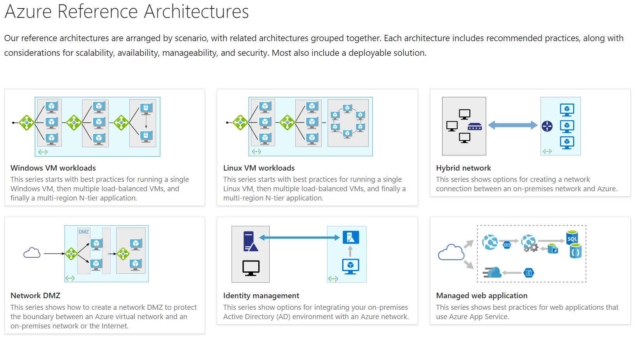
Azure Reference Architectures
https://docs.microsoft.com/en-us/azure/architecture/reference-architectures/

Slide 46

Demo Scenario
We want to host simple app in Azure
We need to apply organizational security policies
  Backend VMs with no internet access
  Frontend VMs internet access only through CheckPoint
  Treat Azure just as another Branch office
We need:
  Highly available Domain Controller (2 x VM WS2016)
  FrontEnd - App server (1 x VM WS2016)
  BackEnd - SQL server (1 x VM WS2016 + SQL2016)
  Connection with existing environment
  Network segmentation in Azure (DMZ, Frontend, Backend)

Slide 49
Deployment options
Manual
  Not easily repeatable
  Not easy to copy the deployment to a second region or subscription
Client-driven automation (PowerShell Script)
  Solves a lot of the manual deployment issues
  Burden of deployment logic and dependencies in the script execution and order
  Uses imperative logic
  Hard to parallelize
  ARM Templates
  Cloud-based orchestration engine
  Fully declarative
  Automatically optimizes the deployment based on dependency graph
  Complements and integrates PowerShell automation for deployment tasks

Slide 50
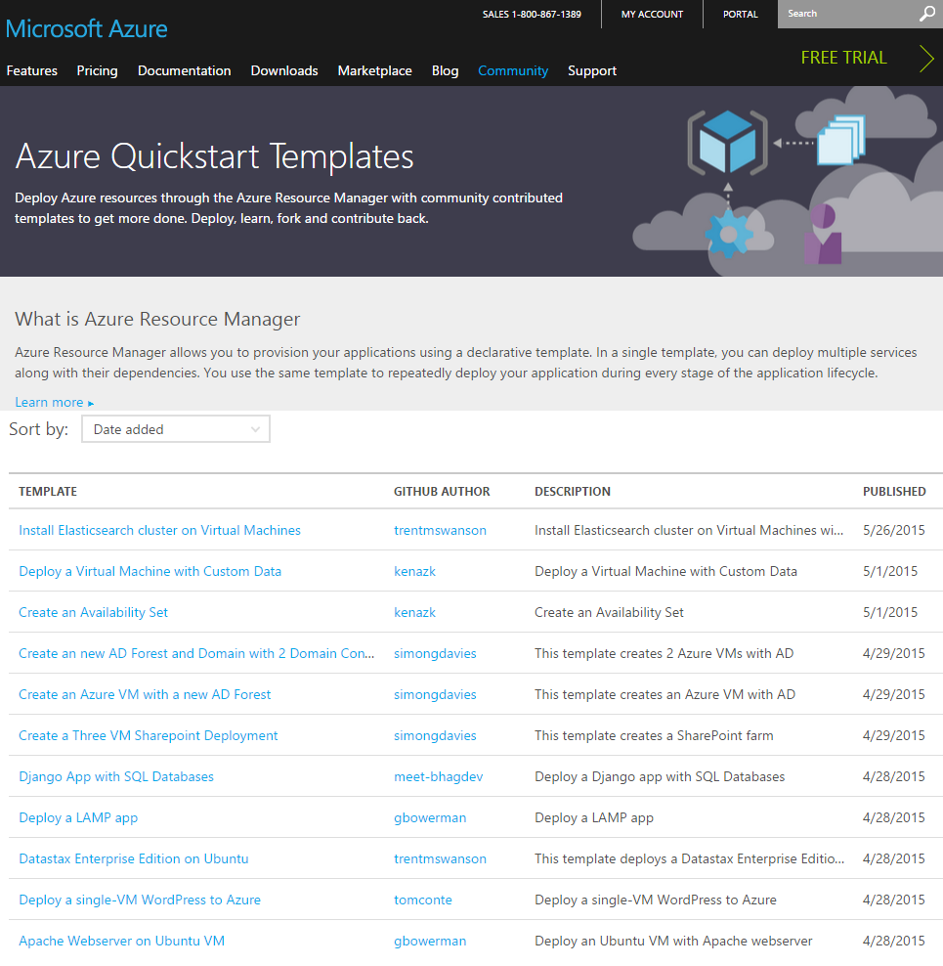
Getting started with Azure templates
Wide range of Quickstart templates
  Indexed on Azure.com
Github Repo:
https://github.com/Azure/azure-quickstart-templates
  Community and Microsoft contributed
Integration of IaaS with Azure Services
Azure Resource Explorer
  https://resources.azure.com/

Slide 51



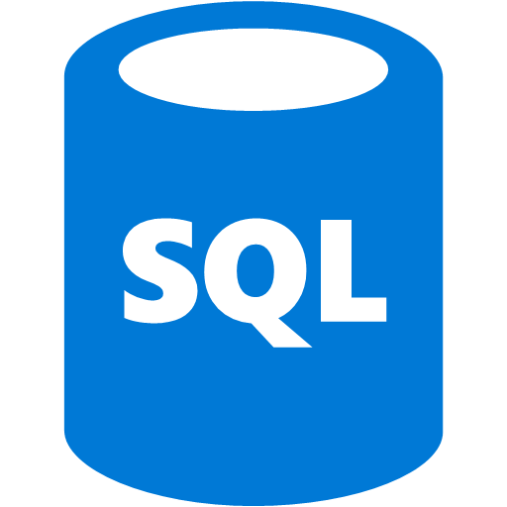

Azure Virtual Networks
10.1.1.0/24
Internet
Virtual Networks are the primary building block for Azure networking
Create subnets with your private or public IP addresses
Bring your own DNS or use Azure-provided DNS
Connect to on premises or the Internet
Control traffic flow with
User Defined Routes and Network Security Groups
10.1.1.0/25
10.1.1.128/25
Front end subnet
Back end subnet
Traffic stays within MS network
Traffic to on-premises and other VNets
Storage
SQL DB

Slide 52
Demo:
Virtual networks deployment

Slide 53



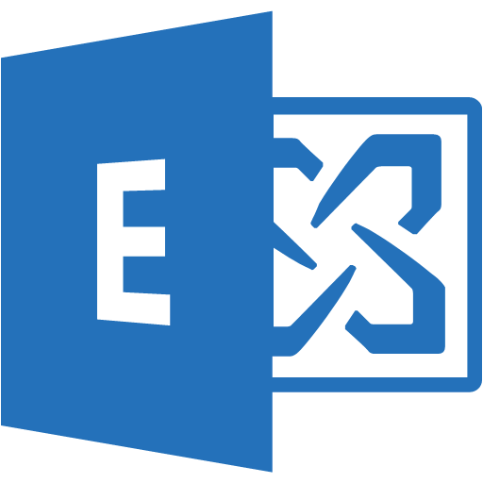
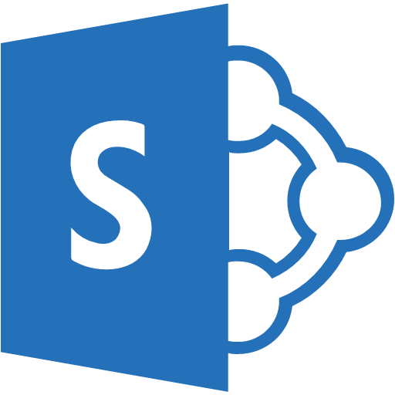


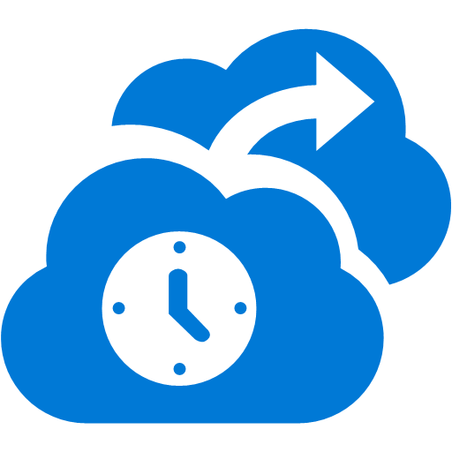





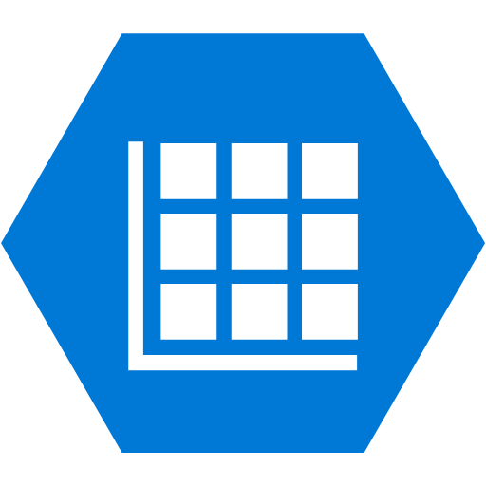

Cross premises connectivity overview
Azure
Azure
P2S SSTP tunnels
Virtual Network
Internet
Backend
Mid-tier
Frontend
IPsec S2S VPN tunnels
Private WAN
ExpressRoute

Slide 54
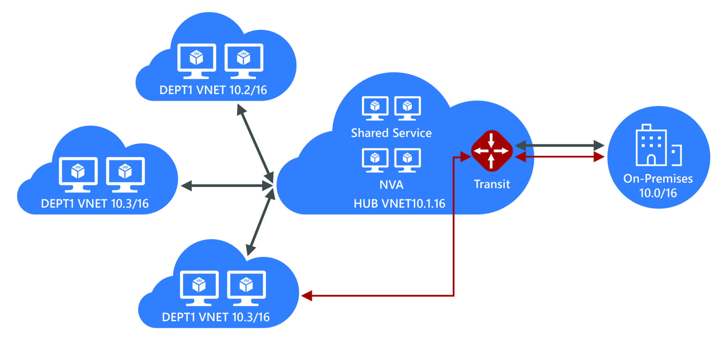
VNet Peering Hub and spoke
Central VNet (Hub) peers with spoke Vnets
Gateway and NVA Transit
UDR next hop IP in central VNet
Consolidate shared services
Virtual DMZ

Slide 55

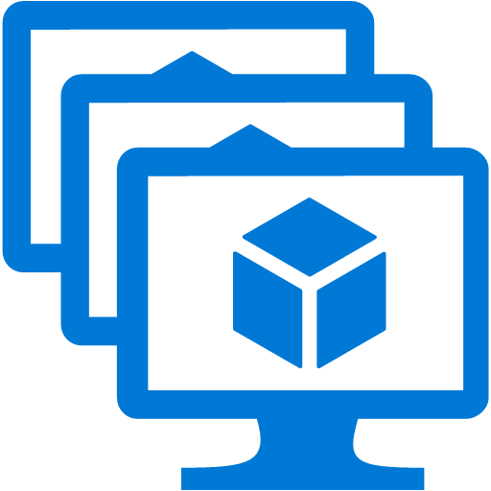


Global VNet Peering
Global VNet Peering enables you to peer VNets belonging to different Azure regions.
Extends peering to cross​
region VNets​
Simple and quick to configure​
Enables cross region database replication over private IP addresses
No bandwidth restrictions
Azure
Azure Region 1
Azure Region 2
Azure
VNet Peering

Slide 56
Internal and External load balancing
Enables load balancing among VMs with private IP addresses
Accessible only from
  Customer’s Vnets
  Customer's on-premises Vnets
Multi-tier applications with internal facing tiers require ILB
  HA LOB apps
  SQL Always On
Internet
Microsoft Azure
Public VIP
Customer Virtual Network
External load balancer
Customer
on-premises
Internal VIP
Internal
load balancer
Back end
Front end

Slide 57
Subnet connected defense in depth
PaaS Services
&
Virtual Machines
VM
firewall
VM or NIC
NSG
Subnet
NSG
Virtual
Appliances
Load
balancer
DDoS
protection
Internet

Slide 58

Network Security Groups (NSG)
  Enables network segmentation and DMZ scenarios
  Access control lists and network traffic rules as security group
  Security groups associated with Virtual Machine network interfaces, or Virtual Machine subnets (not GW subnet)
  Rules define a 5-tuple
  Rules are separated into inbound and outbound rules
  Rules applied in order of priority
  Network traffic rules updated independent of Virtual Machines
  Controlled access to and from Internet
On Premises 10.0/16
Internet
S2S
VPNs
√
√
√
VPN GW
Backend
10.3/16
Mid-tier
10.2/16
Frontend
10.1/16
Virtual Network

Slide 59
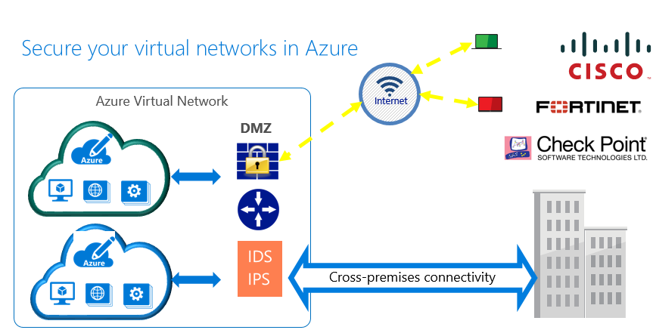
Virtual Appliances – Firewalls, IDS/IPS, VPNs

Slide 60
Demo:
Network Virtual Appliance deployment

Slide 61



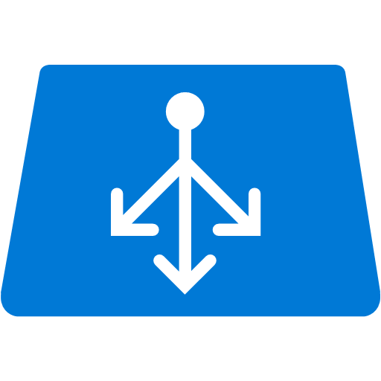

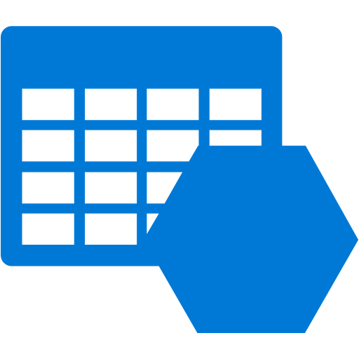

VNet Service Endpoints for Storage
Internet
Internet
Protecting your application
Securing PaaS Services
From the
Internet
VNet Service Endpoint
Within
the VNet
Within Azure
PaaS services
Compute - VNet

Slide 62

Standard storage offerings
Blobs
Files
Queues
Tables
Disks
Object storage
access via REST
File storage
access via SMB, REST
Reliable messaging
access via REST
NOSQL storage
access via REST
IaaS VM VHD/ disks
access via REST
Streaming & random object access scenarios
Lift n shift scenarios
Scheduling async tasks
KeyValue Store
Persistent disks for VMs
Premium option

Slide 63
Azure Blob storage overview
Blobs
“Highly scalable, REST based cloud object store”
Tables
“Massive auto-scaling NoSQL store”
Queues
“Reliable messaging at scale for cloud services”
Disks
“Persistent disks for Azure IaaS VMs”
Files
“SMB access to Azure Storage”
Blobs
Data sharing, Big Data, backups
Block Blobs: Read and write data in blocks. Optimized for sequential IO. Most cost-effective storage
Page Blobs: Sparse files, read/write in 512 byte pages. Optimized for random access
Blobs
Object storage
access via REST
Streaming & random object access scenarios

Slide 64
Azure Files overview
Blobs
“Highly scalable, REST based cloud object store”
Tables
“Massive auto-scaling NoSQL store”
Queues
“Reliable messaging at scale for cloud services”
Disks
“Persistent disks for Azure IaaS VMs”
Files
“SMB access to Azure Storage”
Files
Lift-and-shift on-premises applications
Natively supported by OS APIs, libraries, and tools
Built on SMB2.1, works with Windows and Linux
No limits on number of shares; 5TB and 1000 IOPS per share
Files
File storage
access via SMB, REST
Lift-n-shift scenarios

Slide 65
Azure Disks overview
Blobs
“Highly scalable, REST based cloud object store”
Tables
“Massive auto-scaling NoSQL store”
Queues
“Reliable messaging at scale for cloud services”
Disks
“Persistent disks for Azure IaaS VMs”
Files
“SMB access to Azure Storage”
Disks
All Azure IaaS VMs – Both OS and data disks
VHDs are backed to Page Blobs
3 synchronous, strongly consistent copies
Can stripe disks for more capacity/throughput
Premium Storage disks allow for scale up workloads
Disks
IaaS VM VHD/ disks
access via REST
Persistent disks for VMs
Premium option

Slide 66
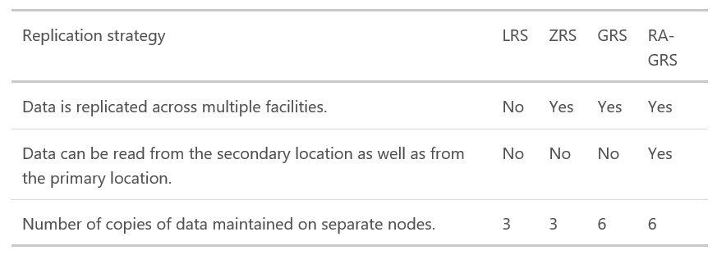
Replication strategy details
Replicas reside in separate fault domains and upgrade domains
  Fault Domain = Group of nodes that represent a physical unit of failure (rack)
  Upgrade Domain = Group of nodes that are upgraded together during a service rollout

Slide 67
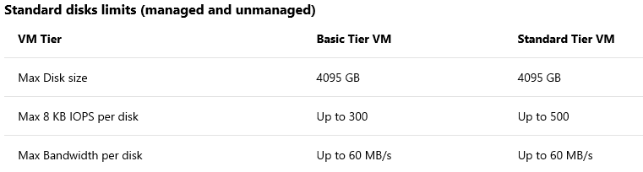
Standard vs. Premium Storage accounts
Standard
  Includes Blob, Table, Queue, and File storage
  VM disks store data on hard disk drives (HDDs)
  Maximum total request rate of 20,000 IOPS
  The total IOPS across all of your virtual machine disks in a standard storage account should not exceed this limit
  If your VM disks do not require high IOPS, you can limit costs by maintaining them in Standard Storage
  Can configure a custom domain name to use with your storage account

Slide 68
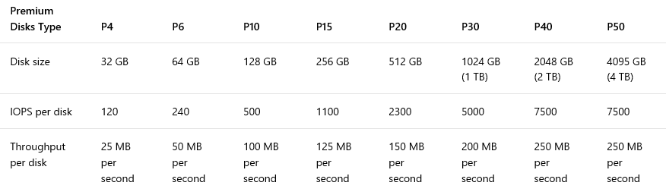
Standard vs. Premium Storage accounts
Premium
  Recommended for virtual machine disks requiring high IOPS for the best application performance
  VM disks store data on solid state drives (SSDs)
  For your VM disks, you need to use the DS-series, FS-series, or GS-series of VMs
  A premium storage account currently supports Azure Virtual Machine disks only
P4, P6 - Managed Disks only

Slide 69
Object storage for every use case
Blob Tiers
  Hot – for commonly used data
  Cool – for rarely used data (GA: 4/16)
  API is 100% identical; similar throughput and latency
  Same durability options: LRS, GRS, RA-GRS
  Archive – for rarely accessed data, applicable on a blob level
Pricing to match your workload
  Hot: Lower access prices for frequent use
  Cool: Lower storage prices for high volume
Switch account tiers as needed
Azure
Blob
Hot
Cool
Archive
Frequently
accessed data
Less frequently accessed data
Rarely
accessed data
PER TB
PER MONTH
$18.40
$10.00
$2.00
PER 10K WRITE
OPERATIONS
$0.05
$0.10
$0.10
RETRIEVAL
TIMES
Immediate
Immediate
Hours
Cloud native application data storage
Repository for server backups
Medical records archiving
USE CASES

Slide 70
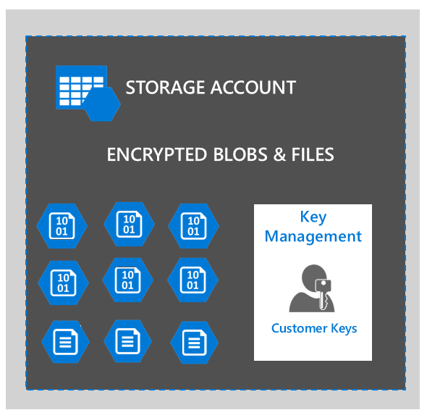
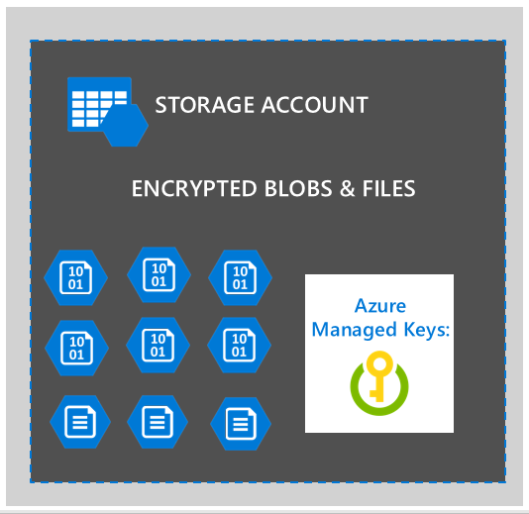
Storage Service Encryption
Protect data at rest on Azure via Microsoft Managed Keys
Automatic handling of encryption & decryption
Microsoft Managed Keys
Supported on all available redundancy types
Protect data at rest on Azure via Customer Managed Keys
Storage service encryption for Azure Blobs & Files
Customer Managed Keys with Key Vault Integration
Recently Launched:
SSE CMK – GA Mar ‘18

Slide 71
Demo:
Storage accounts deployment

Slide 72

Virtual Machine – Sizes and tiers
VM services recently introduced:
SAP HANA on Azure: new M-series VM certification.
Largest memory-optimized VM to date.
New E-series VMs to meet compliance and regulatory requirements
The new E64i_v3 and E64is_v3 VMs are isolated to hardware and dedicated to a single customer.
Continued expansion of the N-series VM portfolio
NCv3 VMs bring NVIDIA’s latest GPU to our best-in-class HPC, machine learning, and AI products.
Additional NVv2 (for graphic intensive applications) and NDv2 (to accelerate machine training and HPC) VMs are on the roadmap.
Entry level
Burstable
General Purpose
Compute Intensive
Storage Optimized
A
Av2
B
D
Dv2
Dv3
F
Fv2
L
Memory Optimized
Graphics Intensive
High Performance Computing
Purpose-built SAP HANA
G
Ev3
M
NC
NCv2
NV
ND
H
HANA
NCv3
NVv2
NDv2
(coming soon)
https://azure.microsoft.com/en-us/services/virtual-machines/

Slide 73
Demo:
Vitual Machine deployment

Slide 74
Virtual Machine – Marketplace and image models
Images make it easier to deploy an application into the Azure environment. The following are the four models of Azure Images:
Image families
VHDs managed and supported by Microsoft. Some may include pre-installed software and configuration.
Partner images
VHDs uploaded by partners for application consumption by the Azure customer. VMs deployed using partner images are not deployed on the same cluster or clusters as other VM workloads.
Latest images
Images are kept as versions in Azure. Typically, you would want to choose the latest image.
Customized images
Customer uploaded VHDs to leverage their own images. This is due to internal security, standard costs, and licensing scenarios.

Slide 75

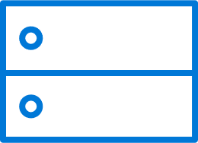




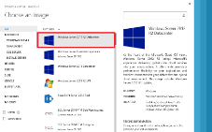
VM extensions
Extending the power of your VM
Enable easier management
Support partner ecosystem
Full control remains with you!
IaaS extended
Curated extensions
Agent
Azure

Slide 76
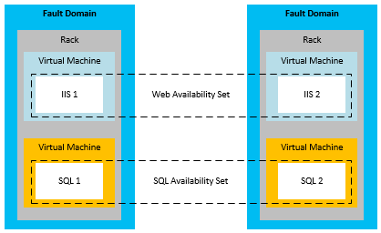
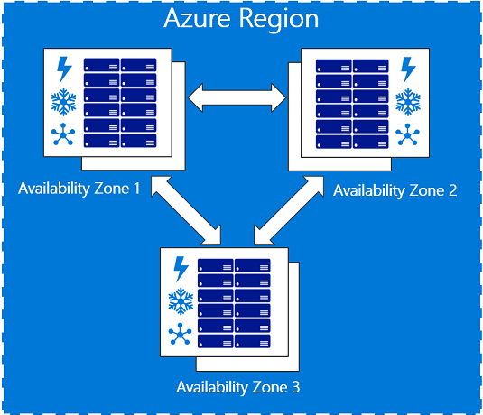
SLA for VMs
Single instance VM: 99,9%
VM deployed in availability set: 99,95%
VM deployed across two Availabiliy Zones: 99,99%
https://azure.microsoft.com/en-us/support/legal/sla/virtual-machines

Slide 77
Virtual machine components
Compute resources
  Virtual machines
  VM extensions
Storage resources
  Storage accounts (blobs)
  Managed Disks
Networking resources
  Virtual networks
  Network interface cards (NICs)
  Load balancers
  IP addresses
  Network Security Groups
Resource group
Resource group
Backend Pool (NICs)
Storage account
VM
NIC
VM IP Address
Load Balancer
LB IP Address
VNet
Disk (blob)
Subnet
Reference
Reference
Reference
DependsOn
Reference
Reference
Network Security Group

Slide 78
Virtual Machine Storage Architecture
IaaS solutions store images and disks used by VMs within VHDs, which attach to the computer instance as persistent or temporary storage.
VMs can have a storage account or Managed Disk.
Currently Azure supports the fixed VHD Format.
Azure Virtual Machine
C:\
OS Disk
D:\
Temporary Disk
E:\, F:\, etc.
Standard Data Disks
E:\, F:\, etc.
Premium Data Disks
Y:\, Z:\, etc.
SMB Share
Disk Cache
SSD Read Cache
Azure Page Blob
Azure Page Blobs (Premium Storage)
Azure Files

Slide 79
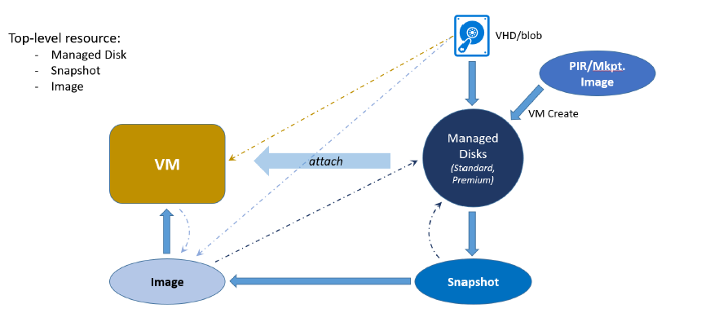
Managed Disks Overview
Hides complexity of storage accounts and scale limits
Simpler management for customers
Better performance
Storage account limits do not apply
Granular access control
Top level ARM resource, apply Azure RBAC
Smarter about Availability sets
Different fault domains – Disks in different Storage clusters
Easy migration from Standard to Premium
Minimal downtime with background migrations
Availability Set
Fault Domains: 3
SQL1
FD:1
SQL2
FD:2
SQL3
FD:3
Disk Service
Blob1
Blob2
Blob3
Storage
Cluster FD1
Storage
Cluster FD2
Storage
Cluster FD3

Slide 80

Virtual Machine Network Architecture
NIC connects a VM to network
VM can have one or more NICs
NIC can have:
1 Private IP – Static or Dynamic
1 Public IP – Static or Dynamic
1 LB VIP – Static or Dynamic
All NICs belong to same VNet
NICs can be in different subnets
NSG can be attached to NIC
Private IP
Private IP
primary
Public IP
LB

Slide 81

Demo

Slide 82
Demo

Slide 83
Demo
Speaker name

Slide 84
Video

Slide 85
Section title

